Slide 1
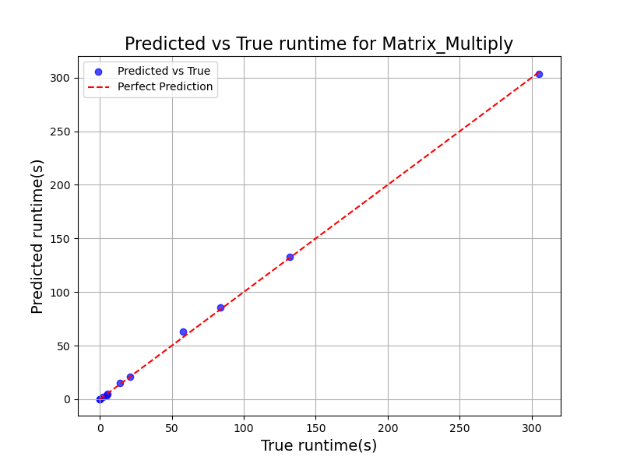

神经网络回归
mlp = MLPRegressor(
hidden_layer_sizes=(100, 50),
activation='relu',
solver='adam',
max_iter=10000,
random_state=2
)
MAPE: 544.7565
R²: 0.9996
RMSE: 1.7809
手动调参
Best params (mlp_tuned): {'regressor__activation': 'relu', 'regressor__alpha': 0.006680351314068706, 'regressor__hidden_layer_sizes': (200, 100), 'regressor__learning_rate_init': 0.07602233354654259, 'regressor__solver': 'lbfgs’}
MAPE: 335.4517
R²: 0.9994
RMSE: 2.1308
引入RandomizedSearchCV自动搜索参数

Slide 2
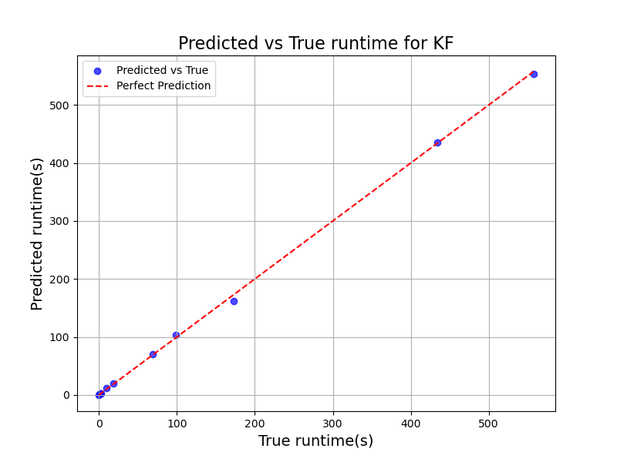
神经网络回归
Best params (mlp_tuned): {'regressor__activation': 'relu', 'regressor__alpha': 0.006680351314068706, 'regressor__hidden_layer_sizes': (200, 100), 'regressor__learning_rate_init': 0.07602233354654259, 'regressor__solver': 'lbfgs’}
MAPE: 46.8010
R²: 0.9995
RMSE: 3.9219

Slide 3


随机森林回归
model = RandomForestRegressor(
n_estimators=100,
random_state=2
)
MAPE: 0.2768
R²: 0.9963
RMSE: 5.3571
model = RandomForestRegressor(
n_estimators=1000,
random_state=2
)
MAPE: 0.3288
R²: 0.9956
RMSE: 5.8434

Slide 4
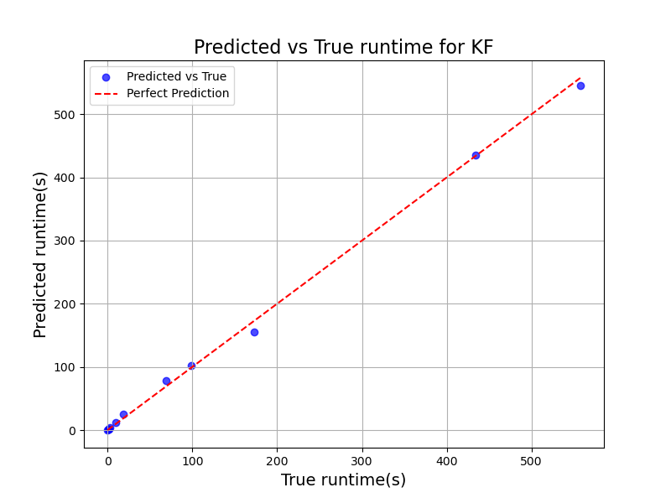

随机森林回归
model = RandomForestRegressor(
n_estimators=200,
random_state=2
)
MAPE: 2.0482
R²: 0.9985
RMSE: 7.1898
model = RandomForestRegressor(
n_estimators=2,
random_state=2
)
MAPE: 1.8589
R²: 0.9987
RMSE: 6.6951

Slide 5


支持向量回归
model = SVR(
kernel='rbf',
C=1000,
epsilon=0.5
)
MAPE: 3784.3033
R²: 0.9996
RMSE: 1.8431
手动调参
Best params (svr_tuned): {'C': 6878.031163887243, 'degree': 4, 'epsilon': 0.38179294084056103, 'gamma': 5.46030627903238, 'kernel': 'rbf’}
MAPE: 2892.1275
R²: 0.9996
RMSE: 1.7198
引入RandomizedSearchCV自动搜索参数

Slide 6
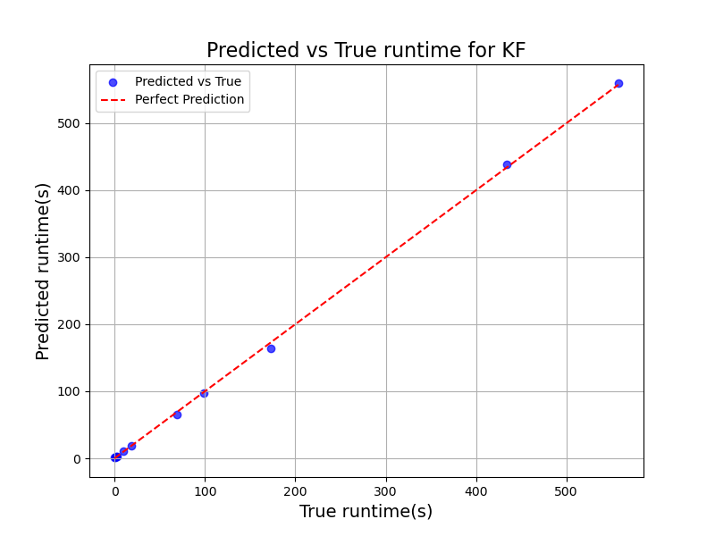

支持向量回归
model = SVR(
kernel='rbf',
C=1000,
epsilon=0.5
)
MAPE: 1357.1281
R²: 0.9997
RMSE: 3.3460
手动调参
Best params (svr_tuned): {'C': 6878.031163887243, 'degree': 4, 'epsilon': 0.38179294084056103, 'gamma': 5.46030627903238, 'kernel': 'rbf’}
MAPE: 1335.9732
R²: 0.9994
RMSE: 4.5853
引入RandomizedSearchCV自动搜索参数

Slide 7

多项式回归
poly = PolynomialFeatures(
degree=3,
include_bias=True
)
MAPE: 2011.0220
R²: 0.9993
RMSE: 2.3611

Slide 8

多项式回归
poly = PolynomialFeatures(
degree=3,
include_bias=True
)
MAPE: 645.0855
R²: 0.9998
RMSE: 2.5920

Slide 9
非线性最小二乘拟合
MAPE: 2011.0434
R²: 0.9993
RMSE: 2.3611

Slide 10
非线性最小二乘拟合
MAPE: 645.0907
R²: 0.9998
RMSE: 2.5920

Slide 11

XGBoost回归
model = XGBRegressor(
n_estimators=500,
max_depth=15,
learning_rate=0.05,
random_state=2,
n_jobs=-1,
verbosity=0
)
MAPE: 4.7861
R²: 0.9865
RMSE: 10.2801
手动调参
Best params (xgboost_tuned): {'colsample_bytree': 0.9447600319730725, 'gamma': 1.1871972283905326e-05, 'learning_rate': 0.0339394647270345, 'max_depth': 13, 'n_estimators': 858, 'reg_alpha': 6.751542867668973e-06, 'reg_lambda': 0.00016239865993185278, 'subsample': 0.63708662969523}
MAPE: 4.8126
R²: 0.9865
RMSE: 10.2800
引入RandomizedSearchCV自动搜索参数

Slide 12

XGBoost回归
model = XGBRegressor(
n_estimators=500,
max_depth=15,
learning_rate=0.05,
random_state=2,
n_jobs=-1,
verbosity=0
)
MAPE: 1.4526
R²: 0.9964
RMSE: 11.0045
手动调参
Best params (xgboost_tuned): {'colsample_bytree': 0.5875581919673329, 'gamma': 0.0004302614800676075, 'learning_rate': 0.23717426076930576, 'max_depth': 14, 'n_estimators': 245, 'reg_alpha': 0.00017320857784693374, 'reg_lambda': 2.9143439864895515e-06, 'subsample': 0.5131920745577545}
MAPE: 7.7352
R²: 0.9964
RMSE: 11.0036
引入RandomizedSearchCV自动搜索参数

