Slide 1



PROGRAMMING COMPETITION
André LeBlanc (He/Him/Il)
Programming competition director
eal4294@umoncton.ca

Slide 2

Table of Contents
Introduction
Programming case
Competition rules
Resources
Timeline
Presentations
Judging/Penalty matrices
Question period (15 minutes)

Slide 3
Introduction
Welcome to AEC 2022!
Questions
Please hold your questions until the end of the presentation. A period of 15 minutes will be allocated at the end.

Slide 4
Programming case
Background
Since landing in early 2021, the Perseverance Rover and Ingenuity Helicopter have been exploring Mars to further our understanding of the planet and help prepare the way for future human exploration. As part of the mission team, a Canadian Systems engineer was tasked with determining when the team will be able to communicate directly with the Perseverance Rover using its High Gain Antenna.

Slide 5
Programming case
The Case
Create a software tool that calculates the distance and transmission latency between two planets orbiting the Sun.
The software should:
Take into consideration the relative positions in orbit at a specific point in time.
Warn users if the specified point in time coincides with a solar conjunction when a planet passes directly behind the Sun relative to the other planet. Transmissions are typically minimized.
Not take into consideration either planet’s rotation or the position of antennae on the surface of the planet.

Slide 6
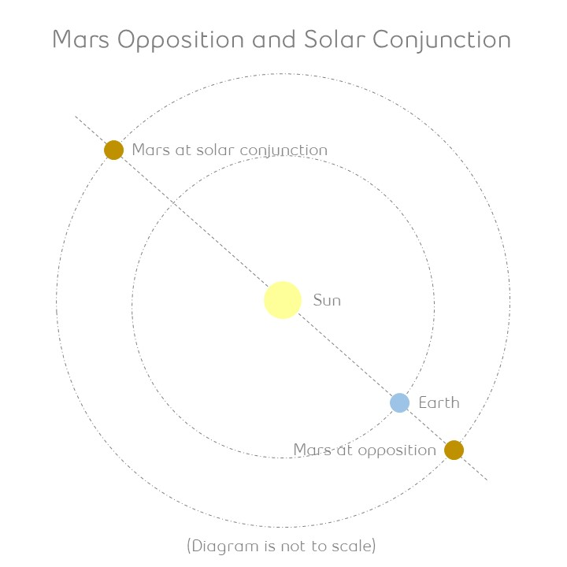
Programming case
Data Category | Data Type | Value
General | Speed of light in a vacuum (m/s) | 299 792 458
Earth Data | Average distance to Sun (Millions of km) | 149,6
 | 1 year orbit (in Earth days) | 365,24
Mars Data | Date & Time of last opposition (relative to Earth) | 2020-10-13 23:20 UTC
 | Average distance to Sun (Millions of km) | 228,9
 | 1 year orbit (in Earth days) | 686,98
Saturn Data | Date & Time of last opposition (relative to Earth) | 2021-08-02 06:00 UTC
 | Average distance to Sun (Millions of km) | 1 482,20
 | 1 year orbit (in Earth days) | 10 759,22

Slide 7
Programming case
Inputs
The software will have two modes of execution: Configuration and Calculation.
In Configuration mode, the data below will be required.
Planet name, Orbital radius, Orbital period, Date/time of last opposition with Earth.
Note: Data may be stored in a file or database and should be easily mutable. Invalid inputs such as “giraffe” as a numerical value should be rejected.
In Calculation mode, the planets name as well as its respective data will be accepted or rejected by the software.

Slide 8
Programming case
Outputs
The following outputs must be returned for the date and the planets specified.
Distance separating the two planets.
Latency associated with transmitting signal between planets.
Whether the date falls within a moratorium on transmitting commands due to solar conjunction (± 7 degrees).
Date of the next planetary conjunction.
A graph illustrating daily signal latency over the next 24 months from specified date.

Slide 9
Programming case
Outputs
The following outputs are optional for the date and the planets specified.
A visualization tool illustrating the positions of both or all defined planets in their orbits on a specified.
Additional data sources, outputs or enhancements that would be beneficial are encouraged if time permits.

Slide 10
Competition rules
Resources
Only the competition director may answer questions during the design period. The director will also answer any questions the judges may have during the competition.
The director will act as timekeeper during the question period, solution development and during the presentations. (See 2022 AEC Official Rules.pdf for more information).
All external materials such as background research, online textbooks, course notes or recycled code may be used as long as it is clearly cited and explained in the presentation.
The IDE and programming language used is at your choice.

Slide 11
Competition rules
Timeline
Following this presentation, a link to a GitHub repository will be given at your disposition. The repository holds the programming case, the powerpoint presentation as well as the competition rules. Teams have right to download/clone the repository but not add branches.
Teams will be given 8 hours (9:00 am to 6:00 pm, with 1 hour allocated for lunch) to develop their solutions, produce all deliverables and prepare their presentations. All deliverables must be submitted prior to the end of the provided time.
During the design phase, the 8 hours will start once teams receive access to the GitHub repository. The time remaining will be announced at 3 hours, 1 hour, 30 minutes and 10 minutes prior to the deadline.

Slide 12
Competition rules
Presentations
Teams will have a maximum of 20 minutes to present their solutions. All team members must be present and must participate.
At the end, a period of 10 minutes will be attributed for the judges’ questions.
Judges hold the right to ask any member of a given team to describe what a particular section of the code does at any given point in the presentation.
Presentation order will be determined randomly and announced at least 30 minutes prior to the start.

Slide 13
Competition rules
Presentations
The presentation briefing will start @ 8:30 am on Sunday.
During the presentations, time is
Halted when a judge asks a question during the presentation and when a team member answers that question.
Indicated to the competitors 10 minutes, 5 minutes and 1 minute before the end of the allocated time. A countdown will be presented during the last 30 seconds of the presentation.

Slide 14
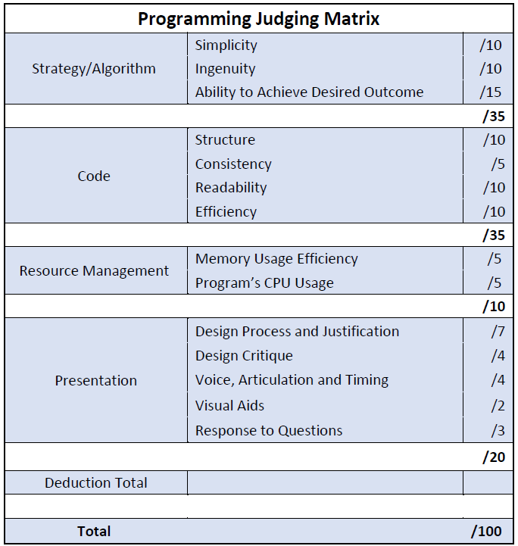
Competition rules
Judging matrix

Slide 15
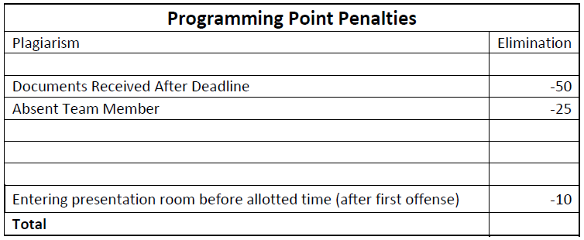
Competition rules
Penalty matrix

Slide 16
QUESTIONS?
André LeBlanc
eal4294@umoncton.ca
GitHub link: https://github.com/AEC2022Programming/Competition-Package
Good luck to all!

