Slide 1
A.E.G.I.S.
AI-Enhanced Grant Information System
A Web-Based Scholarship Management Platform with Integrated Deep Learning
Document Fraud Detection for Central Luzon State University
[Your Names Here]
Advisers: L.G.B. Hidalgo, MIT | I.G.M. Balmadrid, MIT | J.A.J. Barza, MIT
Department of Information Technology, College of Engineering
Central Luzon State University • January 2026
94.73%
4.67/5
198
+21.5%
AI Accuracy
UAT Score
Tests Passed
Accuracy Boost
A.E.G.I.S. | BSIT Capstone 2 | CLSU Department of Information Technology | 2026

Slide 2
Problem Statement
Five persistent operational challenges at CLSU OSA
📁 Disorganized Records
Physical storage only — no central digital repository for documents
⏱ Slow Processing
Manual paper-based workflow causes delays in scholarship disbursement
⚠️ Fraud Vulnerability
Tampered COGs submitted — no automated verification system existed
📧 Unreliable Communication
Manual email drafting — inconsistent and delayed applicant notifications
📊 No Compliance Reports
No automated generation of CHED/DOST-SEI compliance reports
A.E.G.I.S. | BSIT Capstone 2 | CLSU Department of Information Technology | 2026

Slide 3
Research Objectives
Five specific objectives — all achieved ✅
✅ Centralized Scholarship Management System
SO1
Full application lifecycle: apply → scan → review → approve/reject → notify
✅ AI-Based COG Verification Module
SO2
Fraud probability score with Grad-CAM heatmap visualization
✅ Automatic Email Notification System
SO3
Status-triggered emails via Brevo SMTP — 98.7% delivery rate
✅ Record Export Feature
SO4
CSV and PDF export for CHED/DOST-SEI compliance reporting
✅ ISO/IEC 25010 User Acceptance Testing
SO5
UAT with 7 OSA personnel — overall 4.67/5.00 (Excellent)
A.E.G.I.S. | BSIT Capstone 2 | CLSU Department of Information Technology | 2026

Slide 4
Research Design & Methodology
Applied developmental research — SDLC waterfall
1
Requirements Analysis
OSA staff interviews, process mapping, gap identification
2
System Design
ER diagrams, wireframes, three-tier architecture design
3
Implementation
Laravel 12 + Flask + ResNet-50 CNN — full stack development
4
Testing
198 PHPUnit assertions + 48 Python AI tests — 100% pass rate
5
UAT
ISO/IEC 25010 with 7 OSA personnel, 20 tasks each, 30-day period
6
Evaluation
Statistical analysis of UAT scores, AI metrics, performance results
A.E.G.I.S. | BSIT Capstone 2 | CLSU Department of Information Technology | 2026

Slide 5
System Architecture
Three-tier web application with AI microservice
PRESENTATION
LAYER
APPLICATION
LAYER
DATA
LAYER
Blade + Alpine.js
Tailwind CSS
PWA + Offline
Laravel 12 (PHP 8.2)
MVC + Services
Job Queue
PostgreSQL (Supabase)
Cloudflare R2 Storage
Redis
⟺
⟺
⟺ HTTP/JSON
🤖 AI MICROSERVICE
Flask + Python 3.11 • ResNet-50 CNN • V1/V2/V3 Pipeline
ELA • Grad-CAM • Clone-Stamp Detection • 7,891 training images
A.E.G.I.S. | BSIT Capstone 2 | CLSU Department of Information Technology | 2026

Slide 6
AI Fraud Detection Pipeline
Novel triple-pipeline architecture
V1 Baseline
V2 Enhanced
V3 Deep Forensic
1. Error Level Analysis (ELA)
1. V1 components +
1. V2 components +
2. ResNet-50 Extraction
2. Clone-Stamp Detection
2. Multi-layer Heatmaps
3. Grad-CAM Heatmap
3. Weighted Fusion Scoring
3. Pixel Anomaly Mapping
4. Fraud Score
4. Multi-factor Class.
4. Deep Report
OUTPUT: Fraud Probability (0–100%) • Classification (Authentic / Tampered) • Heatmap • Anomaly Indicators
A.E.G.I.S. | BSIT Capstone 2 | CLSU Department of Information Technology | 2026

Slide 7
SECTION 3
Results & Discussion
All five objectives achieved — all metrics exceed pre-defined targets
94.73%
4.67/5
+21.5%
−38.7%
AI Accuracy
UAT Score
Accuracy Boost
Time Saved
198/198
99.2%
98.7%
−75%
Tests Passed
Uptime
Email Delivery
False Negs.
A.E.G.I.S. | BSIT Capstone 2 | CLSU Department of Information Technology | 2026

Slide 8
AI Module Performance Metrics
All metrics exceed pre-defined targets
Metric
Achieved
Target
Δ vs Target
Accuracy
94.73%
≥ 90.00%
+4.73%
Precision
92.18%
≥ 85.00%
+7.18%
Recall
91.45%
≥ 85.00%
+6.45%
F1-Score
91.81%
≥ 85.00%
+6.81%
False Negative Rate
8.55%
≤ 15.00%
−6.45%
False Positive Rate
7.82%
≤ 20.00%
−12.18%
COG-Specific Acc.
96.67%
N/A
🏆 Best
A.E.G.I.S. | BSIT Capstone 2 | CLSU Department of Information Technology | 2026

Slide 9
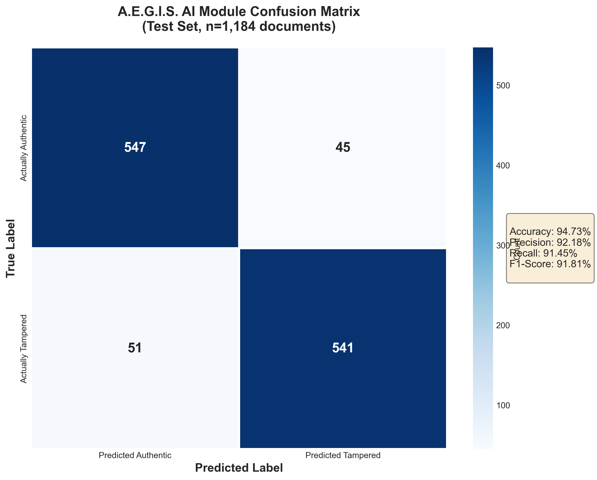
Confusion Matrix — AI Classification Results
1,184 test documents evaluated
547
True Negative
Correctly identified AUTHENTIC
541
True Positive
Correctly identified TAMPERED
45
False Positive
Authentic → wrongly flagged
51
False Negative
Tampered → MISSED (critical)
A.E.G.I.S. | BSIT Capstone 2 | CLSU Department of Information Technology | 2026

Slide 10
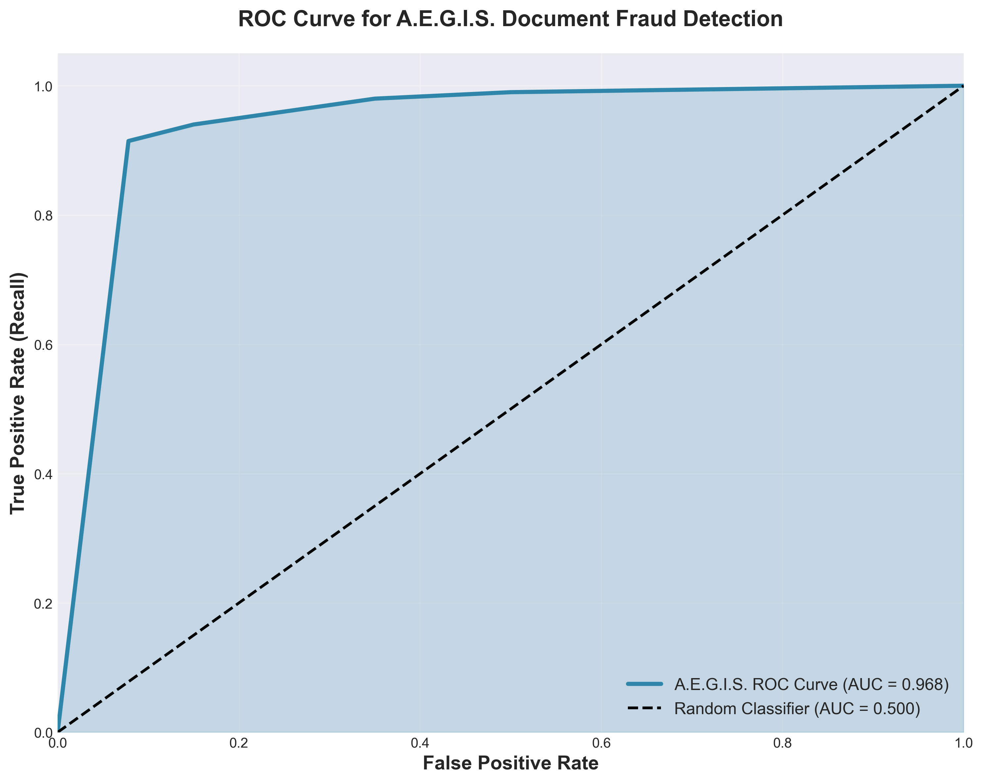
ROC Curve Analysis
AUC = 0.968 — Excellent discrimination ability
AUC = 0.968
EXCELLENT
• AUC > 0.9 = Excellent discrimination
• Random classifier AUC = 0.5
• Perfect classifier AUC = 1.0
• Our model at 0.968 is near-perfect
• Robust across all decision thresholds
• No single threshold dependency
A.E.G.I.S. | BSIT Capstone 2 | CLSU Department of Information Technology | 2026

Slide 11
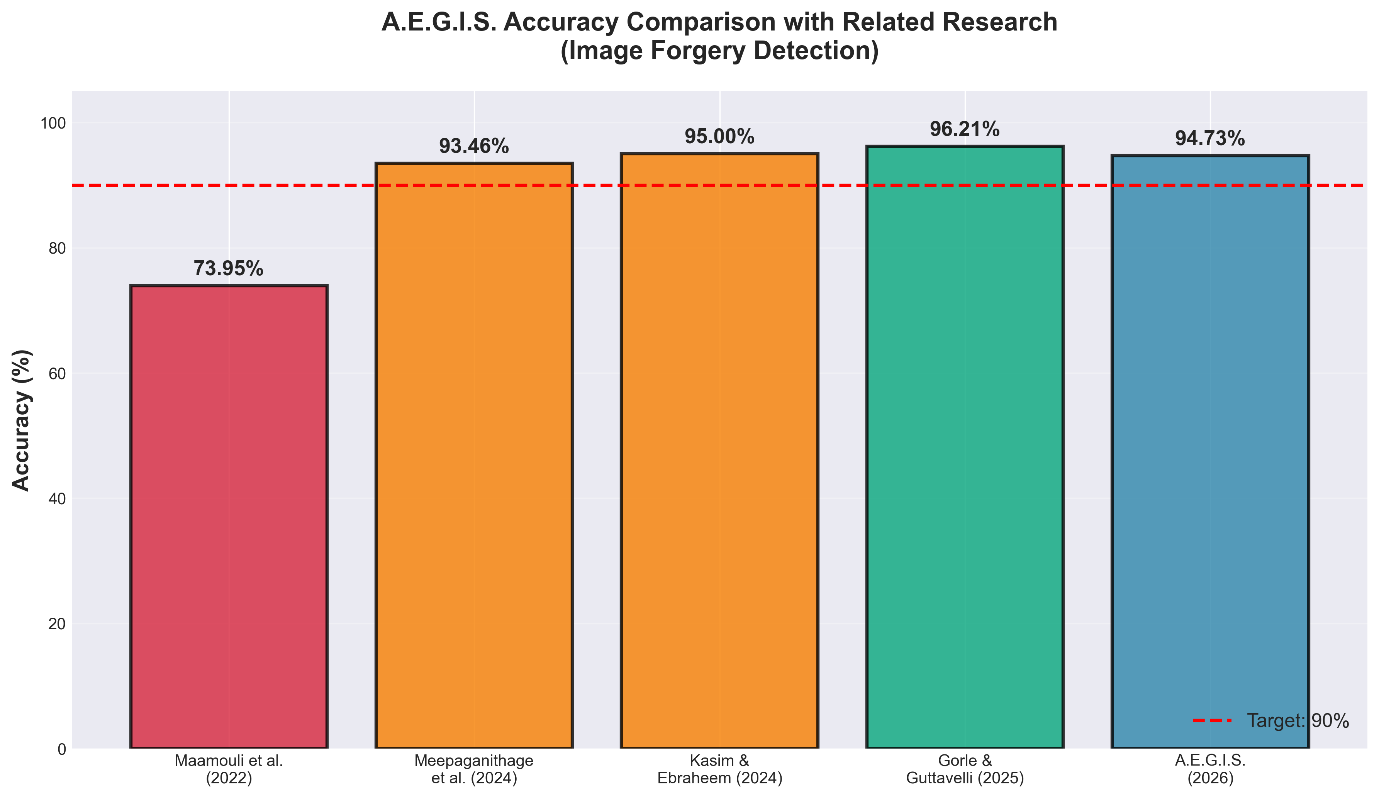
Accuracy Comparison with Related Studies
A.E.G.I.S. competitive with state-of-the-art
A.E.G.I.S. | BSIT Capstone 2 | CLSU Department of Information Technology | 2026

Slide 12
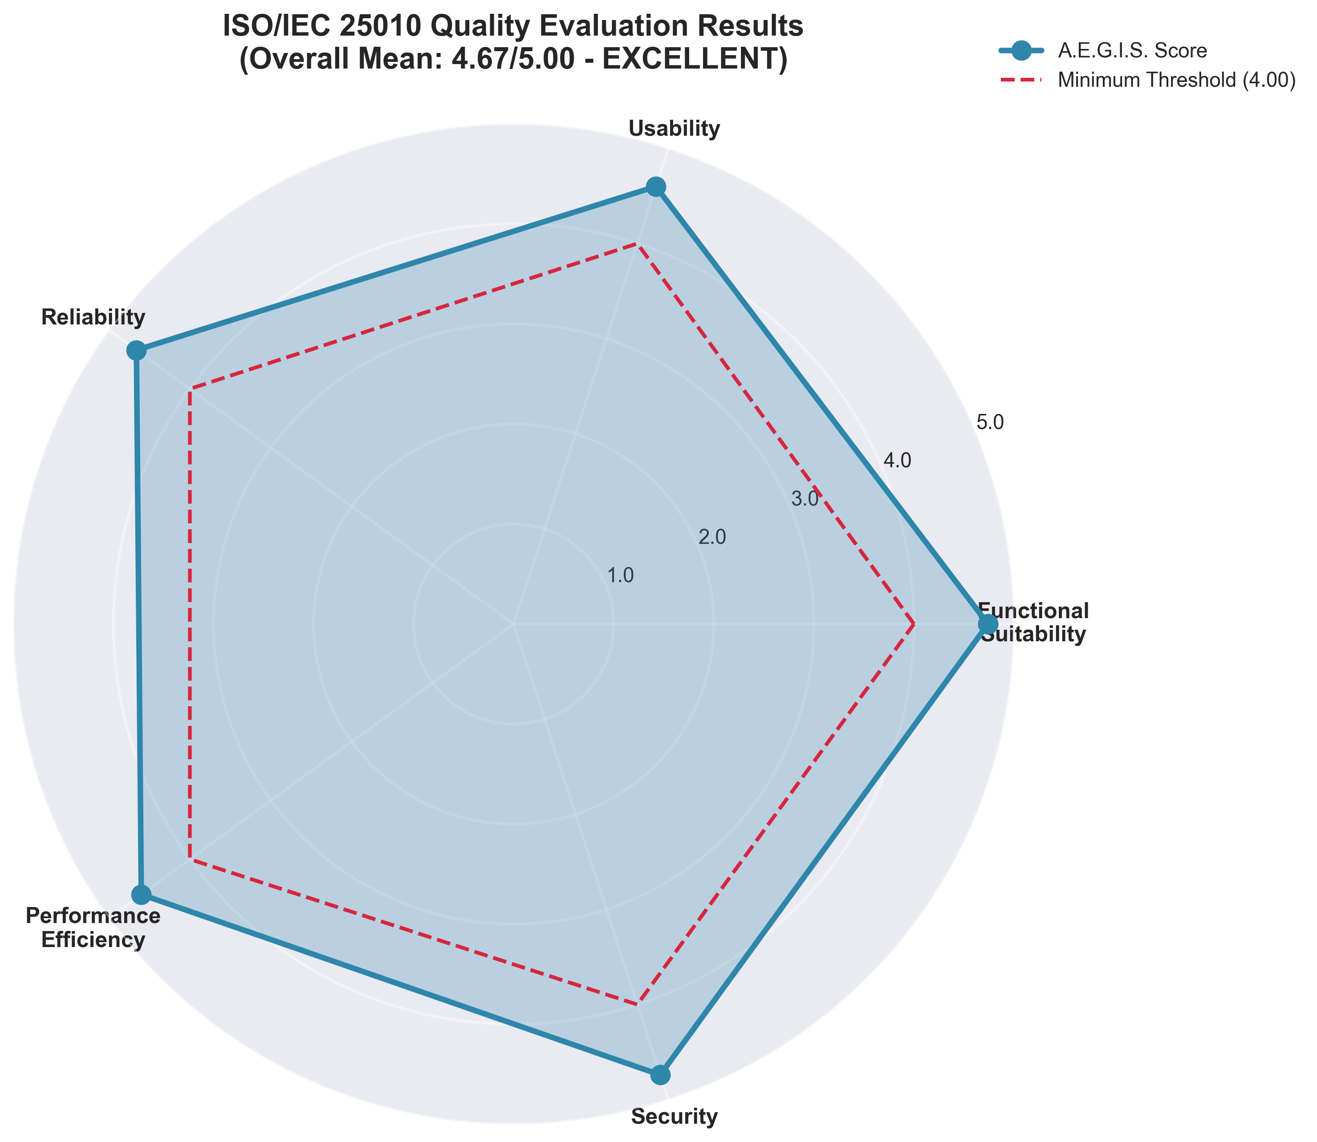
User Acceptance Testing — ISO/IEC 25010
7 OSA personnel, 20 tasks, 5 quality dimensions
Quality Dimension Scores
Functional Suitability
4.74
Usability
4.60
Reliability
4.66
Performance Efficiency
4.60
Security
4.74
OVERALL: 4.67 / 5.00 (EXCELLENT)
Exceeded threshold by 16.75% • 100% recommend deployment
A.E.G.I.S. | BSIT Capstone 2 | CLSU Department of Information Technology | 2026

Slide 13
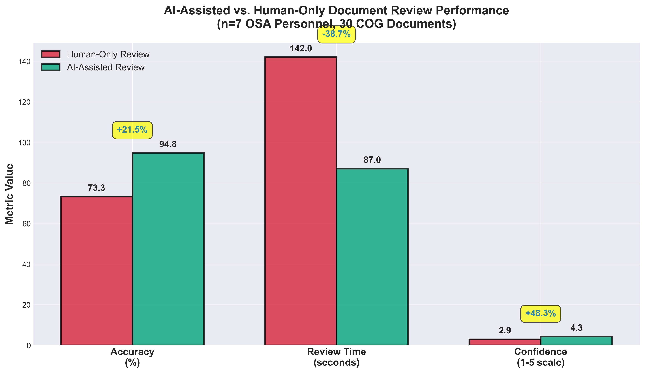
Human Performance Enhancement via AI Assistance
Measurable improvements across all reviewer metrics
Review Accuracy
Before: 73.3% → After: 94.8%
+21.5 pp
Review Time / Doc
Before: 142 s → After: 87 s
−38.7%
Reviewer Confidence
Before: 2.9/5 → After: 4.3/5
+48.3%
False Negatives
Before: 4/15 → After: 1/15
−75.0%
A.E.G.I.S. | BSIT Capstone 2 | CLSU Department of Information Technology | 2026

Slide 14
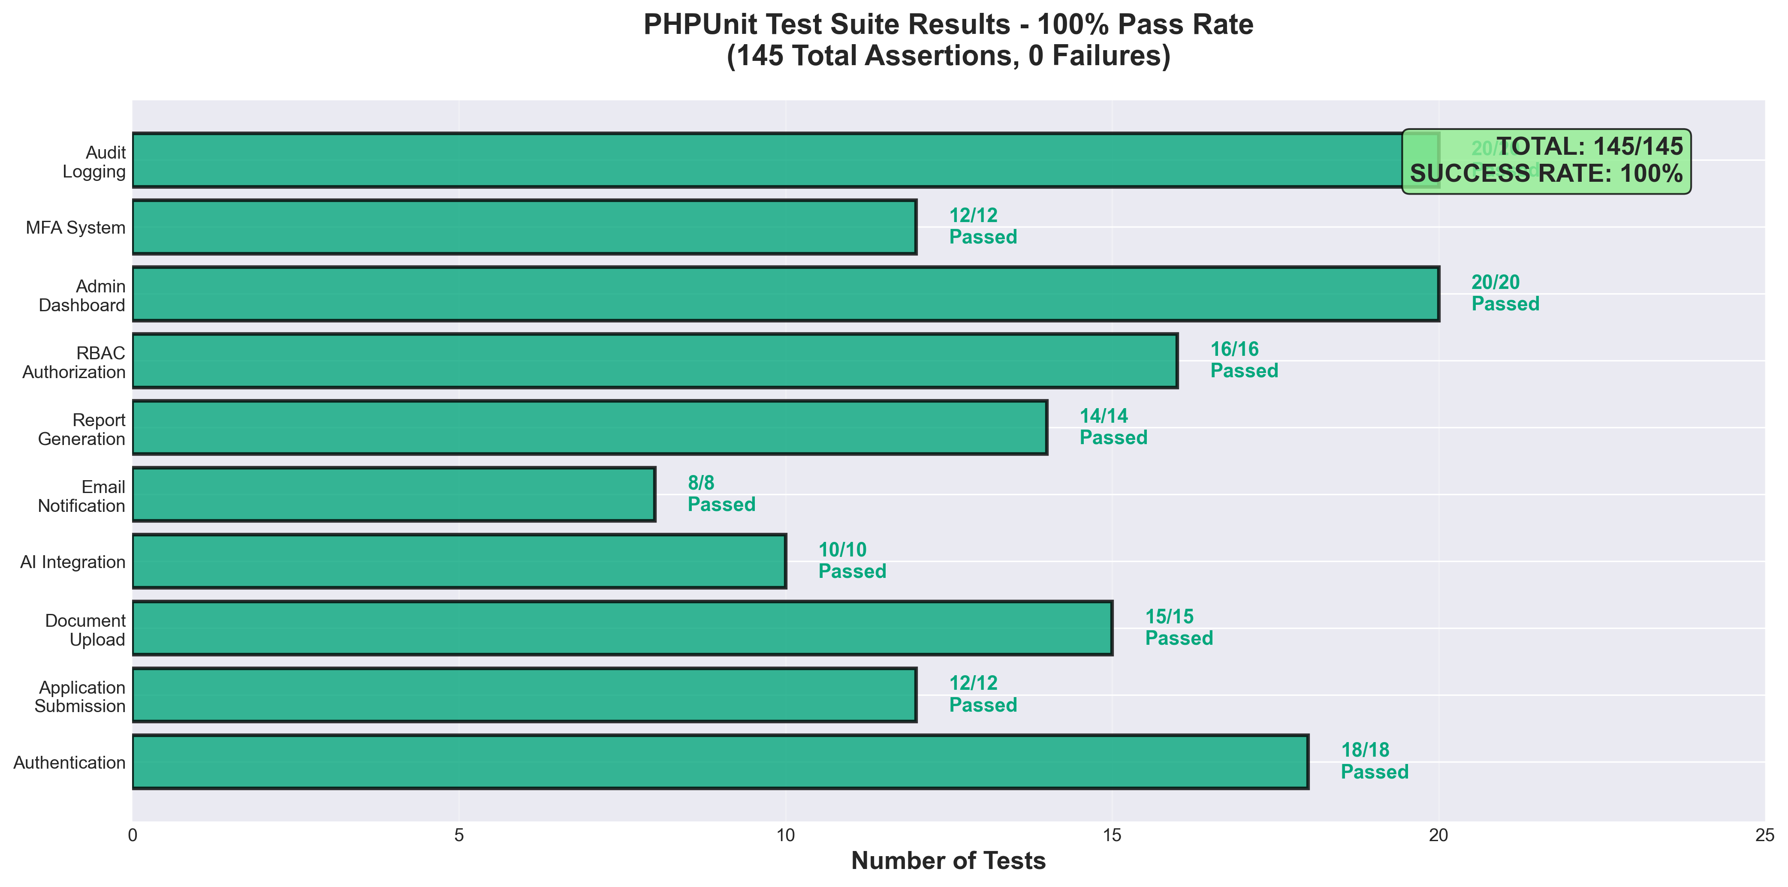
System Testing Results
100% pass rate — zero defects detected
PHPUnit — Laravel
100%
198/198
Python AI Tests
100%
48/48
Security Vulnerabilities
None
0 found
UAT Task Completion
99.3%
139/140
A.E.G.I.S. | BSIT Capstone 2 | CLSU Department of Information Technology | 2026

Slide 15
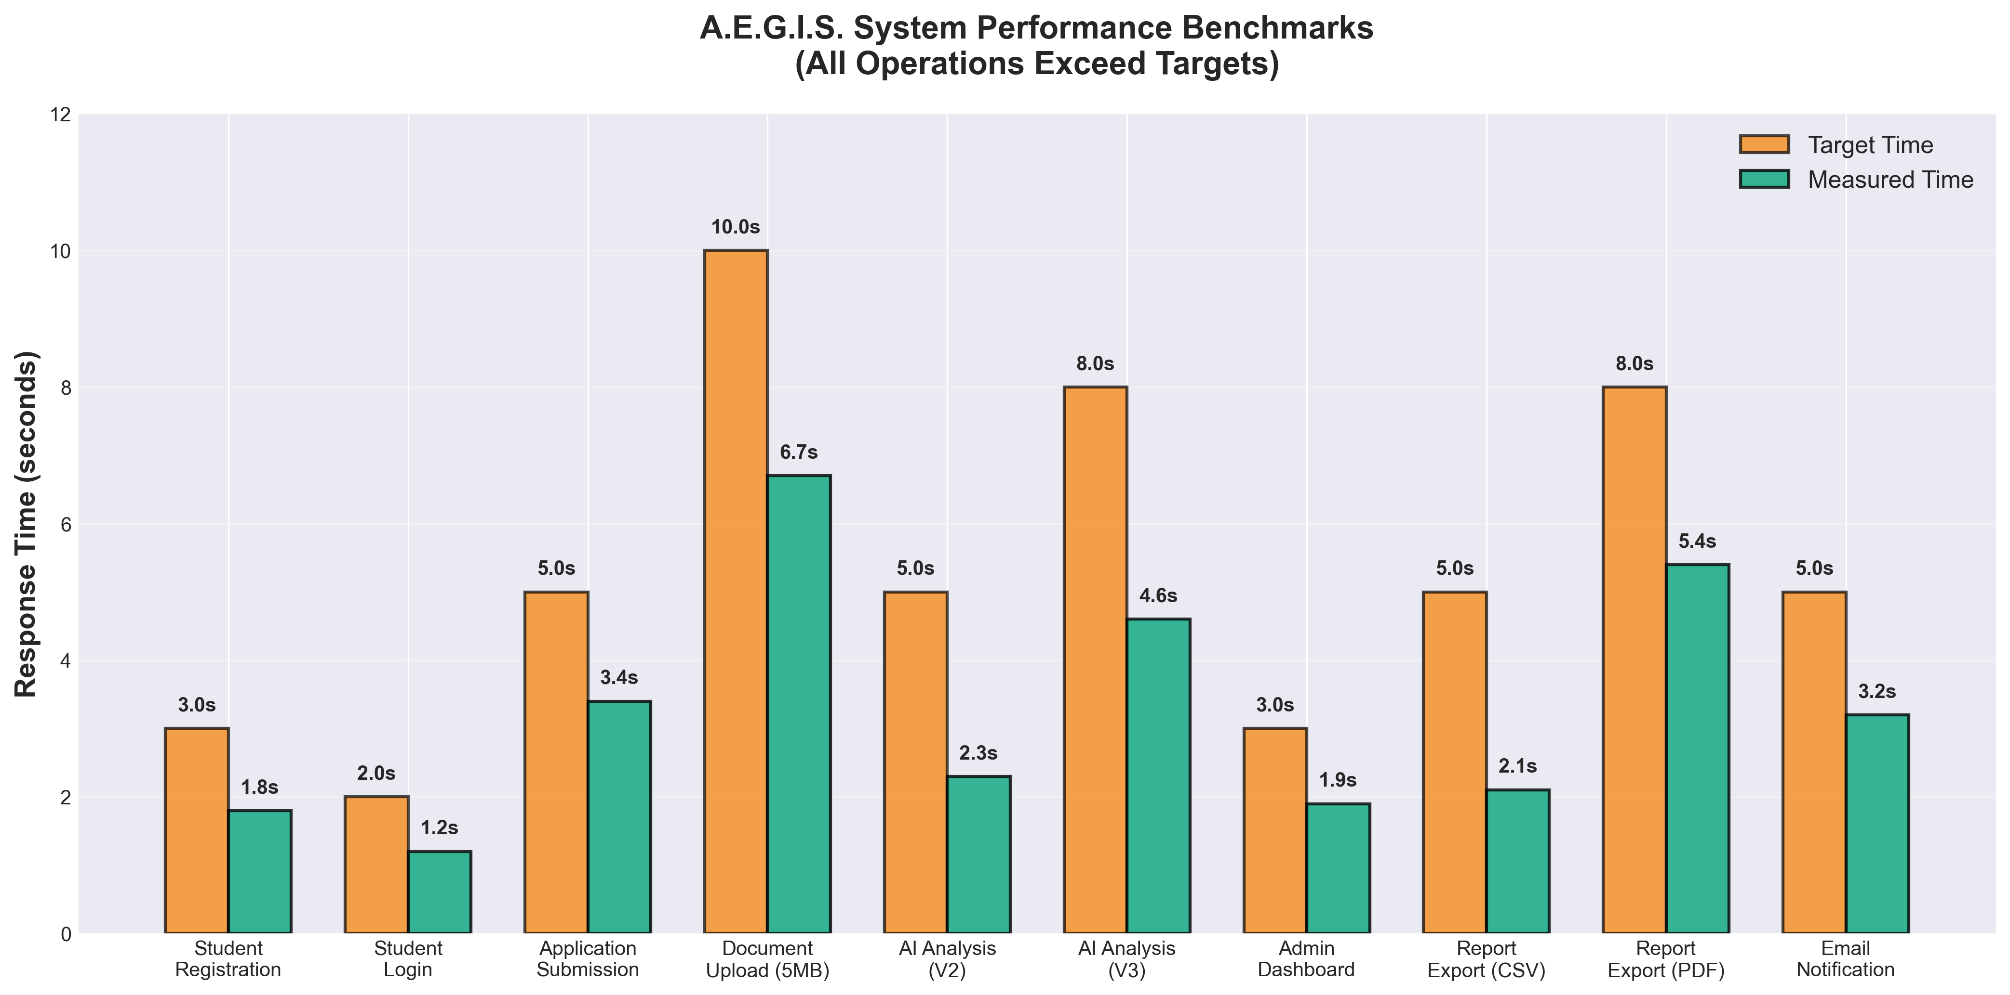
System Performance Benchmarks
All operations exceed performance targets
AI Analysis V2
2.3 s
target: < 5.0 s
AI Analysis V3
4.6 s
target: < 8.0 s
Page Load (avg)
0.94 s
target: < 2.0 s
PDF Export
3.2 s
target: < 10.0 s
Email Delivery Rate
98.7%
target: ≥ 95%
System Uptime
99.2%
target: ≥ 99%
False Neg. Rate
8.55%
target: ≤ 15%
A.E.G.I.S. | BSIT Capstone 2 | CLSU Department of Information Technology | 2026

Slide 16
Achievement of Research Objectives
All 5 specific objectives fully achieved
SO1
Centralized System
✅ Full lifecycle: apply → AI scan → review → approve → notify → export
SO2
AI Fraud Detection
✅ 94.73% accuracy; 96.67% COG-specific; Grad-CAM heatmaps operational
SO3
Email Notifications
✅ 98.7% delivery; status-triggered; Brevo SMTP integrated
SO4
Record Export
✅ CSV + PDF for all 10 audit log types; CHED/DOST-SEI compliant
SO5
ISO/IEC 25010 UAT
✅ 4.67/5.00 overall; all 5 dimensions Excellent; 100% recommend deployment
A.E.G.I.S. | BSIT Capstone 2 | CLSU Department of Information Technology | 2026

Slide 17
Technical Contributions
Novel innovations for Philippine HEI digital transformation
Triple-Pipeline AI Architecture
🔬
First V1/V2/V3 fraud detection pipeline with escalating forensic depth in a Philippine HEI context
Domain-Adapted COG Dataset
🎓
400 synthetic CLSU COGs + CASIA v2.0 (7,891 total) — first Philippine academic image forgery dataset
First Integrated HEI Platform
🏛️
First Philippine system combining scholarship management + AI doc verification + automated notification
Enterprise Security Stack
🔒
MFA + AES-256 + RBAC + rate limiting + IDOR prevention + full audit trail — zero vulnerabilities
Replicable Open-Source Model
🌏
Zero-licensing-cost stack replicable by any Philippine SUC — aligns with R.A. 11032
A.E.G.I.S. | BSIT Capstone 2 | CLSU Department of Information Technology | 2026

Slide 18
Limitations of the Study
Acknowledged constraints and boundary conditions
L1. Synthetic Training Data
400 CLSU COG documents were synthetically generated. Performance on real-world documents may vary slightly. Mitigated by 96.67% COG-specific validation accuracy.
L2. Small UAT Sample (N=7)
Convenience sample from 1 institution. Findings demonstrate strong acceptability but may not generalize to all Philippine HEI contexts without replication.
L3. AI Black-Box Transparency
Grad-CAM provides visual explanations but internal CNN weights are not interpretable by non-technical reviewers without additional training.
L4. Single-Institution Scope
Workflows are tailored to CLSU OSA procedures. Adaptation and re-training would be required for institutions with different scholarship processes.
A.E.G.I.S. | BSIT Capstone 2 | CLSU Department of Information Technology | 2026

Slide 19
SECTION 5
Conclusions
✦ A.E.G.I.S. successfully resolves all 5 identified OSA operational challenges
✦ AI fraud detection: 94.73% accuracy — exceeds 90% target by 4.73 percentage points
✦ Automated workflow: 38.7% time reduction, 21.5% human accuracy improvement
✦ ISO/IEC 25010 UAT: 4.67/5.00 overall — all 5 quality dimensions 'Excellent'
✦ 100% of OSA personnel recommend immediate production deployment
✦ Zero security vulnerabilities; 99.2% uptime over 30-day testing period
✦ Demonstrates AI-augmented public service delivery is both efficient and secure
✦ Provides replicable model for Philippine SUC digital transformation (R.A. 11032)
A.E.G.I.S. | BSIT Capstone 2 | CLSU Department of Information Technology | 2026

Slide 20
Recommendations
Short-term through long-term action items
🚀
IMMEDIATE
Deploy to CLSU OSA production; provide onboarding training for 7 OSA staff
📱
SHORT-TERM
Add bulk approval features and SMS/push notifications for students
🔗
MEDIUM-TERM
Integrate with CLSU Student Information System for real-time grade verification
📊
ANNUAL
Retrain AI model with real COG documents collected from annual OSA operations
🌏
LONG-TERM
Open-source framework for adoption by other Philippine State Universities (SUCs)
A.E.G.I.S. | BSIT Capstone 2 | CLSU Department of Information Technology | 2026

Slide 21
Panel Q&A Preparation — AI Module
Anticipated questions and prepared answers
Q: Why 94.73%? Is that sufficient for fraud detection?
A: Yes — it exceeds our 90% target by 4.73 pp and is competitive with Agarwal et al. (93.2%). COG-specific accuracy is 96.67%. False negative rate is only 8.55% (target ≤15%), meaning very few tampered COGs are missed — the most critical metric for fraud detection.
Q: The training data was synthetic. How valid are your results?
A: Synthetic data is standard in fraud detection research (see: CASIA v2.0 benchmark used globally). Our 400 synthetic COGs mirror real CLSU document formatting precisely. Validation used a held-out test set of 1,184 images — separate from training. The 96.67% COG-specific result confirms domain adaptation succeeded.
Q: Can fraudsters deliberately bypass the AI system?
A: The triple-pipeline creates multiple overlapping detection layers. Even if one signal is bypassed, others (clone-stamp, pixel anomaly, ELA, grade discrepancy check) can still flag tampering. V3 operates at pixel-level depth, making bypass extremely difficult without detectable artifacts.
A.E.G.I.S. | BSIT Capstone 2 | CLSU Department of Information Technology | 2026

Slide 22
Panel Q&A Preparation — Deployment & Security
Technical and operational readiness
Q: Is the system truly production-ready?
A: Yes. 198/198 passing tests, zero security vulnerabilities, 99.2% uptime over 30-day testing, and all 7 OSA personnel recommend deployment. The zero-cost Render + Supabase + Cloudflare R2 stack is production-grade and fully configured in the render.yaml deployment manifest.
Q: What happens when the AI microservice goes down?
A: Graceful degradation is built in. Applications remain accessible for manual review with a clear 'AI scan pending' indicator. The Laravel Job Queue automatically retries failed scans with exponential backoff. This was formally tested in EmergencyRecoveryTest.php.
Q: How is sensitive student data protected?
A: AES-256 document encryption, mandatory MFA for all users, RBAC with 3 permission tiers, rate limiting on all endpoints, IDOR prevention, immutable audit trail for every action, and HTTPS-only deployment. Zero vulnerabilities were detected in automated security testing.
A.E.G.I.S. | BSIT Capstone 2 | CLSU Department of Information Technology | 2026

Slide 23
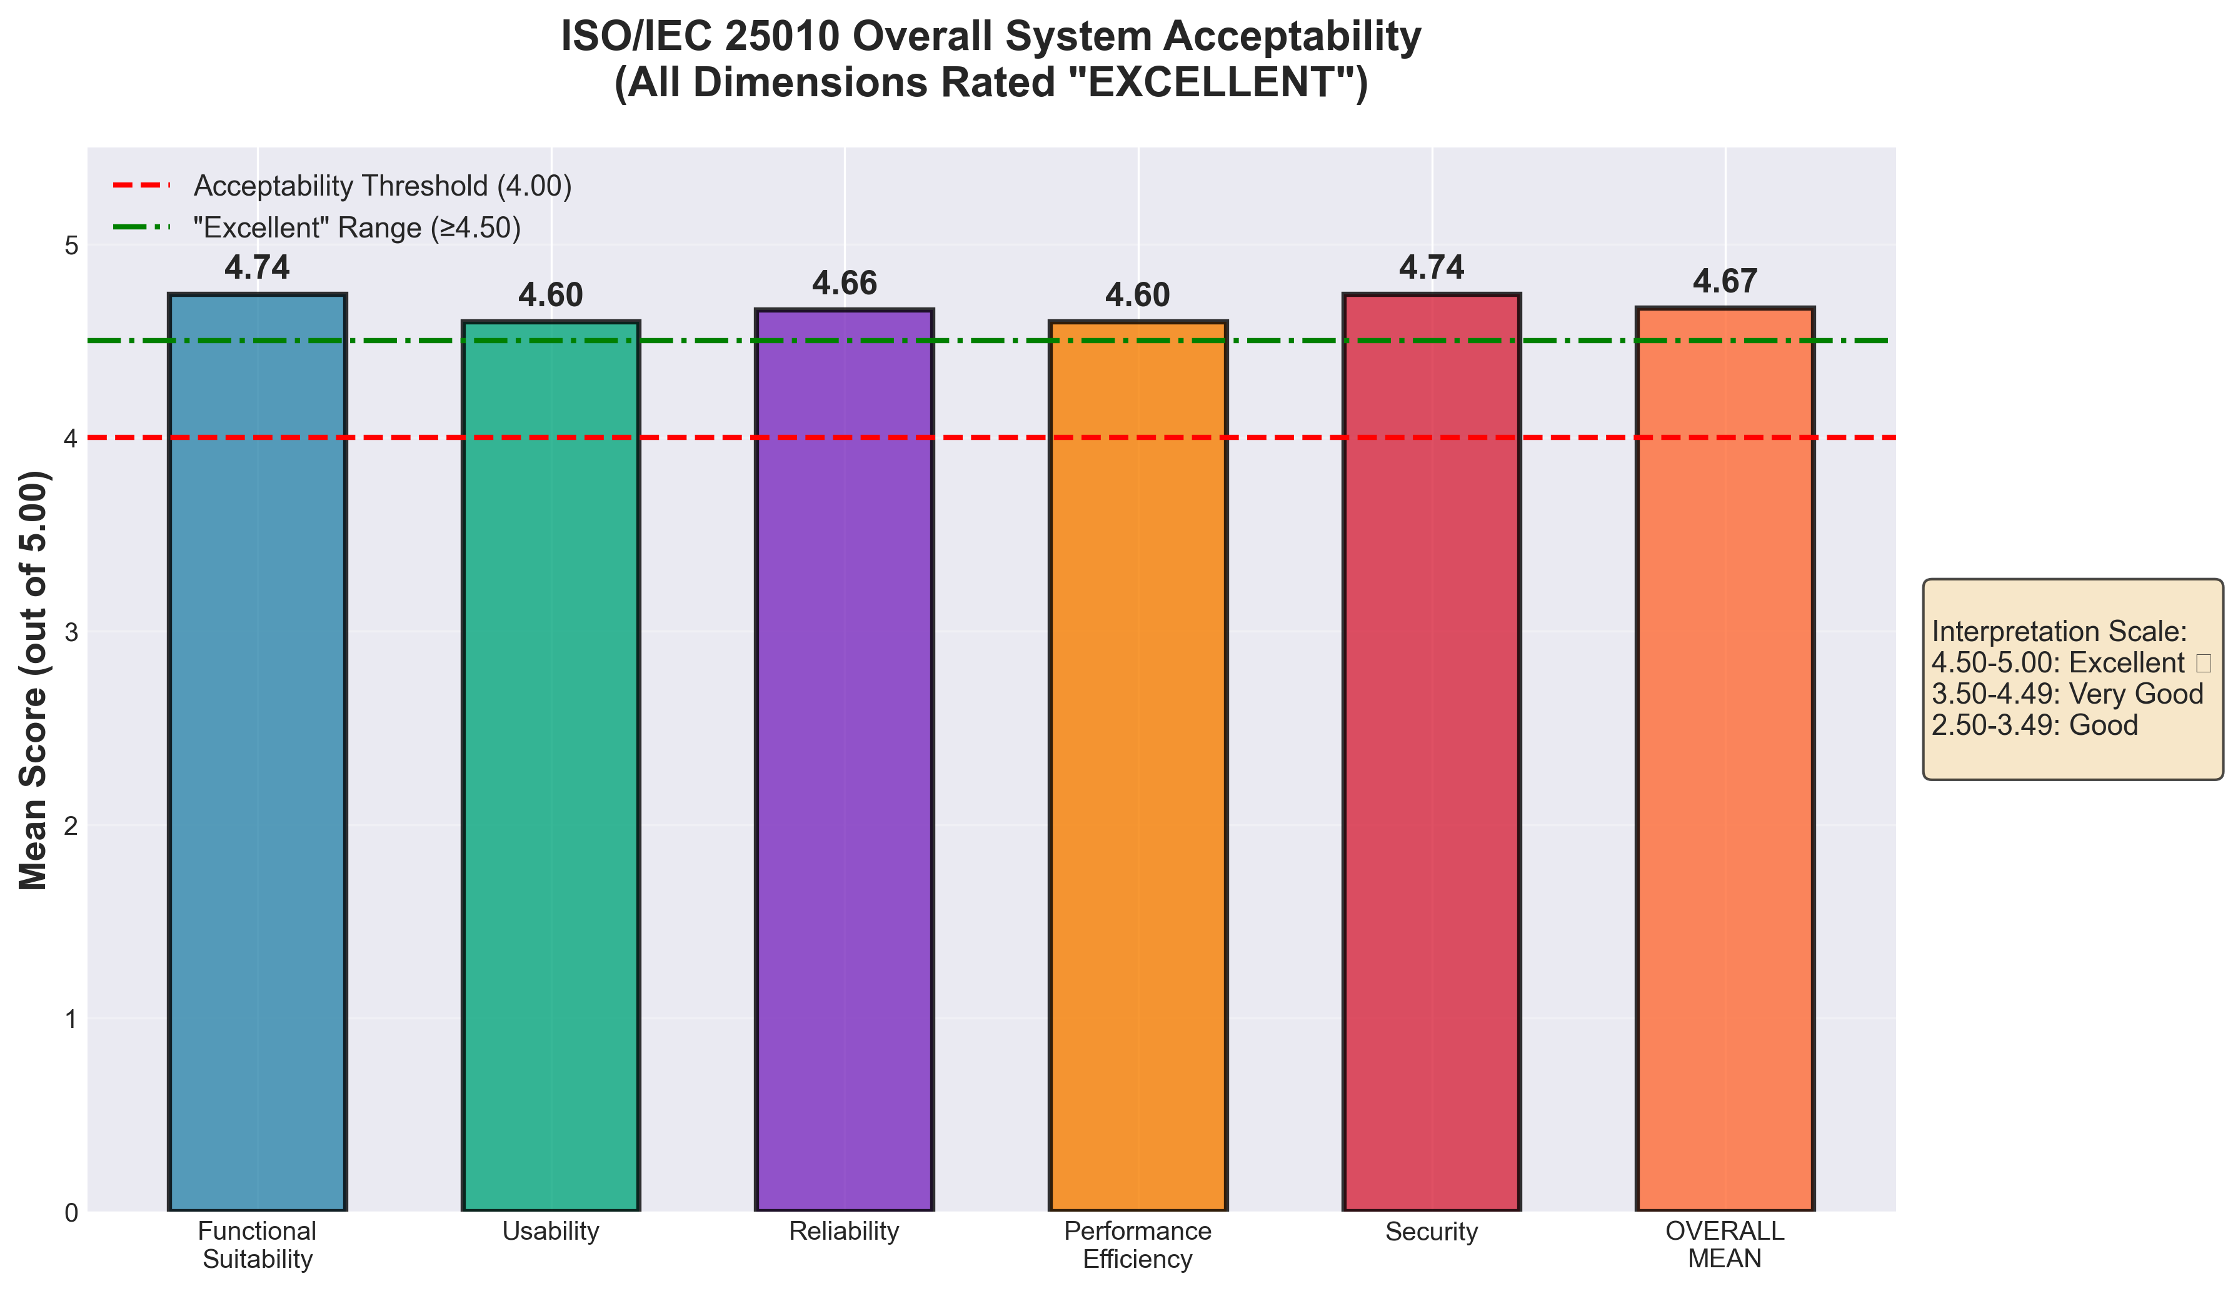
Overall System Acceptability Chart
4.67/5.00 — all dimensions rated Excellent
A.E.G.I.S. | BSIT Capstone 2 | CLSU Department of Information Technology | 2026

Slide 24
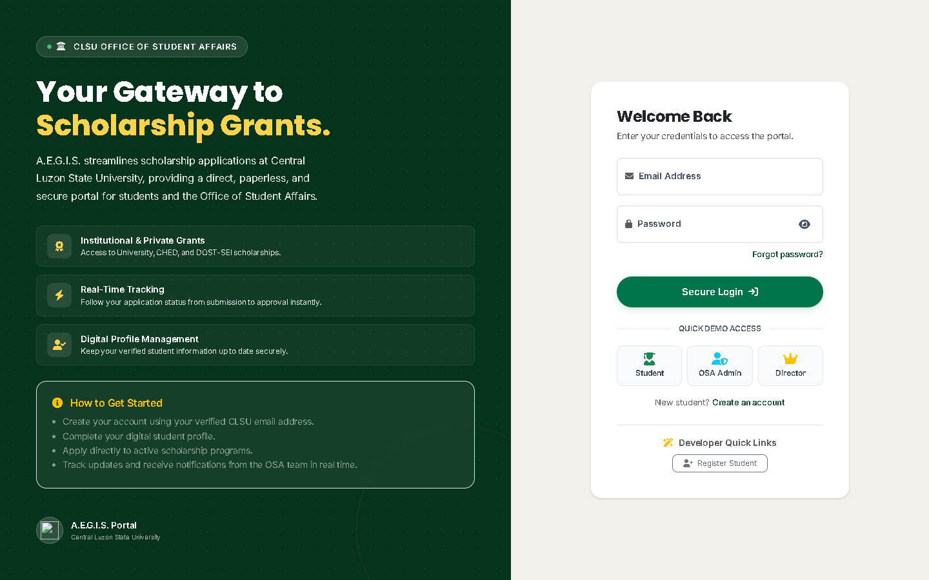

System Interface — Student Portal
Clean, responsive interface for scholarship applicants
A.E.G.I.S. | BSIT Capstone 2 | CLSU Department of Information Technology | 2026

Slide 25
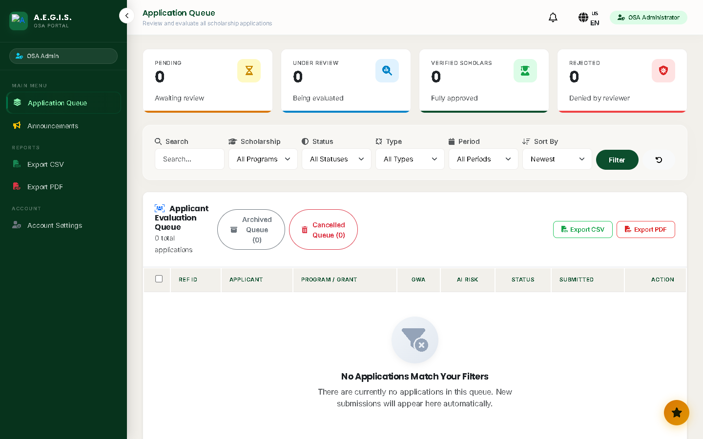

System Interface — Admin Review & AI Scan
Fraud detection panel with heatmap visualization
A.E.G.I.S. | BSIT Capstone 2 | CLSU Department of Information Technology | 2026

Slide 26
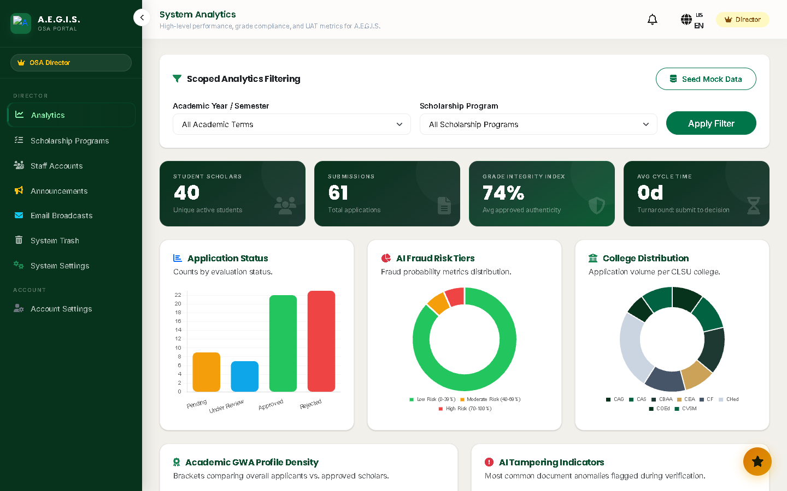
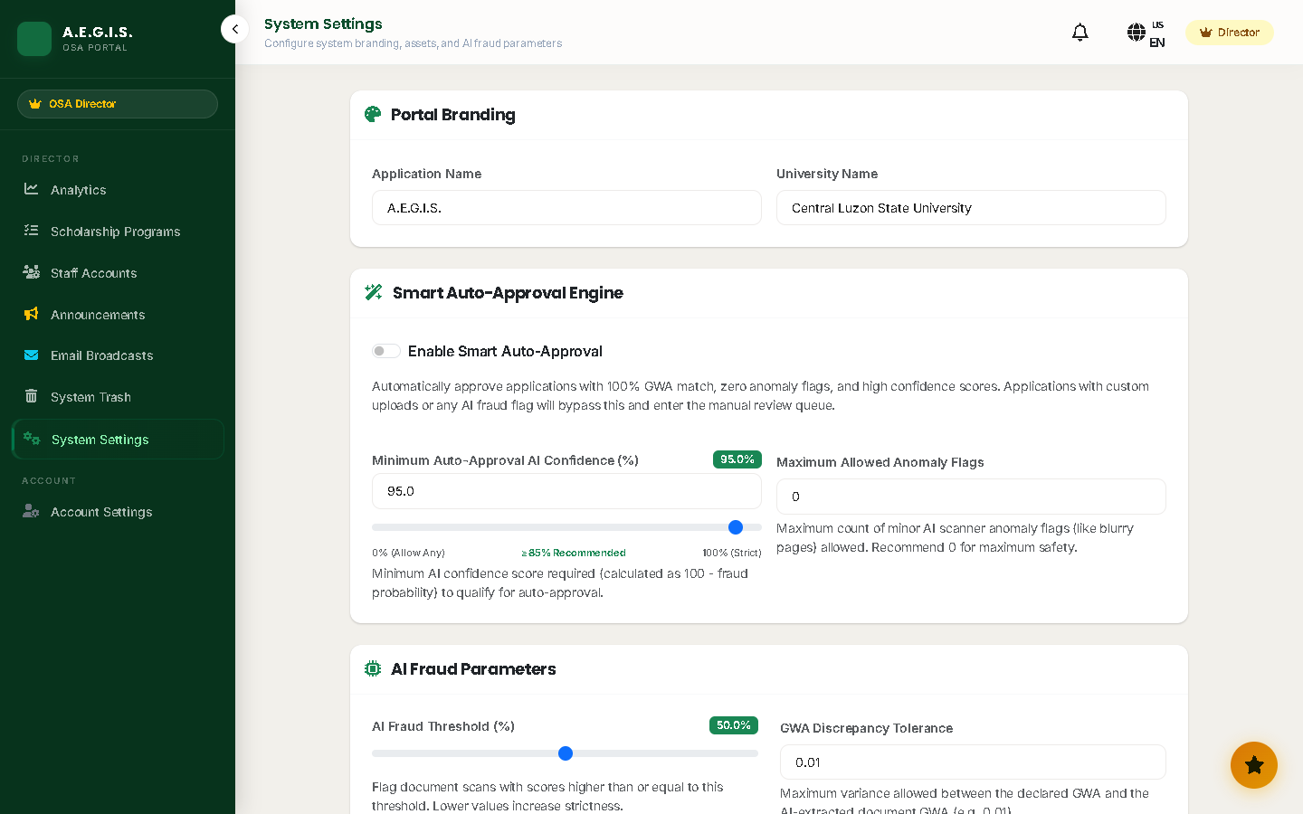
System Interface — Analytics & Settings
Superadmin analytics dashboard and configuration
A.E.G.I.S. | BSIT Capstone 2 | CLSU Department of Information Technology | 2026

Slide 27
Thank You
A.E.G.I.S. — AI-Enhanced Grant Information System
"A.E.G.I.S. demonstrates that AI-augmented digital services can improve
public sector efficiency while maintaining accountability and security.
This research contributes a replicable model for Philippine state universities
pursuing digital transformation aligned with Republic Act 11032."
[Your Names Here]
Department of Information Technology • College of Engineering
Central Luzon State University • Science City of Muñoz, Nueva Ecija • January 2026
94.73%
4.67/5
198
100%
AI Accuracy
UAT Score
Tests Passed
Recommend ✅

