Slide 1
Niveditha Bharadwaj, 001013438
Srushti Dhamangaonkar, 001029631
Rahul Mahadev, 001066762
UNIVERSITY DESIGN ASSIGNMENT 3

Slide 2
Problem statement
Build an effective system to improve the quality of education in a university. The system must enable the university to performance measurement solution to enable universities to measure the quality of the education they deliver to their students.
This will allow the university to devise more effective ways of: measuring student performance, faculty performance, placement opportunity, forecast enrollments and implementing better quality of education.

Slide 3
Employment History Directory
Responsible for Student Job Profile such as
Student Employment Details
Companies details
Promotions.

Slide 4
Student Directory
Student Performance is one of main metric in our Ranking Model. In order to measure student performance following are important factors :
1. GPA
2. Full-time Employment (Promotions).
3. Feedback from Employee.

Slide 5
Teacher Directory
Teacher Performance is also one of the metric in our Ranking Model. In order to measure teacher performance, the following are important factors :
1. Rating from students.
2. Experience.

Slide 6
Recommended Solution for Improving Rating of University.
University Rating = Sum of all college rating.
College Rating = Sum of department performances
Department Rating = Sum of Student Performances + Teacher Performances
Student Performance = GPA + Full-time Employment
Teacher Performance = Rating From Student

Slide 7
Relevance of Department Course Catalog to the Industry
Relevant Course is calculated by comparing the company’s requirements with the courses offered by the department.
Company’s requirement is taken from the Employment History Account and courses offered are taken from the Department course catalog.

Slide 8
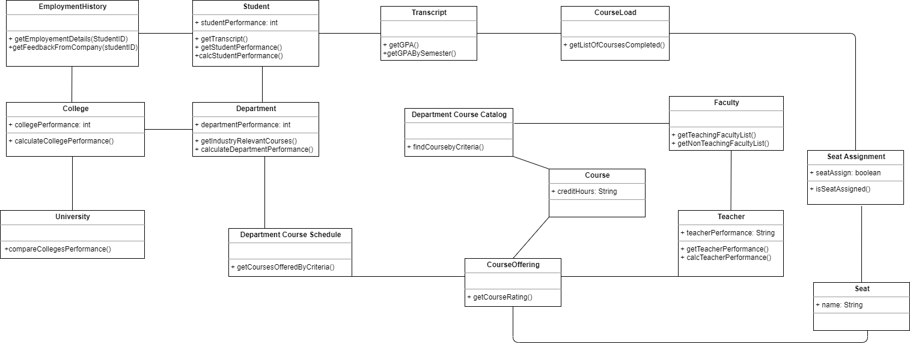
An Object Model

Slide 9
Student Performance
While creating student Account the following attributes needs to be filled
We consider full-time employment details (Role offered, Promotions) which are taken from Employment History Account and GPA is taken from Transcript .

Slide 10
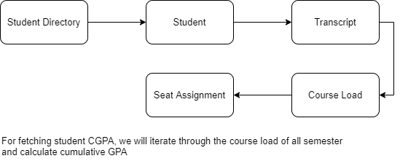
Sequence of Fetching Student CGPA

Slide 11
Sequence of Fetching Employment Details of Student.
We have Student placement information from Employment History, which will return company details, feedback of student and promotions. We will use these values to calculate student performance
Employment History
Student

Slide 12
Teacher Performance
While creating Teacher Account the following attributes needs to be filled:
After Completion of each Semester rating of the teacher from the student is updated in Teacher Account.

Slide 13
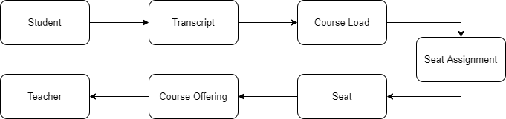
Sequence of Fetching Teacher Performance
Teacher Performance will be calculated by taking student review and the years of experience the teacher has gained.

Slide 14
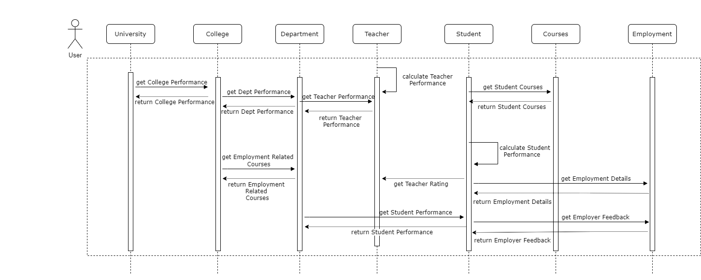
Sequence Diagram of Model

Slide 15
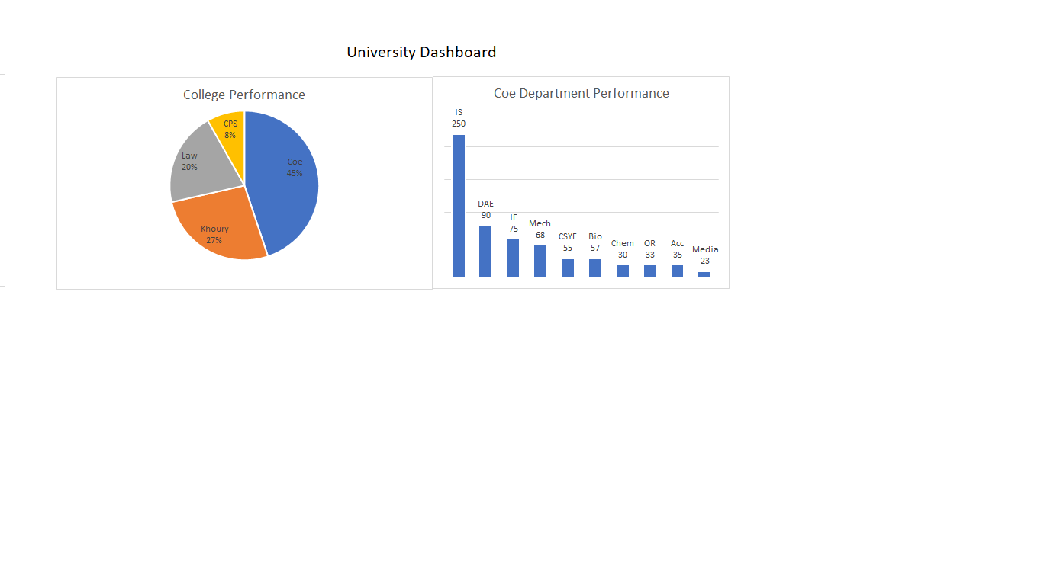
Dashboard

Slide 16
Table for Calculating Student and Teacher Performance.
Student | CGPA | Placement Score / Ph.D. Score | RP Score | Employment Feedback Score
A1 | 9 | 9 | 8 | 10
A2 | 7 | 5 | 5 | 6
A3 | 6 | 0 | 5 | 0
Teacher | Feedback Score | Ph.D. Score | RP Score
T1 | 9 | 9 | 8
T2 | 7 | 5 | 5
T3 | 6 | 0 | 5
College | Score
Coe | 9
Khoury | 10
Cps | 6
Law | 5
Department | Score
Information System | 9
DAE | 10
Data Science | 6
Biotech | 5

Slide 17
Benefits of the Design
By using all the performance metrics , university will be able to make improvements on following
1.Better Industry Relevant Course Curriculum.
2.Improve Opportunities for student in both future studies and Employment.

