Slide 1

Lecture #3 Demand Curve
Alessandro Di Mattia

Slide 2
Demand
Buyers or Consumers are sometimes called demanders.
Consumers are said to “demand” products in the marketplace.
Demand refers to the consumption behavior of buyers in the market.
Demand also means the willingness to pay of consumers at various prices and quantities.

Slide 3
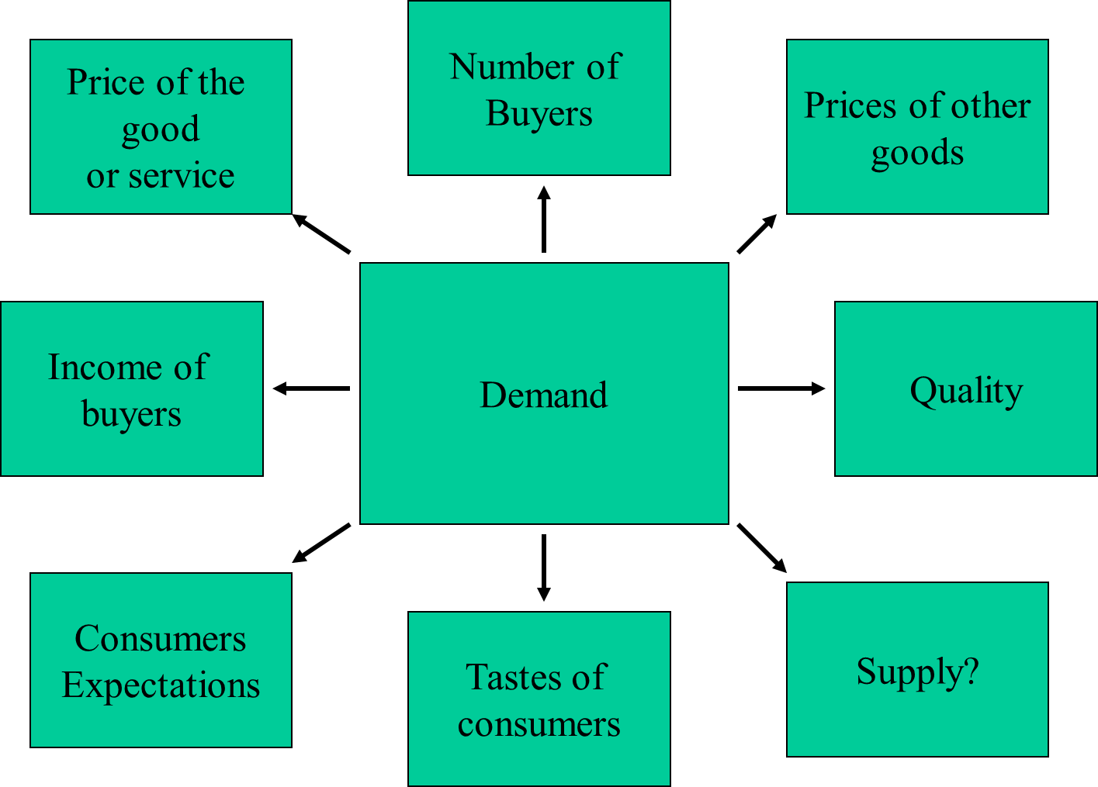
Which factors affect demand?

Slide 4
Demand’s Factors
Each factor has a unique impact on the Demand
All these factors usually change simultaneously and influence each other
To understand how one factor affects demand, we must assume that all the other factors do not change over time (ceteris paribus principle)

Slide 5
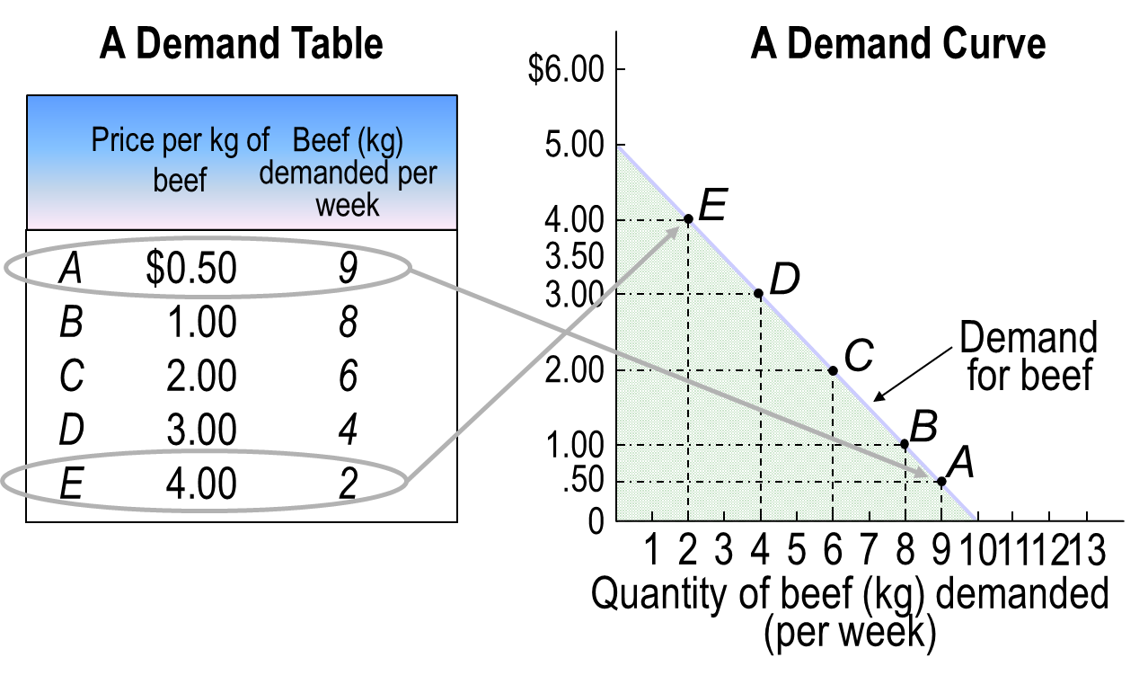
From Demand Table to Demand Curve

Slide 6
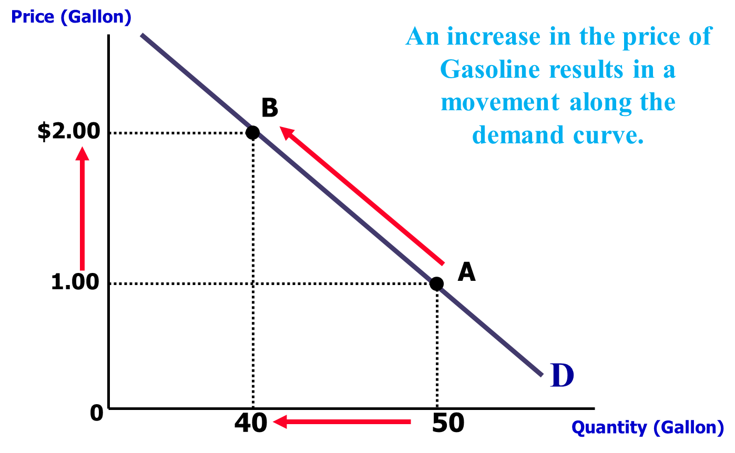
Price

Slide 7
Price
Price is the most important determinant of demand.
The demand curve is a graphical representation of the relationship between the price of a good or service and the quantity demanded for a given period

Slide 8
Number of buyers
An increase in the number of potential buyers will increase the demand for the good.
For example, the demand for land increases as the population increases.
Similarly, baseball tickets are generally more expensive in larger cities. ⚾

Slide 9
Price of other goods
Changes in the prices of other goods can increase or decrease demand.
A good that causes an increase in the demand for another good when its price increases is called a “substitute good.”
Butter and margarine
Tea and coffee
A good that causes a decrease in the demand for another good when its price increases is called a “complementary good.”
Fuel and car
Burgers and chips

Slide 10




# Example - Substitutes
What will happen to the demand of Coke if the price of Pepsi increases?
Pepsi and Coke are substitutes.
$$P$$
$$Q^{D}$$
$$Q^{D}$$
$$Q$$

Slide 11




# Example - Complementary
What will happen to the demand of tea if the price of sugar increases?
Tea and sugar are complementary
$$P$$
$$Q^{D}$$
$$Q^{D}$$
$$Q$$

Slide 12
Quality
Demand curves can shift due to changes in quality.
However, usually we assume that all the products have the same quality (to simplify our assumptions on the real world)

Slide 13
Tastes
Demand curves can shift due to changes in tastes over time.
For example, demand for cereal may be high in the morning but low at night.
Similarly, demand for Saturday Night Fever CDs may be high in the 1970s but low in the 2000s.

Slide 14
Future Prices
An increase in the expected future price of a good increases current demand.
A decrease in the expected future price of a good decreases current demand.
For example, when a good is temporarily put on sale, people stock up on the good.

Slide 15
Income
Changes in income can increase or decrease demand.
A good whose demand decreases with an increase in income is called an “inferior good.”
A good whose demand increases with an increase in income is called a “normal good.”

Slide 16
Examples
An increase in income will increase the demand for cars or clothing.
An increase in income will significantly increase the demand for air travel or jewelry.
An increase in income will reduce the demand for public transportation (will increase the demand for private cars).

Slide 17
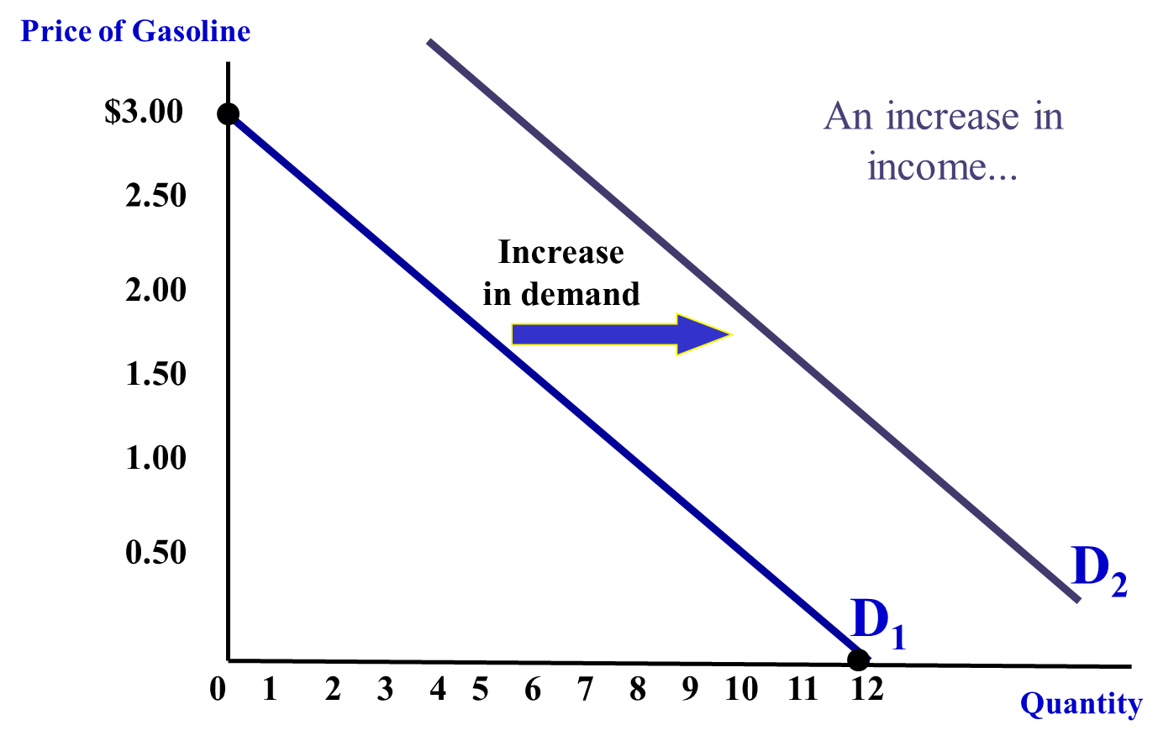
Example – Normal Good

Slide 18
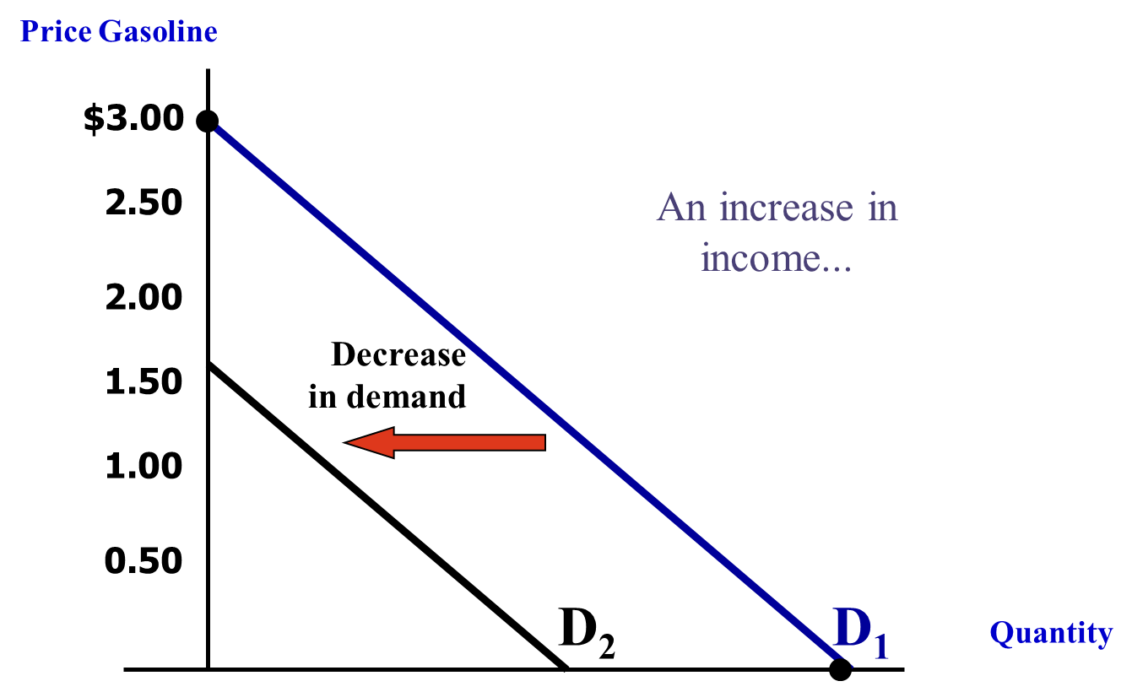
Example – Inferior Good

Slide 19
Market Demand
The market demand curve
Describes the relationship between the price a good is offered at and the corresponding quantity demanded.
It is the horizontal summation of all individual demand curves(consumers) in a given market
It aggregates all the quantities demanded for a particular price and does that for all possible prices

Slide 20
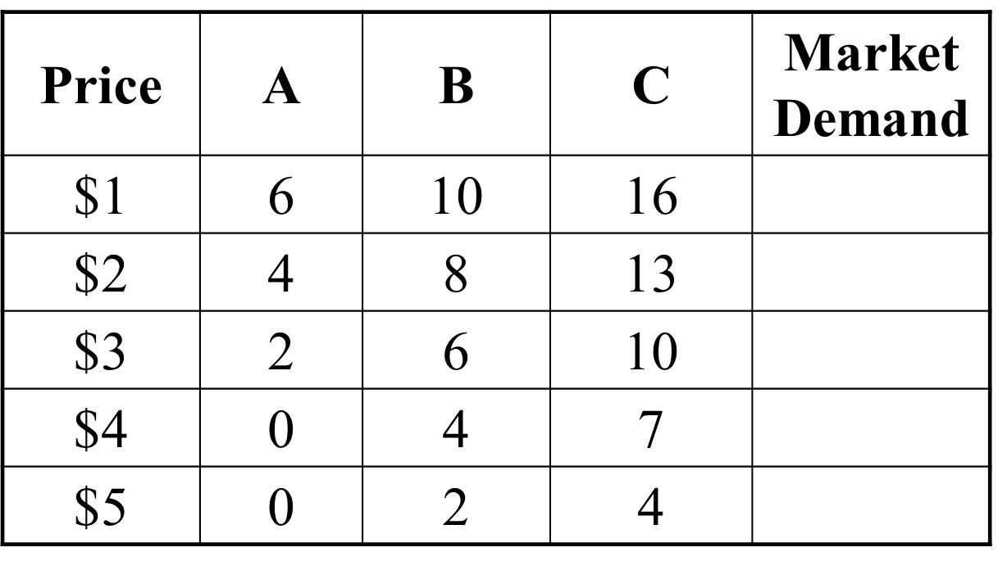

Slide 21
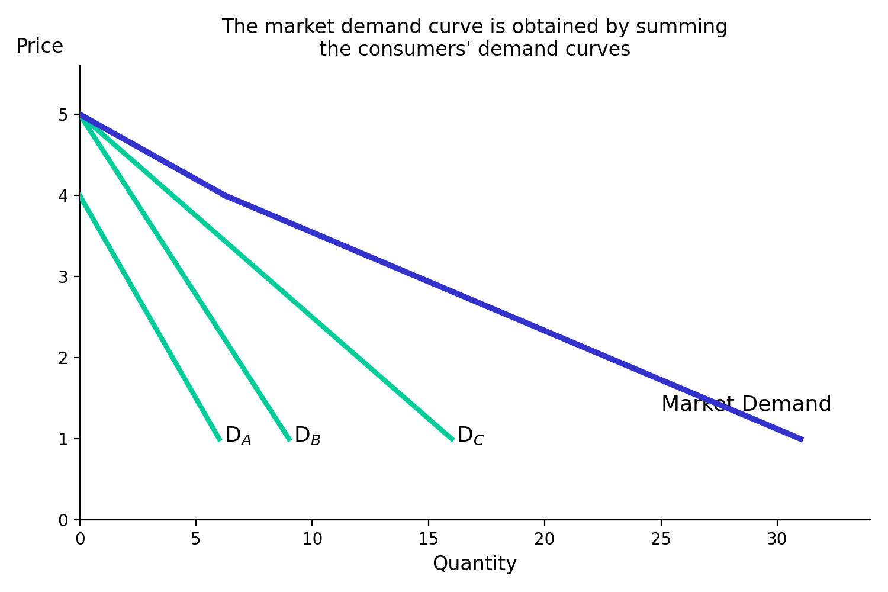

Slide 22

Determining the Market Demand Curve
Suppose that demand by an average consumer in the domestic market for a football game is given by
$$Q_{D}^{D}=28.6 −1.1P$$
Suppose there are two consumers, what is market demand?
Suppose there are 100 consumers, what is market demand?

Slide 23
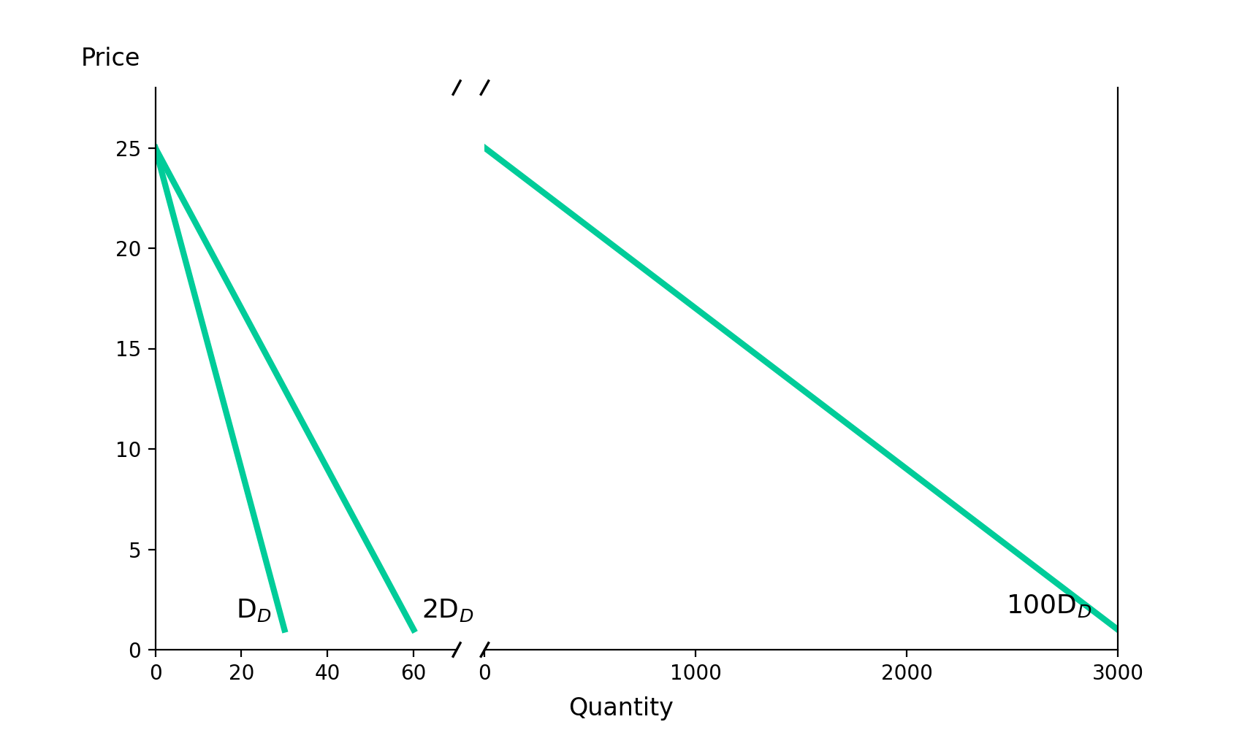
Determining the Market Demand Curve

Slide 24

Determining the Market Demand Curve
Suppose demand for a football game in the foreign market is given by
$$Q_{D}^{F}=2940−140P$$
What is the world demand for a football game?

Slide 25
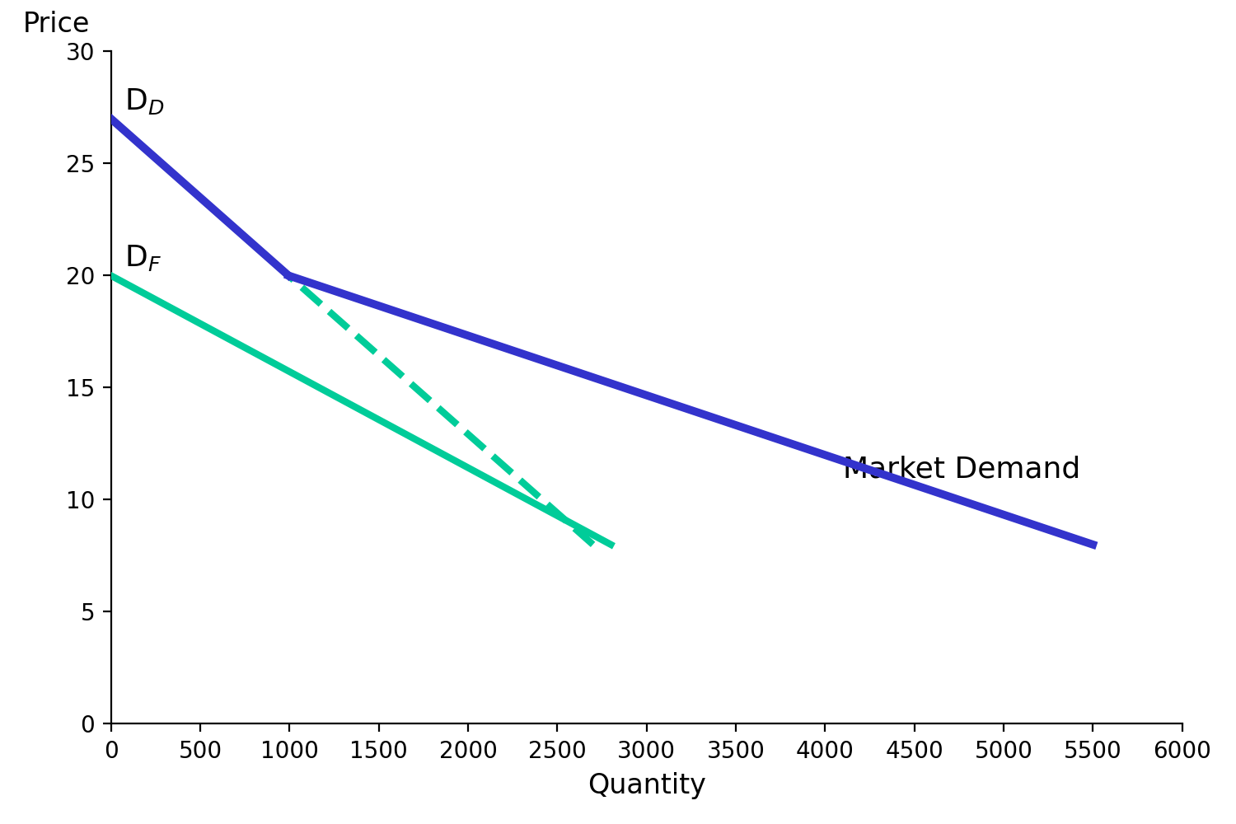
Determining the Market Demand Curve

Slide 26
Market Demand
From this analysis we can deduct two important points:
The market demand curve will shift out as more consumers enter the market
Factors that influence the demands of many consumers will also affect market demand
This aggregation means that changes in demands for groups with similar characteristics may have important consequences for market demand:
Households with children are more likely to purchase minivans
Rural consumers are more likely to buy pickup trucks

Slide 27

Price Elasticity of Demand
It measures the percentage change in the quantity demanded resulting from a percent change in price
$$E_{P} = \frac{\%ΔQ}{\%ΔP}$$
Which is equivalent to:
$$E_{P}=\frac{∂Q}{∂P}\frac{P}{Q}$$

Slide 28
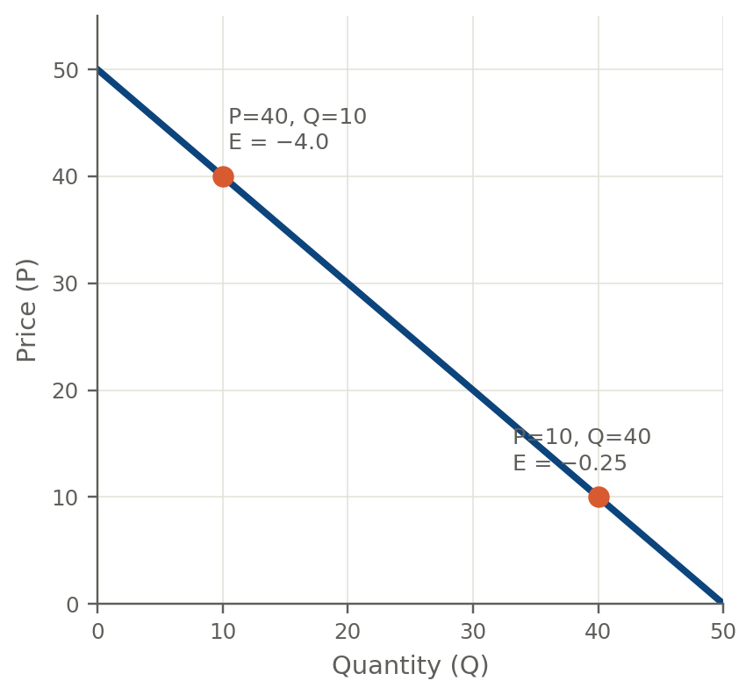
Linear Demand: Elasticity Is Not Constant
For linear demand, P = a − bQ, the slope dQ/dP is constant
But elasticity depends on the ratio P/Q, which changes at every point on the line
High price, low quantity (top of curve): demand is more elastic
Low price, high quantity (bottom of curve): demand is more inelastic
Example: Q = 50 − P → E_{p} = −4.0 at P = 40, but E_{p} = −0.25 at P = 10

Slide 29
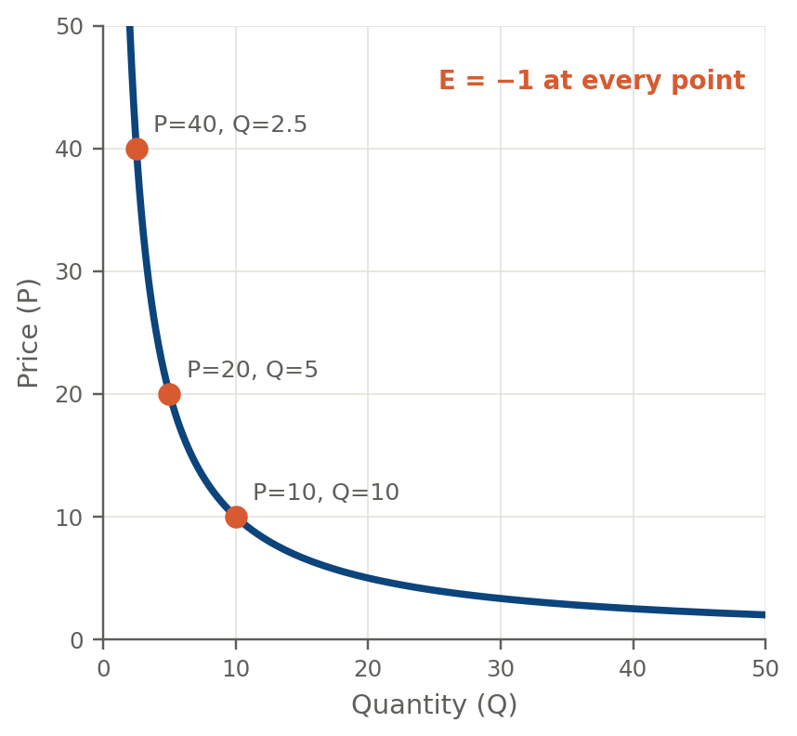
Constant Elasticity (Isoelastic) Demand
Constant elasticity requires Q = A × P^{−Ep} — a power function, not a straight line
This curve is convex to the origin: it bows inward and never touches either axis
Example: unit-elastic demand, Q = 100/P (E_{p} = −1 everywhere)
P = 10 → Q = 10; P = 20 → Q = 5; P = 40 → Q = 2.5 — elasticity stays exactly −1 at every price
Total revenue (P × Q) stays constant along the entire curve

Slide 30
Inelastic Demand
E_{p} is less than 1 in absolute value
Quantity demanded is relatively unresponsive to a change in price
|%ΔQ| < |%ΔP|
% drop quantity bought smaller than % rise in the price
Total expenditure (P*Q) increases when price increases

Slide 31
Unit Elastic Demand
E_{p} is 1 in absolute value
Quantity demanded is neither relatively responsive nor unresponsive to a change in price
|%ΔQ| = |%ΔP|
Total expenditure (P*Q) is unaffected by a price change

Slide 32
Elastic Demand
E_{p} is greater than 1 in absolute value
Quantity demanded is relatively responsive to a change in price
|%ΔQ| > |%ΔP|
Total expenditure (P*Q) decreases when price increases

Slide 33
Isoelastic Demand
When price elasticity of demand is constant along the entire demand curve
Demand curve is curved inwards (not linear)

Slide 34
Example
Suppose that demand is given by
Q_{D}^{F} = 2940 – 140P
What is elasticity when price is 14?
What is elasticity when price is 7?

Slide 35
Elasticity in the News
“There’s very low price-elasticity-of-demand for coffee,” said Paul Christopher, the St. Louis-based chief international strategist at Wells Fargo Advisors, which manages $1.4 trillion. “Would people who like coffee regularly substitute tea, or soda, if prices rise? The answer is ‘No.’”
- “Coffee Cravers Ignoring Bean-Price Surge for Caffeine Fix,” Bloomberg Business, M. Perez & L. Doan, March 13, 2014

Slide 36
Elasticity in the News: 2026 Update
Twelve years after that Wells Fargo quote, the story repeats: U.S. ground coffee hit a record $9.46 a pound in February 2026, up 31% year-over-year. Coffee drinkers still are not switching to tea or soda — they are staying in the category but trading down to home brewing and store-brand beans instead.
- “U.S. coffee prices are surging at a record pace,” TheStreet, H. Remy, based on Bloomberg/BLS data, March 18, 2026
Source: thestreet.com/retail/u-s-coffee-prices-are-surging-at-a-record-pace

Slide 37
Gasoline vs Grapefruits
For every 10 percent increase in price during the late 1970s, demand fell 2.1 to 3.4 percent, researchers found. But in the past five years, every 10 percent price increase drove down gasoline purchases by a mere 0.34 to 0.77 percent. Gas prices hardly affect demand. - David R. Baker, Staff Writer, December 1, 2006
… “But last fall, with the grapefruit crop down substantially, consumer demand for grapefruit juice plummeted by as much as 30 percent after prices increased 20 percent and more.”
-Andrew Martin, December 2, 2006

Slide 38
Gasoline vs Grapefruits: 2026 Update
Congress debated a federal gas tax holiday for summer 2026. Analysts noted that in the short run, both sides of the market stay inelastic: drivers still need fuel regardless of small price changes, so much of any tax cut would be captured by suppliers as higher margins rather than passed through to consumers. Short-run gas demand is still barely price-sensitive. - Penn Wharton Budget Model, May 11, 2026
… Meanwhile in the citrus aisle: with Florida’s grapefruit and orange crop still near a century low, global orange juice demand is projected to fall another 3% in 2026/27 — part of a roughly 40% decline over the past decade — as consumers cut purchases or trade down to cheaper alternatives even though retail prices remain near record highs.
-Rabobank, reported via FreshFruitPortal & Citrus Industry Magazine, June 2026
Source (gas): budgetmodel.wharton.upenn.edu/blog/BE2026-3
Source (OJ): freshfruitportal.com/news/2026/06/01/orange-juice-drop

Slide 39
Consumer Surplus
Consumers buy goods because it makes them better off
Consumer surplus measures how much better off they are
The difference between the maximum amount a consumer is willing to pay for a good and the amount actually paid
We can calculate consumer surplus from the demand curve

Slide 40
Examples
Students want to buy concert tickets
Demand curve tells us willingness to pay for each concert ticket
1st ticket worth $20 but price is $14 so student generates $6 worth surplus
We can measure this for each ticket
Total surplus is the sum of all surplus for each ticket purchased

Slide 41
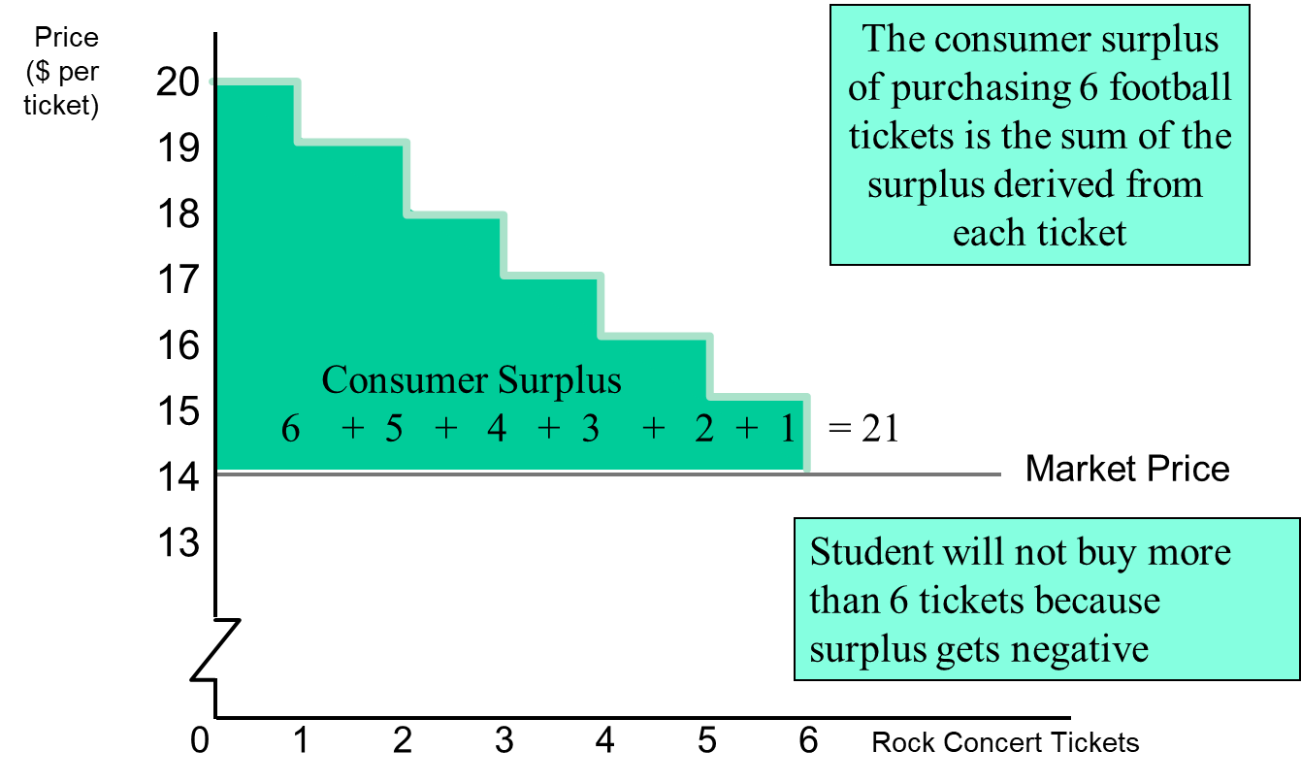

Slide 42
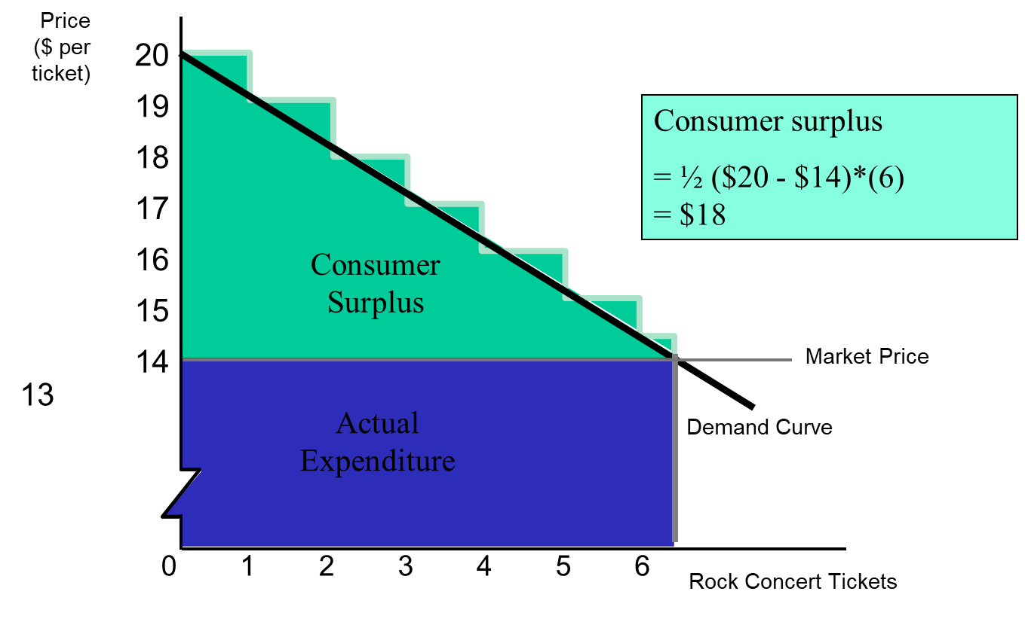

Slide 43
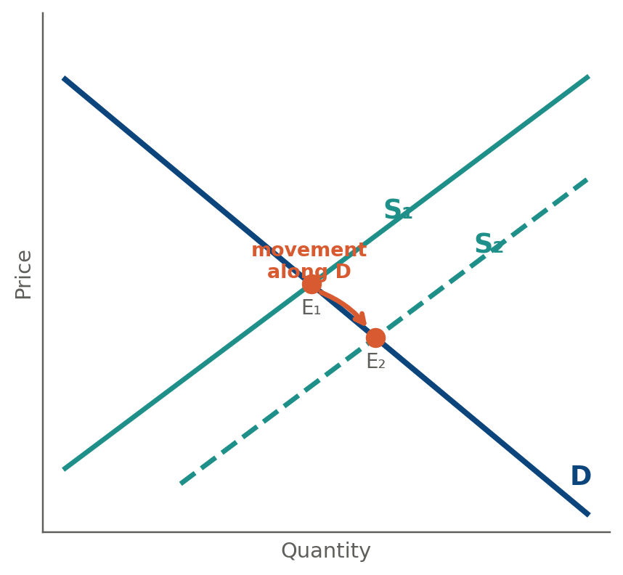
Supply?
A change in supply does not shift the demand curve.
Instead, it shifts the supply curve, which changes the equilibrium price.
That new price causes a movement along the demand curve — a change in quantity demanded, not a shift in demand.

Slide 44
Utility Function – The concept of utility
Why do people consume?
To satisfy their needs/wishes/desires.
Utility function indicates the level of joy or preference given by consumers to specific market bundles.

Slide 45
Cardinal Utility & Ordinal Utility
There are two kind of measurement : (i) Cardinal (ii) Ordinal.
Cardinal utility is measurable.
Ordinal utility is only an ordinal measure.

Slide 46
Cardinal Measures - Examples
High
Weight
Age
Distance
Grades

Slide 47
Ordinal Measures - Examples
Beauty (you can declare who looks better and therefore you can rank them. However, you cannot measure the size/intensity of beauty).
Knowledge (you can claim who knows more about life, but you cannot measure it).
Tastes (you can prefer pizza to meat but you cannot measure by how much).
Utility is an ORDINAL measure

Slide 48
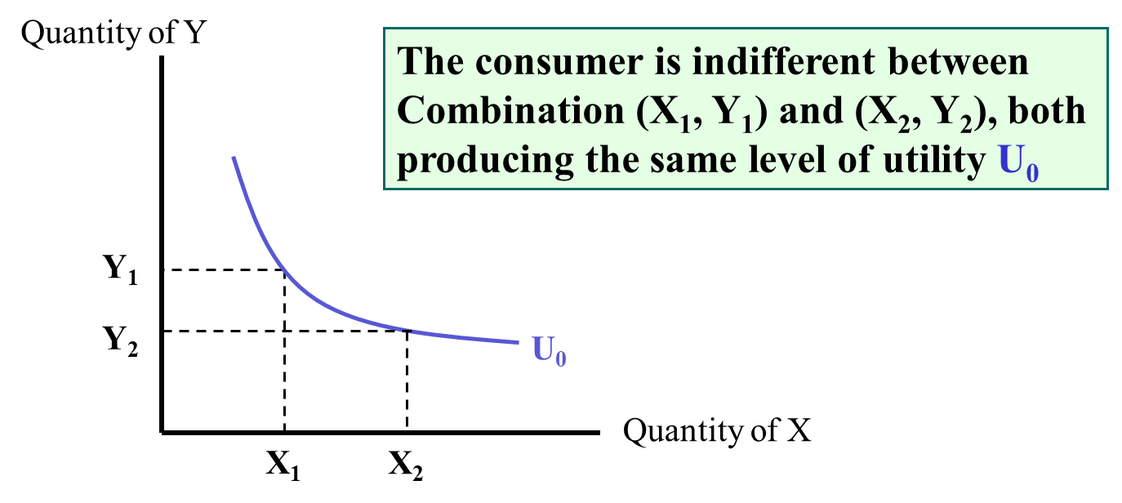
Indifference Curves

Slide 49
Indifference Curve - Definition
An indifference curve shows a set of consumption bundles among which the individual is indifferent.

Slide 50
Summary
Market demand
Horizontal sum of individual demand
Elasticity of Demand
Measures the relationship between price and quantity demanded of a good
Consumer Surplus
Measures the aggregate benefits to consumers from buying goods

Slide 51
Useful links
Relationship Elasticity and Total Expenditure (TE): https://www.economicsdiscussion.net/relationship/relationship-between-price-elasticity-of-demand-and-total-expenditure-microeconomics/31057

