Slide 1

Lecture #2 Basic Economics Models
Alessandro Di Mattia
Notes:
Recap L1 in ~1 min: economics as a science, positive vs normative. Preview today's arc: two foundational models (Circular Flow, PPF) -> opportunity cost -> absolute/comparative advantage -> a full worked numerical trade example (David & Sherry) -> summary. Budget ~90 min.

Slide 2


The Scientific Method
REMEMBER: Economics is a Social Science
Notes:
Bridge from L1's methodology slides. Ask: 'why does it matter that economics is a SOCIAL science and not a natural science?' (people react, expectations shift, no controlled lab). Keep to 2 min - this is a launchpad into slide 3.

Slide 3
The Scientific Method
The scientific method involves identifying a problem, gathering data, forming a hypothesis, testing the hypothesis, and analyzing the results.
Observation
An apple hit me on the head 🍎🤕
When Molde FK plays at home, it is more likely to win ⚽
Question
What led the apple to fall?
Why Molde FK is more likely to win at home?
Hypothesis
A force drives the apple (i.e., gravity)
A force drives Molde FK (i.e., supporters)
Experiment
Understand which variables come into play and their role
Results
Data visualization
Conclusion
Notes:
Walk the steps once with the apple (familiar, physical), then immediately re-map each step onto Molde FK's home advantage. Pause after 'Hypothesis' and ask students to propose their own 'Experiment' (e.g., compare home vs away win % controlling for opponent strength). ~5 min including discussion.

Slide 4
Role of Assumptions
Economists make assumptions in order to simplify the complex world and make it easier to understand.
Economists use different assumptions to answer different questions.
For studying short-run effects we may assume that prices do not change much.
Ticket prices fixed
For studying long-run effects we may assume that prices are completely flexible.
Ticket prices renegotiated between seasons
Notes:
Add a concrete example: ticket prices fixed for a season vs renegotiated between seasons; player wages fixed mid-contract vs flexible at renewal.

Slide 5
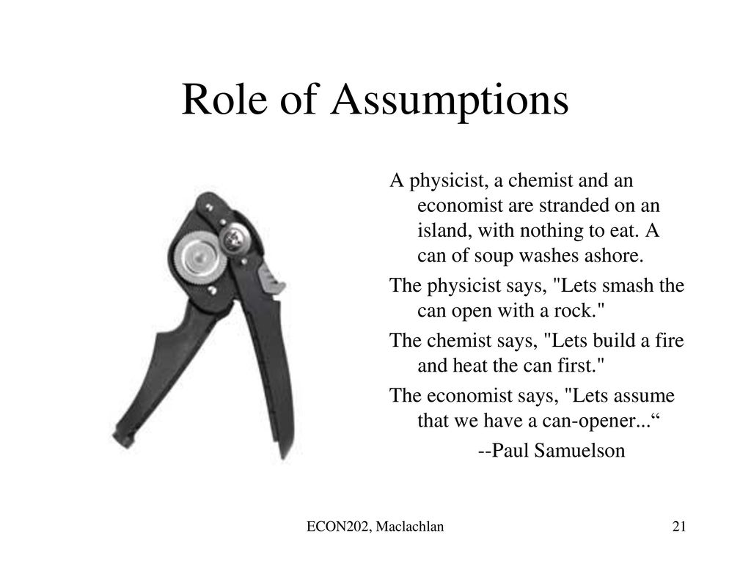
Notes:
Slide credited to ECON202, Maclachlan - a borrowed slide, keep as-is. Use as comic relief and to land the point: assumptions aren't 'wrong', they're tools chosen for the question at hand. Transition line: 'Now let's build two models economists actually use.'

Slide 6
Economic Models
Two of the most basic models in economics are :
The Circular Flow Diagram
The Production Possibilities Frontier
Notes:
Preview only - Circular Flow (how market actors connect) and PPF (constraints and choice). Don't explain either yet, just name them.

Slide 7
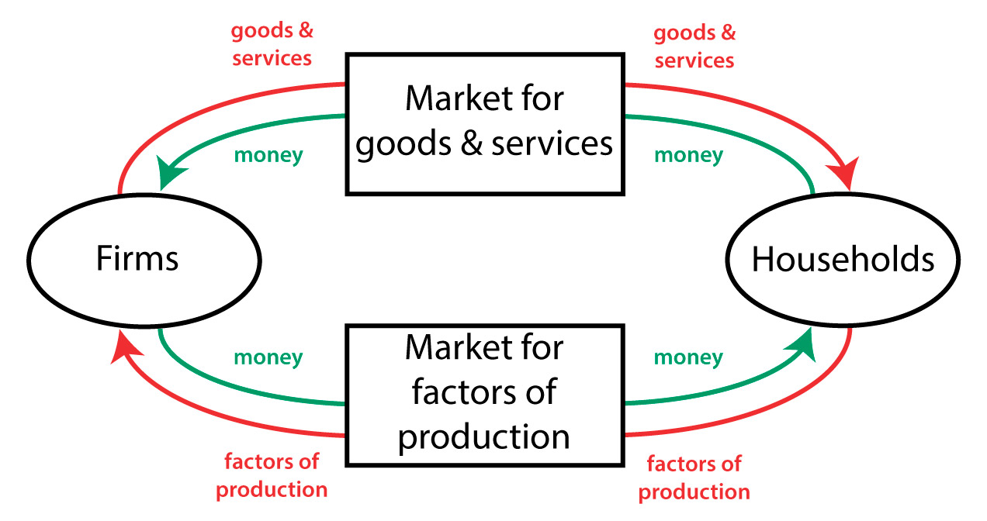
The Circular-Flow Diagram
Notes:
Show the full diagram cold, without explaining the arrows yet. Tell students 'we'll build this piece by piece' to build anticipation before slide 8's definition.

Slide 8
The Circular-Flow Diagram
The circular-flow diagram (or circular-flow model) depicts the flows of goods and money between two distinct parts of the economy:
Goods and Services Market
Factors of Production Market
Notes:
Define the two markets explicitly: Market for Goods & Services vs Market for Factors of Production. Point at slide 7's diagram to locate each before zooming into each half separately.

Slide 9
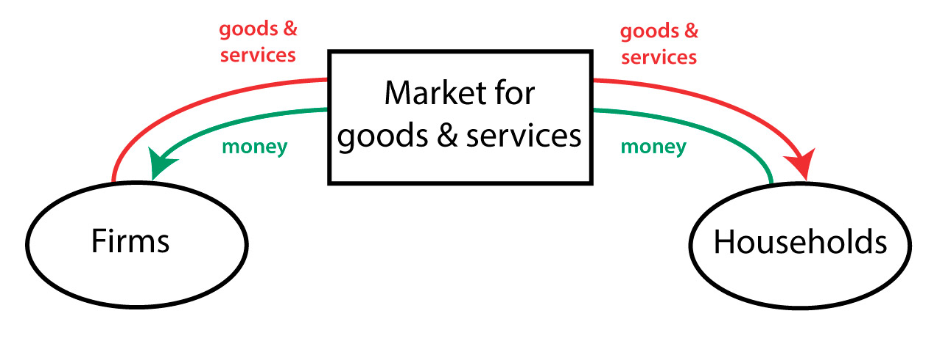
Goods and Services Markets
Notes:
Zoom-in view of the right-hand loop. Trace it with a pointer: goods/services flow one way (red, firms -> households), money flows the opposite way (green, households -> firms).

Slide 10
Goods and Services Market
Households buy finished goods and services from firms in exchange for money.
It is the place where firms sell the goods and services they have produced, receiving a revenue paid by households
If the goods and services market was the only existing market, what would happen?
Frims would end up having all the money, while households would have all the finished products. In this case, economic activity would stop. But this is just half-story!
Ex: Coop, Rema1000, gas stations, Burger King, Ikea, dentist….
Notes:
Ask the rhetorical question FIRST ('what would happen if this was the only market?') and let 2-3 students answer before revealing the text. The examples given (Coop, Rema1000, Burger King...) are Norwegian retail - ask students to add sport-specific ones (ticket sales, merchandise, stadium concessions) to keep it relevant to Sport Management.

Slide 11
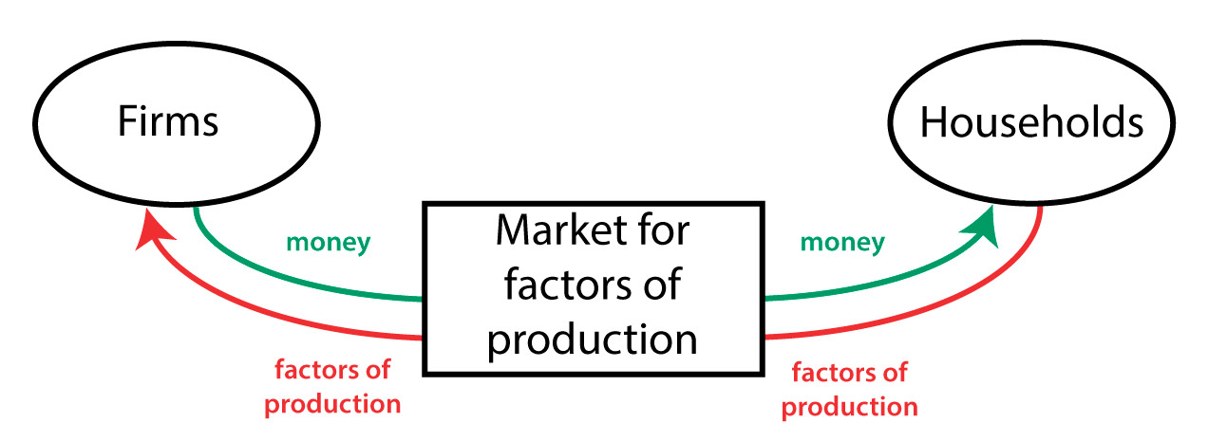
Factors Market
Notes:
Zoom-in view of the other half of the loop (factors market).

Slide 12
Factors Market
«Factors of production» refers to anything that is used by a firm in order to make a final prodcut
Some examples:
Labor = work done by households, athletes, coaches, staff
Capital = machines used to make products, funds used to buy machines, stadiums/training equipment
Land
Households offer their labour, capital, and land in exchange of money ( in the form of income)
Notes:
Ask for sport-specific examples of each factor before reading the slide: labor = athletes/coaches/staff, capital = stadiums/training equipment, land = pitch/training grounds. This is the strongest natural tie-in to Sport Management in this section - don't skip it.

Slide 13
Circular-Flow Diagram (Full Picture)
Notes:
Before explaining, ask students to predict: 'how do the two loops connect?' Then confirm with slide 14's explanation.

Slide 14
Circular-Flow Diagram (Full Picture)
When we combine both diagrams, we get the full picture.
A close loop for the flow is formed. As a result, continued economic activity is sustainable in the long run, since neither firms nor households are going to end up with all the money.
In this basic model, firms use factors of production to create finished products and households consume finished products in order to maintain their ability to provide factors of production.
It is an oversimplified model representing a purely capitalistic economy (only production, distribution, and consumption are considered).
Notes:
Key point: money and goods flow in OPPOSITE directions around the loop, forming a closed, sustainable cycle. Explicitly flag the model's limitations (no savings, no government, no foreign trade) - this sets up the 'Advanced' extension on the next slide.

Slide 15
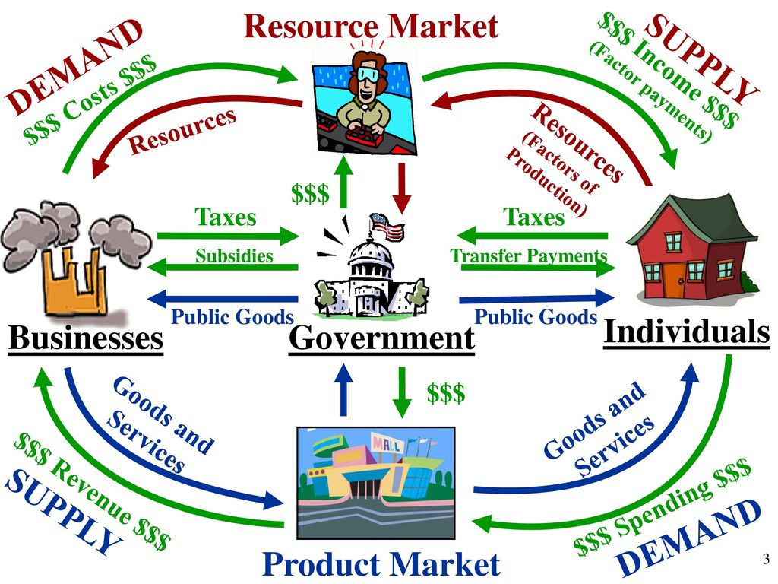
Circular-Flow Diagram (Advanced)
Notes:
New, denser diagram - give students 10-15 seconds to visually scan before narrating. Ask: 'what's new here compared to before?' (a Government box, plus taxes/subsidies/transfers).

Slide 16
Circular-Flow Diagram (Advanced)
We could extend the model to include government intervention.
Income tax = link between households and factors market
Tax on producer = link between firms and goods and services market
Notes:
Only two links matter here: income tax (households <-> factors market) and producer tax (firms <-> goods market). Don't over-explain fiscal policy now - say explicitly 'we'll come back to taxes and subsidies in depth in Lecture 7.'

Slide 17
Step 1 — Factor Market side: Income Tax
Anna works for the café and earns a gross wage of 500 NOK/day (flows: Businesses → Resource Market → Individuals, the "Income $$$" arrow).
The government taxes this income at 20%:
Income tax collected: 100 NOK
Anna's disposable income: 400 NOK
This tax sits on the arrow between the Resource Market and Individuals — government intercepts part of the factor payment before it becomes household spending power.

Slide 18
Step 2 — Product Market side: Tax on Producers
The café sells coffees and generates 50 NOK in daily sales revenue (flows: Businesses → Product Market → Individuals pay for Goods and Services).
The government taxes the producer at 10%:
Producer tax collected: 5 NOK
Café's net revenue: 45 NOK
This tax sits on the arrow between Businesses and the Product Market — government intercepts part of the firm's revenue before it becomes profit/investment.

Slide 19

Step 3 — Total Government Revenue
$\text{Total} \text{Tax} \text{Revenue}=100\text{ (}\text{income} \text{tax}\text{)}+5\text{ (}\text{producer} \text{tax}\text{)}=105 \text{NOK}$

Slide 20
Step 4 — Government Redistributes: Subsidies & Transfer Payments
Government spends → | Amount | Flow direction
Subsidy to the café (e.g., energy subsidy) | 30 NOK | Government → Businesses
Transfer payment to Anna (e.g., child benefit) | 50 NOK | Government → Individuals
Public goods (roads, healthcare) | 25 NOK | Government → Businesses & Individuals
30+50+25=105 NOK (fully recirculated)

Slide 21
Step 5 — Net Effect on Each Actor
Actor | Paid to Govt. | Received from Govt. | Net Position
Anna (Individual) | 100 (income tax) | 50 (transfer) + share of public goods | Net payer, partially offset
Café (Business) | 5 (producer tax) | 30 (subsidy) + share of public goods | Net receiver
Government | 105 collected | 105 spent | Balanced budget

Slide 22
Key takeaway
Government intervention doesn't remove money from the circular flow, it redirects it. Taxes are a leakage at two points (factor income and product revenue), while subsidies, transfers, and public goods are an injection back into the same loop, closing the circle between Businesses, Individuals, and the Government.
Notes:
A leakage is any point where money is pulled out of that loop rather than passed along to the next actor. The classic three leakages in macro are: taxes, savings, and imports. Taxes is the one relevant here.

Slide 23
Why Circular-Flow Diagram is important?
It gives us the first grasp of supply and demand model
Goods and services market
Demand: houseolds
Supply: firms
Factors market
Demand: firms
Supply: households
Notes:
Payoff slide - make sure students see the demand/supply role-reversal between the two markets, the most common confusion point. Comprehension check: 'In the factors/labor market, who demands and who supplies?' (Firms demand, households supply - opposite of the goods market roles.)

Slide 24
Production Possibilities Model
Unlimited wants, need, desires, and dreams. But limited resources (such as time and money) ⏳💸 → It becomes critical to allocate our (scarce) resources among alternative choices
The Production Possibilities Frontier is an analytical tool which is used to illustrate and explain this problem of choice.
The Production Possibilities Frontier (PPF) is a graph that shows all possible combinations of two goods when an economy is producing at full potential.
Simplified model, since it assumes only two goods are produced.
It only shows what can be produced – not what is consumed.
Notes:
Explicit transition: 'We just saw HOW actors connect (circular flow). Now: HOW MUCH can they produce given limited resources (PPF)?' Emphasize scarcity as THE core economic problem before reading the bullet points.

Slide 25
Assumptions
Only two goods are produced in different proportions in the economy
The same resources can be used to produce either or both two goods and can be shifted freely between them
The supplies of factors are fixed. But they can be re-allocated to produce the two goods within limits.
The production techniques are given and constant.
The economy’s resources are fully employed and technically efficient.
The time period is short
Notes:
Move quickly through the six assumptions - don't dwell on each one. Flag the ones that resurface later: only two goods, resources can shift freely between them, and a fixed short time period (the David/Sherry example uses exactly one month).

Slide 26
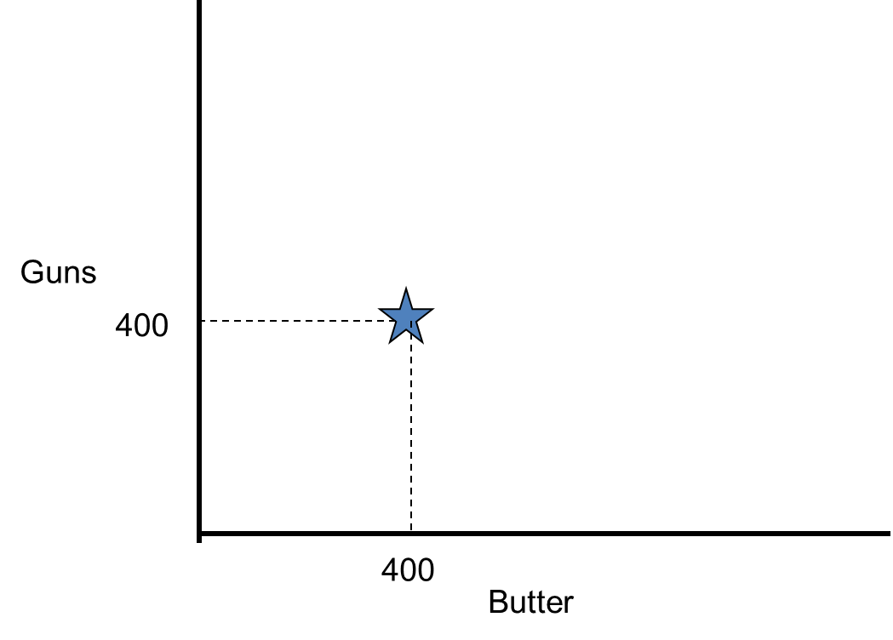
Production Possibilities Model
A point on the graph represents how much of each good is being produced.
Notes:
First exposure to the classic 'guns and butter' framing. Plot the point together and ask: 'what would it mean to move this point up? Down and to the right?'

Slide 27
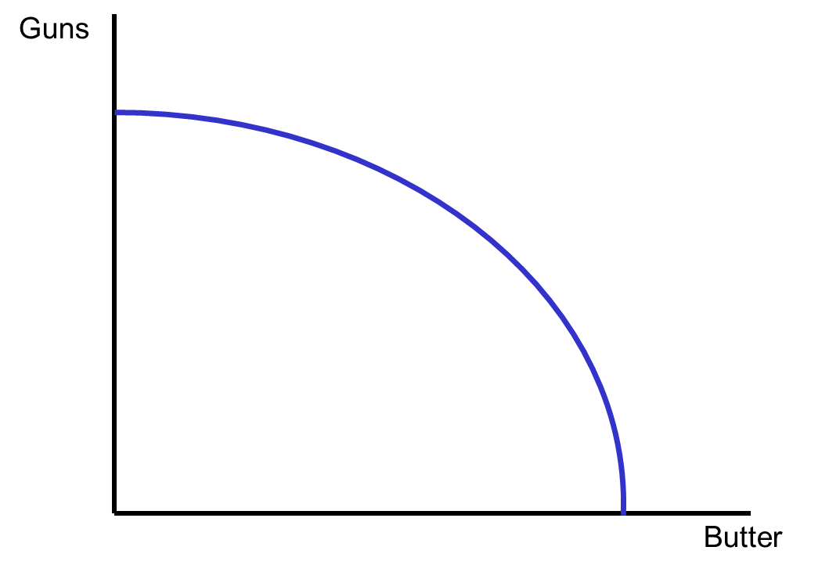
Production Possibilities Model
The frontier shows all possible combinations when all resources are fully employed.
Notes:
Emphasize the two conditions together: 'possible' AND 'fully employed'. The curve itself - not the area under it - is the object of interest; that distinction pays off on slide 22.

Slide 28
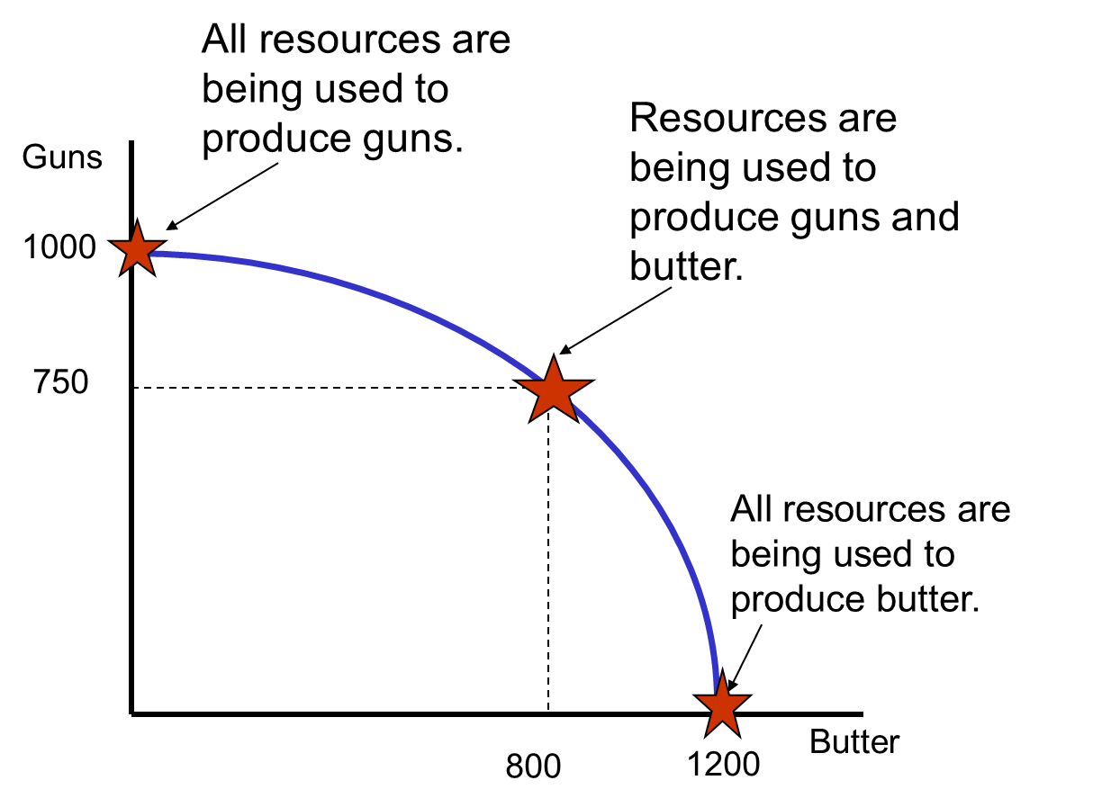
Production Possibilities Model
Notes:
Use the three labeled stars (all guns, all butter, a mix) to show the range of the frontier. Ask: 'why is this curve bowed outward instead of a straight line?' - this primes the concavity discussion on slides 34-35 without answering it yet.

Slide 29
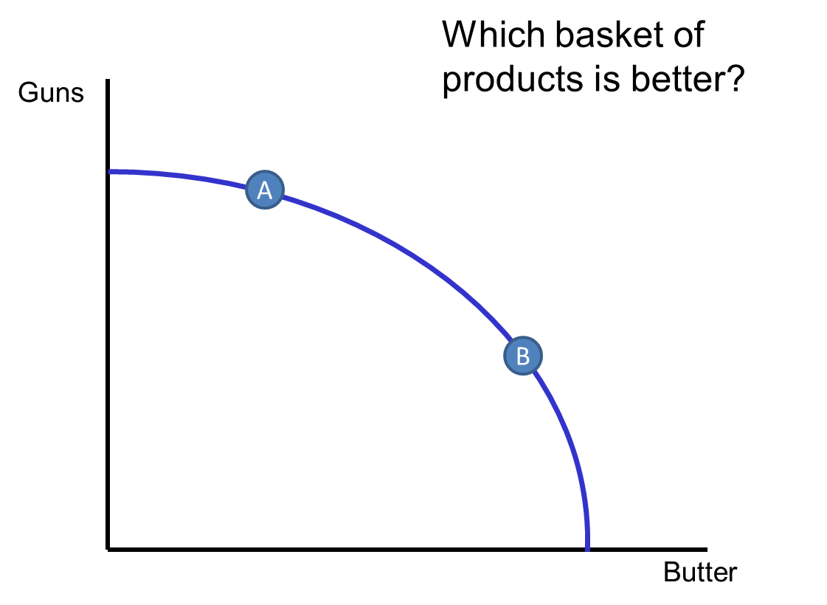
Production Possibilities Model
Notes:
Click-through build across slides 23-26: point A moves around relative to fixed point B. Here, both A and B sit ON the frontier - ask 'is A better than B?' and let students discover there's no objective answer (it depends on preferences for guns vs butter) before advancing.

Slide 30
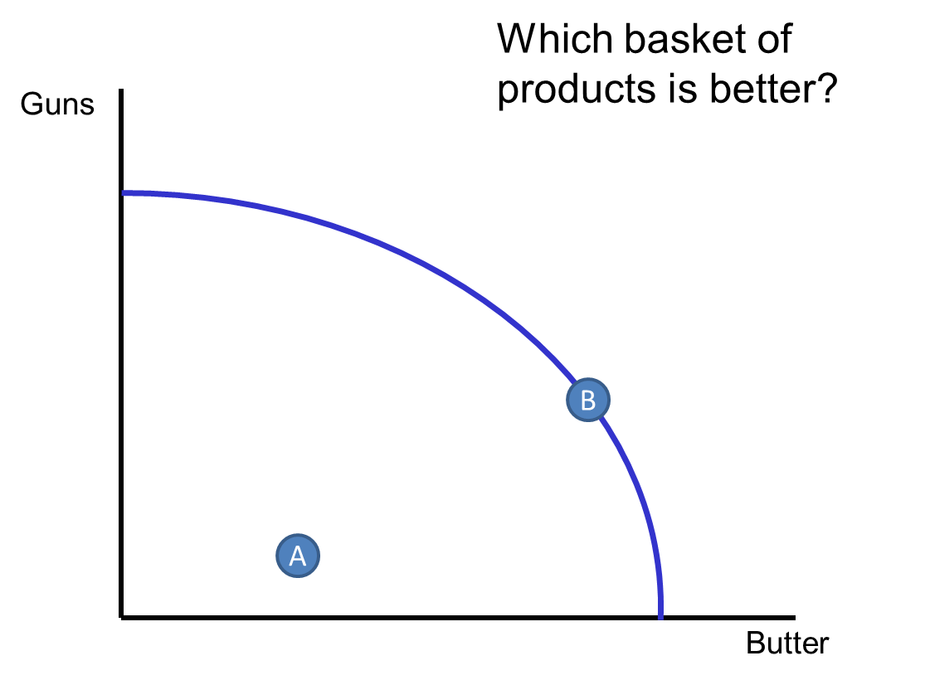
Production Possibilities Model
Notes:
Continuation of the build - watch where A moves and ask the same 'better/worse/not comparable?' question each time before revealing the next slide's position.

Slide 31
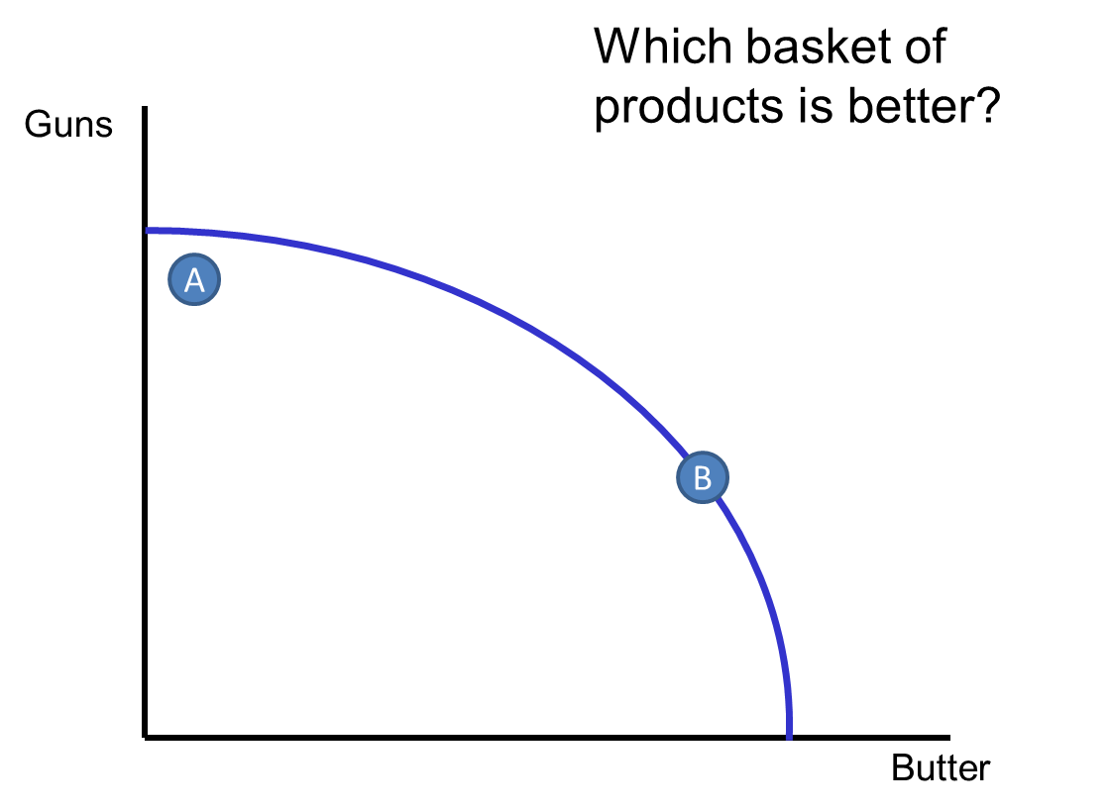
Production Possibilities Model
Notes:
Continuation of the build.

Slide 32
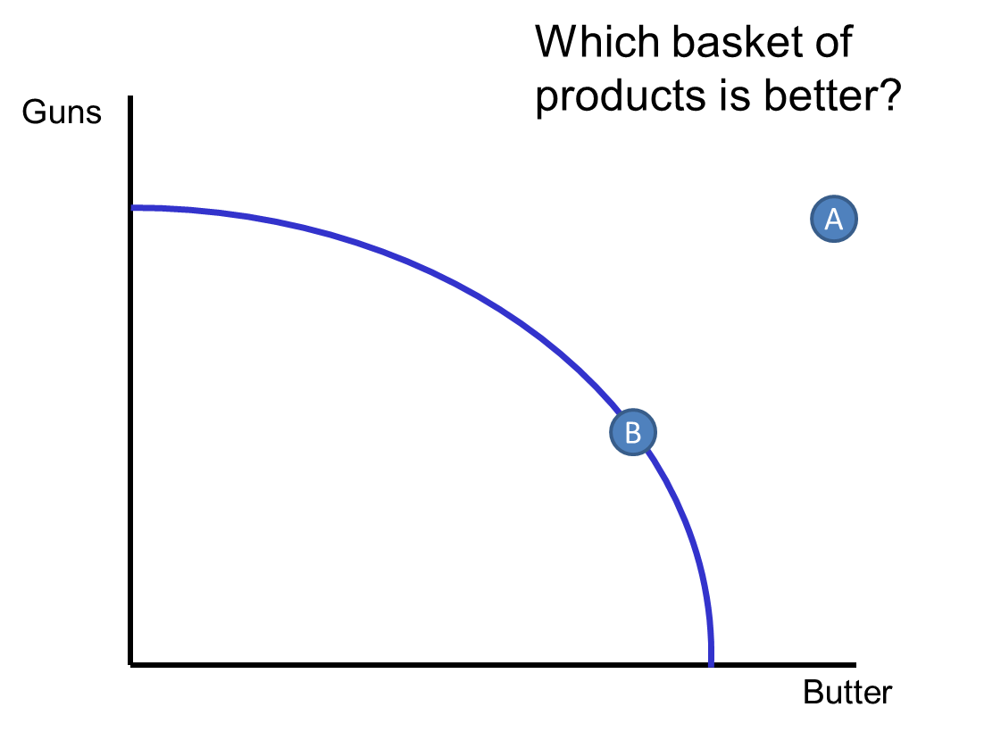
Production Possibilities Model
Notes:
A now sits OUTSIDE the frontier - ask 'can we have A now?' before revealing the answer: it's unattainable with current resources/technology. This is the payoff of the whole 23-26 sequence.

Slide 33
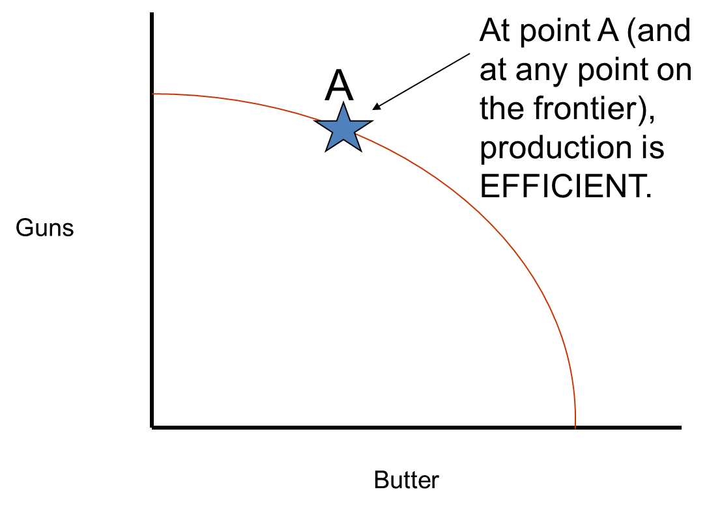
Production Possibilities Model
Notes:
Formal takeaway sentence for the build: any point ON the frontier is efficient. Tie explicitly back to slide 21's 'fully employed' condition.

Slide 34
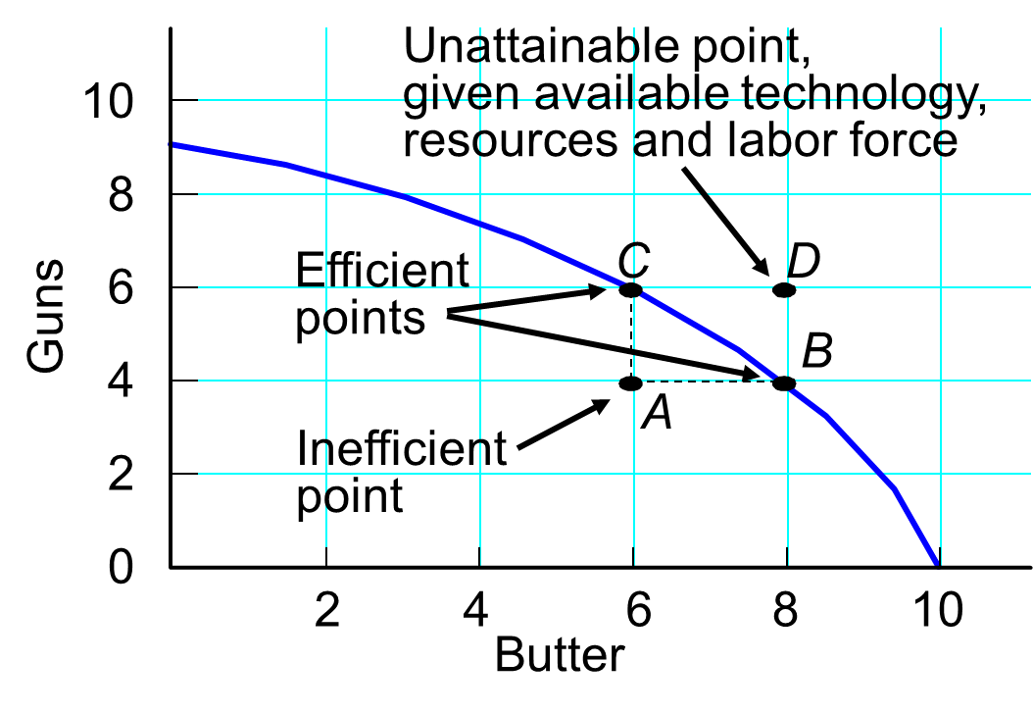
Efficiency and Inefficiency
Notes:
Clean reference diagram with four labeled points (A=inefficient/interior, B & C=efficient/on curve, D=unattainable/exterior). This is the single clearest slide for the three-way classification - if slides 23-26 left anyone confused, anchor the recap here.

Slide 35
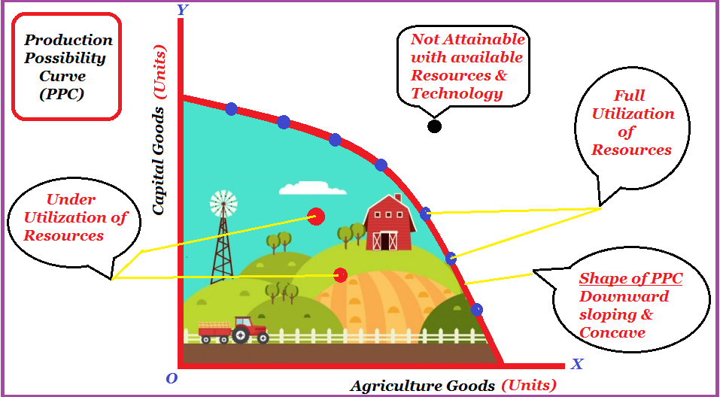
Production Possibilities Model (Full Picture)
Notes:
Different context (capital vs agricultural goods, illustrated with a farm) shows the model generalizes beyond guns/butter. Good moment to ask: 'what would this look like for a sports club - say, choosing between spending budget on player wages vs stadium infrastructure?' Plants a seed for later sport-economics lectures (L7-L8).

Slide 36
Opportunity Cost
Opportunity Cost: the loss of all possible alternatives when one good is chosen (decision is made).
Total: trade-off between the selected good and all the other goods
Marginal: trade-off between a small part (or unit) of the selected good and a possible alternative
Average: how much, on average, of one good is sacrificed to produce a possible alternative
Notes:
Caution when presenting: only the MARGINAL definition is actually used later (it's the slope David/Sherry compute, e.g. 0.5 or 2 units of wood per unit of food). Total and Average opportunity cost are defined here but not reused numerically anywhere else in this deck - say so explicitly so students focus on 'marginal' and aren't left expecting a worked average-cost example.

Slide 37
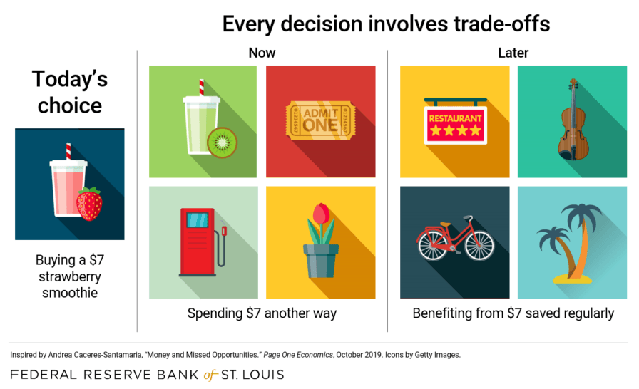
Notes:
Light, relatable everyday example (a $7 smoothie vs other uses of that $7, now or later) before returning to the abstract PPF. Keep this under a minute.

Slide 38
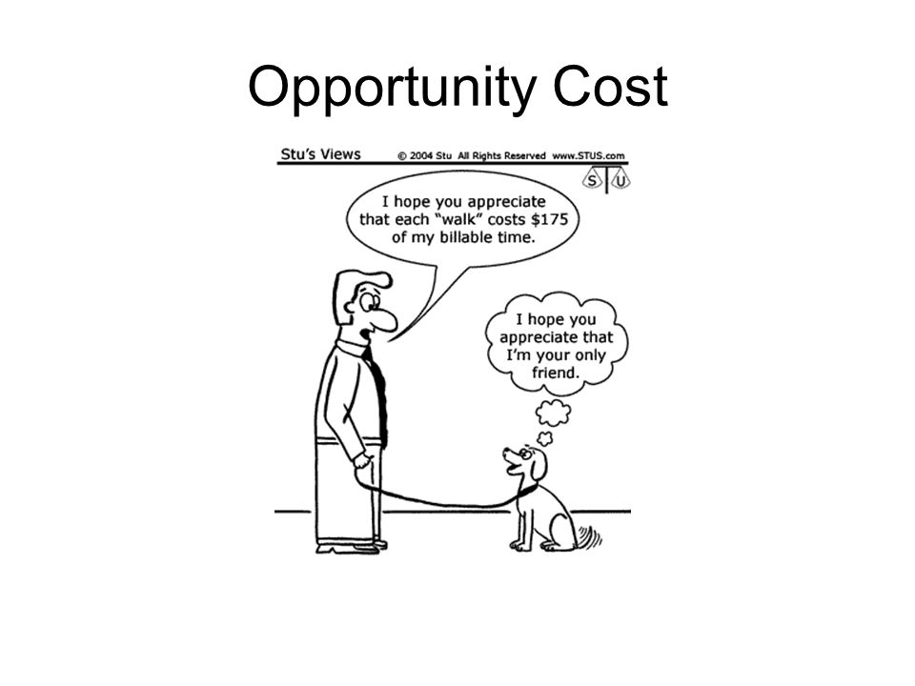
Notes:
Comic relief, but also sneaks in opportunity cost of TIME (billable hours), not just goods - useful groundwork since David and Sherry will soon be allocating DAYS, not just physical units.

Slide 39
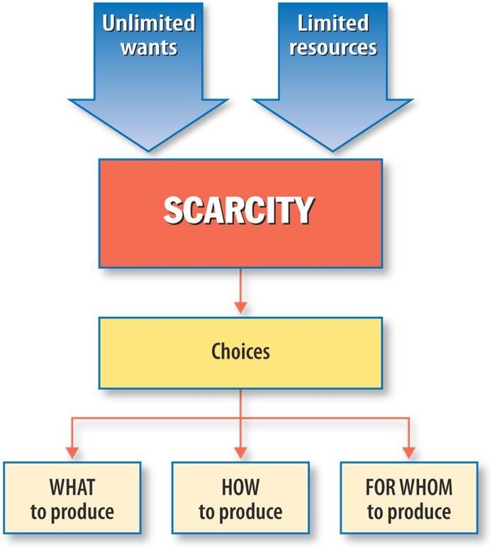
Notes:
Ties opportunity cost back to the three fundamental questions from Lecture 1 (What/How/For Whom to produce). Call out the connection to L1 explicitly - it's a natural bridge slide, easy to blow past without students noticing the link.

Slide 40
Characteristics of the Production Possibility Frontier (PPF)
Downward sloping
It is given by the inverse relationship between changes in quantity of two goods
Remember: PPF shows all the best possible combinations of two goods, which can be produced given the available resources and technology
Therefore, more of one good can be produced only by taking resources away from the production of another good.
Concave shaped
Increasing marginal opportunity costs = more and more units of one good are sacrificed to gain an additional unit of another good.
Notes:
Core theory slide. Make sure 'concave shape = increasing opportunity cost' lands before the numeric proof on slide 35. Ask: 'why would producing more and more fish cost MORE coconuts each time?' (the best-suited resources for fish get used first; less-suited ones are pulled in later).

Slide 41
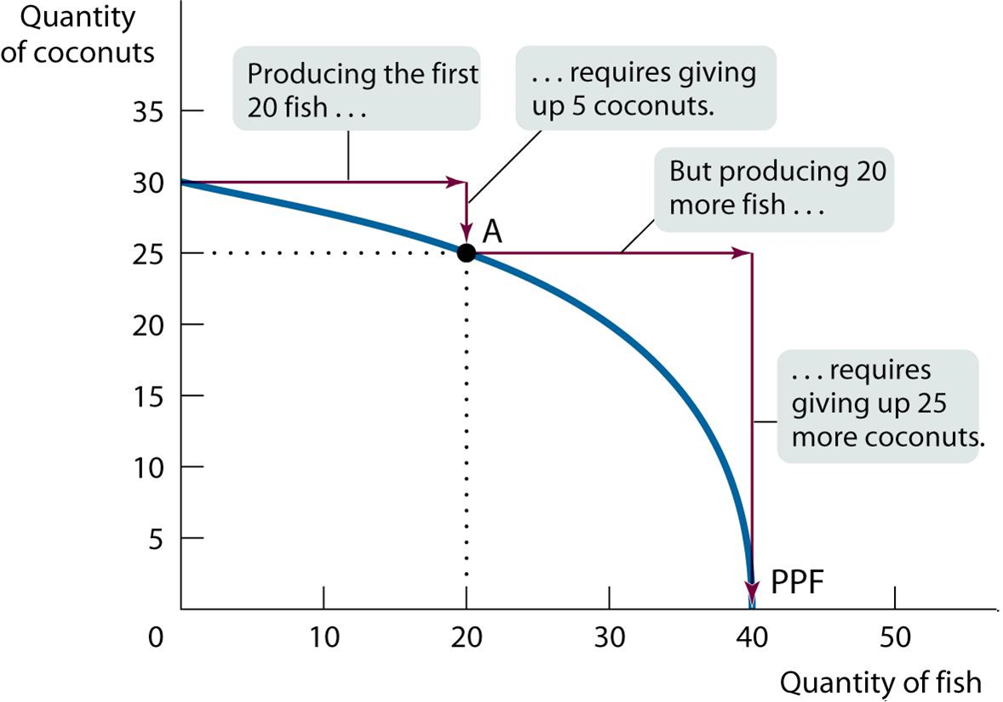
Increasing Opportunity Cost
Notes:
Walk the annotated arrows literally: the first 20 fish cost only 5 coconuts, but the next 20 fish cost 25 more coconuts. This is the concrete numeric anchor for slide 34's abstract claim - don't rush past it.

Slide 42
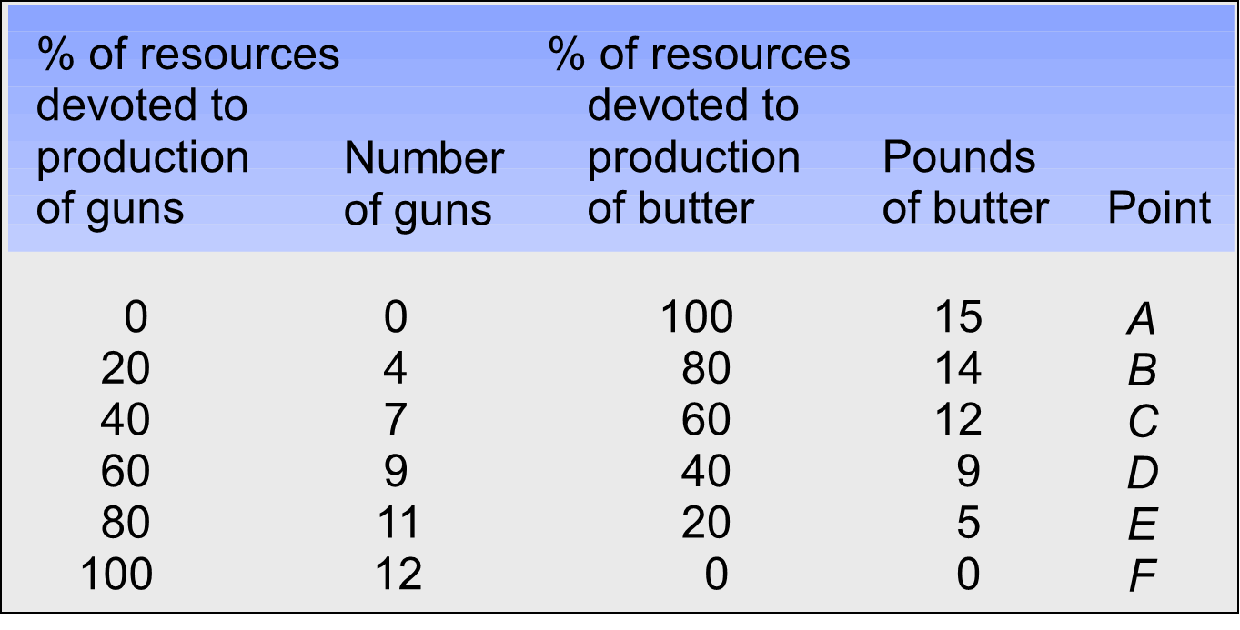
Production Possibilities Table
Notes:
Have students compute an opportunity cost themselves before you move to slide 37: e.g., going from point A to B, 4 guns are given up for 1 pound of butter; going from E to F, only 20% of resources shift but butter gains 5 pounds. Sets up the visual version next.

Slide 43
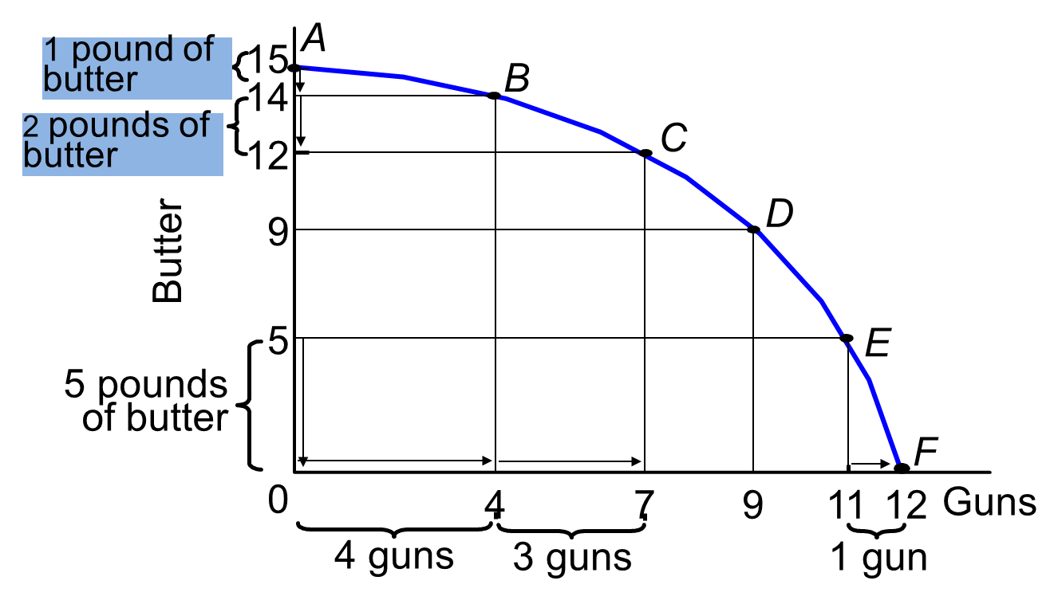
Production Possibilities Curve
Notes:
Same data as slide 36, now graphed. Use the bracket annotations (1 lb / 2 lb / 5 lb of butter against 4 guns / 3 guns / 1 gun) to show that equal-sized butter gains cost different amounts of guns depending on where you are on the curve - walk through one or two bracket pairs live rather than reading every number.

Slide 44
Example
- 30 days in a month
- two workers: David and Sherry
- two products: Wood and Food
- David can produce 8 unit of food or 4 units of wood per day (or any other linear combination of food and wood).
- Sherry can produce 10 units of food or wood per day (or any other linear combination of food and wood).
Notes:
This is the big worked example anchoring the rest of the lecture (through slide 57). Write the 2x2 productivity table on the board now (David: 8 food or 4 wood/day; Sherry: 10 food or 10 wood/day; 30-day month) - you will reuse it constantly. Tell students explicitly: 'we'll use this one example for absolute advantage, comparative advantage, the monthly PPF, and trade - keep track of it.'

Slide 45
Assumptions
We can produce any positive real number of units including (for example: 2.35 units)
Since products can be measured in any number of ways (pounds, grams, packages, weight, volume etc.) we will simply describe the items in terms of the total number of units.
Notes:
Quick technical clarifier - output can be fractional (e.g. 2.35 units). Don't dwell, 30 seconds.

Slide 46
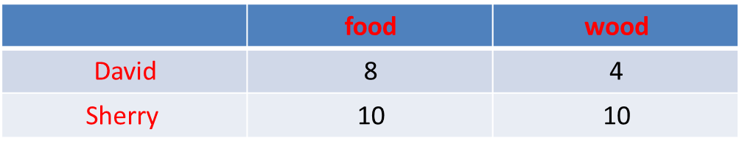
Economists define “absolute advantage” as the ability to produce a good or service in greater quantity for the same cost, or the same quantity at a lower cost, than other producers
Who has absolute advantage in producing food? 🍔
Who has absolute advantage in producing wood? 🎄
Notes:
Ask the class to answer both questions themselves, using slide 38's table, before revealing the answers on slides 41-42.

Slide 47
🍔
🍔 10 > 8
Notes:
Reveal: Sherry produces more food (10 > 8), so she has the absolute advantage in food.

Slide 48
🎄
🎄 10 > 4
Notes:
Reveal: Sherry also produces more wood (10 > 4), so she has the absolute advantage in wood too. Flag this explicitly: 'Sherry is better at both goods - does that mean trading with David is pointless?' Hold the answer for comparative advantage.

Slide 49
Similarly, Economists define “comparative advantage” as the ability to produce a good or service at a lower opportunity cost than the other producer
Who has comparative advantage in producing food? 🍔
Who has comparative advantage in producing wood? 🎄
Notes:
Same pattern as slide 40 - pose both questions and let students guess before revealing 44-46. This is the direct answer to the question raised on slide 42.

Slide 50
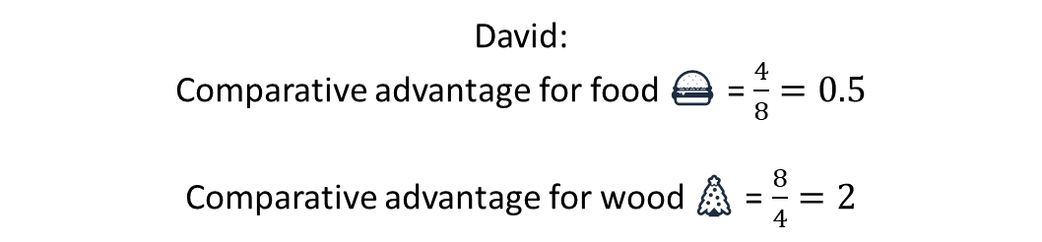
🍔
🎄
David:
Comparative advantage for food 🍔 = $\frac{4}{8}=0.5$
Comparative advantage for wood 🎄 = $\frac{8}{4}=2$
Notes:
Explain the ratio literally: David's wood-to-food output ratio (4/8 = 0.5) is exactly his opportunity cost of food in terms of wood. Write it as 'to get 1 more unit of food, David gives up 0.5 units of wood.'

Slide 51
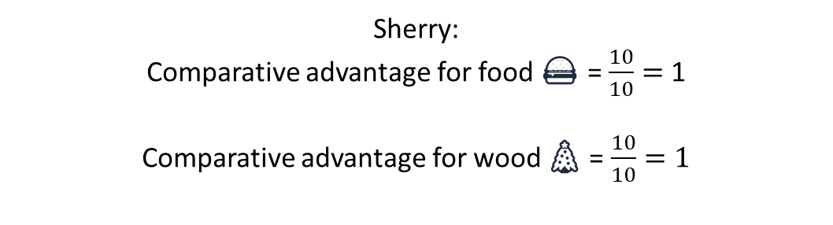
🍔
🎄
Sherry:
Comparative advantage for food 🍔 = $\frac{10}{10}=$ 1
Comparative advantage for wood 🎄 = $\frac{10}{10}=1$
Notes:
Same calculation for Sherry: her ratio is 10/10 = 1 for both goods, since she's equally productive at each.

Slide 52


David 🍔 $=0.5<1=$Sherry 🍔
Sherry 🎄 $=1<2=$David 🎄
Therefore, Sherry has a comparative advantage in producing wood 🎄 while David has a comparative advantage in producing food 🍔
Notes:
Punchline: compare David's food cost (0.5) to Sherry's (1) - David is cheaper at food, so he has the comparative advantage there. Compare wood costs (2 vs 1) - Sherry is cheaper at wood. Reinforce: comparative advantage is about the LOWEST opportunity cost, not who produces more in absolute terms (contrast directly with slides 41-42).

Slide 53
Daily production
Food | Wood
10 | 10 | Sherry
8 | 4 | David
What is the monthly production possibilities frontier?
On aggregate, how much food can David and Sherry produce?
How much wood?
Notes:
Have students compute the two totals themselves (30 x 8 + 30 x 10 for food; 30 x 4 + 30 x 10 for wood) before revealing slide 48 - these are the two extreme corners of the combined monthly PPF.

Slide 54
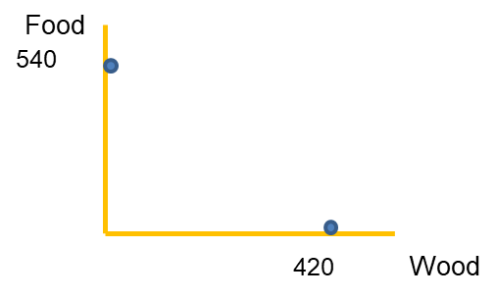
wood | food
4 | 8 | David
10 | 10 | Sherry
Max Food: 10*30 + 8*30 = 300 + 240 = 540
Max Wood: 10*30 + 4*30 = 300 + 120 = 420
Notes:
Confirm the numbers: max food = 540, max wood = 420. These become the axis endpoints of the joint (monthly, two-person) production possibilities frontier.

Slide 55
Supposed we are producing just 420 pieces of wood, but we need some food. Who is going to produce the food? David or Sherry ?
🗝 Key answer: Opportunity cost
Opportunity cost of Food | Opportunity cost of Wood | Food | Wood
1 | 1 | 10 | 10 | Sherry
0.5 | 2 | 8 | 4 | David
Notes:
Central applied question of the lecture: if both are fully specialized in wood (420 units) but some food is needed, who should switch? Build the opportunity-cost table live if possible. Answer: David's opportunity cost of food (0.5 wood) is lower than Sherry's (1 wood), so David switches first. Spend real time here - this operationalizes comparative advantage as an allocation decision, not just an abstract ratio.

Slide 56
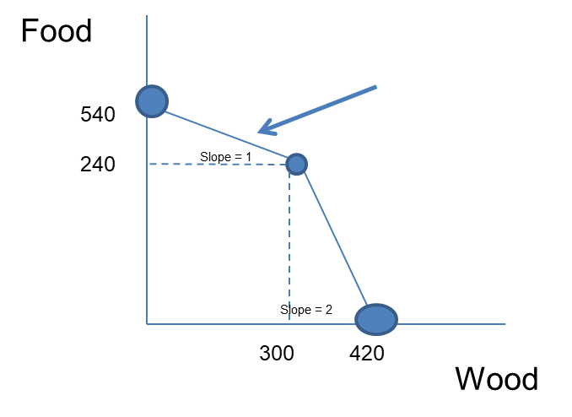
If they need more than 240 units of food, Sherry should stop chopping wood and start gathering food. For 1 unit of food, she will lose 1 unit of wood.
David can gather 240 units of Food instead of 120 units of Wood.
In this case, they can produce 240 (30*8) units of food and 300 (30*10) of wood.
Note: David can decide how many days to spend cutting wood and how many days to gather food. The cost opportunity is always 0.5 wood (Linear line)
Notes:
Walk the logic slowly: once food needs exceed what David alone can supply working full time (240 units, i.e. 30 days x 8), Sherry must also switch, even though it costs her more per unit of food (1 wood vs David's 0.5). Note David's opportunity cost stays constant at 0.5 regardless of how many days he allocates - flag this as a simplification (linear, constant-cost PPF for each individual) versus the increasing-cost PPF shown earlier on slides 34-35.

Slide 57
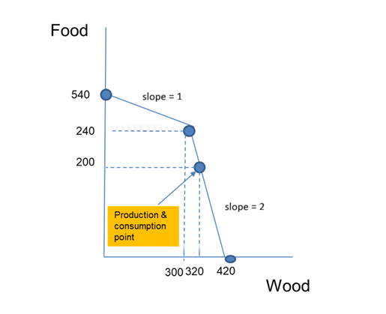
Suppose they need 200 units of food and as many of woods as they can get. How many units of wood can they produce ?
David has a comparative advantage in producing food. He can spend 25 days (200/8) producing food and 5 days chopping woods. Sherry is going to just chop woods. Therefore, they produce 200 units of food and 320 ((4*5)+(10*30)) units of wood.
Notes:
Live-solve with the class rather than reading the answer: David needs 200/8 = 25 days on food, leaving 5 days for wood (5 x 4 = 20 units); Sherry spends all 30 days on wood (300 units); total wood = 320. Cold-call students through each step.

Slide 58
TRADE - Assumptions
No transaction costs
Same products are exchanged in the market
Producers cannot affect the market price (no market power)
Producers can sell and buy unlimited quantities from/to the world market.
Notes:
Standard 'perfectly competitive trade' assumptions - brief, 30 seconds. Flag they're simplifications (real-world trade has transport costs, tariffs, market power) that will NOT be relaxed in this lecture.

Slide 59
TRADE #1
Suppose David and Sherry can trade 1 unit of food for 2 units wood and that they still need 200 units of food and as many woods as they can get. Find the production and consumption point.
Notes:
Set-up for the first numerical trade problem: trade rate is 1 food for 2 wood, target is still 200 units of food plus as much wood as possible.

Slide 60
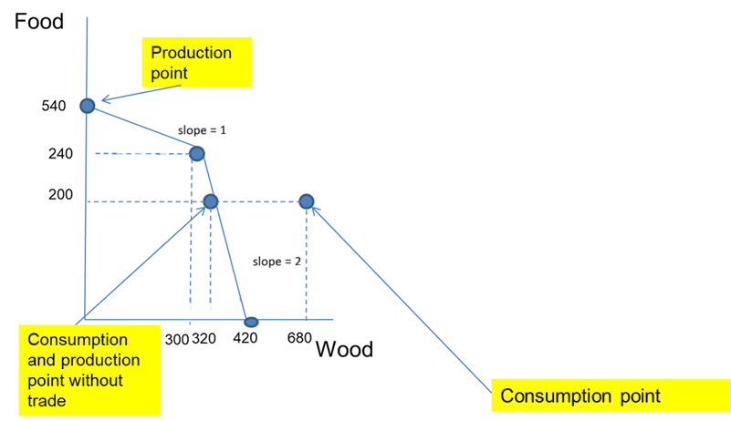
The opportunity cost of producing 1 food is either 1 or 0.5. In both cases the opportunity cost is lower than in trading. Therefore, David and Sherry will produce only food (540 units of food) and sell the extra 340 units of food for 680 units of wood.
Notes:
Compare the trade rate (1 food = 2 wood) against both producers' opportunity costs of food (David: 0.5, Sherry: 1). Since 2 wood per food is a better deal than either domestic cost, BOTH fully specialize in food (540 units total) and trade the surplus (340 units) for 680 units of wood. Emphasize: when the trade rate beats everyone's opportunity cost, full specialization is optimal.

Slide 61
TRADE #2
Suppose they now trade 1 unit of food for 0.75 of wood
Notes:
Second trade scenario: now the rate is only 0.75 wood per unit of food - deliberately chosen to sit between David's cost (0.5) and Sherry's (1).

Slide 62
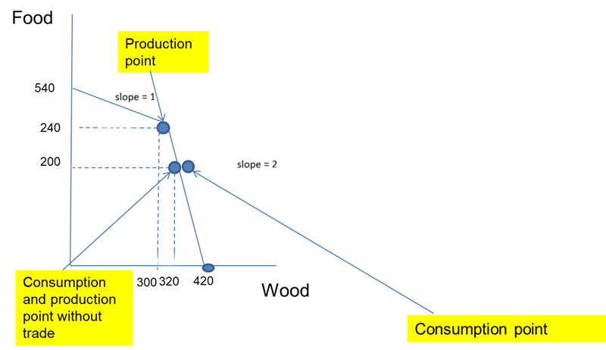
The opportunity cost of producing 1 unit of food is either 1 or 0.5. David has a comparative advantage in producing food while Sherry in wood. Production point: (300,240). Consumption point: (330,200)
330 = 300+(240-200)*0.75
Notes:
Contrast directly with slide 54: because 0.75 is better than David's cost but worse than Sherry's, only David finds trade worthwhile - Sherry keeps producing both goods domestically. This is the key comparative-statics point: the trade rate relative to EACH party's opportunity cost, not a single 'is trade good' answer, determines who specializes. Walk through the consumption-point arithmetic: 330 = 300 + (240-200) x 0.75.

Slide 63
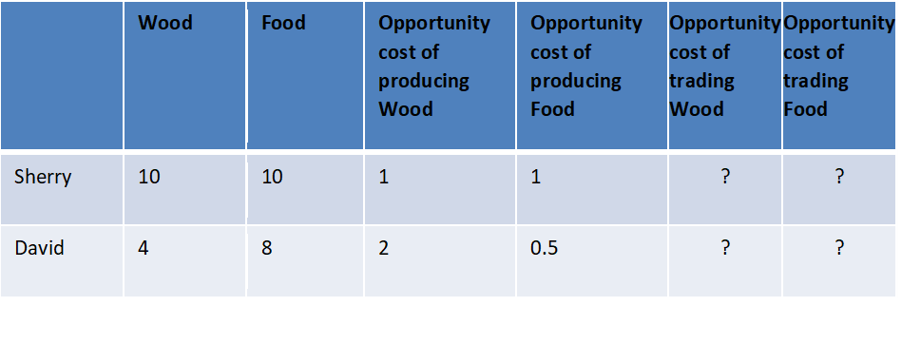
TRADE #3 (Homework)
DIY (at home) Suppose they can trade 1 unit of food for 0.2 of woods. Find the consumption and production point.
Notes:
Explicitly assign as homework (DIY), same method as slides 53-56 with a rate of 0.2. Worth clarifying for students whether this is a warm-up for the standalone 'Exercise on Production Possibilities' worksheet in the course materials, or a separate, smaller task - make the distinction and expectations clear.

Slide 64
Summary #1
The field of economics is divided into two subfields: microeconomics and macroeconomics.
Economists try to address their subject with scientific objectivity.
A positive statement is an assertion about how the world is.
A normative statement is an assertion about how the world should be.
The production Possibilities Frontier is a graph that shows all the combinations of goods and services that can be produced if all the society’s resources are fully employed and used efficiently.
Notes:
This recap covers BOTH Lecture 1 (micro/macro split, positive vs normative) AND today's PPF material - useful as a two-lecture cumulative check. Consider 2 quick cold-call questions here before moving on.

Slide 65
Summary #2
The cost of something is what you give up to get it. This is called the opportunity cost.
A producer has a comparative advantage over another in the production of a good or service if he/she can produce the good or service at lower opportunity cost.
A producer has an absolute advantage over another in the production of good or service if he/she can produce the good or service using fewer resources.
Notes:
Final line to leave on the board: 'the cost of something is what you give up to get it.' Point students to the Production Possibilities exercise sheet now for practice before Lecture 3 (Demand).

