Slide 1

Introduction to Economics for Sport Management
Introduction and Preliminaries
⚽🏀🏈🎾🎿🎮
Alessandro Di Mattia
Notes:
Welcome. Introduce yourself briefly and frame the course: microeconomics + a bit of finance, taught through the lens of sport. Ask students to shout out their favorite sport as an icebreaker -- ties directly to the emoji row on this slide. Keep this to 2-3 minutes.

Slide 2
What is Economics for you?
Notes:
Icebreaker discussion, not a definition slide. Ask 3-4 students 'What is economics, to you?' before showing/explaining the meme. Common answers: money, stock market, government policy -- all partially right. Use the Michael Scott meme to get a laugh and lower the temperature before the etymology slide.

Slide 3
Economics
From Acient Greek «oikonomia»:
«oikos» - «family, household»
«nemein» - «management and dispensation»
Oikos + nemein = «family/household management»
Economics as the «study of wealth» which studies the process of production, consumption, and accumulation of wealth.
Notes:
Walk through the Greek roots slowly (oikos + nemein). Point out this is deliberately the very first content of the course: economics originally meant managing a HOUSEHOLD's scarce resources, and the entire discipline is really that idea scaled up to firms, markets and countries. This etymology is a good 'sticky' fact for students to remember. It was about livestock, land, servants, provision. According to Adam Smith, individuals pursuing their own self-interest, within a system of free exchange and competition, tend to produce good outcomes for society as a whole

Slide 4
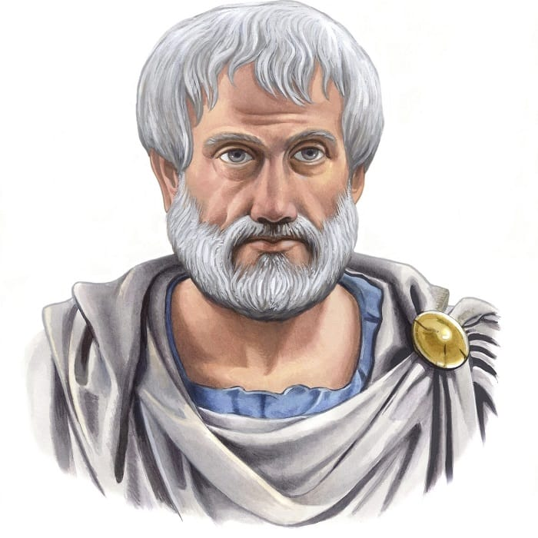
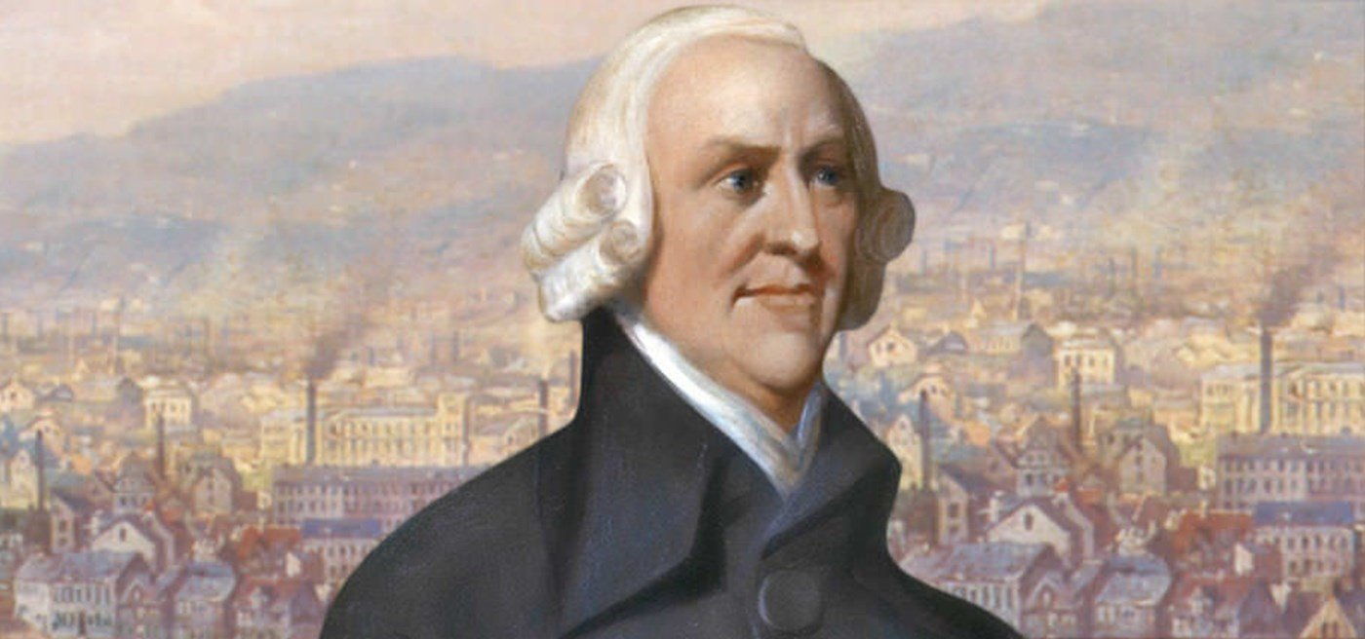

Aristotle (384-322 BC)
Adam Smith (1723-90)
Notes:
Three figures, three eras of economic thought -- use to set up historical arc. Aristotle: earliest writings on household management (Politics/Oikonomikos), where the word comes from. Adam Smith: Wealth of Nations (1776), division of labor, the 'invisible hand' -- father of classical/modern economics. Kahneman: psychologist, Nobel Prize in Economics 2002, founder of behavioral economics -- signals that this course won't assume people are perfectly rational, just mostly rational. Good spot for a 1-line editorial: 'economics today borrows heavily from psychology.’ Kahneman showed that real people make systematic, predictable errors that classical economic models don't account for.

Slide 5
About the course
This is a sophisticated introduction to economics and finance for students like you!
You will learn:
The most fundamental tools that economists use
How modern economic theory allows us to understand economic phenomena
Notes:
Set expectations for tone: rigorous but applied. Emphasize the two learning outcomes explicitly -- tools AND how to read real economic phenomena (in sport, specifically) through them.

Slide 6
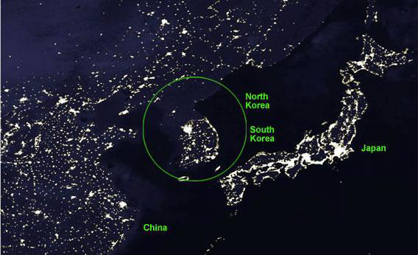
Importance of Economic Systems
Night-lights image contrasting North vs. South Korea's economic systems.
Notes:
North and South Korea are the same people, same language, same culture, split into two countries with two different economic systems after 1953 (South = market economy, North = centrally planned, closed economy). The night-lights image is a proxy for economic activity — electrification, industry, commerce, consumption all require energy and show up as light at night.
Talking points:
- Same peninsula, same people/culture, split into two very different economic systems since 1945.
- South Korea: market economy -> visible lights = economic activity, electrification, production, trade.
- North Korea: centrally planned/closed economy -> darkness = collapsed output, isolation.
- Use as a hook: the choice of economic system has first-order effects on living standards -- this is what the course gives you tools to analyze.
- Segues into 'About the course' / course goals.

Slide 7
Grading Policy
Final exam 100%
Exercises will be posted on Canvas as well as their solutions after we solve them in class.
Prerequisites
Basic Algebra and Calculus 👶
Notes:
Be direct about the 100% final exam weight -- this is the single most important logistics slide, don't rush it. Clarify how in-class exercises work (practice + solutions posted after) and that they are the best exam prep even though they're not graded. Reassure on prerequisites: basic algebra/calculus is enough, no calculus-heavy derivations expected day-to-day.

Slide 8
Course Goals 🔑 🥅 ⚽️
Learn main microeconomic concepts and how to use them to analyze real world problems.
Key Economic Concepts :
Marginal Costs and Benefits
Opportunity Costs
Supply and Demand
Value of assets
Interest Rate

Slide 9
Some Important Points
Advanced course:
Use and understanding of formal language, models and math
Interpretation and logic reasoning
Real world implications
Steep learning curve and a toolkit for future course work.

Slide 10
Today: Introduction and Some Basic Concepts
Economics as a social science
Methods and fields of study
Basic concepts:
Normative versus positive analysis
Market Mechanism

Slide 11
Economics: Definition
Economics is the study of how a society uses its limited resources to produce, trade and consume goods and services
Limited budgets and time for consumers
Limited ability to produce for producers

Slide 12
Economic Imperialism
A new era?
…. economists have been acting a lot like intellectual imperialists in the last decade or so. They have been using their tools … to examine everything from politics to French wine vintages.
“The Future of Economics Isn’t So Dismal”
By DAVID LEONHARDT
Published: January 10, 2007
https://www.nytimes.com/2007/01/10/business/10leonhardt.html
Notes:
If economists can rigorously study wine vintages and politics, sport is a completely natural application.

Slide 13
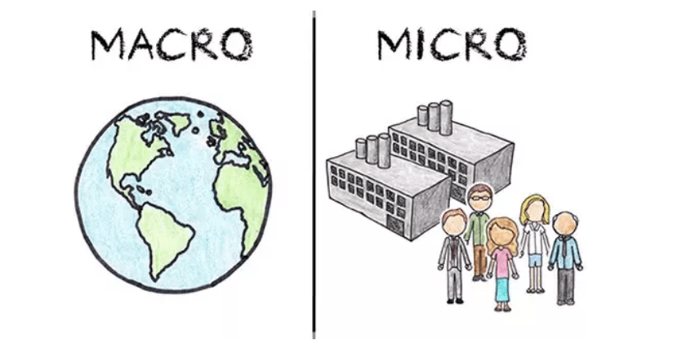
Notes:
Pure visual anchor, no new content -- 20 seconds. Just reinforces the macro (globe/whole economies) vs micro (firms/individuals) distinction they're about to see defined formally.

Slide 14
Microeconomics
Study of decisions made by individuals and businesses
Human behavior and decision
Allocation of resources
Notes:
Formal definition of microeconomics. Note explicitly: this course is almost entirely microeconomics (individual decisions, firms, markets) -- macro shows up briefly later (inflation, in Lecture 9) but isn't the focus.

Slide 15
Microeconomics
Studying individual decisions of economic units
Behavior of consumers: DEMAND
Production decisions of firms: SUPPLY
Interaction between agents in market environments (relevant for public policy, antitrust authorities, etc.)
Notes:
Purpose: expand the one-line 'Microeconomics' definition into the DEMAND/SUPPLY framing used throughout the course.
Talking points:
- Microeconomics = individual decisions, not aggregates (contrast with macro on a later slide).
- Consumers' behavior -> DEMAND side.
- Firms' production decisions -> SUPPLY side.
- The interaction of demand and supply in markets is also what public policy / antitrust authorities care about (e.g. is a market competitive, are firms colluding).
- Sets up vocabulary (DEMAND, SUPPLY) you'll reuse for the rest of the course.

Slide 16
Themes of Microeconomics
Demand, Supply and Equilibrium
Prices
Production theory
Creation and manufacture of goods and services
Cost of production
Cost of resources during production
Labor economics
Wages, employment, and income
Notes:
Preview the semester's topic map. Worth explicitly linking each theme to an upcoming lecture number if your syllabus order matches: demand/supply/equilibrium (L3, L5-6), production/costs (L4), labor economics (touched via NBA/NFL case studies later). This slide doubles as a syllabus outline.

Slide 17
Themes of Microeconomics — Example Questions
Workers, firms and consumers must make trade-offs:
How do consumers make choices?
How do we allocate organs to transplant patients?
Why are wages rising faster for the top 1% than the 99%?
Models provide insight by providing basic structure
Notes:
Purpose: make 'themes of microeconomics' concrete with real questions, instead of just listing topics.
Talking points:
- Everyone (workers, firms, consumers) faces trade-offs given scarce resources.
- Use the three example questions as class discussion starters:
1) How do consumers make choices? (consumer theory)
2) How do we allocate organs to transplant patients? (markets vs. non-price allocation)
3) Why are wages rising faster for the top 1% than the 99%? (labor economics / inequality)
- Point: economic models don't answer everything perfectly, but they give a basic structure to reason about these very different questions with the same toolkit.

Slide 18
Macroeconomics
Macroeconomics deals with aggregate economic quantities
Countries and their policies
Macro-economist questions
What should the rate of inflation be?
What causes unemployment?
What are the factors that stimulate or create economic growth?
Notes:
Macro definition + the three classic macro questions. Flag clearly that these questions are NOT the focus of this course (beyond one lecture on inflation/PV later) -- otherwise students may expect a macro-heavy course.

Slide 19
Analyzes demand and supply of labor | 01 | Analyzes total employment in the economy
Study of decisions made by individuals and businesses | 02 | Study of decisions made by governments in a country
Deals with household and firm decisions | 03 | Deals with performance and behavior of the entire economy
Examines the individual market's behavior | 04 | Analyzes the sum total of the economic activity
Bottom-up approach | 05 | Top-down approach
Investors generally focus in-depth on microeconomics | 06 | Seasoned investors pay little attention to macroeconomics
Notes:
Use this table as a recap/self-test: cover the right-hand column and ask students to guess the macro equivalent of each micro item, or vice versa. Good moment to pause and check for questions before moving into methodology.

Slide 20
The Methodology
How? Construct theories in order to:
Understand the different forces driving the economy
Make predictions of what will happen if these forces change
Improve outcomes changing institutions
Notes:
First half of 'how economists actually work': build theories to (a) understand forces, (b) predict, (c) improve outcomes via policy/institutions. Mention this mirrors the scientific method used in natural sciences.

Slide 21
The Methodology (cont’d)
Use data and rigorous statistical methods in order to validate a theory :
Theories are tested and improved
Theories are invariably imperfect – but give much insight into observed phenomena
Notes:
Second half: theories must be validated with data and statistics. Be honest about the caveat -- 'theories are invariably imperfect' -- this directly sets up the George Box quote on slide 19, so consider previewing it here ('as we'll see next...').

Slide 22
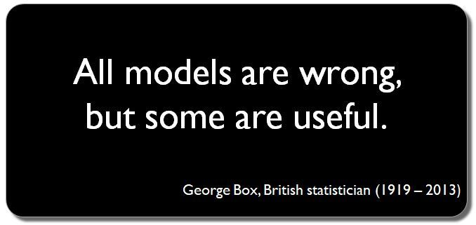
Notes:
Let this quote breathe -- pause for a few seconds after revealing it. This is arguably the single most important epistemological message of the whole course: models simplify reality on purpose, and 'wrong but useful' is the standard economists actually work to, not 'perfectly true.' Students will hear this phrase again when you introduce the first formal model (PPF, Lecture 2).

Slide 23

Notes:
Explain the illustration explicitly: the SAME cylinder casts a square shadow from one light source and a circular shadow from another. Neither shadow is 'wrong,' each is a valid simplified projection depending on what question you're asking. This is a visual restatement of slide 19 -- explicitly say 'this is what George Box meant.'

Slide 24
Theories and Models
Theories are expressed in the form of Economic Models.
An economic model is a description of an economic situation via words and mathematical expressions.
Often mathematical expressions are depicted with diagrams.
Notes:
Formal definition of an economic model: words + math, often visualized with diagrams. Tell students that starting next lecture (PPF, then demand/supply) they'll be building exactly these kinds of models themselves.

Slide 25
Economic Models: Description
A model usually consists of:
Agents: their resources, objectives, preferences, how they behave, etc.
Economic environment: markets, contractual arrangements, other relevant institutions.
Notes:
Two ingredients of every model: agents (who, with what resources/preferences) and environment (the market/institutional setting). Worth a quick example: in a demand-curve model, the 'agent' is the consumer, the 'environment' is the market for a good at a given price.

Slide 26
Positive & Normative Analysis
Economists take different roles: business consultant, media analyst, advisers on government policy etc.
It is important to understand when economists are making objective, evidence-based statements (positive analysis) and when they are making value judgements (normative analysis)
Notes:
Introduce the positive/normative distinction as a skill, not trivia -- economists (and journalists, and politicians quoting economists) constantly blur the two, and being able to tell them apart is a core critical-thinking skill for the course and beyond.

Slide 27
Positive Analysis
Descriptive and factual statements about the world
Positive does not necessarily mean «good news». Economists can make true negative-positive statements
Positive Analysis uses scientific principles to draw objective and testable conclusions.
Examples
The unemployment rate is currently at 9%
Molde FK is winning 1-0 against Viking FK
(Are they negative-positive statements?)
Notes:
Definition + two examples. The unemployment example is neutral; the Molde FK example is the fun one -- ask the class directly 'is that a positive statement?' (yes, it's a testable, factual claim about a score, regardless of whether it's good or bad news). Reinforce: positive =/= good news.

Slide 28


Notes:
Pure reaction/transition slide, no bullets needed -- use it as a visual punchline connecting the Molde FK 'positive statement' example to the upcoming normative one (Mark Cuban's shocked face works well as 'wait, is that opinion or fact?'). 15-20 seconds, mostly for pacing/humor.

Slide 29
Normative Analysis
Prescriptive and value-based statements about the world
Normative statements use factual evidence (i.e., positive statements) as support, but they are not by themselves factual
Normative statements incorporate opinions and morals
Examples
The unemployment rate is too high
Molde FK is a good team.
Notes:
Mirror of slide 24. Emphasize that normative statements often ride on top of positive ones (e.g., 'the unemployment rate is too high' presumes the factual rate, then adds a value judgment about what's acceptable). The Molde FK 'good team' example is deliberately subjective -- ask students to justify their own opinion to show how normative reasoning still uses evidence.

Slide 30
Causality versus Correlation
First, let’s watch a video!
https://youtu.be/HUti6vGctQM
You can find nice examples of spurious correlations, which mean absolutely nothing:
http://tylervigen.com/spurious-correlations
Notes:
Play the video live if time allows (short). Use tylervigen.com as an in-class or take-home exercise: have students pick their favorite spurious correlation and explain in one sentence why correlation isn't causation there. Good lightweight assessment of whether the positive-analysis rigor from earlier landed.

Slide 31
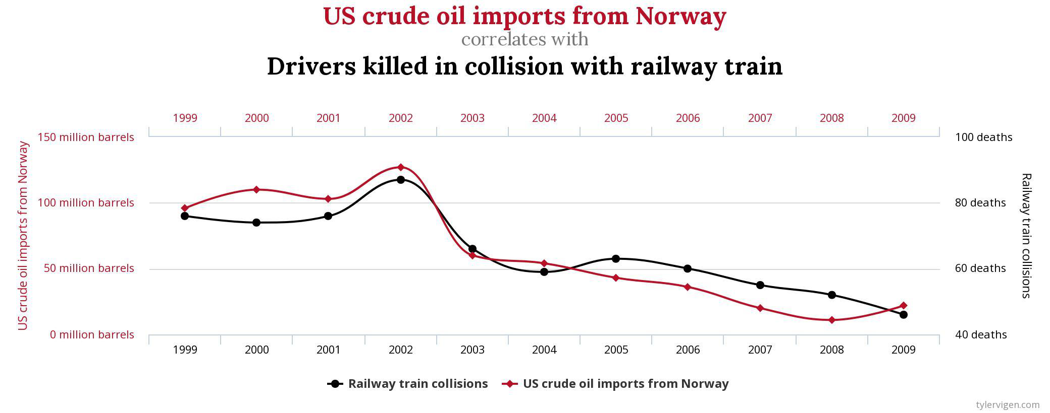
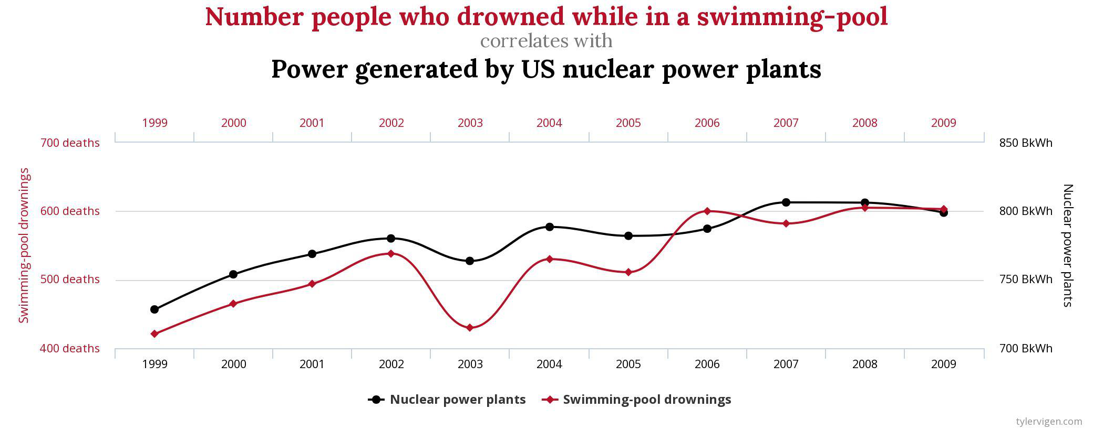
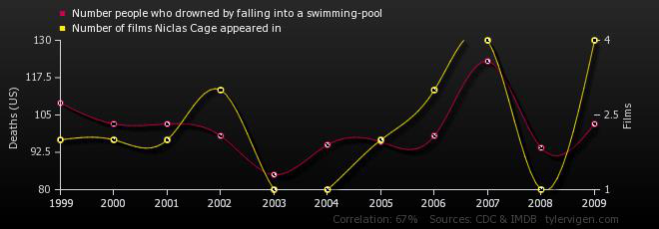
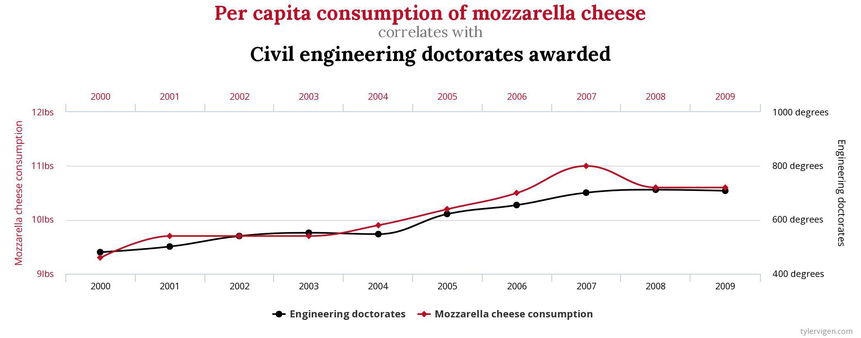
[NEW] Causality vs Correlation — Example Charts (expand slide 27)
Notes:
Purpose: give visual, memorable examples of spurious correlation before/alongside the tylervigen.com link and video.
Talking points:
- Top-left: US crude oil imports from Norway vs. railway train collision deaths -- track each other but have no causal link.
- Top-right: nuclear power generation vs. swimming-pool drownings -- both trend up over time (common trend), not causally related.
- Bottom-left: Nicolas Cage films per year vs. pool drownings -- absurd example to drive the point home.
- Bottom-right: mozzarella cheese consumption vs. civil engineering doctorates awarded.
- Key takeaway: correlation (even strong, statistically significant correlation) is not causation -- watch for confounders / common trends.
- Use before or after the video link and the tylervigen.com website reference.

Slide 32

Required Reading 📙
“Microeconomics" edited by Pindyck, Robert S., and Daniel L. Rubinfeld
Notes:
State clearly this is the required text and how it'll be used (readings assigned per lecture, presumably). If you assign specific chapters per lecture, consider adding that mapping here or in the syllabus rather than only on this slide.

Slide 33
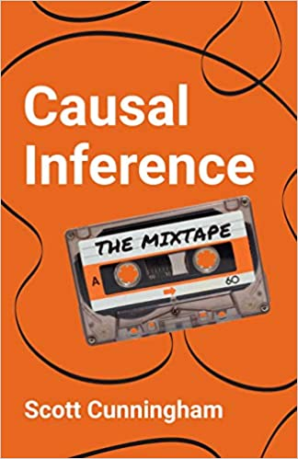
Recommended readings 📚
«Casual Inference: The Mixtape» - Scott Cunnigham
https://mixtape.scunning.com/index.html
“The effects” - Nick Huntington-Klein
https://theeffectbook.net/
Notes:
Optional/recommended, not required -- say so explicitly so students don't feel obligated. Useful to flag which later lecture (if any) draws on causal inference concepts, if applicable.

Slide 34
Interesting links
GDP 📊
https://ec.europa.eu/eurostat/statistics-explained/index.php?title=Beginners:GDP_-_What_is_gross_domestic_product_(GDP)?#What.E2.80.99s_covered_by_GDP.3F
Legalizing weed🌿 https://www.investopedia.com/articles/insights/110916/economic-benefits-legalizing-weed.asp
Notes:
Two optional rabbit holes for curious students. Consider assigning one as ungraded pre-reading before Lecture 2 (GDP link pairs naturally with the macro/micro material just covered).

