Slide 1

Lecture #7
Government Policy
Alessandro Di Mattia

Slide 2
Producer Surplus
Producer surplus is the difference between the price received for a product and the marginal cost to produce it
In some sense, the supply curve represents the opportunity cost for suppliers
Excess value suppliers are getting above and beyond their opportunity cost

Slide 3
Potatoes 🥔
Price (in $)
S
P1
D
Q1
Quantity (kg)

Slide 4
Consumers and Producers Surplus
Price
Equilibrium Price
S
Consumer Surplus
Producer Surplus
D
Equilibrium Quantity
Quantity

Slide 5
Government Policies
So far we assumed we were operating in a free market (i.e., no government intervention)
Our actors: government, consumers, and firms
Our measure of efficiency: consumer surplus + producer surplus + government revenue/expenditure = market surplus
Market surplus is the measure of the net benefits accruing to all participants in the market

Slide 6
Competitive Markets
Competitive markets maximize market surplus
Any intervention that changes our equilibrium will inevitably decreases market surplus → deadweight loss and inefficient outcome
Then, why would the government intervene?

Slide 7
Government Policies (cont’d)
Government Revenue
  Generate revenue → taxes
Politics
  Interest of some specific groups
    Demand create inefficiencies
    Care more about getting votes than the overall social good
Equity
  Efficiency can not be the first priority
  Ex. Price ceiling → help low-income family
  Efficiency just for small and less wealthy groups
Externalities
  External costs firms and consumers do not consider
Notes:
governments intervene for revenue (taxes), politics (interest groups, votes), equity (helping low-income groups even at an efficiency cost — e.g., price ceilings), and externalities (costs the market doesn't price in).

Slide 8

Meet Joe Black (1998) – You should find it on Netflix.

Slide 9
Governments Policies (cont’d)
Price controls
Quantity controls
Taxes and subsidies

Slide 10
Price Controls
Price Ceiling
  Ex. Rental market
  I, as a landlord, cannot charge more than a specific price per month
  If the ceiling is rising, I have more space
  If the ceiling is falling, I have less space → price ceiling aims to lower the price
Price Floor
  Ex. Minimum wage policy
  If the floor is rising, I have less space
  If the floor is falling, I have more space → price floor aim to increase the price
Only a price floor above the equilibrium and a price ceiling below the equilibrium is binding
Notes:
A price ceiling only bites if it's set below equilibrium price (if you set the ceiling above what the market would charge anyway, nobody notices.
A price floor only bites if it's set above equilibrium price (a minimum wage below what the market already pays changes nothing).

Slide 11
Price ceiling – Market Surplus
Notes:
Consumers who still get a home (the 200 who do) pay less than before, so they gain surplus on those units. But consumers who wanted a home at the old equilibrium and can no longer get one (the 100 units lost to rationing) lose surplus entirely. Whether CS nets out higher or lower depends on the specific shapes of supply and demand

Slide 12

Price ceiling – Market Surplus
BEFORE
  Consumer Surplus (Blue Area): $\frac{\left[\left(1200 −600\right)∗300\right]}{2}=\$90.000$
  Producer Surplus (Red Area): $\frac{600∗300}{2}=\$90.000$
  Market surplus = CS + PS = $=\$90.000+\$90.000=\$180.000$
AFTER
  Consumers have lost surplus in some areas but gained it in others. Overall, are they better off or worse off?
  Producers have lost surplus
  Consumer Surplus (Blue Area): $\frac{\left[\left(1200 −800\right)∗200\right]}{2}+(400∗200)=\$120.000$
  Producer Surplus (Red Area): $\frac{400∗200}{2}=\$40.000$
  Market surplus = CS + PS = $=\$120.000+\$40.000=\$160.00$

Slide 13
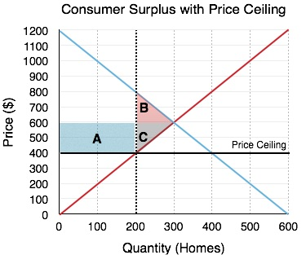
Price ceiling – Redistribution
It is easy to see that the market surplus (i.e., social welfare) has decreased
But how has it been distribuited between consumers and firms?
Notes:
Transfer = Area A: money that moves from landlords to the remaining renters. This comes purely from the price effect of the ceiling (same 200 units trade, just at a lower price).
DWL = Areas B + C: surplus that vanishes because 100 units (Q 200→300) stop trading altogether — this comes from the quantity effect of the ceiling.
Summary rule: change in quantity → DWL; change in price → transfer.

Slide 14
Price ceiling – Redistribution (cont’d)
We can divide the redistribution into two main categories:
  Transfer from consumers to produces and vice versa.
  Deadweight loss: social optimal quantity is not produced anymore. It represents the market inefficiency that occurs when supply and demand are out of equilibrium. Part of the social optimal quantity is “burned” when setting a price ceiling.
In this case,
  The quantity supplied in the market decreases
  We can assume that consumers that are willing to invest more money in their homes will end up with the rental units since they will start looking earlier and have more options at their disposal.
  Therefore, consumers that are willing to pay between $800 and $600 will be cut out of the market (area B)

Slide 15
Price ceiling – Redistribution (cont’d)
It follows that …
  Consumers who are able to find homes now pay less, resulting in an increase in consumer surplus (area A)
What about producers?
  We can see they lose A and C areas.
  Landlords reconsider staying in the market once the price ceiling is set, as fewer landlords can make a profit with the lower price (area C)
  Like consumers, some producers will stay in the market but with different conditions. These producers will now make less profit with a lower rent revenue. (area A)

Slide 16
Price ceiling – Transfer and DWL (death weight loss)
Transfer surplus
  Area A was transferred from the landlords to the renters who remained in the market
  This is the result of the price effect of the price ceiling
DWL
  DWL area is the loss resulting from renters who are no longer able to be in the market
  This is the result of the quantity effect of the price ceiling
To put it short
  Change in quantity → DWL
  Change in price → transfers

Slide 17
Price floor – Market Surplus

Slide 18
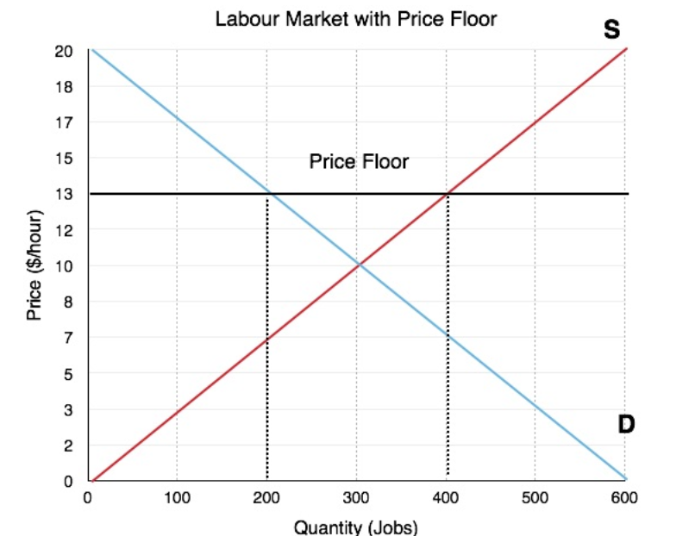
Price Floor – Minimum wage policy
Workers are the producers of labor
Firms are the consumers of labor
Price is defined as hourly wage

Slide 19
Price Floor – Minimum wage policy
In equilibrium ($10/hour) there is no unemployment
One the government sets a minimum wage ($13/hour)
  Quantity of labor supplied (workers looking for jobs) will be 400
  Quantity demanded (firms hiring workers) will be 200
  200 workers will be unemployed

Slide 20

Price floor – Market Surplus
BEFORE
  Consumer Surplus (Blue Area): $\frac{\left[\left(20−10\right)∗300\right]}{2}=\$1.500$
  Producer Surplus (Red Area): $\frac{10∗300}{2}=\$1.500$
  Market surplus = CS + PS = $=\$1.500+\$1.500=\$3.000$
AFTER
  Consumer Surplus (Blue Area): $\frac{\left[\left(20−13\right)∗200\right]}{2}=\$700$
  Producer Surplus (Red Area) = Red square + red triangle = $\left[\left(13−7\right)∗200\right]+\frac{7∗200}{2}=\$1900$
  Market surplus = CS + PS = $=\$700+\$1900=\$2600$

Slide 21
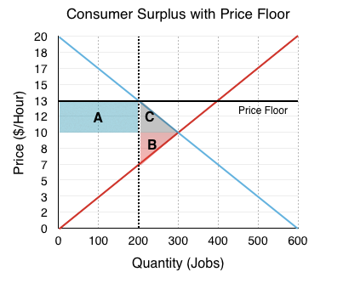
Price floor – Market Surplus
Market surplus after the price floor is less → deadweight loss
Transfer from consumers (firms) to producers (workers)
  Workers who find job are better off
  Fewer workers are able to find jobs

Slide 22
Price controls - Summary
Both price floor and price ceiling result in deadweight loss
Transfer from one player to another
If we want to change the quantity level offered, both policies are effective
DWL area is the same after the two policies are introduced but the surplus distribution will be different

Slide 23
Quantity Controls
So far, we have seen how the government can change the equilibrium quantity by changing prices?
What if the government operates directly on quantities?
  Same deadweight loss but different surplus distribution

Slide 24
Quantity Controls - Example
Market oil
Environmental strategy to reduce both the level of production and consumption → quota
Equilibrium quantity 3.5 barrels of oil
The Government sets a quota of 2 million barrels → both consumers and producers have to reduce their production and consumption to that level

Slide 25
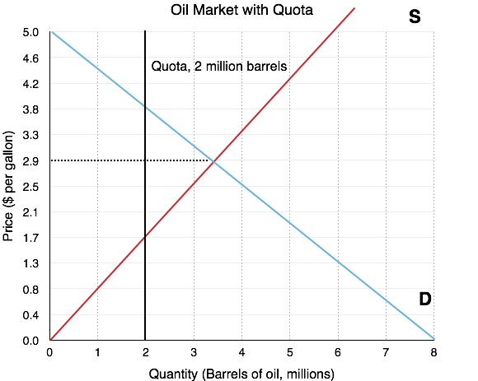

Slide 26
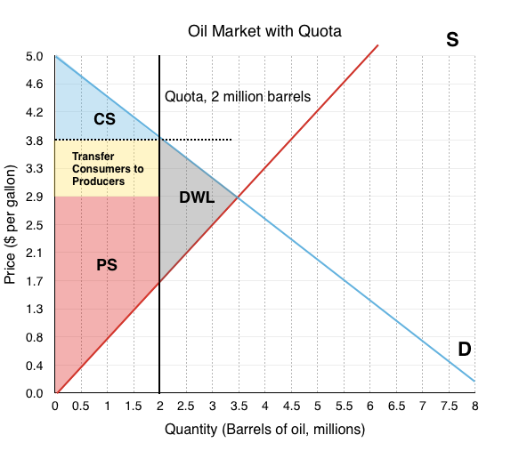

Slide 27
Effect of a quota
Price increases from $2.9/gallon to $3.8/gallon
Consumers are willing to pay more
Producers will increase prices

Slide 28

Quota– Market Surplus
BEFORE
  Consumer Surplus (Blue Area) = $\$3.675 million$
  Producer Surplus (Red Area) = $\$5.075 million$
  Market surplus = CS + PS = $\$8.75 million$
AFTER
  Consumer Surplus (Blue Area) = $\$1.2 million$
  Producer Surplus (Red Area) = Red square + red triangle + yellow square = $\$5.9 million$
  Market surplus = CS + PS = $=\$7.1 million$

Slide 29
Quantity controls – Summary
The effect of a quota is similar to that of price floor
Main difference
  Quota → government puts a restriction on a quantity and price changes accordingly
  Price restrictions → government puts a restriction on price and quantity changes accordingly.

Slide 30
Taxes and Subsidies
Tax can be addressed both to producers and consumers
Ex. Gas tax
  Producers will transfer some of the cost of the tax to a higher price
Ex. Tax on consumers
  It decreases quantity demanded and reduces producer surplus

Slide 31
Taxes, Supply and Demand curves
Producers (Supply)
  Supply curve can be derived by the Marginal Cost (MC)
    Portion of MC that lies above the AVC curve
  Market change → Supply Curve shifts → MC changes
  Taxes work in a similar way
  Tax collected by the government = increase in the MC per unit
Consumers (Demand)
  Demand = consumers’ willingness to pay → tax → downward shift demand curve
Not matter if a tax is addressed to consumer or producers, the result is the same.

Slide 32
Equilibrium before tax
6
Consumer Surplus
4
Producer Surplus
4

Slide 33
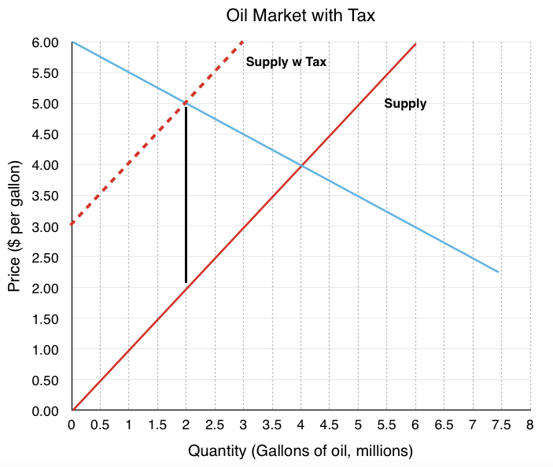
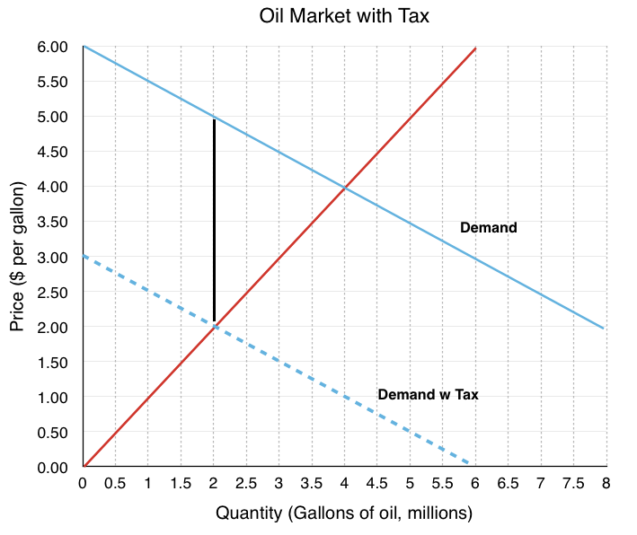
Effect of a tax - example

Slide 34
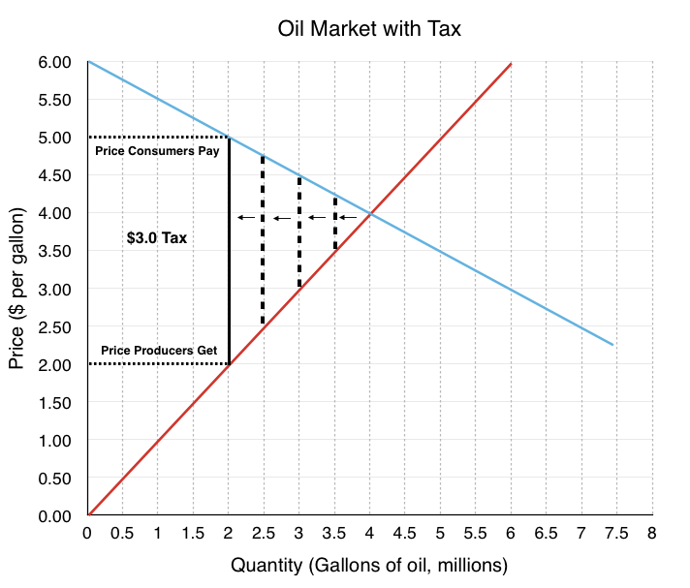

Slide 35

Tax– Market Surplus
BEFORE
  Consumer Surplus (Blue Area) = $\$4 million$
  Producer Surplus (Red Area) = $\$8 million$
  Market surplus = CS + PS = $\$12million$
AFTER
  Consumer Surplus (Blue Area) = $\$1 million$
  Producer Surplus (Red Area) = $\$2 million$
  Government Revenue (Green Area) = $\$6 million$
  Market surplus = CS + PS = $=\$9 million$
Both consumer and producer surplus decreases because of a reduced quantity
Government Revenue are included in Market Surplus

Slide 36
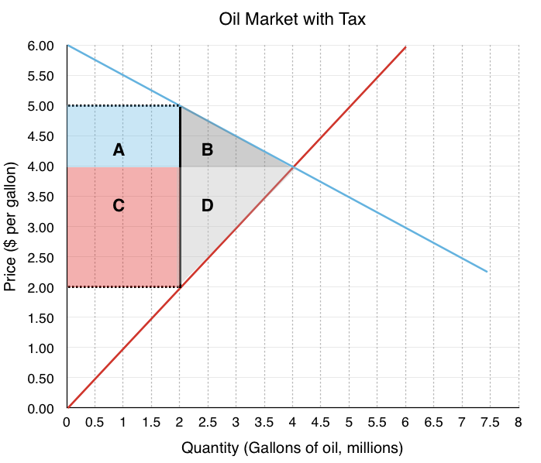
Tax – Transfer and Deadweight Loss

Slide 37
Tax – Transfer
Area A and C are transferred from consumer and producer to government revenue
Area A – Consumers to Government
  Before Consumers paid $4/gallon for gas
  After Consumers pay $5/gallon for gas
  The $1 increase in price is the tax consumers have to pay
  The tax is addressed to producers. However, it has an indirect effect on consumers since they have to bear a share of the price change
    The size of the share depends on price elasticity: ↓ price to producers → ↓ quantity offered → ↓ quantity demanded → equilibrium
  The government collects $2 million in tax revenue from consumers ($1X2 oil million gallons)
  Direct transfer from consumers to government → no direct effect on market surplus

Slide 38
Tax – Transfer (cont’d)
Area C – Producers to Government
  Before Producers received $4/gallon for gas
  After Producers received $2/gallon for gas
  The $2 increase in price is the tax producers have to pay
  The government collects $4 million in tax revenue from producers ($2X2 million gallons)
Government revenue = Area A + Area C

Slide 39

Tax – Deadweight Loss
Price change (tax) → change in quantity
Area B – Consumer surplus (decrease)
  Consumers will try to find substitute goods to oil when the tax is put
  Decreased in quantity demanded of $2 million and a deadweight loss of $1 million
Area D – Producer surplus (decrease)
  Producers now only receive $2.00/gallon
  Quantity supplied decreased by $2 million (is it a coincidence that it is equal to the reduction in the quantity demanded? → equilibrium)
  Decrease in PS ($2 million) > Decrease in CS ($1 million) → elasticity
Tot deadweight loss = $Market Surplus_{after}−Market Surplus_{before}=\$3 million$
Notes:
A market can only actually trade one quantity — you can't have consumers buying 3M while producers sell 2.5M; whatever amount physically changes hands is a single number, full stop. What a tax does is not create two competing quantities — it creates two prices for that one quantity: the price consumers pay (higher) and the price producers receive (lower), separated by the tax.

Slide 40
Subsidy
Benefit (financial aid, direct or indirect payments) given by the government to groups or individuals
  Direct subsidies: actual payment
  Indirect subsidies: price reduction for specific goods and services that are government-supported. Products are purchased below the current market rate
  Government subsidies: welfare payments → combat unemployment / lower rates on student loans/taxes → promote education
    Italy: «Bonus cultura»: 500€ for people who turned 18 that can be spent for cultural goods or events
Ex. Cash payment or tax reduction
  Great Depression – agricultural subsidy → profits rise → more workers → more productivity (invisible cost?)
Government expense, consumers pay less, producers receive more

Slide 41
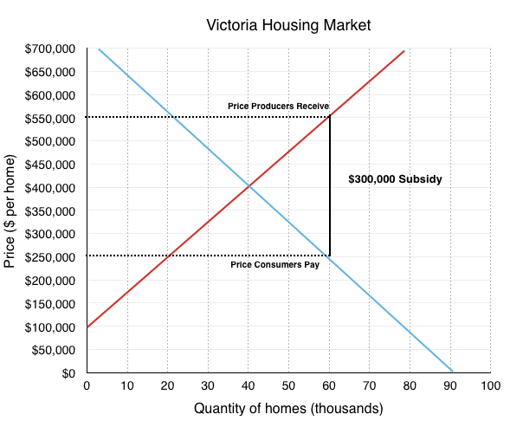
Subsidy - Example
Government wants to allow low-income families to buy a house

Slide 42
Subsidy – Example (cont’d)
Equilibrium: $400.000 per home and 40.000 home bought
$300.000 subsidy for any consumer buying a home
  $250.000 – what consumers paid
  $550.000 – what home builder companies receive

Slide 43
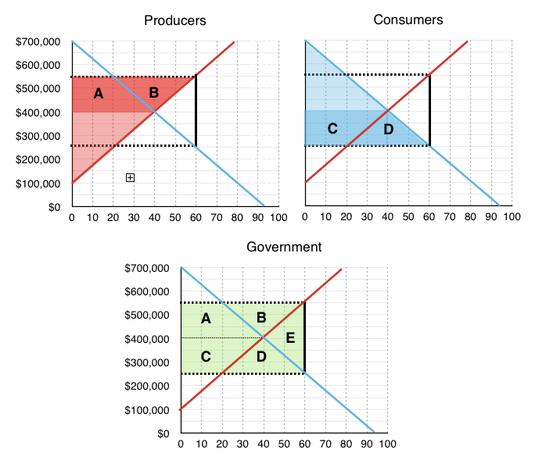

Slide 44
Subsidy – Market Surplus
Producers
  They now receive $550.000 instead of $400.00, increasing quantity supplied to 60.000 houses
  Producers surplus increases by Area A and B
Consumers
  They now pay $250.000 instead of $400.000, increasing quantity demanded to 60.000 houses
  Consumers surplus increase by Area C and D
Government
  It has to pay $300.000 per home to subsidize the 60.000 consumers buying new home (very improbable that the government makes available $18 billion)
  Government expenditures: Area A,B,C,D, and E

Slide 45
Subsidy – Market Surplus (cont’d)
Total gains: CS+PS = Area A, B, C, and D
  Transferred from government to consumers and producers
Total losses: Area A, B, C, D, and E
  E deadweight loss from the subsidy
The subsidy was successful since quantity increased from 40.000 homes to 60.000 homes
Deadweight loss is due to the fact we always have to go back to equilibrium and equilibrium quantity was too high after the change
REMEMBER: every time we changed the equilibrium quantity, we will result in a deadweight loss in the absence of externalities!

Slide 46
Elasticity&Policy
So far, we have seen how markets respond to price changes.
  Taxes and price controls → deadweight loss and redistribution among market players (consumers, producers, government)
  How the dedwieght loss is distributed among market players depends on the relative elasticity of a market
Ex.
  US dairy market has been seen inelastic for many years (US government had full control on dairy products)
    Something has changed in the past years
      Data collection on consumers’ behavior and preferences more disaggregated and precise
  Canadian dairy market very inelastic due to high tariffs and quota requirements

Slide 47
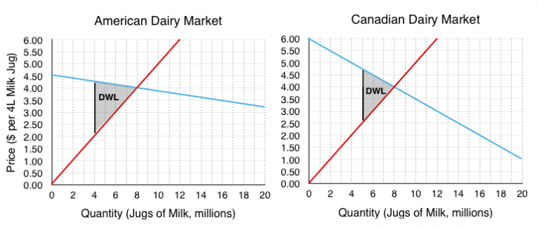
US vs Canada

Slide 48

Assumptions
$2.25 per unit tax on the American and Canadian dairy market
$P_{equilibrium}=\$4/jug$
$Q_{equilibrium}=8 million$
American market demand relatively more elastic

Slide 49
First Glance Observations
Which deadweight loss is greater?
Deadweightloss = change in quantity → ignore the redistributive effects of the tax
We can take a look to the change in consumers and producers' surplus

Slide 50

Deadweight loss US – More elastic demand
Tax $2.25
  Consumers pay $4.25
  Producers receive $2.00
  Decrease in equilibrium from 8 million milk/jug to 4 millon milk/jug
$Deadweight loss_{ US}=\frac{\left(4.25−2.00\right)X\left(8−4\right)}{2}=\$4.5 million$

Slide 51

Deadweight loss Canada – Less elastic demand
Tax $2.25
  Consumers pay $4.75
  Producers receive $2.50
  Decrease in equilibrium from 8 million milk/jug to 5 millon milk/jug
$Deadweight loss_{ CANADA}=\frac{\left(4.75−2.50\right)X\left(8−5\right)}{2}=\$3.375 million$

Slide 52
Conclusions
Ceteris paribus (Keeping everything else constant/equal), the deadweight loss is greater for the market that experiences the larger decrease in equilibrium quantity
  Base of thw two triangles is equal
  Height (= decrease in equilibrium quantity) is different
But how does relative elasticity affect the loss redistribution between producers and consumers?
  Intuitively, in the American market demand is more elastic therefore consumers bear a smaller loss

Slide 53
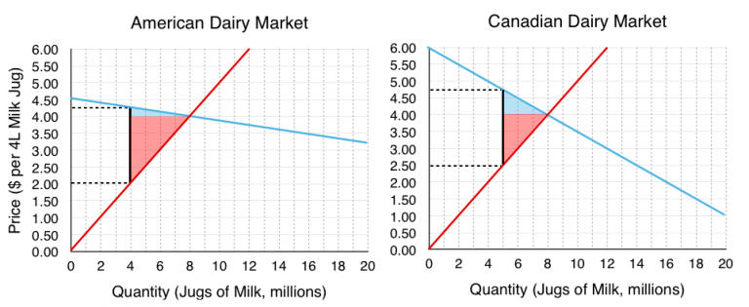
CS, PS, and elasticity

Slide 54

CS, PS, and elasticity - math
US market
  $Deadweight Lo{st}_{Consumers}=\frac{\left(4.25−4.00\right)\left(8−4\right)}{2}=\$ 0.5 million$
  $Deadweight Lo{st}_{Producers}=\frac{\left(4.00−2.00\right)\left(8−4\right)}{2}=\$ 4 million$
  $Deadweight Lo{st}_{TOT}=\$ 4.5 million$
    $\frac{\$4 million}{\$4.5 million} = 88.89\%$ of the tax is bore by producers
    $\frac{\$0.5 million}{\$4.5 million} =11.11\%$ of the tax is bore by consumers
Canada market
  $Deadweight Lo{st}_{Consumers}=\frac{\left(4.75−4.00\right)\left(8−5\right)}{2}=\$ 1.125 million$
  $Deadweight Lo{st}_{Producers}=\frac{\left(4.00−2.50\right)\left(8−5\right)}{2}=\$ 2.25 million$
  $Deadweight Lo{st}_{TOT}=\$ 3.375 million$
    $\frac{\$2.25 million}{\$3.375 million} =66.67\%$ of the tax is bore by producers
    $\frac{\$1.125 million}{\$3.375 million} =33.33\%$ of the tax is bore by consumers

Slide 55
CS, PS, and elasticity - conclusions
Consumers bear a smaller loss in the US market
A smaller loss is bore by consumers than producers

Slide 56
Two main conclusions
1) For a more elastic market a price change causes a greater decrease in quantity therefore a policy in a more elastic market will cause a greater deadweight loss.
2A) As supply (demand) grows relatively more inelastic, producers (consumers) bear a greater burden of the tax.
2B) As supply (demand) grows relatively more elastic, producers (consumers) bear a smaller burden of the tax.
In our example, producers bear over 50% of the tax in both markets, meaning supply is relatively less elastic than demand, and since US demand is comparatively more elastic than Canada’s, producers bear an even larger share in the US (88.9%) than in Canada (66.7%).

Slide 57
Price Ceiling - Example
Relationship between Us home ownership and rent control (price ceiling)
  OPA chose a date for each urban area depending on the impact
  We cannot control just for aggregate national trend since individuals within a nation are different – different salaries, savings, taxes etc.
  We have to be sure that the rent reduction is not related to any other trend that can drive home ownership (ex. House demand, authority’s choice, timing of rent increase)
  Comparison across cities with similar rent conditions prior to control but different conditions after the control
  Landlords cannot rent at on thier terms, they then decide to sell their (house) properties
    This was the hypothesis that was verified

Slide 58
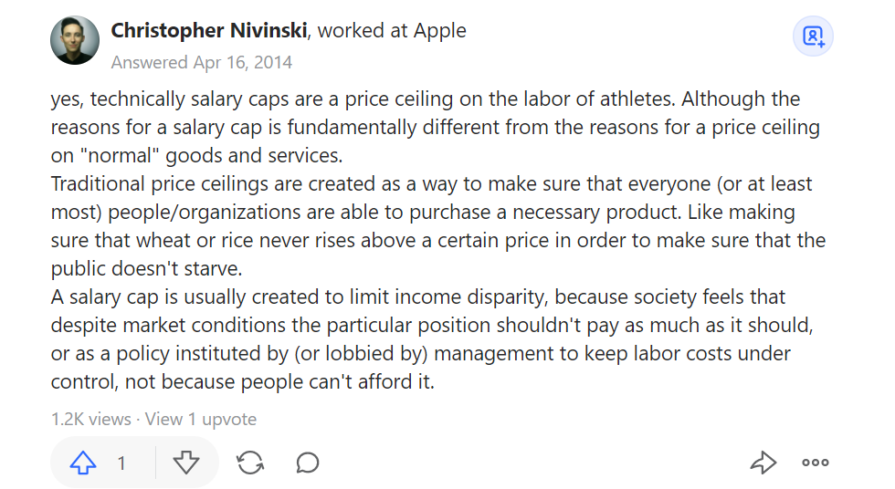
Are salary caps a form of price ceiling?

Slide 59

Government policy in Sport
Are labor market regulations necessary to promote competitive balance in professional sports?
  The Australian Football League AFL and the National Rugby League NRL
    Use of salary cap to promote competitive balance
      Teams cannot take out the competition just buying the best players on the market
  How to measure competitive balance?
    Real vs Ideal mean of wins (could they have used points instead?) → larger number bigger disparity
    Herfindahl-Hirschman Index: $HHI=\frac{∑top^{2}}{N}$
      Measure of degree of concentration in a market ( sport competitions can be seen as markets)
      top = number of times each team was first in the league at the end of each season
      High HHI → few team are dominating the league or over a period
  Competition seems more balance under salary cap and draft rule
    We cannot directly compare the two leagues since they have different characteristics
      Sponsorship deals, contract terms, league and points system etc.

Slide 60


Competitive Balance (CB)

Slide 61
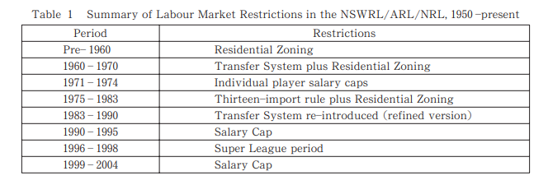
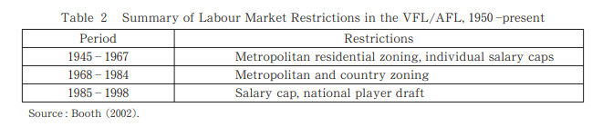
Rugby
Australian Football

Slide 62
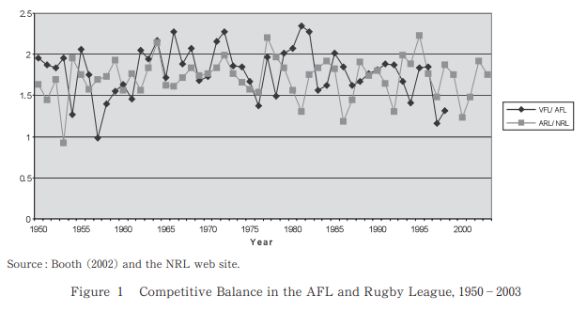
CB as standard deviation of wins

Slide 63
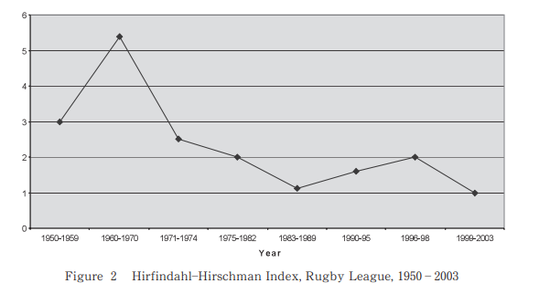
CB as HHI

Slide 64
Government policy in Sport
Japanese Baseball
  In 1993, rookie draft system was revised, and free agency was introduced to reduce salary and contract money of rookie players
    Compensation payments disincentive the transfer of free-agent players
    Results
      Salaries competition for rookie players
      Deterioration of competitive balance: stronger teams will become stronger and weaker teams will become weaker if trasnfer are allowed
        Tradeoff money and player can offset this gap between teams

Slide 65
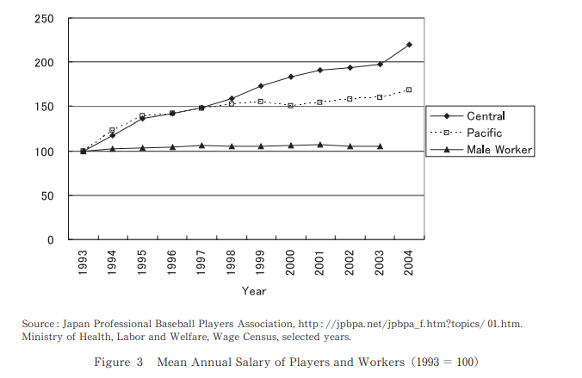
Salary
Baseball players’ salaries increased substantially after the deregulation in 1993, especially for teams in the Central League

Slide 66
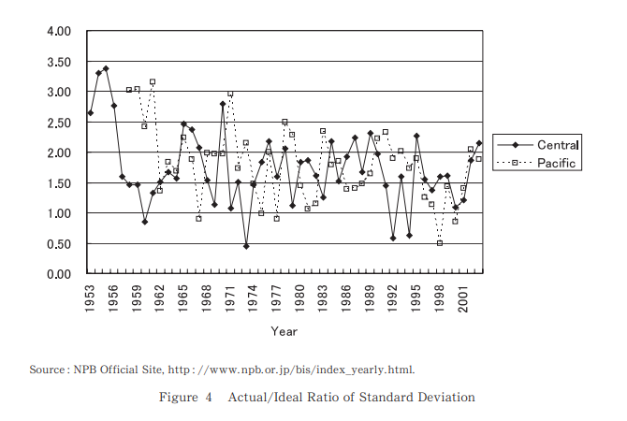
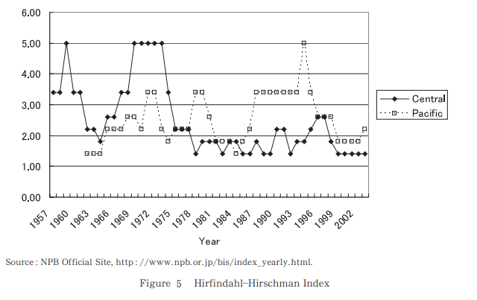
Real/Ideal ratio mean
HHI
Ratio slightly declined after 1993 and the decline was not even statistically significant
Competitive balance not only did not decrease but also increased for teams playing in the Pacific League

Slide 67
Conclusion
The examples provided do not support the fact that a strict labour market regulations are necessary to sustain competitive balance in professional sport

Slide 68
Interesting Links
https://freakonomics.com/podcast/child-poverty/

