Slide 1

Lecture #10
The Bosman Case
Alessandro Di Mattia

Slide 2
Topics
The transfer system before 1995
Jean-Marc Bosman and the legal challenge
The 1995 ECJ ruling
The economics: monopsony power in football labor markets
What changed after Bosman (wages, agents, competitive balance).

Slide 3
The Transfer System Before 1995
Even after a player’s contract expired, his old club could still demand a transfer fee from the new club
In effect, a club retained rights over a player beyond the life of his contract (he could not simply walk away and sign elsewhere for free).
On top of this, UEFA’s “3+2 rule” capped every club at 3 foreign players + 2 “assimilated” (who had played in the domestic league for at least five year)
Together, these two rules sharply limited where a player could actually take his labor, exactly the kind of restriction on mobility we saw with rent control and the NBA draft (L7–L8), just applied to workers instead of tenants or draft picks

Slide 4
Jean-Marc Bosman
Belgian midfielder under contract at RFC Liège (Belgium)
1990: his contract expired; Liège offered a renewal at roughly a quarter of his previous salary, he refused
He arranged a move to US Dunkerque (French second division)
Liège demanded a transfer fee from Dunkerque anyway, despite Bosman being out of contract, the fee was not paid and the deal collapsed
Liège suspended Bosman, leaving him without a club and on reduced pay
Bosman sued RFC Liège, the Belgian FA, and UEFA, arguing the transfer-fee system and nationality quotas violated his rights as an EU worker

Slide 5
The Legal Basis
Article 48 of the EEC Treaty: freedom of movement for workers within the European Community (today Article 45 TFEU)
Bosman’s argument: a professional footballer is a “worker” like any other, and cannot be blocked from taking a job in another member state
Court: European Court of Justice (ECJ), Case C-415/93
Referred by the Liège Court of Appeal in 1990; judgment delivered 15 December 1995

Slide 6
The Ruling, 15 December 1995
Two distinct legal effects:
  No transfer fee can be demanded for a player moving to a club in another EU member state once his contract has expired
  Nationality quotas on EU players (UEFA’s “3+2 rule”) are unlawful, a club must be free to field any number of players who are EU nationals
UEFA formally abolished the 3+2 rule on 19 February 1996
This did not end transfer fees altogether, a club can still be paid a fee for a player who is transferred while still under contract

Slide 7
The Economics: Monopsony Power
Before Bosman, a club effectively held exclusive rights to a player’s labor even after his contract ended.
This is monopsony power: a market with (in the extreme) a single buyer of labor, rather than many competing buyers
Just like a monopolist restricts output below the competitive level, a monopsonist restricts employment below the competitive level, and pays a wage below what that labor is actually worth (its Value of Marginal Product, from L4)
The next slide shows this formally

Slide 8
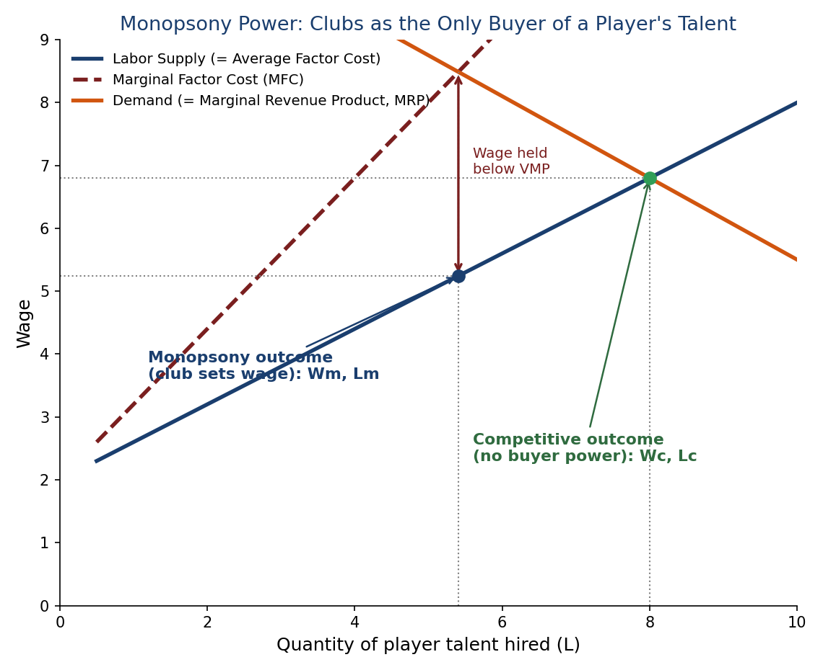
Monopsony Power in the Labor Market
MFC lies above the supply curve because hiring one more player raises the wage for everyone. The club hires where MFC = MRP (Lm), then pays only Wm , below both the competitive wage and the player’s VMP.

Slide 9
After Bosman: Free Agency Changes the Balance of Power
An out-of-contract player can now simply leave for free
This shifts bargaining power from clubs toward players (and their agents)
Clubs can no longer bank on transfer-fee income from out-of-contract sales, and players (correctly) demand to capture more of their own value directly, through salary
Result: money that used to flow to selling clubs as transfer fees increasingly flows to players as wages and signing bonuses instead

Slide 10
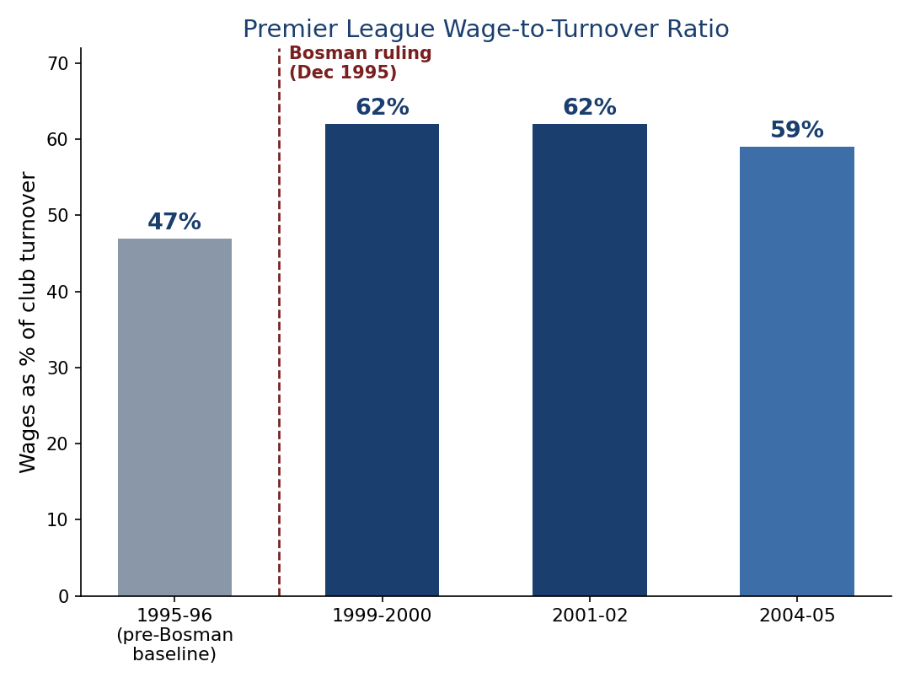
Real Data: The Premier League Wage Bill
Source: Deloitte Annual Review of Football Finance. Caution: this period also saw the Sky/Premier League TV-rights boom , the rise is associated with Bosman, not proven to be caused by it alone.

Slide 11
Did Bosman Change Competitive Balance? A Paradox
At club level: research finds Bosman is associated with REDUCED competitive balance: big clubs could now acquire top out-of-contract talent without paying a fee, and smaller clubs increasingly became net sellers rather than competitors
At national-team level: the same research finds the performance gap between stronger and weaker EU football nations NARROWED after Bosman
  Why? Smaller football nations, facing tougher competition for talent, invested more in youth development, raising the quality of players they produced
Source: Norbäck, Olsson & Persson, “Talent Development and Labour Market Integration: The Case of EU Football”

Slide 12
The Rise of the Football Agent
Free agency gave players (and by extension their agents) real leverage at the negotiating table for the first time
A credible “I can just leave for free” threat is worth far more in a negotiation than a threat that requires your club’s cooperation
Agents became central to contract negotiations, transfer deals, and commercial arrangements, and their commissions grew alongside rising transfer and wage sums (amplified further by the same TV-rights boom noted on the previous slide)
This is a qualitative, widely reported consequence of Bosman, precise historical data on agent numbers/earnings in the 1990s is not well documented, so treat it as a trend rather than a hard statistic

Slide 13
Key Takeaways
Before 1995, clubs held real monopsony power over players — even after a contract ended
The ECJ’s Bosman ruling (1995) ended fee-for-out-of-contract transfers and abolished EU nationality quotas, on freedom-of-movement grounds
Removing monopsony power moved wages toward the competitive level, and the data show a real jump in the wage share of revenue
The effects were not uniformly “good”: club-level competitive balance may have worsened even as national-team balance improved
Bosman is one of the two forces (with rising TV revenue) that set up the conditions Financial Fair Play was later built to address

