Slide 1

Lecture #11
Financial Fair Play
Alessandro Di Mattia

Slide 2
Recap — Why FFP Exists
From Lecture 8: Sloane (1971) argued football clubs are utility-maximizers, not profit-maximizers, they chase sporting success subject only to a break-even constraint
When a club overspends and fails financially, it enters administration rather than fully repaying debts or going extinct
Two pressure points made this worse over time:
  Rising Pay-Per-View / broadcast revenue (more money, less discipline)
  The Bosman ruling (Lecture 10) — free agency pushed wages up and gave agents new leverage
Today: how UEFA actually built a rule to enforce that break-even constraint, and whether it worked

Slide 3
UEFA FFP — The Break-Even Rule (2011)
Introduced 2011, effective from the 2013/14 season
Core requirement: a club’s “football-relevant” revenue must roughly balance its “football-relevant” costs over a rolling monitoring period (assessed across multiple seasons, not just one)
Allowed deviation (loss) if covered by owner/related-party equity:
  €45m over 2013/14–2014/15 (≈ €22.5m/year)
  Reduced to €30m over any 3-year period from 2015/16 (≈ €10m/year)
Without owner equity funding: only €5m allowed over 3 years

Slide 4
What Counts and What Doesn’t
Counted (“relevant income/expenses”): gate receipts, broadcasting, sponsorship, commercial revenue, prize money, transfer fees, wages, agents’ fees
Deliberately EXCLUDED from the break-even calculation:
  Youth academy development
  Women’s football
  Community development programs
  Infrastructure investment (stadium, training ground)
Why exclude these? To avoid discouraging the kind of long-term investment that’s good for the club and the game, only op-ex-style overspending on wages/transfers is constrained

Slide 5
Enforcement: the Club Financial Control Body (CFCB)
Two chambers: an Investigatory Chamber and an Adjudicatory (Appeals) Chamber
Full range of possible sanctions:
  Warning or reprimand
  Fine
  Deduction of points
  Withholding of prize money from a UEFA competition
  Restriction on registering new players, or a cap on total squad cost
  Disqualification from a competition in progress, or exclusion from future competitions

Slide 6
Real Case: Manchester City & PSG (2014)
First major test of FFP enforcement
Both clubs fined €60m, with €20m suspended, effectively ≈€40m payable, partly refundable if the clubs stayed compliant for two seasons
Both capped at a 21-player Champions League squad (instead of the normal 25) for 2014/15
Both agreed to limit transfer spending and freeze wage bills at prior-season levels for two seasons
UEFA also reserved the right to withhold prize money from European competition

Slide 7
Real Case: Manchester City’s 2020 CAS Appeal
Feb 2020: UEFA’s CFCB Adjudicatory Chamber banned City from UEFA competitions for 2 seasons + a €30m fine, for allegedly overstating sponsorship revenue and misleading investigators (2012–2016)
City appealed to the Court of Arbitration for Sport (CAS)
July 2020: CAS partially upheld the appeal, the ban was lifted entirely; the fine was reduced from €30m to €10m
CAS found most alleged breaches were either not established or time-barred, but that City had failed to cooperate with investigators, the basis for the reduced (not eliminated) fine
Shows a real limit on FFP enforcement: rules are only as strong as what can be proven, within a statute of limitations

Slide 8
Criticism #1: Does FFP Entrench the Incumbents?
A break-even rule caps how much a club can spend RELATIVE TO its own revenue
But clubs don’t start with equal revenue, the biggest clubs already earn the most from broadcasting, sponsorship and prize money
Result: rich clubs can spend more and still comply; ambitious smaller clubs are constrained exactly when they’d need to spend heavily to break into the elite
Peeters & Szymanski: FFP raises club profitability mainly by suppressing wage spending, but cements the competitive advantage of incumbent top clubs
Empirical studies (Spain, Germany, France) report fewer distinct league-title winners after FFP’s introduction: the opposite of a competitive-balance goal

Slide 9
Criticism #2: Limiting an Owner’s Own Money
In an ordinary business, an owner can inject as much of their own capital as they like, no regulator stops a founder from funding losses out of pocket
FFP caps this directly: owner equity injections beyond the allowed deviation (€30m/3 years, or €5m without owner funding) don’t exempt a club from breach
The justification: unlimited owner subsidy would let a wealthy benefactor simply buy sporting success regardless of the club’s own economics, undermining both solvency discipline and competitive balance
The tension: is it fair to restrict what an owner does with their own money, in a way no other industry faces?

Slide 10
What Does the Evidence Actually Show?
Alabi & Urquhart (2024): a study of the English Premier League (2011–2019) found FFP improved measured profitability, clubs managed income and expenses more carefully
But it did NOT clearly improve underlying financial sustainability
  Clubs instead became more interconnected through installment-payment debt owed to each other (e.g. transfer fees paid in installments), a new kind of interdependency risk, not necessarily less risk overall
Gallagher & Quinn: the break-even rule reduced average club efficiency and shifted club priorities toward financial targets over sporting ones
Takeaway: FFP achieved some of its accounting goals, but the deeper claims (financial safety, competitive balance) are much less clearly supported

Slide 11
FFP 2.0: The Financial Sustainability Regulations (2022+)
Approved April 2022, phased in from the 2022/23 season, replacing the old break-even-only approach (UEFA explainer)
Three pillars: solvency, stability, and a new Squad Cost Ratio (SCR)
  SCR caps spending on player/coach wages, transfer amortization, and agent fees as a percentage of club revenue
A breach triggers predefined fines plus possible sporting sanctions, more automatic and less case-by-case than the old CFCB process

Slide 12
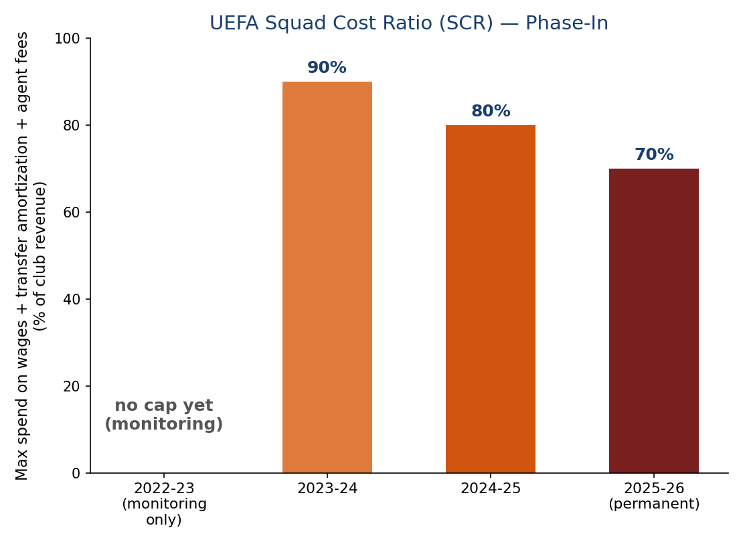
The Squad Cost Ratio, Phased In
2025/26 monitoring already shows breaches by Aston Villa, Chelsea, Newcastle and Nottingham Forest — this is a very recent, still-evolving rule,

Slide 13
Two Different Fixes for the Same Problem — FFP vs. the NBA
From Lecture 8: the NBA controls cost with a salary cap + luxury tax, a price-based tool, with the tax revenue redistributed to compliant teams
UEFA’s FFP/SCR controls cost with a break-even / spend-ratio rule, tied to each club’s OWN revenue, not a league-wide fixed number
Consequence: the NBA’s cap applies (roughly) equally to all 30 teams; UEFA’s SCR lets big-revenue clubs spend far more in absolute terms and still comply
The NBA’s tax money is redistributed to smaller-market teams (Lecture 8); FFP’s fines mostly just go to UEFA, no redistribution mechanism to help smaller clubs catch up
Open question for discussion: could European football adopt something closer to a league-wide cap, given its open promotion/relegation structure (Sloane, Lecture 8) makes a closed-league-style cap harder to design?

Slide 14
Key Takeaways
FFP’s break-even rule was built to stop clubs from spending beyond their means, directly targeting the utility-maximization problem from Sloane (1971)
Enforcement is real but imperfect: City and PSG were sanctioned in 2014, but City’s 2020 ban was overturned on procedural grounds by CAS
The evidence is mixed: FFP improved measured profitability, but the deeper goals (financial safety and competitive balance) are much less clearly achieved, and some studies find balance got WORSE
A revenue-tied rule like FFP/SCR structurally favors clubs that already earn the most, a very different design choice from the NBA’s flatter salary cap
The newer Financial Sustainability Regulations (2022+) are still being tested in real time.

