Slide 1

Lecture #9
Time value of money
Alessandro Di Mattia

Slide 2
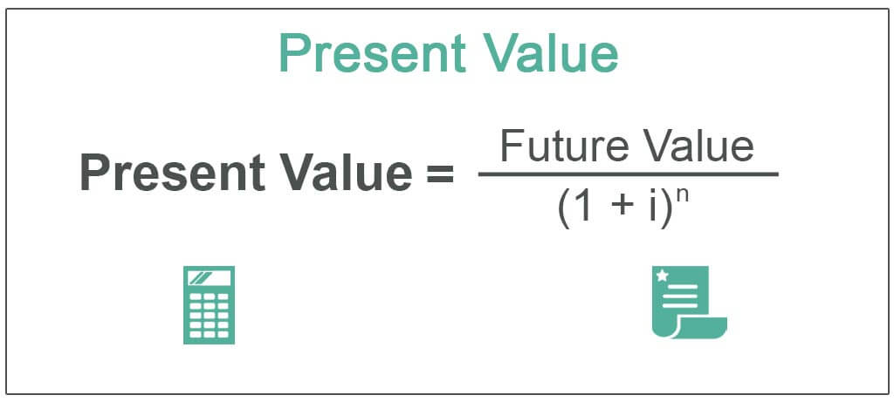
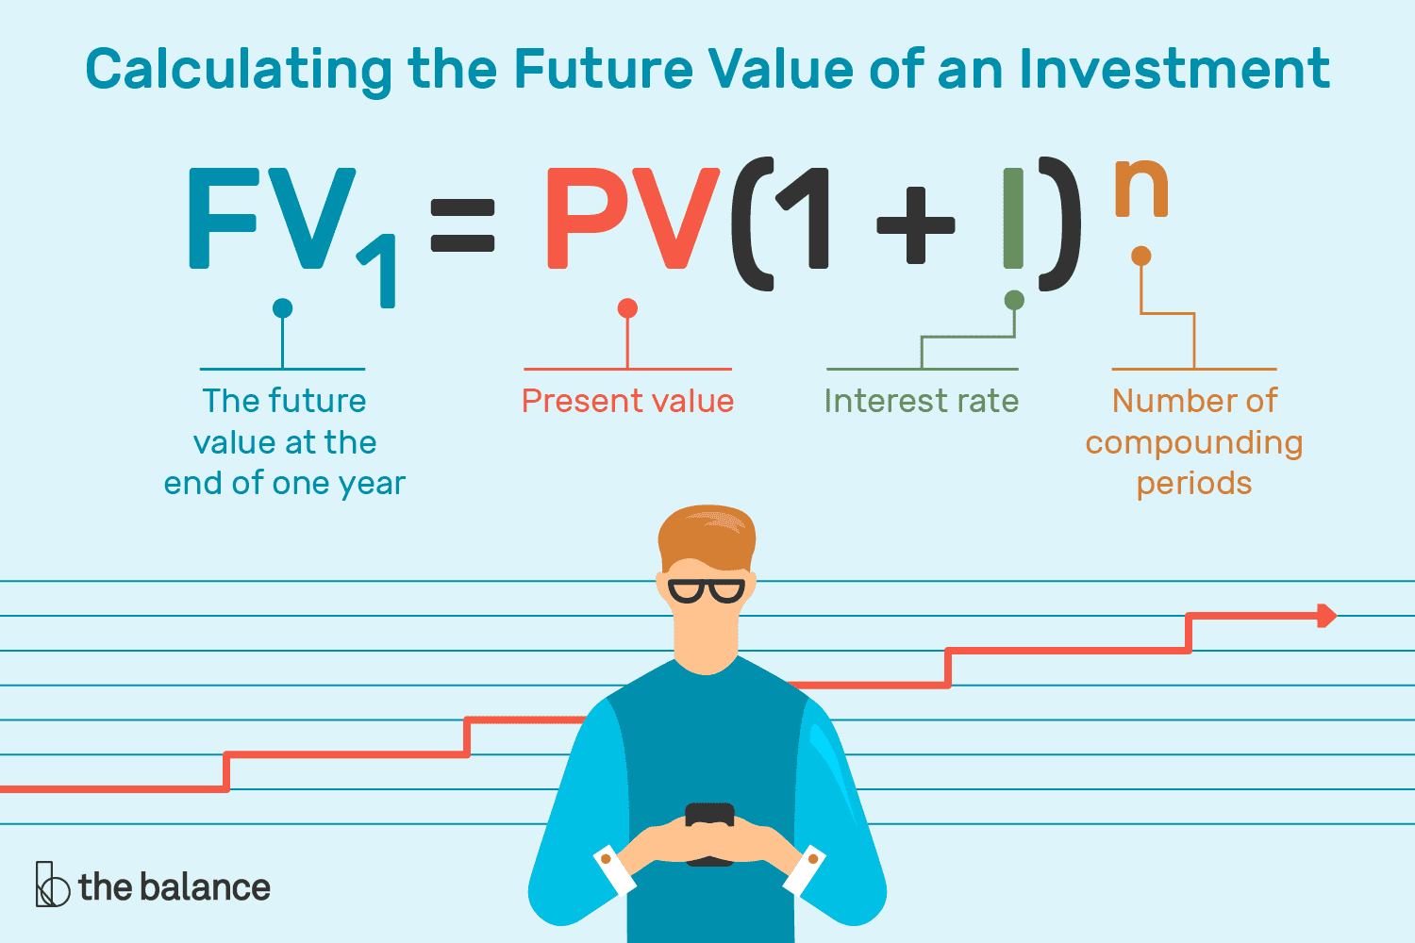
Topics
Present Value (PV)
  “i” = interest rate = discount rate
  “n” = number of periods
Future Value (FV)

Slide 4
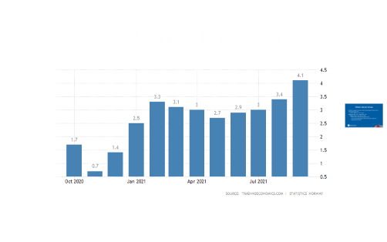

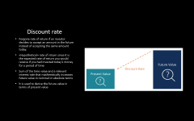

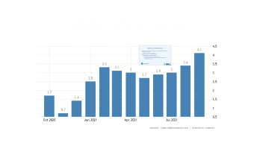
Present Value (PV)
Today’s money is worth more than the same amount in the future, for two separate reasons:
  Reason 1 — Inflation ($π$)
    Prices rise over time, so a dollar today buys more than the same dollar will buy later
  Reason 2 — The Discount Rate ($i$)
    Today’s money could be invested right now — a future payment has to compete with what that money could already have earned

Slide 5
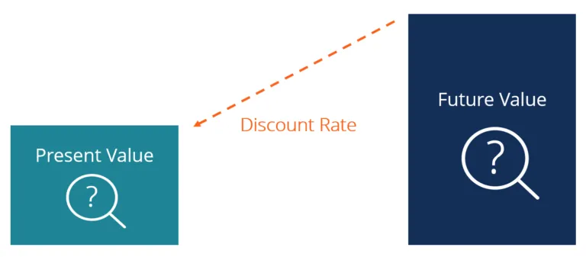
Discount rate
Rate used to discount future cash flows back to their present value
Forgone rate of return if an investor decides to accept an amount in the future instead of accepting the same amount today.
«Hypothetical» rate of return since it is the expected rate of return you would receive if you had invested today’s money for a period of time
It is used to derive the future value in terms of present value

Slide 6

PV’s formula
$PV=FV ∗\frac{1}{{\left(1+i\right)}^{n}}$
  PV = present value
  FV = future value
  $i$ = Rate of return
  $n$ = number of periods
Excel (example here)
  PV(rate, nper, pmt, [fv], [type]).
    RATE = Interest rate per period
    NPER = Number of payment periods
    PMT = Amount paid each period (if omitted—it’s assumed to be 0 and FV must be included)
    [FV] = Future value of the investment (if omitted—it’s assumed to be 0 and PMT must be included)
    [TYPE] = When payments are made (0, or if omitted—assumed to be at the end of the period, or 1—assumed to be at the beginning of the period)

Slide 7
PV of Multiple Cash Flows — The Annuity Formula
A contract is not a single payment, it is a stream of cash flows spread over several years
Extend the single-payment PV formula by discounting and summing each year’s cash flow separately:
  PV = Σ CFₜ / (1+i)ᵗ (t = 1 to n)
  CFₜ = the cash flow in year t (e.g. that year’s salary)
  Every term uses the same discount rate i, but a different exponent t, later cash flows get discounted more
This is exactly what the NFL contract table (coming up) applies year-by-year to each player’s salary

Slide 8
Why is PV important?
Assessing the fairness of any future financial benefits and liabilities
  Is the price I am paying today for an investment appropriate?
Areas: investment analysis, risk management, and finanacial planning
  Net present value (NPV)
    The sum of the present values of expected future cash flows, minus the initial cost of the investment
    It useful to find today’s value of future stream of payments
  Bond yields
  Pension obligations

Slide 9
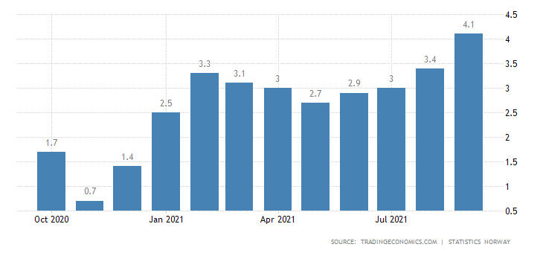



Inflation rate ($π)$ Norway

Slide 10

Inflation rate ($π)$ Norway
Inflation is a general increase in the price level of goods and services in the economy over time
  Inflation → ↑ future price of goods
September 2021 4.1% - August 2021 3.4%
  Highest inflation rate since July 2016
    Faster rise in prices of housing and utilities
    Furnishing household equipment and routine maintenance
    Recreation and culture

Slide 12
Future Value (FV) vs Present Value (PV)
Money’s today is worth more than the same money tomorrow because of the passage of time
  Money you receive in the future (an incoming cash flow) increases your future value
  Money you pay out in the future (an outgoing payment) decreases your future value
Future Value (FV)
  Value of a current (present) asset (good or service) at a specified date in the future based on an assumed rate of interest (or growth)
  Tells you what an investment is worth in the future
  It allows investor to forecast, with a certain degree of accuracy, the amount of profit that can be generated by different investments
Present value from a future value perspective
  Current value of a future sum of money or cash flow given a specified rate of return
  Tells you how much you would need in today’s dollars to earn a specific amount in the future

Slide 13

NFL’s contracts

Slide 14

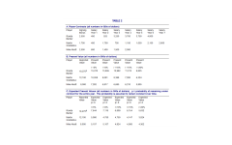
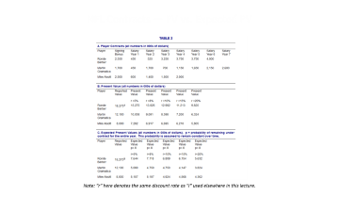
NFL’s contracts
Signing bonus + annual salary
Both negotiable
Contracts change over years
Players can be cut at any point, neverthelees they can keep the bonus
Players want the money guaranteed and be paid in the early years
If we consider just the cash flows (bonus+salary) and not the PV, players can be overpaid
  Will the player remain in the team forever?
    Risky cash flow tied to the probability a player will leave the club.
    In this case, values are significantly lower
    Methodology: the bonus is guaranteed; salary is discounted by (1+i)^{t} and compounding retention odds p^{t}
    Correlation between probability of remaining in a club and market factors that influence the discount rate ($i$)

Slide 15
Worked Example — Ronde Barber, Year 3
Contracted (nominal) salary in Year 3: $3,250K
Step 1 — discount for time only, at i = 8%:
  PV = 3,250 / (1.08)³ = 3,250 / 1.2597 ≈ $2,580K
Step 2 — weight by the compounding chance he is still on the roster in year 3, p = 0.8:
  Survival to year 3 = p³ = 0.8³ = 0.512
  Expected PV = 2,580 × 0.512 ≈ $1,321K
Result: a $3,250K salary line is really worth about $1,321K today, a 59% reduction once time and retention risk are both priced in

Slide 16
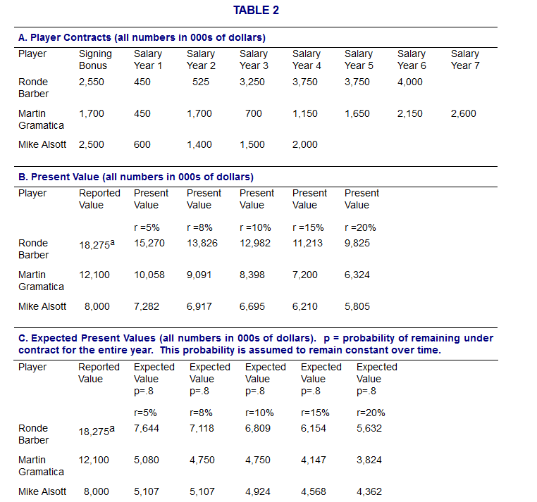
NFL Contracts — PV vs. Expected PV
Note: "r" here denotes the same discount rate as "i" used elsewhere in this lecture.

Slide 17
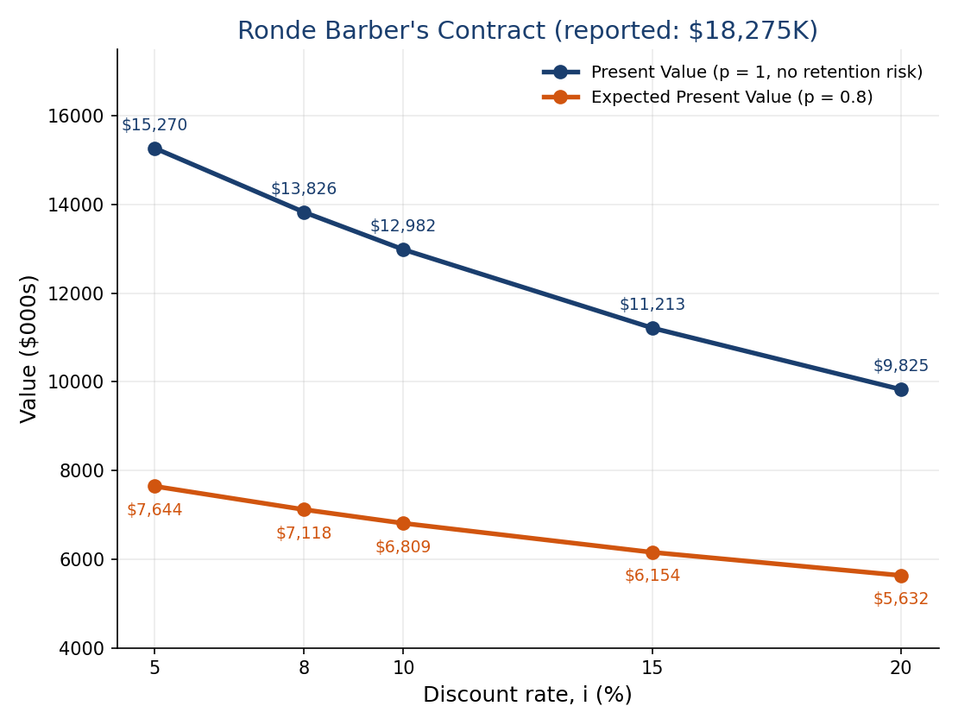
Sensitivity — How Much Does the Discount Rate Matter?

Slide 18
Guaranteed vs. Non-Guaranteed Contracts — NFL vs. NBA
NFL: contracts are mostly not guaranteed — a cut player forfeits future salary (keeps only the bonus)
NBA (from Lecture 8): contracts are fully guaranteed — salary is owed even if the player is cut, so p = 1 and only time is discounted
Same nominal salary → higher expected value under a guaranteed contract
Ronde Barber, at i = 8%:
  NFL-style (p = 0.8): Expected PV = $7,118K
  If fully guaranteed, NBA-style (p = 1): PV = $13,826K — about 94% more, for the exact same salary numbers
Guarantee structure is itself a form of value — not just the dollar amount on paper

Slide 19
Key Takeaways
Money today is worth more than the same money tomorrow — always discount future cash flows before comparing them
Discount rate (i) ≠ inflation (π) — related but distinct concepts
A contract’s reported (nominal) value overstates its true worth once you account for both time and risk
Expected PV = discount for time, (1+i)ᵗ, AND for the probability the cash flow actually happens, pᵗ
Whether a cash flow is guaranteed changes its value — before you’ve even factored in risk aversion

