Slide 1

Lecture #4 Producer Theory
Alessandro Di Mattia

Slide 2
Firm’s Production Decisions
Production Technology
Describes how inputs can be transformed into outputs
Inputs: land, labour, capital and raw materials
Outputs: cars, desks, books, etc.
Firms can produce different amounts of outputs using different combinations of inputs

Slide 3
Firm’s Production Decisions
Cost Constraints
Firms must consider prices of labor, capital and other inputs
Firms want to minimize total production costs partly determined by input prices
As consumers maximize utility, firms must be concerned about minimizing the costs of production

Slide 4
Firm’s Production Decisions
Input Choices
Given input prices and production technology, the firm must choose how much of each input to use in producing output
Given prices of different inputs, the firm may choose different combinations of inputs to minimize costs
If labour is cheap, firm may choose to produce the same product using more labour and less capital

Slide 5
Firm’s Production Decisions
Market supply:
The aggregation of all individual firms' supply curves in a market.
Short run supply tends to be less elastic (inelastic)
Firms are stuck with existing capacity and can only change labour/overtime/materials at the margin.
Long run supply tends to be more elastic
firms can build new plants, enter the market, or adopt new technology, so output responds much more to price changes.

Slide 6
The Technology of Production
Production Function:
Indicates the highest output (Q) that a firm can produce for every specified combination of inputs
For simplicity, we will consider only labor (L) and capital (K)
Shows what is technically feasible when the firm operates efficiently

Slide 7
The Technology of Production
The production function for two inputs:
Q = F(K,L)
Output (Q) is a function of capital (K) and labor (L)
The technology available in a particular industry or economy allows firms to use labor and capital more or less efficiently
Technology alters the combination of input required in the process
For this reason, we will consider the production function for a given technology
Q = A*F(L,K)
Notes:
When technology improves — e.g. better machinery, faster software, improved logistics — the same K and L combination produces more output than before (efficiency goes up), or equivalently you need less K and L to produce the same output.

Slide 8
Production: One Variable Input
We will begin by considering the case when only one input can be varied (the short run)
Assume capital is fixed (can be changed in the long run) and labor is variable (can be changed in the short run)
Notes:
Labor (L) — the human work applied to production: hours worked, number of workers, their effort/skill. In the short run, a firm can adjust this relatively easily (hire, fire, add overtime shifts).
Capital (K) — the physical/durable inputs used to produce output: machinery, equipment, buildings, tools. This is treated as fixed in the short run because it typically takes time to build a new plant or buy new machines — you can't scale it up or down overnight.

Slide 9
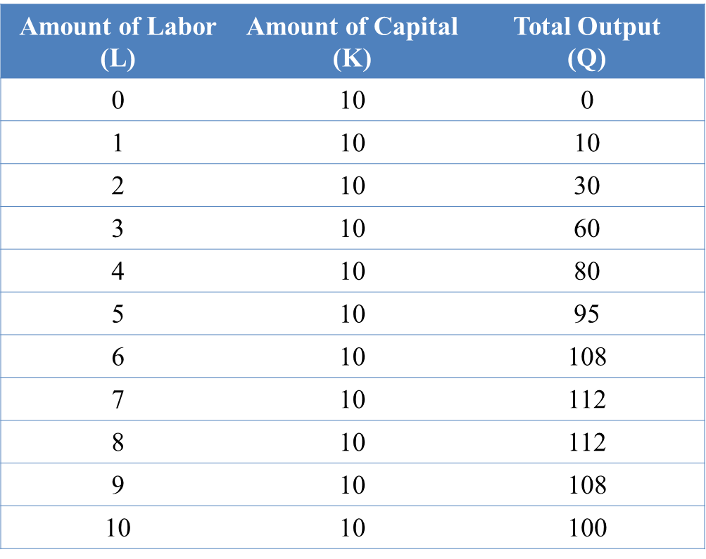

Slide 10
Input
Observations:
When labor is zero, output is zero as well
With additional workers, output (Q) increases up to 8 units of labor
Beyond this point, output declines
Increasing labor can make better use of existing capital initially
After a point, more labor is not useful and can be counterproductive

Slide 11
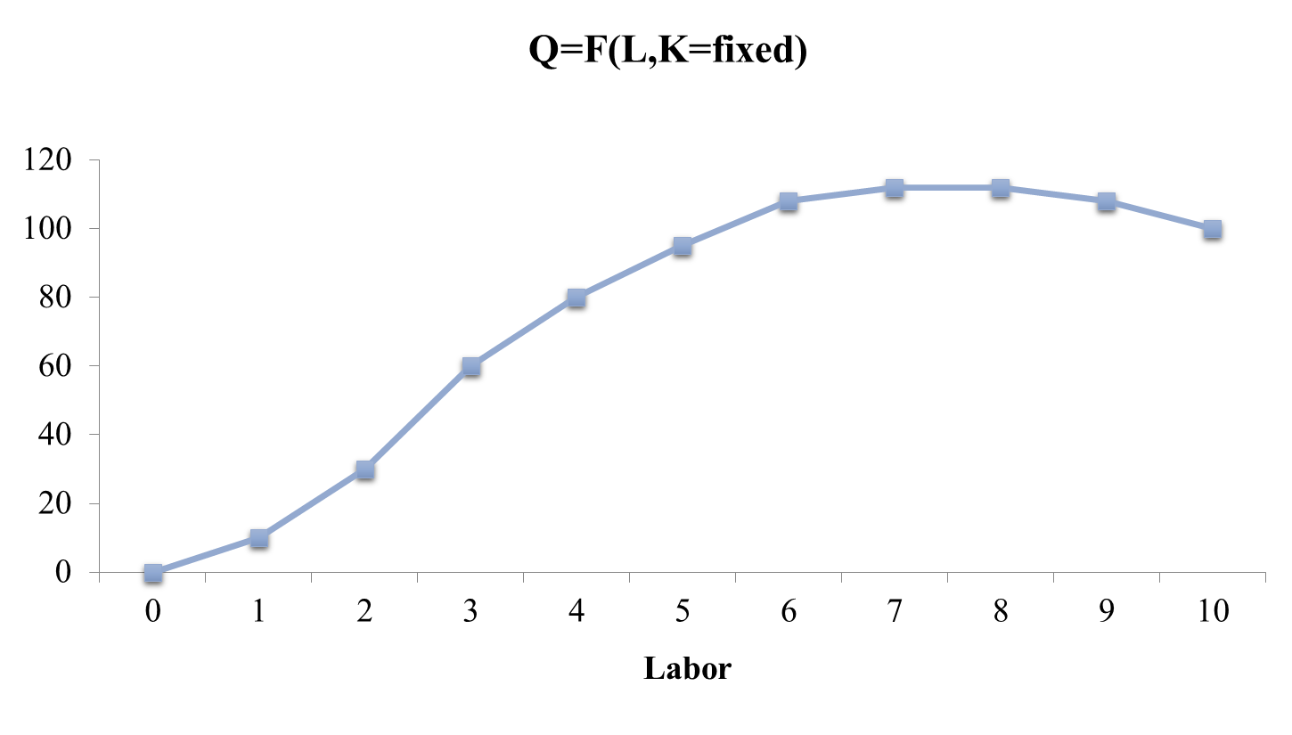

Slide 12
Production: One Variable Input
Two important measures:
Marginal product of labor (MPL)
Additional output that is generated by an additional input unit (labor)
Average product of labor (APL)
Measures the average productivity over a range of an input

Slide 13
Production: One Variable Input
Average product of labor
Output per unit of a particular input
Measures the productivity of a firm’s labor in terms of how much, on average, each worker can produce

Slide 14
Production: One Variable Input
Marginal product of labor
Additional output produced when labor increases by one unit
Measures the productivity of an additional unit of a firm’s labor in terms of how much each additional unit will produce

Slide 15
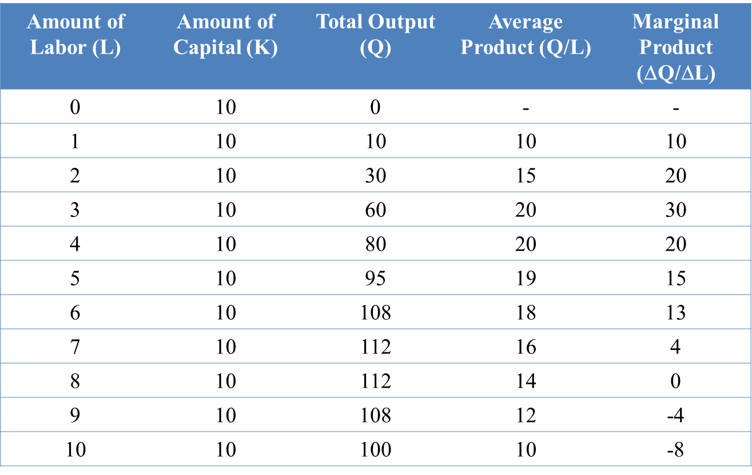

Slide 16
Production: One Variable Input
We can see graphically:
How output varies with changes in labor
Output is maximized at 112 units
Average and marginal products
Marginal product is positive if total output is increasing
Marginal product crosses average product when average product is at its maximum

Slide 17
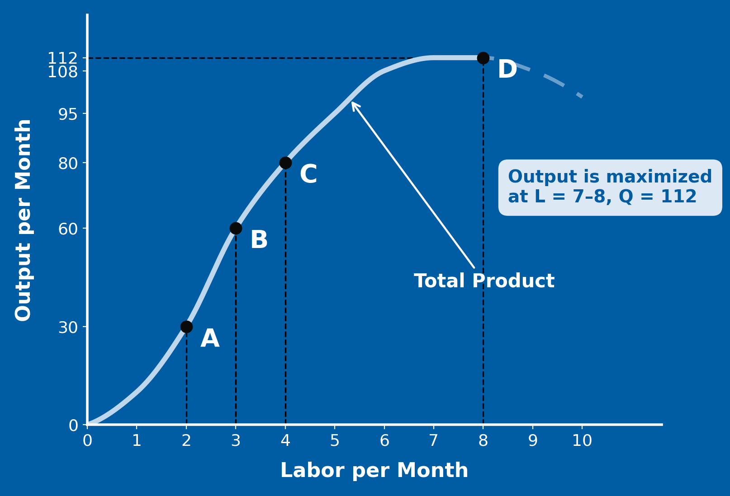

Slide 18
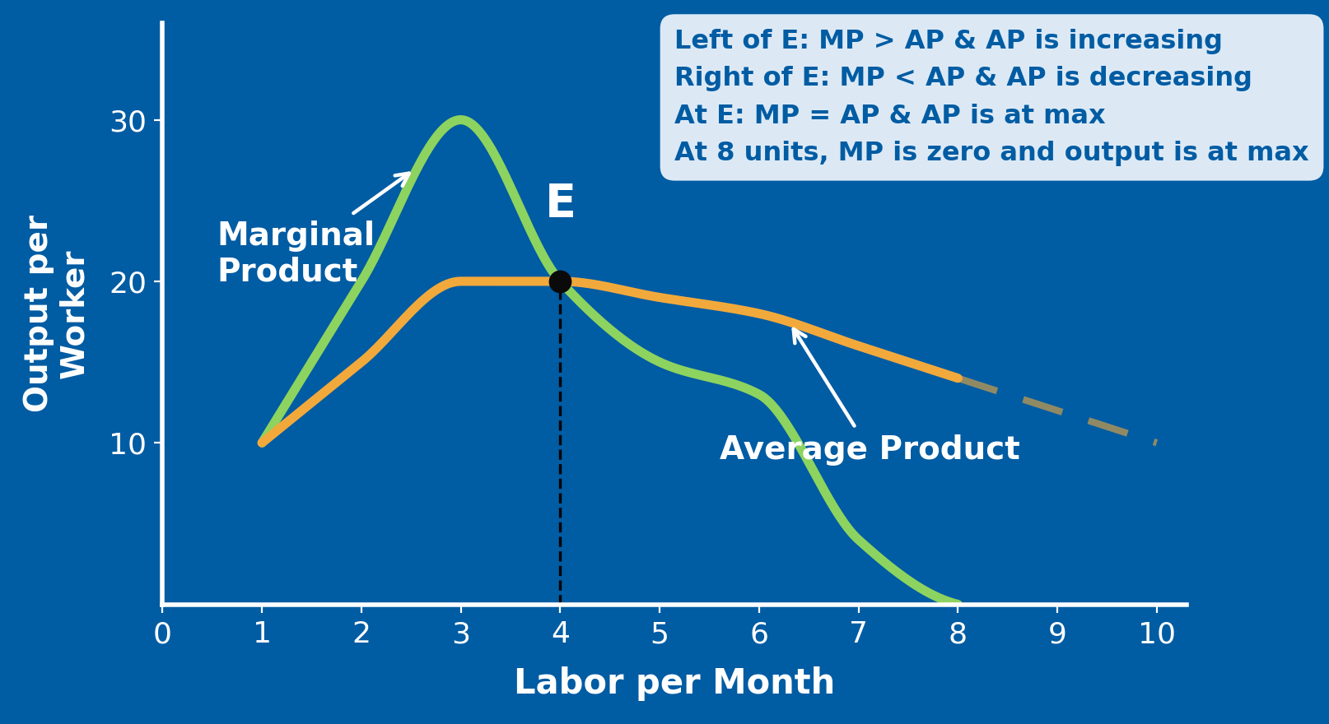
Production: One Variable Input

Slide 19
Production: One Variable Input
The law of diminishing marginal returns: as you keep adding more units of one variable input (here, labor) while holding all other inputs fixed (here, capital = 10 units), the additional output from each extra unit (the marginal product) eventually starts to fall.
Diminishing marginal returns does not mean total output is falling — output is still rising, just at a decreasing rate — until marginal product hits zero (L=8 in the table), at which point total output peaks (Q=112) and would start to decline if you kept adding labor beyond that.

Slide 20
Law of Diminishing Marginal Returns
When the use of labor input is small and capital is fixed, output increases considerably since workers can begin to specialize and MP of labor increases
When the use of labor input is large, some workers become less efficient and MP of labor decreases

Slide 21
Causes of Diminishing Marginal Returns
Comes from pairing a fixed input with a variable one
Fixed: capital (or a club's existing squad/system)
Variable: labor (or players added to that setup)
Adding more labor to fixed capital lowers each extra unit's output
Less capital per worker, more congestion and coordination costs
Ex. A striker moving between RB Leipzig and Salzburg (same owner) joins an established system — may score fewer goals than expected at first
It's a short-run phenomenon
Assumes capital is fixed — true only in the short run
Long run: capital can expand too, so the constraint disappears

Slide 22
Law of Diminishing Marginal Returns
Easily confused with negative returns – decreases in output
Explains a declining marginal product, not necessarily a negative one (Haaland did not start scoring own-goals)
Additional output can be declining while total output is increasing

Slide 23
Law of Diminishing Marginal Returns
Assumes a constant technology:
Changes in technology will cause shifts in the production possibilities curve
More output can be produced with the same inputs
Labor productivity can increase if there are improvements in technology, even though any given production process exhibits diminishing returns to labor

Slide 24
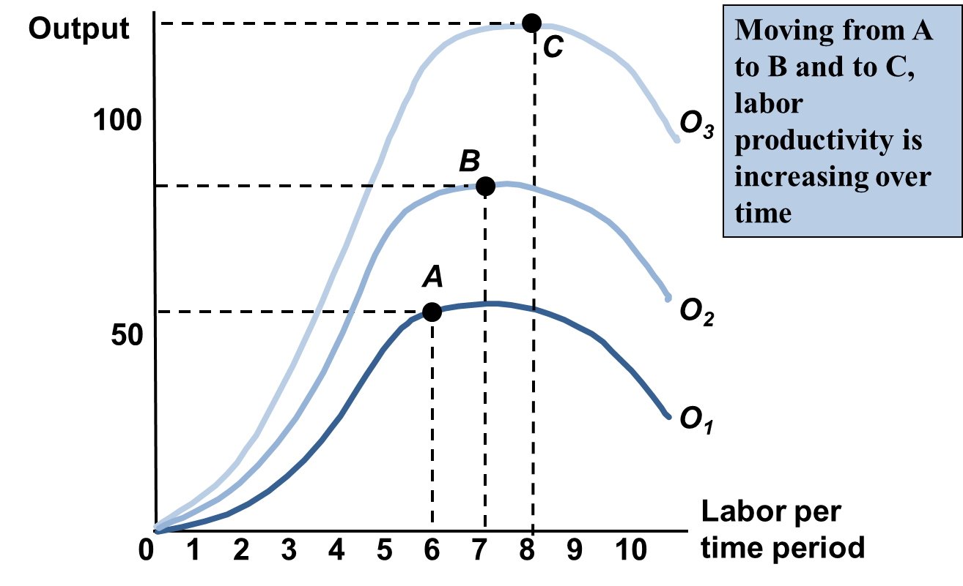
Technological Change

Slide 25
Technological Change
Thomas Malthus predicted famine and poor living conditions
Population growth increases at increasing rate
Food production increases at decreasing rate
Where Malthus failed?
Technology (pesticides, machines, refrigeration, etc.)
https://ourworldindata.org/population-growth-and-famines

Slide 26
Labor Productivity
Macroeconomists are particularly concerned with labor productivity
The average product of labor for an entire industry or the economy as a whole
Links macroeconomics and microeconomics
Can provide useful comparisons across time and across industries

Slide 27
Production Costs
Total cost is the sum of fixed and variable costs
Variable costs change according to the quantity of goods and services produced
Fixed costs are independent of the quantity of goods or services produced
Ex. Salaries monthly rental fees (time related cost)
Only short term
Long run: all costs are variable.

Slide 28

Fixed Costs
According to Forbes

Slide 29
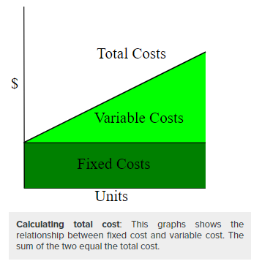
Total Costs
Variable Costs (VC)
Fixed Costs (FC)

Slide 30
Measuring Cost Directly: Which Costs Matter?
If we want to start from costs, we must clarify what is meant by costs and how to measure them
The real world is more complicated than just K (capital) and L (labor)
If a firm has to rent equipment or buildings, the rent they pay is a cost
What if a firm owns its own equipment or building?
How are costs calculated?

Slide 31
Accounting cost
Everything a business/ firm has paid for
Rent
Utility expenses: electricity, water, waste disposal, heating etc.
Travel expenses
Payroll expenses
Food and entertainment expenses
Explicit costs directly associated with the business

Slide 32
Economic cost
Accounting costs plus opportunity costs (implicit)
« An income a company forgoes when it chooses to do or not to do something»
Asset that I already have and I do not pay the rent on
Ex. Attending university
Accounting cost: tutition, books, kantine, SiMolde Bolig rent etc.
Alternative: go straight to work and make money
Partying hard → no sleeping → attending class

Slide 33
Opportunity Cost

Slide 34
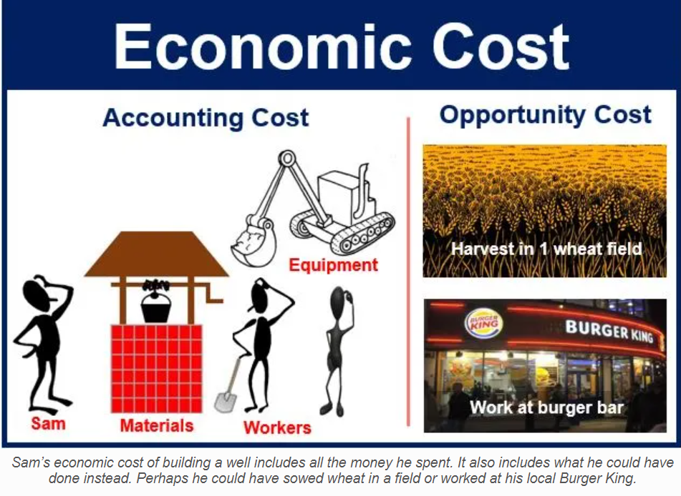

Slide 35
Sunk Cost
Money that I have already spent and cannot be recovered
Manufacturing firm
Cost of machinery
Equipment
BE Economics
I paid to go the Champions Final. I will attend it no matters what.
No considered in firms' decisions
We consider just relevant costs that still have to occur
Cost-revenue decisions
All sunk costs are fixed costs, not all fixed costs are sunk conts
I can resell my match ticket ( I will incur in some losses anyway)

Slide 36
Average Total Cost (ATC)
Total cost divided by the quantity of output
U-Shape
Total cost (TC) ≈ Fixed cost (FC), output (denominator) small
ATC declines as FC are spread over an increasing quantity of output. TC grows relatively slower than output.
Diminishing returns → TC rises

Slide 37
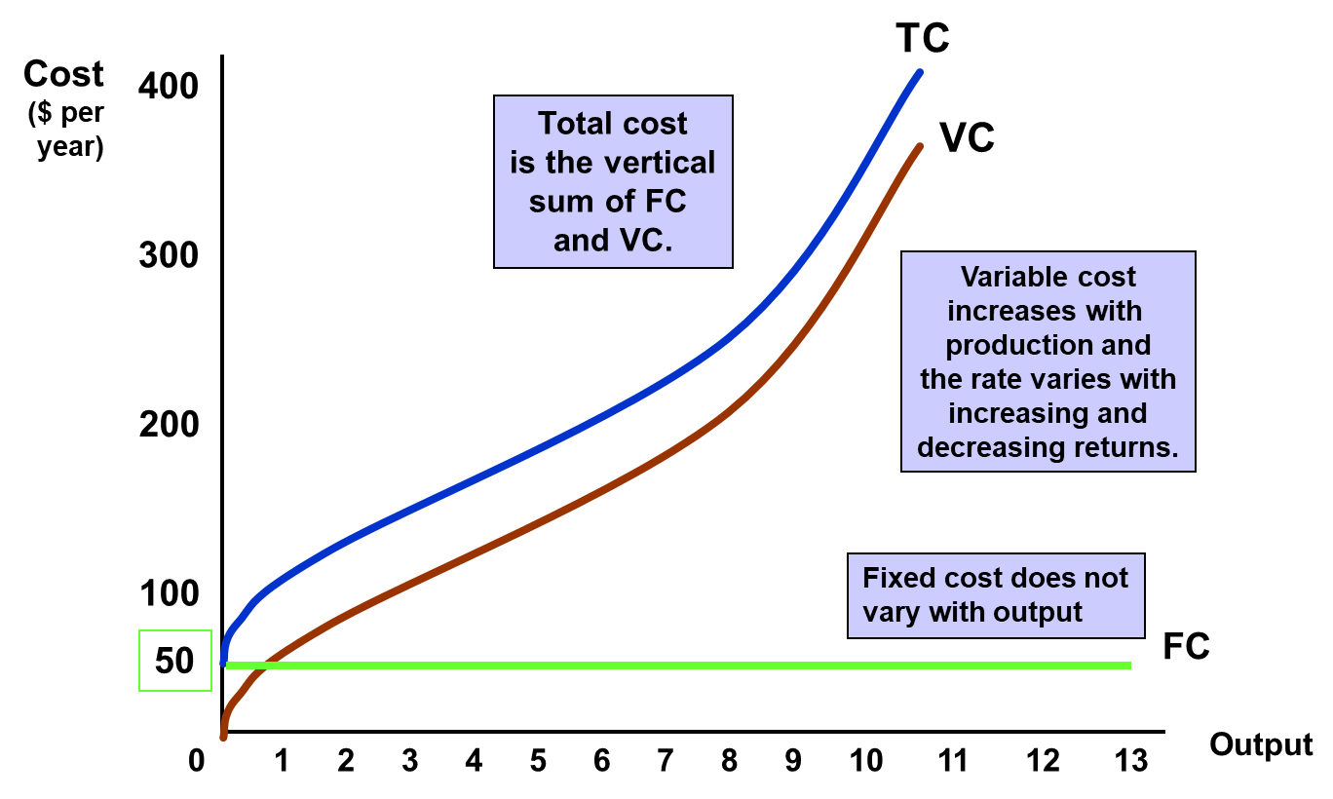

Slide 38
Marginal Cost (MC) and Average Variable Cost (AVC)
Marginal cost (MC)
It is calculated by taking the change in total cost between two levels of output and dividing by the change in output
Fixed costs do not affect marginal cost
Average Variable Cost (AVC)
Variable cost for each unit produced.

Slide 39
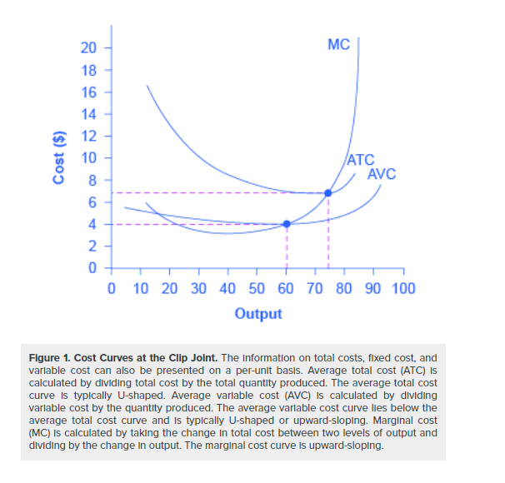

Slide 40
ATC, AVC, and MC relationship
When MC is below AVC, AVC is falling
When MC is above AVC, AVC is rising
When MC is below ATC, ATC is falling
When MC is above ATC, ATC is rising
Therefore, MC crosses AVC and ATC at their minimums

Slide 41
Why?
We could explain it mathematically, but we won’t ( Lucky Guys 🍀)
But we will provide an economic intuition:
Point to the left where MC crosses ATC (i.e., marginal cost of production is below the average total cost of producing) → Producing one more additional unit will decrease average cost overall → ATC downward-sloping
Point to the right where MC crosses ATC (i.e., marginal cost of production is above the average total cost of producing) → Producing one more additional unit will increase average cost overall → ATC upward-sloping
The point of transition, must necessarily occur at the minimum of the ATC curve
We can say the same for MC and AVC

Slide 42
Law of diminishing returns (or increasing costs)
In any production process, at one point adding one more production unit while keeping the other factors constant will cause the overall output to decrease
Costs of production increase rapidly
More inputs are needed to produce more output

Slide 43

Determinants of Short Run Costs
Assume the wage rate (w) is fixed relative to the number of workers hired
Capital is fixed in the short run, so it is a fixed cost
Variable cost is defined as the unit cost of extra labor times the amount of extra labor: $w∗∆L$
$$MC=\frac{ΔVC}{ΔQ}=w\frac{ΔL}{ΔQ}=\frac{w}{{MP}_{L}}$$
Marginal Product of Labor ($MP_{L})$
Change in output that results from employing an added unit of labor
${MP}_{L}=\frac{∆Q}{∆L}$
Value of Marginal Product (VMP) = ${MP}_{L}∗P (price)$

Slide 44

Cobb-Douglas Example
Economic production function with two or more variables (inputs) that describe the output of a firm
$f\left(L,K\right)=Y=AL^{α}K^{β}$
$α and β=elasticity of inputs$
$α+ β=1$ → constant returns to scale
$L=K^{−\frac{α}{β}} Q^{\frac{1}{β}}$
Inputs have a degree of substitutability
Marginal cost with respect to (w.r.t.) production (Y)
$C\left(w,r,Y,A\right)= \min_{L,K}{wL+rK}$ = $w \min_{L,K}{K^{−\frac{α}{β}} Q^{\frac{1}{β}}+rK}$
Capital = fixed cost
Price of capital = r

Slide 45
Cobb-Douglas
Which are fixed and variable costs?
TC = VC + FC = wL + rK
Where do diminishing returns show up?
Exponents

Slide 46
Shutdown Rule
In the short run, a firm may be operating at a loss
Revenue is less than the total cost
Price is less than unit cost
Why not?
Price may increase soon
Shutting down & Restarting can be more costly than keeping it going
Firms have two choices in the short run
Keep producing
Shutting down temporarily
Which is more profitable?

Slide 47

Shutdown Rule
If TR (Total Revenue) > VC (variable costs) → firm is covering all variable costs and it can partially or entirely cover fixed costs with the remaining revenue
If TR (Total Revenue) < VC (variable costs) → firm is not even able to cover shot-run production costs. Therefore, it should shut down
TR < VC = P (price) * Q (quantity) < VC = $\frac{P∗Q}{Q}>\frac{VC}{Q}=P>AVC (average variable costs)$

Slide 48

Shutdown Rule
If firm shuts down
Zero revenues, no variable costs, yes fixed costs → $π \left(profit\right)$= -FC
Operating firm (not shut down)
$π \left(profit\right)$= R – VC – FC
In order to operate,
R – VC – FC ≥ -FC → R ≥ VC

Slide 49
Shutdown Rule
« In the short run a firm should continue to operate if price exceed average variable costs»
If AVC < P < ATC → firm will partially or entirely cover fixed costs in the long run
If If P < AVC ( < ATC)→ firm is not covering production cost → shutdown
Shutdown is temporary
Not necessarily a firm goes out of business
Market conditions can improve
Firm still has to pay fixed costs
Marginal revenue (MR)
Additional profit that will be generated by increasing product sales by one unit

Slide 50
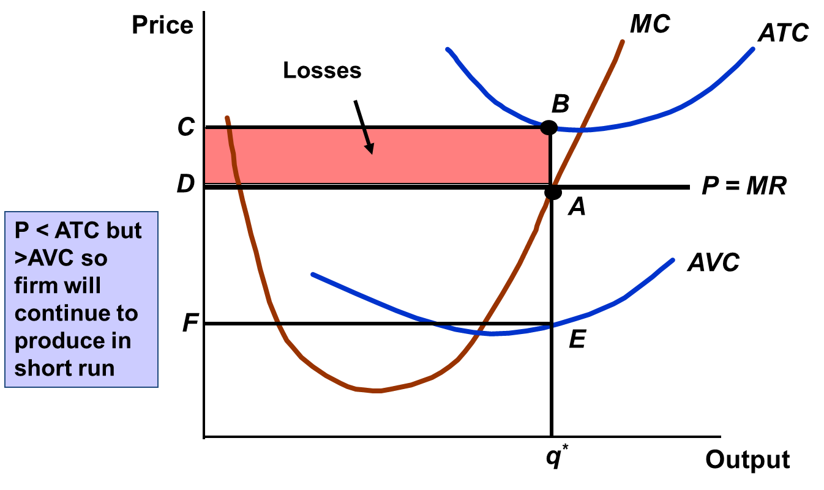
Notes:
The firm produces at output q*, where the price line (P = MR) crosses MC — that's the profit-maximizing quantity (the MR = MC rule from slide 52, applied here).
At that output: price is D, but ATC is B (point B, height C) — so P < ATC. The firm is making a loss.
The pink rectangle (C–D, width q*) is that loss: (ATC − P) × q* — the same "loss box" logic used for profit boxes elsewhere in the course, just below zero.
However, price D is still above AVC (point E, height F) — so P > AVC.

Slide 51
Short Run Supply Curve
It tells us how much output is produced at different prices
Portion of a firm’s marginal cost curve that lies above its average cost curve
Below shutdown point, we do not have supply, the firm is not producing
Upward sloping: quantity supplied increases as price rises

Slide 52
Profit Maximization
It is determined by price and output level
Marginal Profit (MP) = Marginal Revenue (MR) – Marginal Cost (MC)
A firm will continue to produce till marginal profit is equal to zero → MP = MR-MC → 0=MR-MC → MR=MC

Slide 53
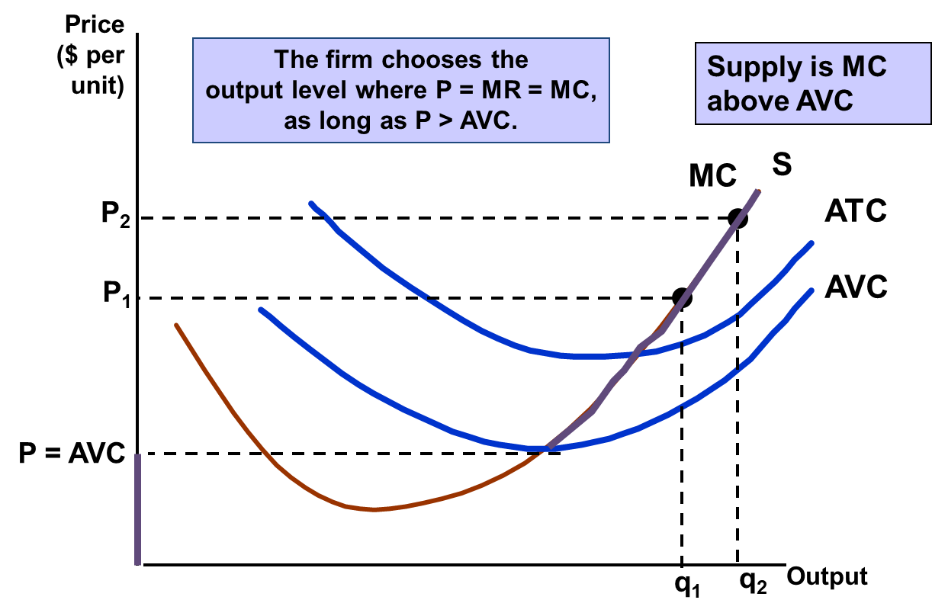

Slide 54
Short-run Supply Curve
Over time, prices of product and inputs can change
How does the firm’s output change in response to a change in the price of an input?
We can show how an increase in marginal costs change firm’s output decisions

Slide 55
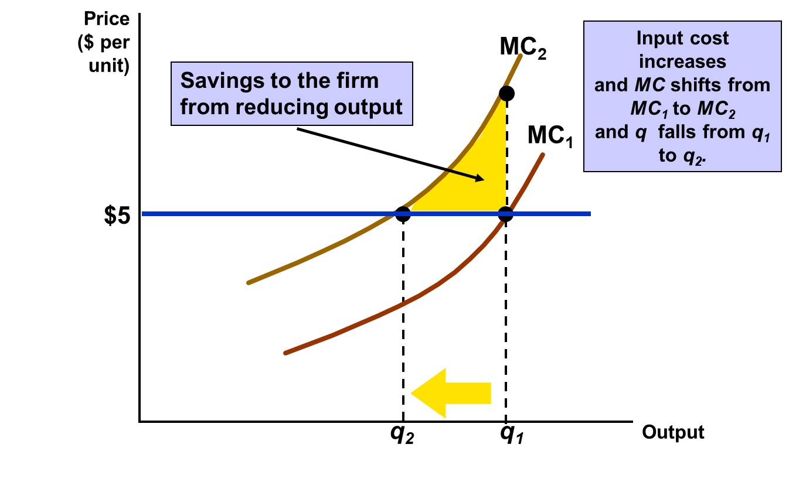

Slide 56
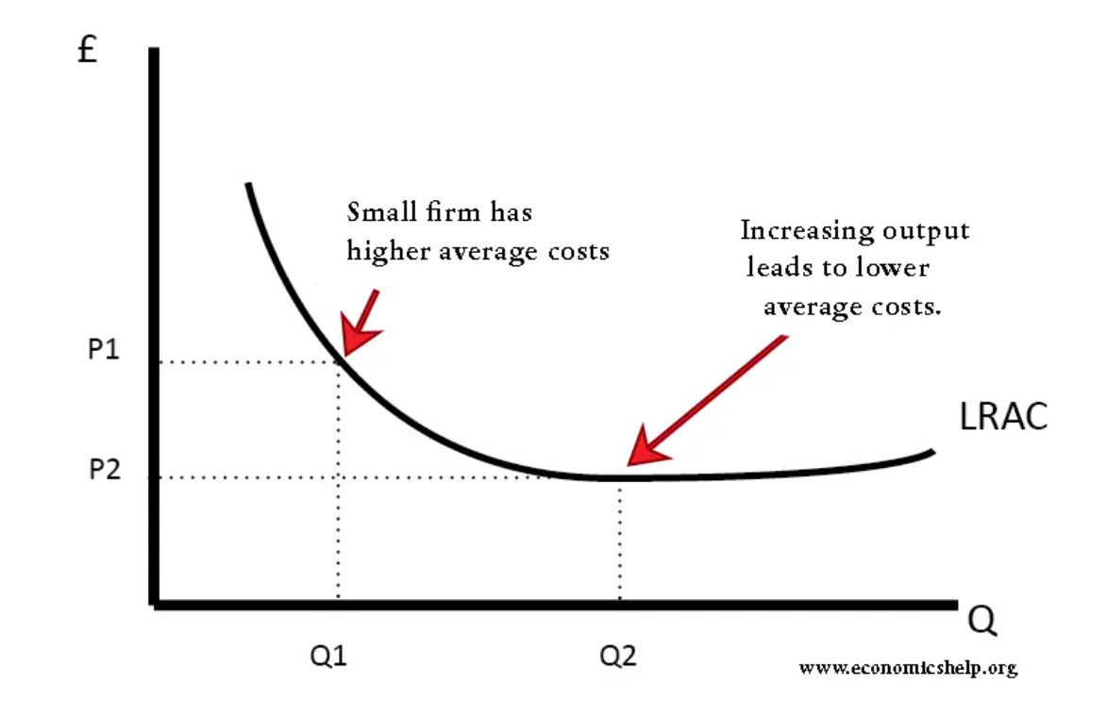
Economies of Scale
As output increases, the cost per unit of production (average cost) decreases
Example – Specialization: assembly line with many different jobs

Slide 57

Long-Run Costs
Economies of scale are measured in terms of cost-output elasticity, $E_{C}$
$E_{c}$ is the percentage change in the cost of production resulting from a small increase in output
$$E_{c}=\frac{\frac{∆C}{C}}{\frac{∆Q}{Q}}=\frac{MC}{AC}$$

Slide 58
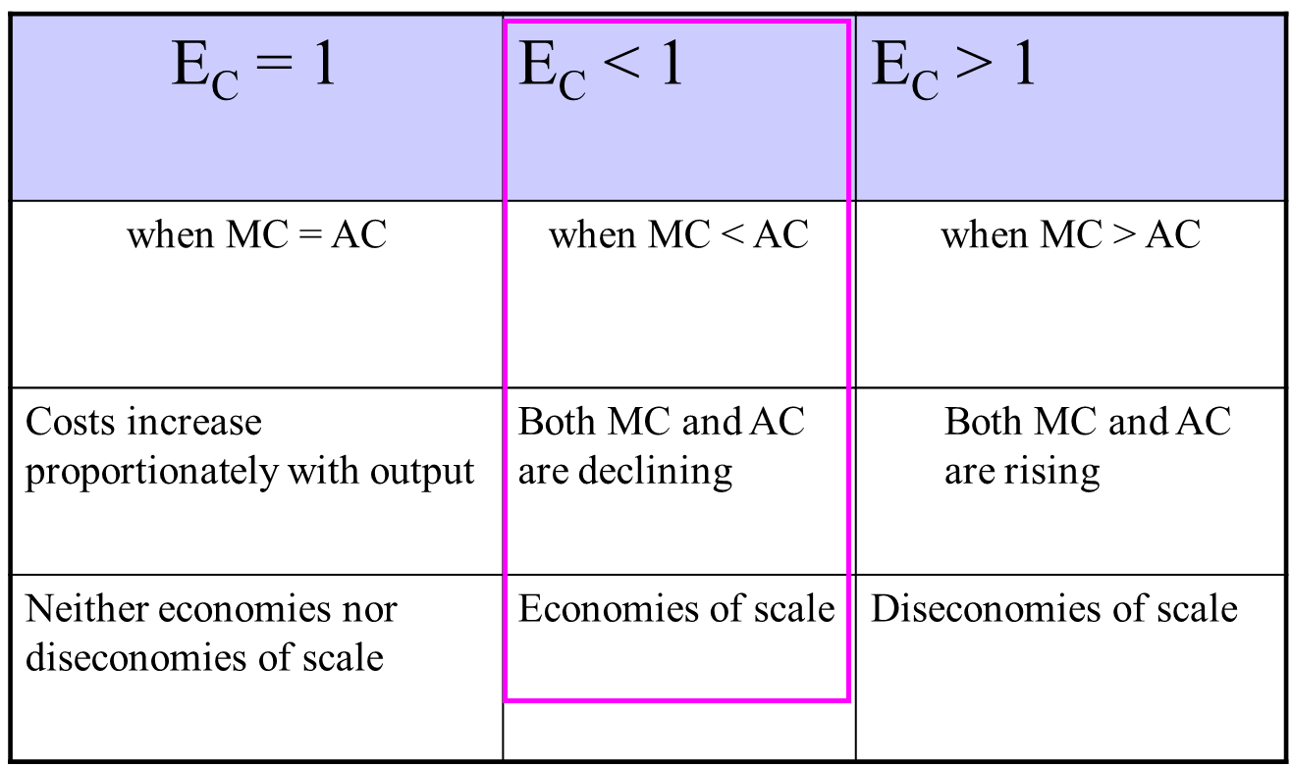

Cost-output elasticity $E_{c}$

Slide 59
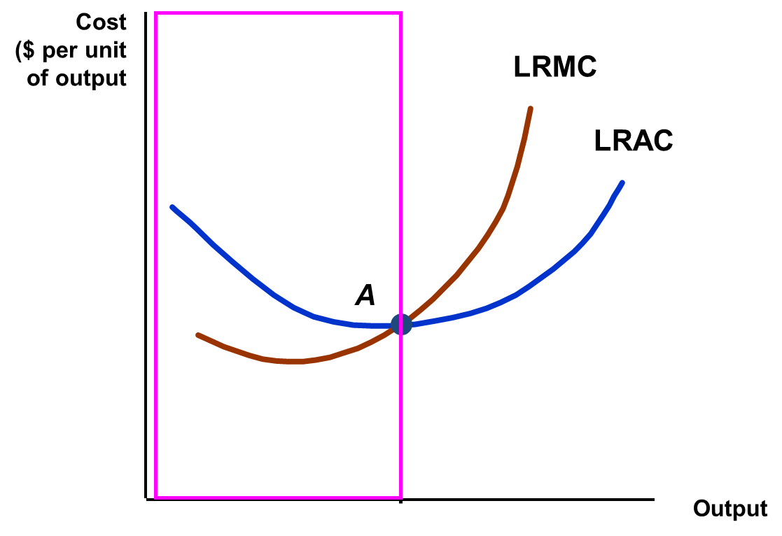
Long Run Average and Marginal Cost
The LRMC crosses the LRAC at the minimum point of the LRAC. When LRMC is below LRAC, LRAC is falling (as additional units of output are considered).
Minimum efficient scale is the point where the smallest quantity of good is produced in the long run

Slide 60
Summary
Production function explains the relationship between the quantities of inputs (labor and capital) used and the amount of output obtained.
Marginal product refers to the additional output produced by a unit-increase of input (usually labor)
Average product is the total product per unit of inputs
Law of diminishing returns: while increasing the production of an input and keeping the others constant, a point will be eventually reached at which additional input will produce progressively smaller (i.e., diminishing) increases in output
Technological change provides an explanation for why total output may increase given the law of diminishing marginal returns

