Slide 1

Lecture #5 Supply
Alessandro Di Mattia

Slide 2
Supply
The Quantity supplied of any good or service is the amount that sellers are willing and able to sell.
The law of supply: Other things equal, when the price of a good rises, the quantity supplied of good also rises and vise versa.
Supply schedule - A table that describes how much product a supplier will have to produce to meet consumer demand at a specific price based on the supply curve

Slide 3
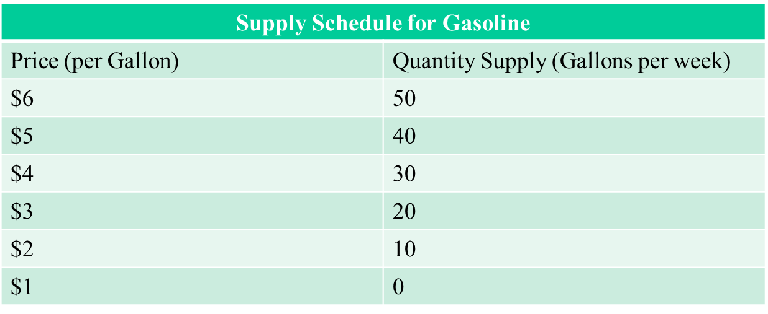
Supply schedule

Slide 4
Supply Curve
The Supply curve shows the correlation between the cost of a good or service and the quantity supplied for a given period

Slide 5
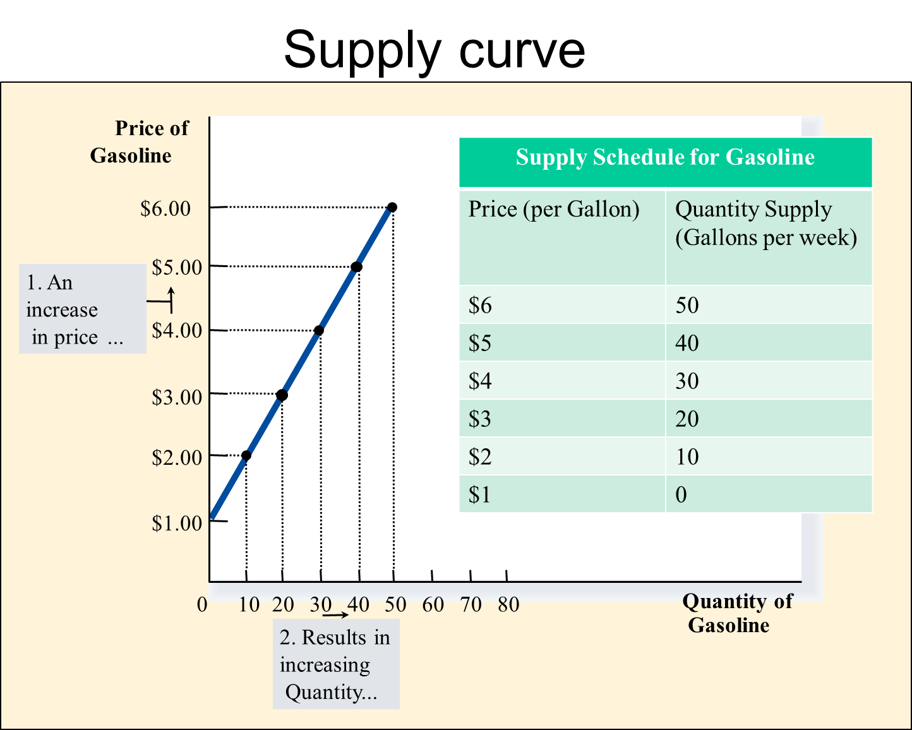

Slide 6
Individual Supply VS Market Supply
Individual Supply refers to the quantity of a good or service supplied by a single seller
Individual supply is a component of Market Supply
Market supply refers to the quantity of a good or service supplied by all the sellers or firms in the market.
Market Supply is shown by the Market Supply Schedule and Market Supply Curve
Market Supply is the aggregation of different indivual supplies

Slide 7
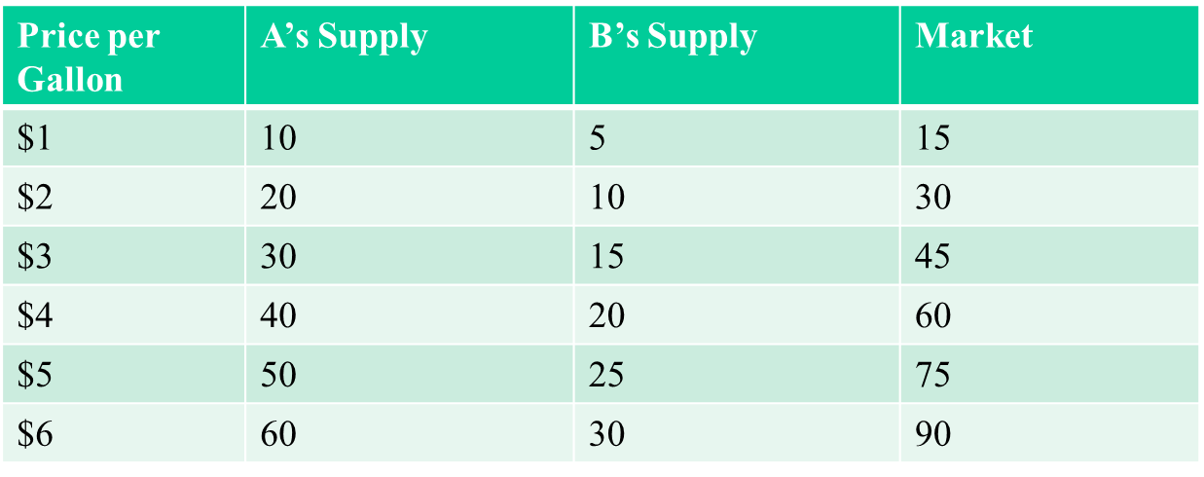

Slide 8
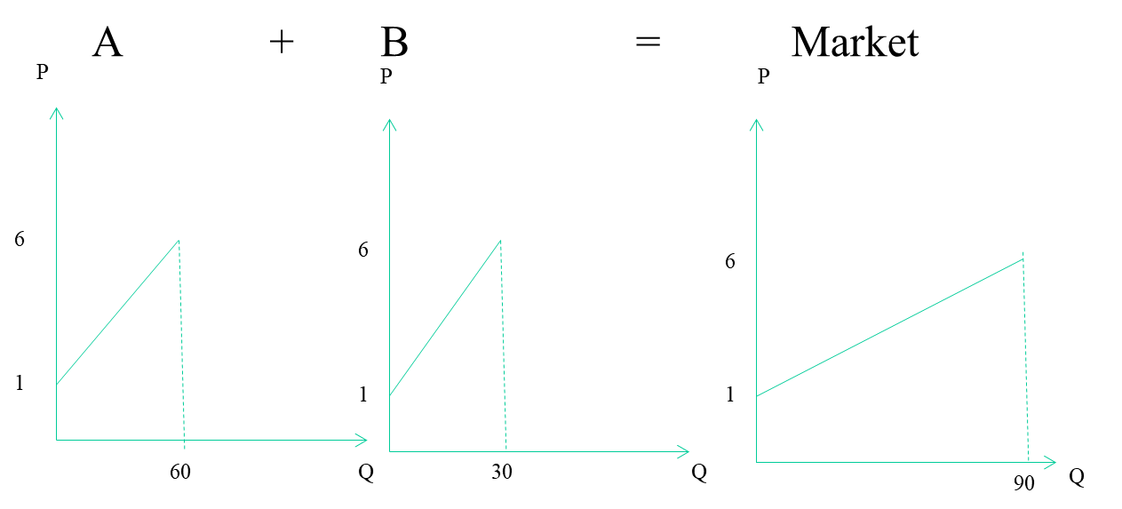
Individual Supply is relatively steepr while Market Supply is relatively flatter

Slide 9
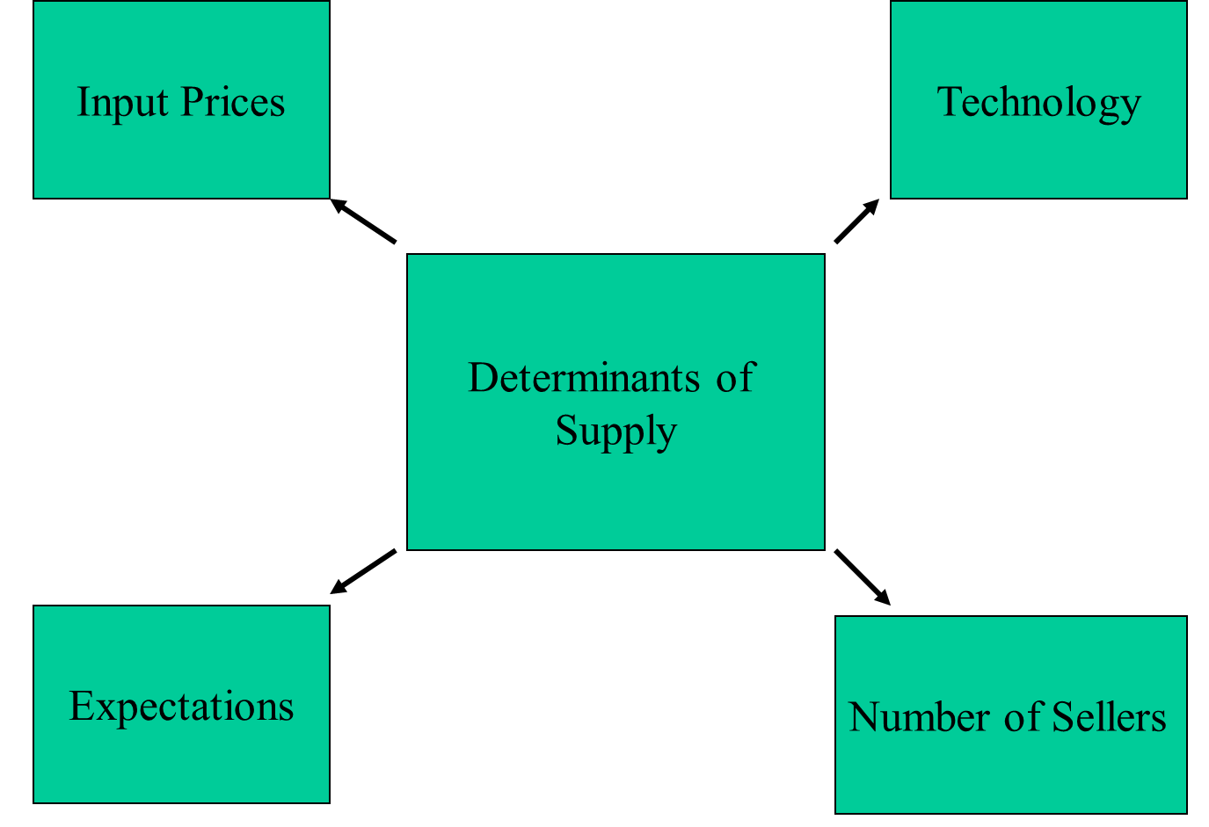
Supply Determinants

Slide 10
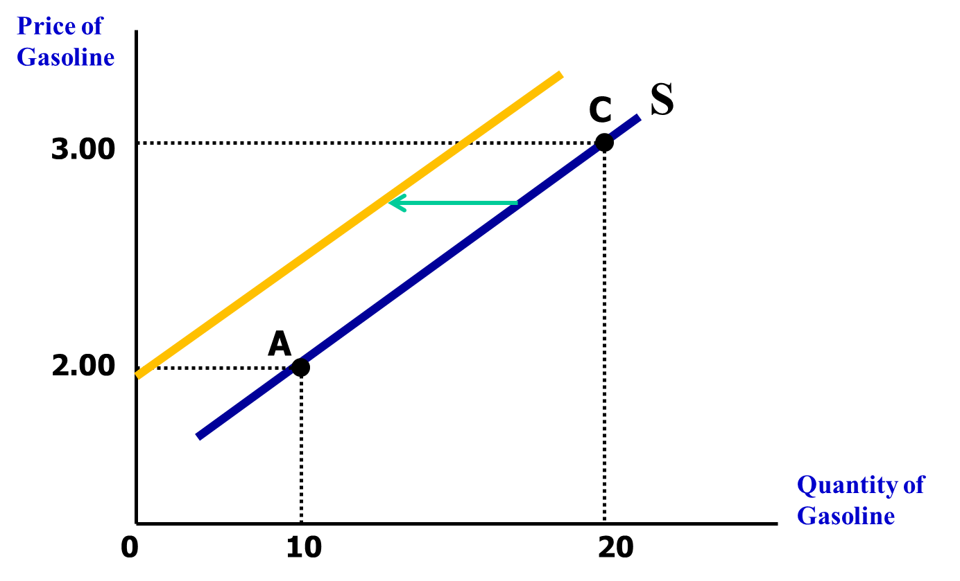
Input Prices
As the price of a sold goods rises, profitability decreases: leading to a decrease in the quantity of good supplied at any price

Slide 11
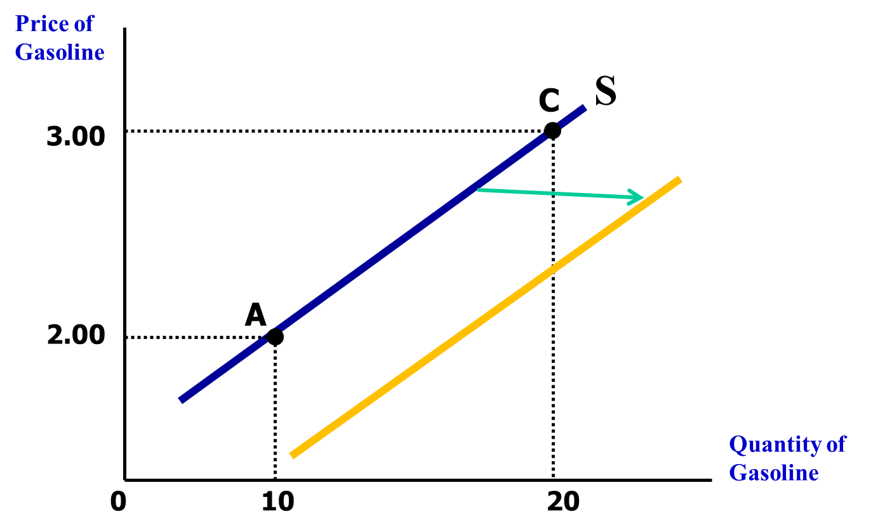
Technology
Technological improvements (and any changes that raise the productivity of labor) lower production costs and increase profitability.

