Slide 1

Lecture #6 Supply and Demand
Alessandro Di Mattia

Slide 2
Topics
Relationship between demand (consumers) and supply (producers)
Funtion of price and quantity sold on the market
Simple policies used to control price

Slide 3
Equilibrium
Equilibrium – where the supply curve (S) and demand curve (D) cross
Equilibrium price – there exists only price where the expections of consumes meet the ones of producers
Equilibrium quantity - where the amount of the product consumers want to buy (quantity demanded) is equal to the amount producers want to sell (quantity supplied)

Slide 4
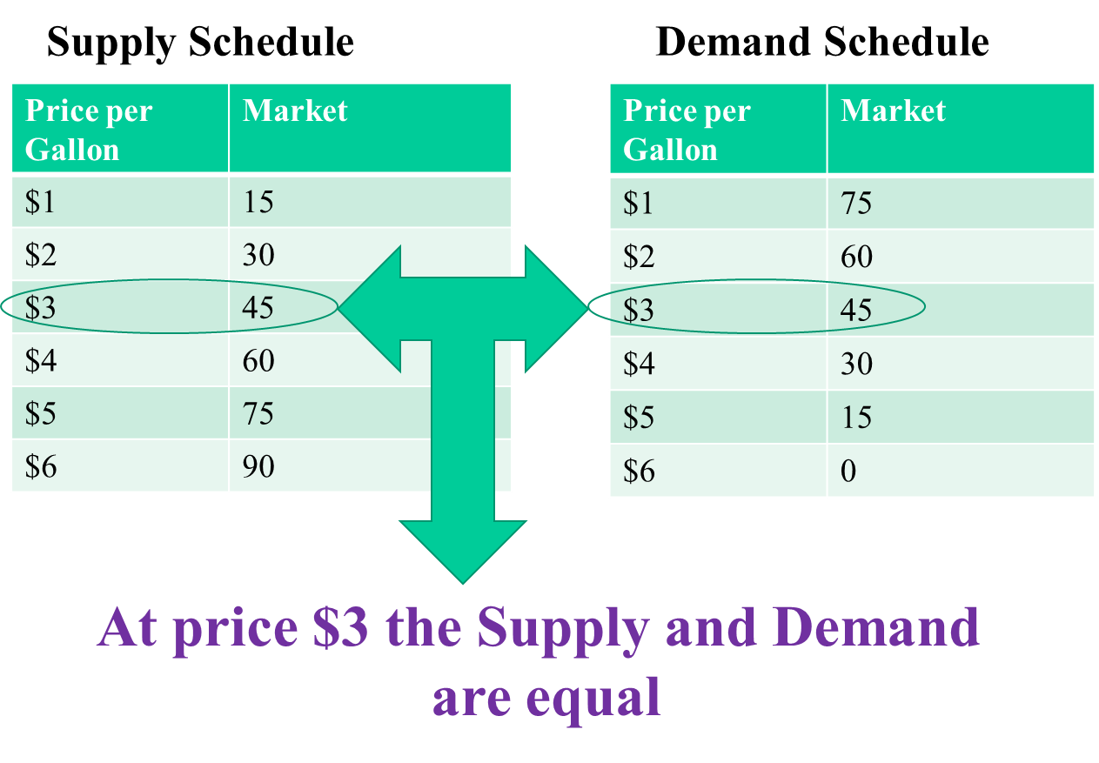

Slide 5
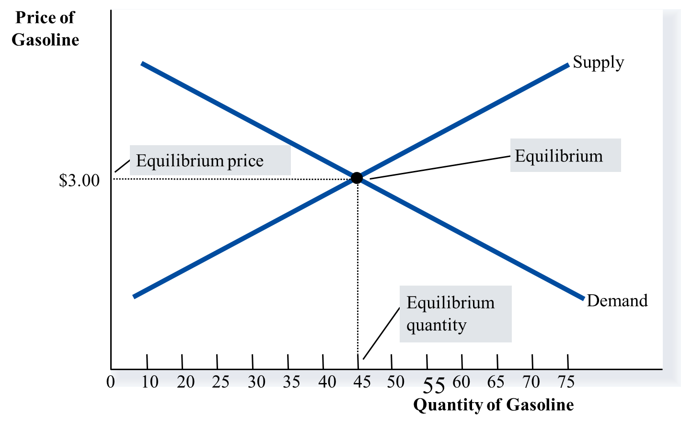

Slide 6
Excess Supply
A situation where the price is above the equilibrium price.
The quantity producers are willing to sell is higher than the quantity demanded by consumers
Can it be a permanent situation? No, we will always go back to equilibrium
Producers will decrese their prices
This will lead to an increase in the quantity demanded and a decrease in the quantity supplied
At some point, a new equilibrium will be reached

Slide 7
Excess Demand
A situation where the price is below the equilibrium price.
The quantity producers are willing to sell is lower than the quantity demanded by consumers
Can it be a permanent situation? Once again no!
Producers will increase their prices
This will lead to a decrease in the quantity demanded and an increase in the quantity supplied
At some point, a new equilibrium will be reached

Slide 8
Law of supply and demand
What we have just seen: a theory that explains the interaction between the sellers and the buyers of a good or service
Price varies in order to get the equilibrium quantity
Once the market reaches its equilibrium, all buyers and sellers are satisfied, and there is any upward or downward shift along the demand and supply curves.

