Slide 1

Lecture #9 Time value of money
Alessandro Di Mattia

Slide 2
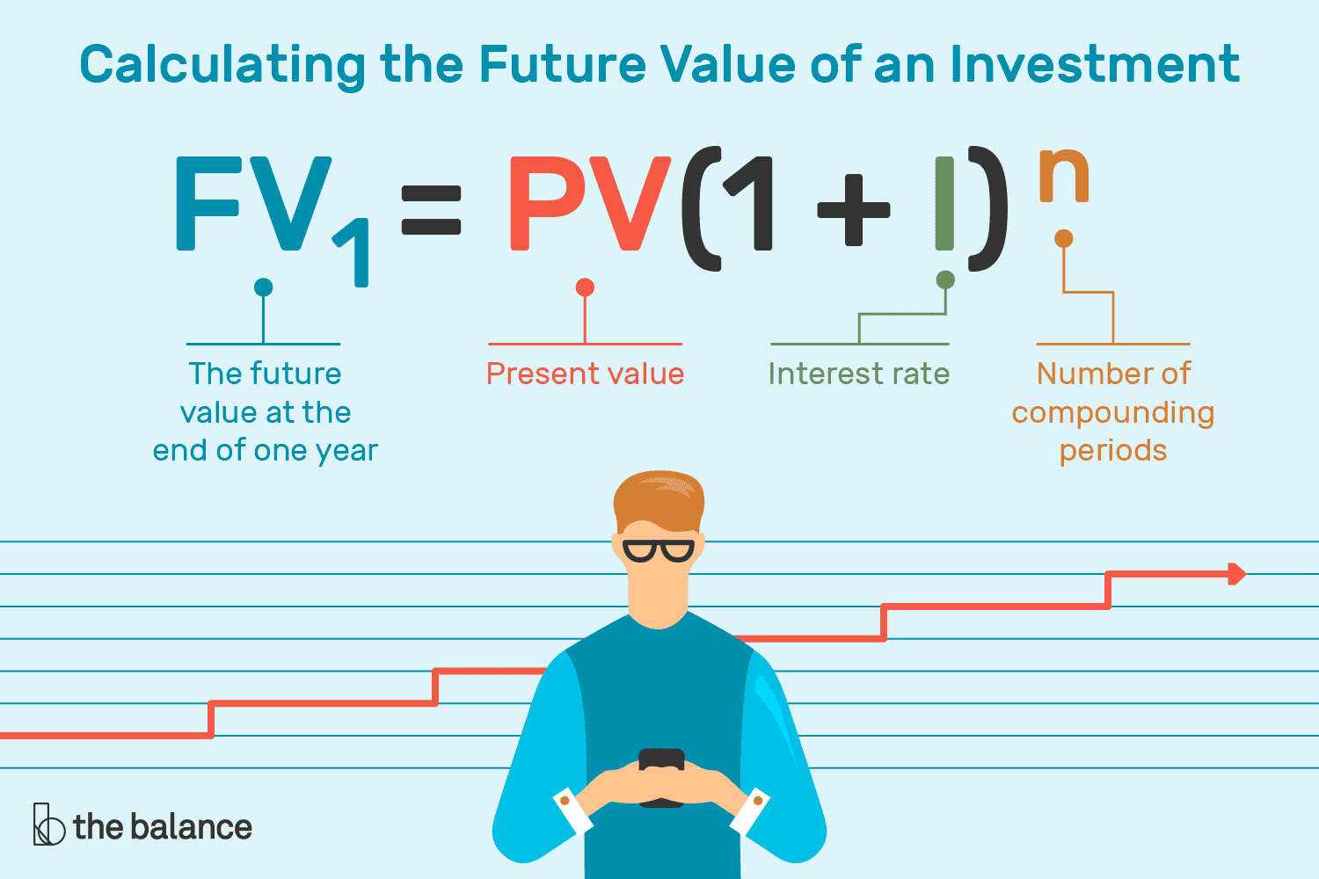
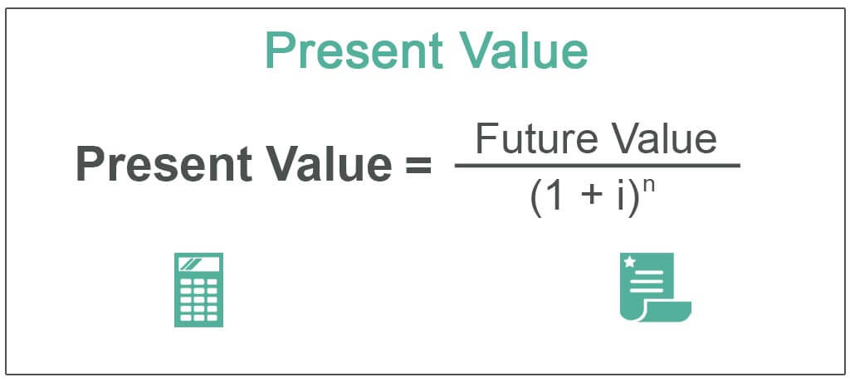
Topics
Present Value (PV)
“i” = interest rate = discount rate
“n” = number of periods
Future Value (FV)

Slide 4
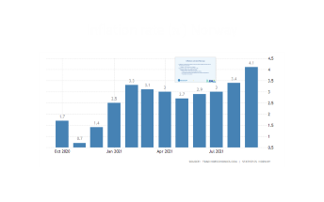

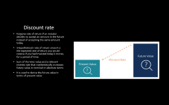
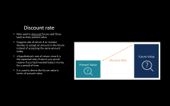

Present Value (PV)
Today’s money is worth more that the same amount in the future
Today’s money takes into account any interest rate (i) → investing
Unspent money today can lose value in the future
Inflation ($π$)
Rate of return for money invested
Discount rate

Slide 5
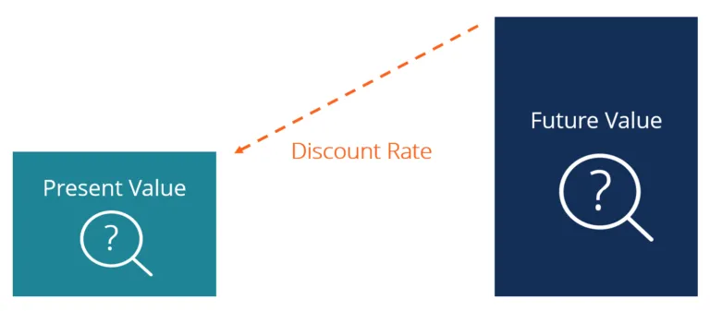
Discount rate
Rate used to discount future cash flows back to their present value
Forgone rate of return if an investor decides to accept an amount in the future instead of accepting the same amount today.
«Hypothetical» rate of return since it is the expected rate of return you would receive if you had invested today’s money for a period of time
It is used to derive the future value in terms of present value

Slide 6

PV’s formula
$PV=FV ∗\frac{1}{{\left(1+i\right)}^{n}}$
PV = present value
FV = future value
$i$ = Rate of return
$n$ = number of periods
Excel (example here)
PV(rate, nper, pmt, [fv], [type]).
RATE = Interest rate per period
NPER = Number of payment periods
PMT = Amount paid each period (if omitted—it’s assumed to be 0 and FV must be included)
[FV] = Future value of the investment (if omitted—it’s assumed to be 0 and PMT must be included)
[TYPE] = When payments are made (0, or if omitted—assumed to be at the end of the period, or 1—assumed to be at the beginning of the period)

Slide 7
Why is PV important?
Assessing the fairness of any future financial benefits and liabilities
Is the price I am paying today for an investment appropriate?
Areas: investment analysis, risk management, and finanacial planning
Net present value (NPV)
Difference between the present cash flows and the PV of cash flows over a period of time
It useful to find today’s value of future stream of payments
Bond yields
Pension obligations
Always remember that no interest rate is guaranteed, espcially when you are managing a portfolio with different projects and different interest rates

Slide 8
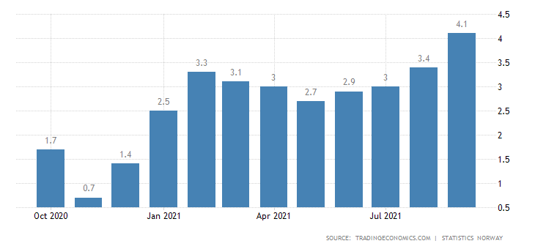



Inflation rate ($π)$ Norway

Slide 9

Inflation rate ($π)$ Norway
Inflation is a general increase in the price level of goods and services in the economy over time
Inflation → ↑ future price of goods
September 2021 4.1% - August 2021 3.4%
Highest inflation rate since July 2016
Faster rise in prices of housing and utilities
Furnishing household equipment and routine maintenance
Recreation and culture

Slide 11
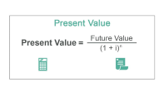
Future Value (FV) vs Present Value (PV)
Money’s today is worth more than the same money tomorrow because of the passage of time
Future cash flow → FV ↑
Future payment → FV ↓
Future Value (FV)
Value of a current (present) asset (good or service) at a specified date in the future based on an assumed rate of interest (or growth)
Tells you what an investment is worth in the future
It allows investor to forecast, with a certain degree of accuracy, the amount of profit that can be generated by different investments
Present value from a future value perspective
Current value of a future sum of money or cash flow given a specified rate of return
Tells you how much you would need in today’s dollars to earn a specific amount in the future

Slide 12
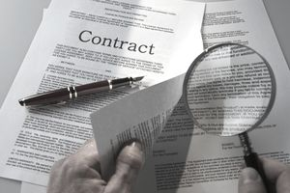
NFL’s contracts

Slide 13

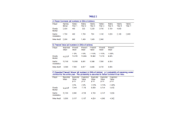
NFL’s contracts
Signing bonus + annual salary
Both negotiable
Contracts change over years
Players can be cut at any point, neverthelees they can keep the bonus
Players want the money guaranteed and be paid in the early years
If we consider just the cash flows (bonus+salary) and not the PV, players can be overpaid
Will the player remain in the team forever?
Risky cash flow tied to the probability a player will leave the club.
In this case, values are significantly lower
Correlation between probability of remaining in a club and market factors that influence the discount rate ($δ$)

Slide 14
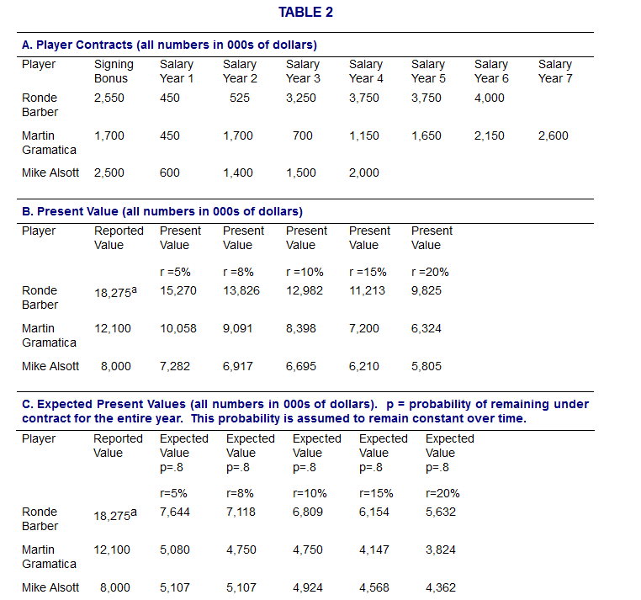

Slide 15
