Slide 1



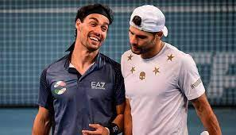
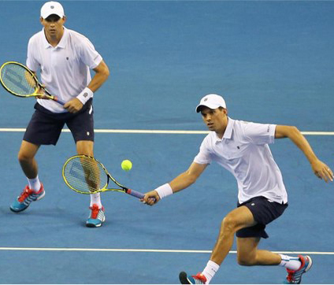
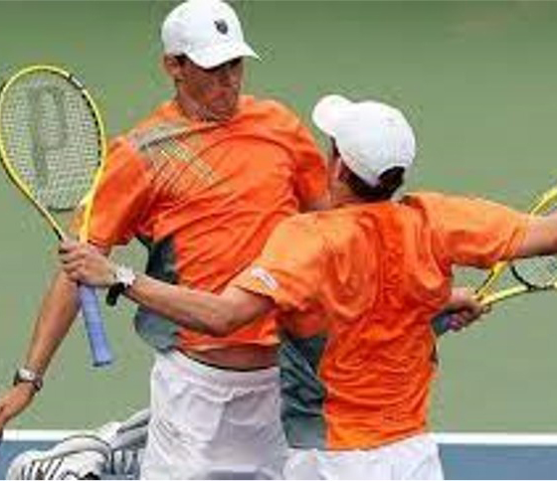
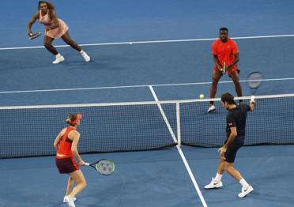
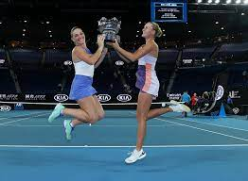
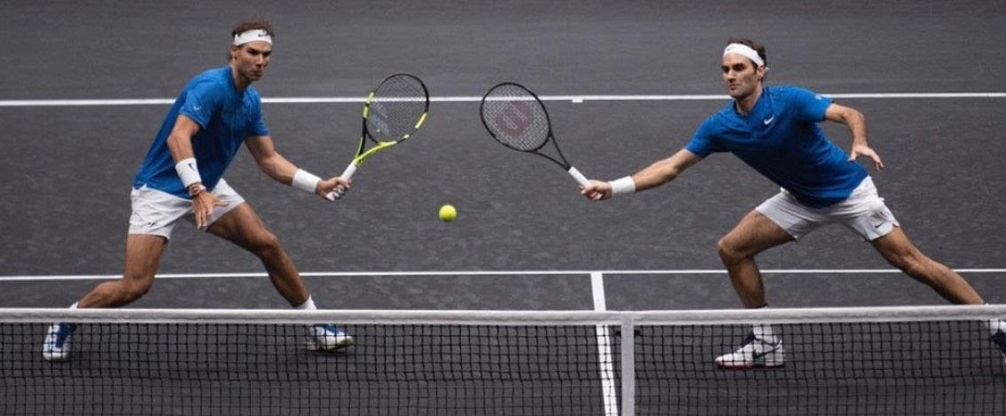



HOMOPHILY AND PERFORMANCE IN ATP DOUBLES TENNIS COMPETITION
AUTORI:
Dr. Alessandro Di Mattia (Sport Economist) (1) | PhD Student , Dottorando in Economia dello Sport
Dr. Daniel Di Mattia (Medicine and Surgery) (2,3) | Medical Director of General Surgery, President AMS Milan
Dr. Lingqing Jiang (Behavioral Economist) (4) | Lecturer Department of Economics
(1) Molde University College - (Molde - Norway)
(2) Ospedale Luigi Sacco ASST-FBF-Sacco - (Milan – Italy)
(3) Istituto Medicina dello Sport - (Milan - Italy)
(4) University of Essex- (Colchester – United Kindom)
AIM OF THE STUDY
The effect of heterogeneity and skill differences on performance at the highest levels of ATP Tennis competitions has been extensively discussed across various social and scientific disciplines (sports medicine, biology, psychology, sociology, and economics). However, there is limited literature on how homophily and common factors between doubles partners can significantly influence gameplay performance.
MATERIALS AND METHODS
 | (1) | (2) | (3) | (4) | (5)
VARIABLES | N | mean | sd | min | max
Performance measure
Points | 2,576 | 272.0 | 615.2 | 4 | 8,805
Ranking | 2,576 | 95.02 | 54.61 | 1 | 216
Ranking_KM | 2,576 | 1.841 | 1.347 | 0.245 | 8
Geographical factors
res_diff | 2,576 | 0.907 | 0.290 | 0 | 1
res_naz_diff | 2,576 | 0.722 | 0.448 | 0 | 1
lang_diff | 2,576 | 0.534 | 0.499 | 0 | 1
nat diff | 2,576 | 0.558 | 0.497 | 0 | 1
Physiological factors
Age1 | 2,576 | 28.98 | 4.731 | 16 | 45
Age2 | 2,576 | 29.05 | 4.651 | 18 | 46
age_diff | 2,576 | 4.228 | 3.403 | 0 | 21
height_diff | 2,576 | 7.117 | 5.543 | 0 | 33
weight_diff | 2,576 | 7.474 | 5.774 | 0 | 35
Style of play
back_diff | 2,576 | 0.407 | 0.491 | 0 | 1
hand_diff | 2,576 | 0.729 | 0.444 | 0 | 1
Control variables: Ability
atp_pres_diff | 2,576 | 0.196 | 0.397 | 0 | 1
atp_past_diff | 2,576 | 0.809 | 0.393 | 0 | 1
pro1_time | 2,235 | 10.51 | 4.344 | -1 | 28
pro2_time | 2,207 | 10.74 | 4.509 | 0 | 27
pro_diff | 2,109 | 4.037 | 3.320 | 0 | 19
Control variables: Experience
TournPlayed | 2,576 | 2.784 | 3.297 | 0 | 19
Tournaments_Played_previous_year | 2,576 | 0.816 | 2.581 | 0 | 16
Data were collected from the rankings of male doubles tennis players provided by the Association of Tennis Professionals (ATP). The dataset includes professional doubles tennis players ranked between 2007 and 2019. To evaluate the role of homophily in determining performance, the relationship between ranking points and three categories of variables—physiological, geographical, and playing style factors—was examined. Three different multiple linear regression models were applied, comparing common and similar traits among ATP male doubles players.
Frequencies backhand by age player1
Frequencies backhand by age player2
RESULTS
Players using opposite hands scored 47.19 more ATP ranking points than players using the same hand. A notable historical case is the Bryan Brothers, Mike and Bob, exhibiting maximum homophily with their respective right-hand and left-hand grips.
Players living in different cities scored 69.51 more ATP ranking points than those residing in the same city.
CONCLUSIONS
This study aims to gather further evidence on how shared characteristics and similar skills influence the likelihood of success and improve overall performance. Selecting the right doubles partner is critical for increasing the chances of success in competitions at any level. The study will be extended to analyze the role of homophily in female and mixed doubles to provide a comprehensive view of how gender-related variables can affect performance at the highest levels of play in WTA and ATP tournaments.

