Slide 1
UEFA vs FIFA Tie Break: Which Creates More Suspense?
Alessandro Di Mattia · Alex Krumer
Supervisor Meeting · June 2026
Sports Economics · Tournament Design · Suspense Measurement

Slide 2
Motivation
Why tie-breaking rules matter for fans and revenues
The Economic Stakes
▸ 2022 FIFA World Cup: ~2.87 billion viewers; USD 6.3 bn in broadcasting & commercial rights
▸ Euro 2024: 5.7 billion worldwide TV viewers; 2.67 million stadium attendees across 51 matches
▸ Fan engagement translates directly into broadcasting fees, sponsorships, and ticket revenues
The Academic Insight
▸ Fans derive enjoyment from non-instrumental information: suspense & uncertainty (Ely, 2015; Zillmann, 2013)
▸ In-game dynamics — not just final outcome — drive demand (Alavy et al., 2010; Buraimo et al., 2020)
▸ Low-stakes games reduce interest; rules that preserve uncertainty extend attention across the tournament
▶ Tie-breaking criteria are an under-studied institutional rules that shapes suspense for billions of fans.

Slide 3
Research Question & Contribution
Does the choice of tie-breaking criterion — FIFA goal difference vs UEFA head-to-head — affect the level of group-stage suspense in international football?
Our Contributions
▸ New binary suspense indicator defined at the group level (not match level)
▸ Counterfactual design: apply both rules to the same historical data
▸ Empirical test using ~662 goals and ~10,800 minute-by-minute observations (WC 1986–2022; Euro 1984–2024)
▸ European Championship as a built-in placebo check
▸ Bridges tournament design & sports demand literatures (Csató, 2023; Buraimo et al., 2020)
Main result: FIFA's goal-difference rule generates significantly more suspense in the World Cup (+4.2 pp, p < 0.01)

Slide 4
Data
World Cup 1986–2022 and European Championship 1984–2024
FIFA World Cup
UEFA European Championship
▸ Editions: 1986 – 2022 (10 tournaments)
▸ Editions: 1984 – 2024 (11 tournaments)
▸ Groups: 6 (1986–1994) → 8 (1998–2022), 4 teams each
▸ Groups: 2 (1984–1992) → 4 (1996–2012) → 6 (2016–2024)
▸ Qualifying format: Top 2 (+ best 4 thirds in 6-group era)
▸ Qualifying format: Top 2 (+ best 4 thirds in 6-group era)
▸ Goals scraped: 455 | Minute rows: 6,789
▸ Goals scraped: 207 | Minute rows: 4,044
▸ Points: 2 for win until 1992; 3 for win from 1994
▸ Points: same evolution as FIFA
▸ Elo ratings: from www.international-football.net
▸ Elo ratings: same source
▸ Cross-checked with official FIFA sources
▸ Cross-checked with official UEFA sources
Counterfactual: both tie-breaking rules applied to the same observed match data

Slide 5
Methodology: Binary Suspense Indicator
Suspense = 1 if a single additional goal in any ongoing group match would change which teams advance to the knockout stage
After each goal
Minute by minute
Update group standings in real time; evaluate whether next goal changes qualifiers
⟷ Same data, two rule-sets, fully counterfactual
Track suspense on a 90-minute scale; capture how long groups remain undecided
Worked Examples
▸ Euro 2024 Group F — Portugal & Turkey qualify; Czech Republic starts 0-0 vs Turkey → Czech goal flips qualification → Suspense = 1
▸ Euro 2024 Group A — Hungary scores in minute 100 vs Scotland → briefly becomes a best 3rd-place team → Suspense = 1 at that moment
▸ Two shocks evaluated: lagging team scores (+1) OR leading team concedes (+1)
▸ Full tie on all criteria still counts as suspenseful (next tie-break could be lots)

Slide 6
Descriptive Statistics
Goal-level data — mean values
Variable
FIFA Rules (World Cup)
UEFA Rules (World Cup)
FIFA Rules (Euro)
UEFA Rules (Euro)
Qualification changed (mean)
0.19
0.18
0.32
0.29
Qualification count (mean)
0.72
0.71
1.27
1.11
Suspense (mean)
0.44
0.36
0.50
0.49
Elo home (mean)
1,797
1,797
1,857
1,857
Elo away (mean)
1,838
1,838
1,896
1,896
Observations
381
381
226
226
WC: Suspense under FIFA (0.44) > UEFA (0.36) | Euro: almost identical (0.50 vs 0.49)

Slide 7
Statistical Tests
Paired t-tests and Wilcoxon signed-rank tests across all groups
World Cup (74 groups)
European Championship (44 groups)
Metric
Mean Diff.
p-value (t-test)
p-value (Wilcoxon)
Metric
Mean Diff.
p-value (t-test)
p-value (Wilcoxon)
Qualification Count
−0.024
0.535
0.605
Qualification Count
−0.106
0.182
0.250
Suspense
−0.040
0.008 ***
0.010 ***
Suspense
✘ No significant difference in either metric This serves as a placebo check: the effect is specific to the World Cup, not an artefact of how the rules operate in any tournament context.
−0.015
0.389
0.438
✔ FIFA rule significantly higher suspense (p < 0.01) ✔ No significant difference in actual qualification changes
FIFA raises potential qualification changes (suspense) without changing actual qualification changes — it keeps more scenarios alive.
Note: mean differences reported as UEFA − FIFA (negative = FIFA generates more suspense)

Slide 8
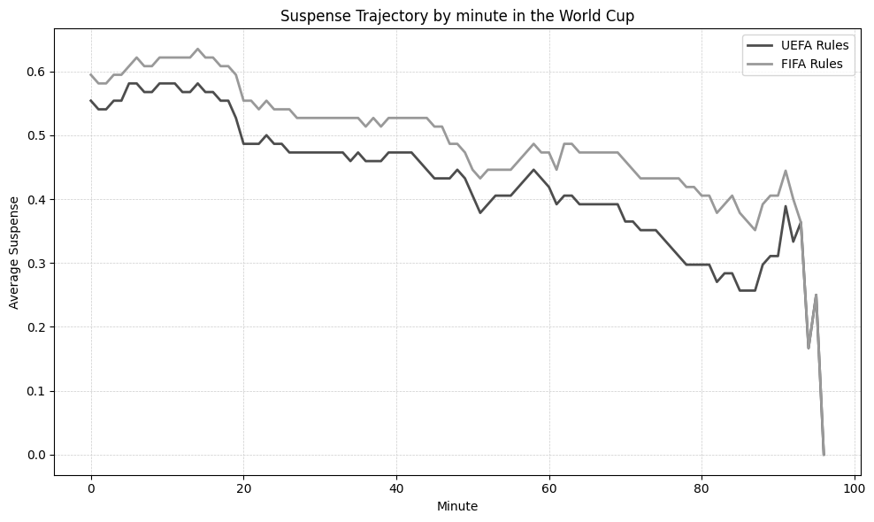
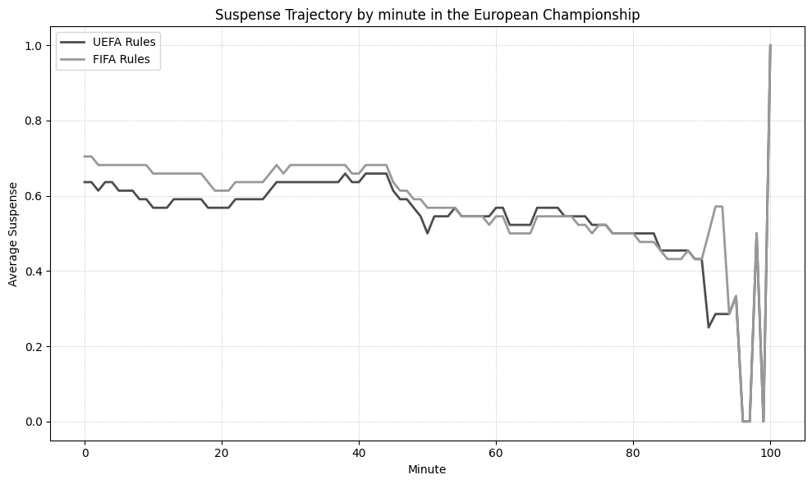
Suspense Over Time (Minute by Minute)
Average suspense per minute under FIFA vs UEFA rules
World Cup
European Championship (placebo)
WC: FIFA generates systematically higher suspense across all 90 minutes — gap widens near the end. Euro: rules produce almost identical suspense profiles.

Slide 9
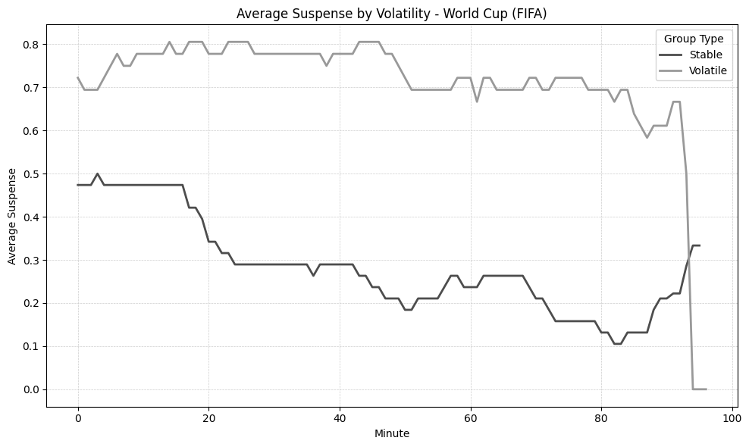
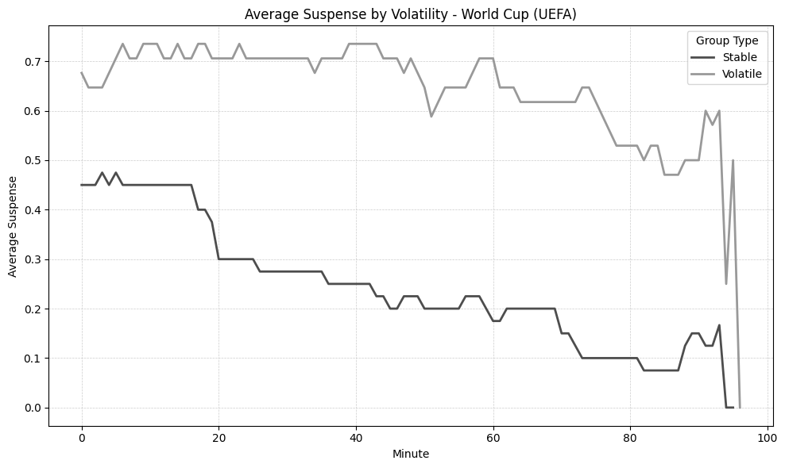
Suspense Trajectories by Group Volatility (World Cup)
Stable groups = below-median qualification changes; Volatile = above median
Under FIFA rules
Under UEFA rules
FIFA: stable/volatile gap is large from kick-off and persists (~0.4 pts). UEFA: gap starts small (~0.2 pts) but widens as the match progresses.

Slide 10
Regression Results
Linear Probability Model — goal-level, matchday 3
Spec 1: suspense = α + β FIFA_rule + γ t + δ t² + λ Elo_diff + year FE
Spec 2: Spec 1 + Elo_std + (FIFA_rule × Elo_std) | SEs clustered at group level
Variable
Euro Spec 1
Euro Spec 2
WC Spec 1
WC Spec 2
FIFA_rule
0.009
0.031
0.042***
0.075**
(0.021)
(0.039)
(0.015)
(0.034)
Minute
−0.007
−0.007
−0.007*
−0.007**
(0.005)
(0.005)
(0.004)
(0.004)
Elo diff
0.000
0.000
0.000
0.000
Elo std
—
0.001
—
−0.002**
FIFA × Elo std
—
−0.001
—
−0.001
Year FE
Yes
Yes
Yes
Yes
N
452
450
762
760
WC: +4.2 pp (Spec 1) / +7.5 pp (Spec 2) — effect is structural, independent of competitive balance (FIFA×Elo std insignificant) Euro: insignificant in both specs — consistent with placebo interpretation

Slide 11
Key Findings
FIFA's goal-difference rule generates significantly more suspense in the World Cup
1
A goal on matchday 3 under FIFA rules is 4.2 pp more likely to occur in a suspenseful state (p < 0.01); robust to competitive balance controls.
The effect is structural — not driven by competitive imbalance
2
Interaction FIFA × Elo std is statistically insignificant: FIFA advantage is uniform across balanced and unbalanced groups.
Suspense under FIFA rules is more stable and persistent over time
3
FIFA produces higher suspense throughout the full 90 minutes; the gap is largest near the end. Volatile groups are more suspenseful under both rules.
European Championship as a placebo: no significant effect
4
Neither t-test nor Wilcoxon test detects a difference in Euro groups (p > 0.38). Effect is specific to the World Cup's goals distribution.

Slide 12
Conclusion & Policy Implications
Institutional design matters: the choice of tie-breaking criterion has measurable consequences for the suspense experienced by billions of fans who follow the World Cup.
Take-aways for Governing Bodies
▸ Goal-difference (FIFA) keeps more qualification scenarios alive simultaneously → more persistent suspense
▸ Head-to-head (UEFA) locks in outcomes early once previous fixtures are played → lower potential suspense
▸ Audiences aware of qualification stakes respond to this uncertainty → direct link to entertainment value
▸ 2026 FIFA World Cup will switch to head-to-head as primary tiebreaker → our results predict a decline in WC group-stage suspense
▸ Governing bodies should weigh suspension-generating properties of rules alongside fairness considerations
Paper status: all sections complete (Intro · Lit Review · Data · Methodology · Results · Conclusion · Appendix) Next steps: final proofread, journal submission target TBD

