Slide 1
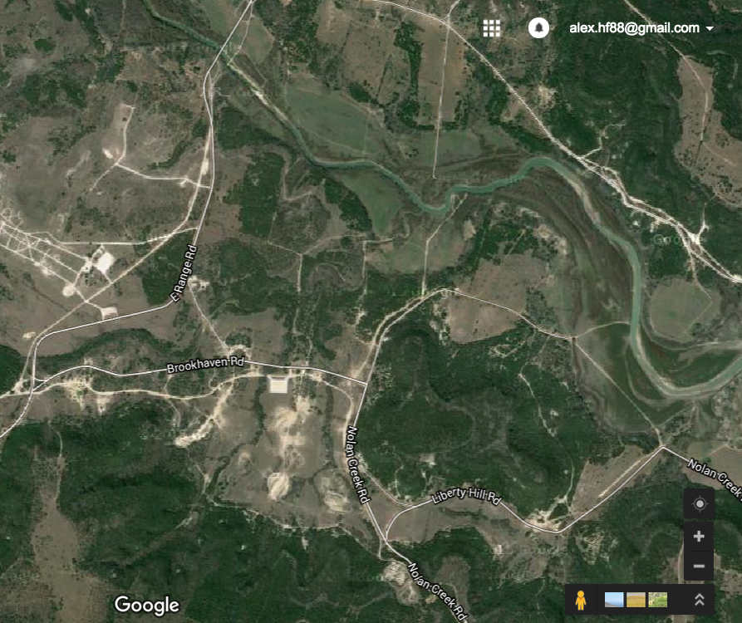
Retrans Training– 17-20NOV15 - S6 Shop
HHT/4/3d CR
REFERENCES:
TM 11-5820-890-10-8
MISSION: S6 Retrans Section conducts training at TA31 from 17NOV15 to 20NOV15 to enable the execution of retransmission operations at the National Training Center.
SITUATION: On 22 0600 SEP 15 to 23 1400 SEP 15, CBRN Mounted Recon, HHT Troop will move to TA 44 grid 14R GV 0925 5220 to stage and initiate mounted an maneuver training. This will be the culmination training in the series of Mounted Maneuver training.
MISSION: CBRN Mounted Recon will conduct mounted maneuver training starting 22 0700 SEP 15 and ending on 23 1400 SEP 15 at Fort Hood TA 44 14R GV 0925 5220 IOT to ensure troopers understand
KEY TASKS:
-Mission Analysis
-Site Selection
-Establish Retrans Site
TA31
CONCEPT:
PHASE I: Preparation (16-17NOV15)
16NOV two Retrans Strykers will go through PMCS and be dispatched; PMCS conducted on all required Comms equipment. All necessary equipment will be packed. 17NOV final PCC/PCIs will be conducted.
PHASE II: Execution (17-19NOV15)
Every morning Retrans teams will receive WARNO and Team Chief will plan mission brief. Teams will SP to retrans site. Teams will ensure sites are secure then establish retrans site. Teams will conduct radio checks with distant stations. Teams will jump to alternate retrans site locations, establish site, and conduct radio checks.
PHASE III: Recovery (20NOV15)
This phase consists of accountability of all equipment and an AAR conducted with the Retrans Teams.
TIMELINE
17NOV15
18NOV15
19NOV15
-0930 Receive WARNO
-1030 SP
- Establish Retrans Site/Comms Check
-Jump to alternate Retrans site
-Establish Retrans Site/Comms Check
-15:45 return to 4/3 CR motor pool
20NOV15
-0900 Retrans equipment layout/accountability
-1300 AAR
Resources Required:
MREs: x32 Latrine:
Fuel:
Instructor: SFC Roseburgh
Alternate Instructor: SGT Banks
HHT TRP, 4/3d CR TRAINING CONOP
16SEP15

