Slide 1
Classic UI Dynamic Dialogs
Pavel Nosau

Slide 2




Slide 3

Agenda
Classic UI Dialogs
Event handling on Fields
Sample
Tips and Tricks

Slide 4
Classic UI Dialogs

Slide 5
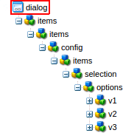

Classic UI Dialogs
dialog node
ExtJS widgets / xtypes
rendered on client

Slide 6
Classic UI Dialogs
dialog node
ExtJS widgets / xtypes
rendered on client

Slide 7
Classic UI Dialogs
dialog node
ExtJS widgets / xtypes
rendered on client

Slide 8
Classic UI Dialogs

Slide 9

Classic UI Dialogs

Slide 10
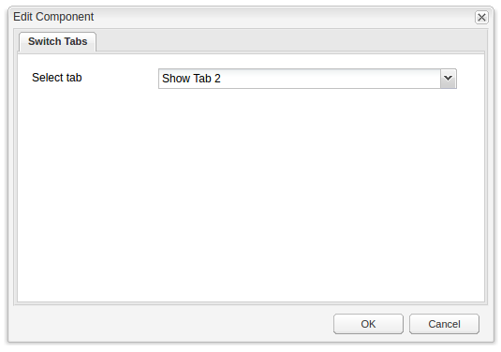
Classic UI Dialogs
ExtJS API + xtypes + config JSON

Slide 11
Classic UI Dialogs
Using xtypes:
https://docs.adobe.com/docs/en/aem/6-0/develop/components/xtypes.html

Slide 12


Slide 13
Event handling on Dialog Fields

Slide 14
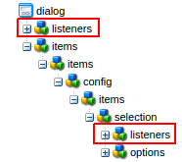

Event handling on Fields
listeners node
listener - simple js function
each fields has xtype
each xtype has Public Events

Slide 15
Event handling on Fields
listeners node
listener - simple js function
each fields has xtype
each xtype has Public Events

Slide 16
Event handling on Fields
listeners node
listener - simple js function
each fields has xtype
each xtype has Public Events

Slide 17
Event handling on Fields
listeners node
listener - simple js function
each fields has xtype
each xtype has Public Events

Slide 18
Event handling on Fields
Using xtypes:
https://docs.adobe.com/docs/en/aem/6-0/develop/components/xtypes.html
Widget API Documentation:
https://docs.adobe.com/docs/en/aem/6-0/develop/ref/widgets-api/index.html

Slide 19

Sample

Slide 20
Sample: dev steps
Step 1: create dialog with all tabs, fields, etc …
Step 2: choose listeners which will be used
Step 3: create clientLibs, define js module
Step 4: hide all tabs
Step 5: show tabs in depends on chosen select value
Step 6: fix bug with required fields

Slide 21
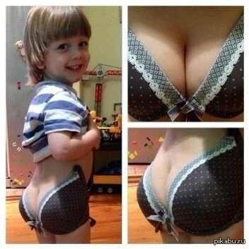
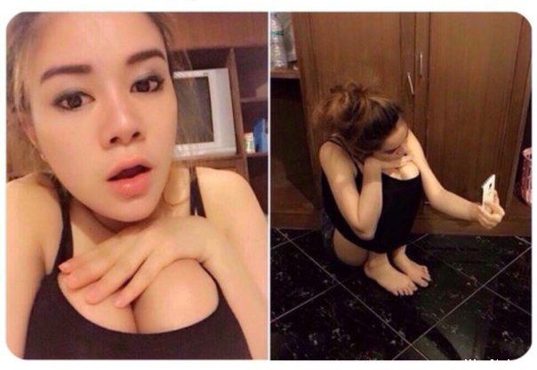
Tips and Tricks

Slide 22
Tips and Tricks
Chose hide/show rather then add/delete

Slide 23
Tips and Tricks
Chose hide/show rather then add/delete
ability to test all dialog components before adding of
dynamic behavior
easier to debug
more complex behavior can be implemented
...

Slide 24
Tips and Tricks
Chose hide/show rather then add/delete
ability to test all dialog components before adding of
dynamic behavior
easier to debug
more complex behavior can be implemented
...

Slide 25

Tips and Tricks
Chose hide/show rather then add/delete
ability to test all dialog components before adding of
dynamic behavior
easier to debug
more complex behavior can be implemented
...

Slide 26
Tips and Tricks
Avoid placing logic under dialog -> listeners

Slide 27
Tips and Tricks
Avoid placing logic under dialog -> listeners
easier to develop
easier to debug
code can be reused
more complex behavior can be implemented
...

Slide 28
Tips and Tricks
Avoid placing logic under dialog -> listeners
easier to develop
easier to debug
code can be reused
more complex behavior can be implemented
...

Slide 29
Tips and Tricks
Avoid placing logic under dialog -> listeners
easier to develop
easier to debug
code can be reused
more complex behavior can be implemented
...

Slide 30
Tips and Tricks
Avoid placing logic under dialog -> listeners
easier to develop
easier to debug
code can be reused
more complex behavior can be implemented
...

Slide 31
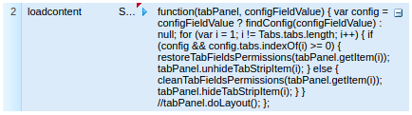
Tips and Tricks
Avoid placing logic under dialog -> listeners
VS

Slide 32
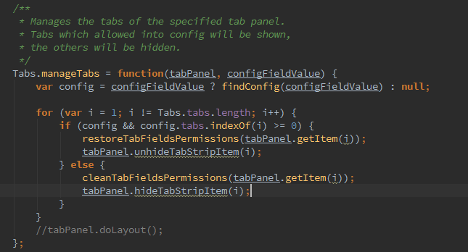
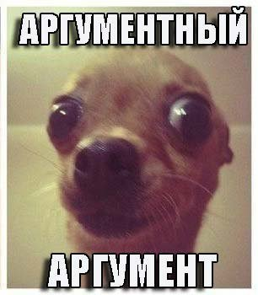
Tips and Tricks
Avoid placing logic under dialog -> listeners
VS
+

Slide 33
Tips and Tricks
Keep logic under clientlibs

Slide 34

Tips and Tricks
Keep logic under clientlibs
CQ way to implement js logic
can be switched on/off
clientlibs features can be used
more complex behavior can be implemented
...

Slide 35
Tips and Tricks
Keep logic under clientlibs
cq way to implement js logic
can be switched on/off
clientlibs features can be used
more complex behavior can be implemented
...

Slide 36
Tips and Tricks
Keep logic under clientlibs
cq way to implement js logic
can be switched on/off
clientlibs features can be used
more complex behavior can be implemented
...

Slide 37
Tips and Tricks
Keep logic under clientlibs
cq way to implement js logic
can be switched on/off
clientlibs features can be used
more complex behavior can be implemented
...

Slide 38
Tips and Tricks
If something is not visible it doesn't mean it is not validatable

Slide 39
Tips and Tricks
If something is not visible it doesn't mean it is not validatable
switched on/off validation once show/hide
store validation rules before hide

Slide 40
Tips and Tricks
If something is not visible it doesn't mean it is not validatable
switched on/off validation once show/hide
store validation rules before hide

Slide 41
Thank you!

Slide 42

Questions

