Slide 1
Queries in AEM. JCR-SQL2
Pavel Nosau

Slide 2
Agenda
Grammar
* AEM specific

Slide 3
Grammar
http://www.h2database.com/jcr/grammar.html
https://en.wikipedia.org/wiki/Syntax_diagram
http://www.day.com/specs/jcr/2.0/6_Query.html
http://svn.apache.org/viewvc/jackrabbit/trunk/jackrabbit-spi-commons/src/test/resources/org/apache/jackrabbit/spi/commons/query/sql2/test.sql2.txt?view=markup

Slide 4
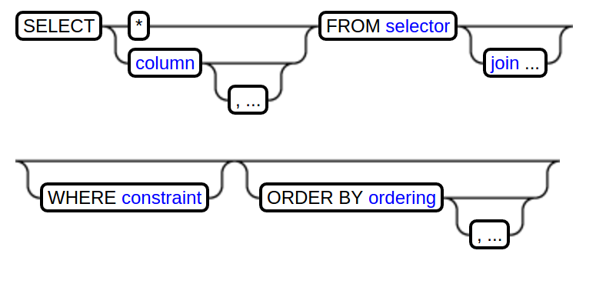
Grammar:Query structure

Slide 5
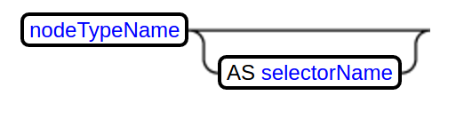
Grammar:Selector

Slide 6
Grammar:Selector
http://{host}:{port}/crx/explorer/nodetypes/index.jsp

Slide 7
Grammar:Selector
… FROM [nt:base] ...
… FROM [nt:unstructured] AS parent ...

Slide 8
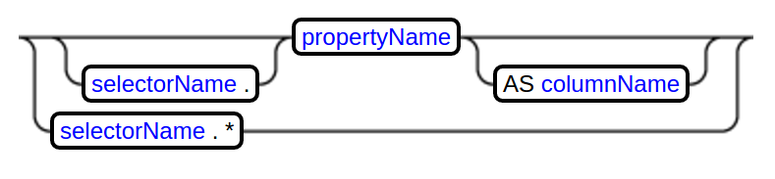
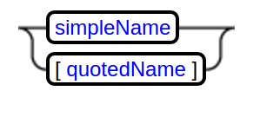
Grammar:Column

Slide 9
Grammar:Column
SELECT * FROM ...
SELECT s.* FROM [nt:base] AS s ...
SELECT title, description FROM …
SELECT title, [jcr:title] FROM ...
SELECT s.title, s.[jcr:title] FROM [nt:base] AS s ...
SELECT s.[jcr:title] AS t FROM [nt:base] AS s ...

Slide 10
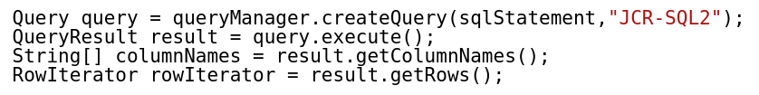
Column and Table View

Slide 11
Column and Table View
SELECT * FROM [cq:Page] WHERE ISCHILDNODE( '/content/geometrixx/en/toolbar')

Slide 12
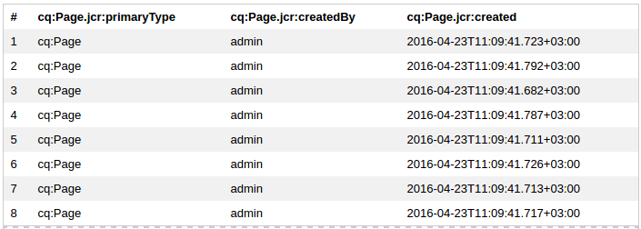
Column and Table View
SELECT * FROM [cq:Page] WHERE ISCHILDNODE( '/content/geometrixx/en/toolbar')

Slide 13
Column and Table View
SELECT p.* FROM [cq:Page] AS p WHERE ISCHILDNODE(p, '/content/geometrixx/en/toolbar')

Slide 14
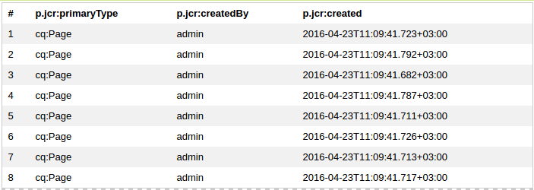
Column and Table View
SELECT p.* FROM [cq:Page] AS p WHERE ISCHILDNODE(p, '/content/geometrixx/en/toolbar')

Slide 15
Column and Table View
SELECT p.[jcr:primaryType] AS primaryType, p.[jcr:createdBy] AS createdBy, p.[jcr:created] AS created FROM [cq:Page] AS p WHERE ISCHILDNODE(p, '/content/geometrixx/en/toolbar')

Slide 16
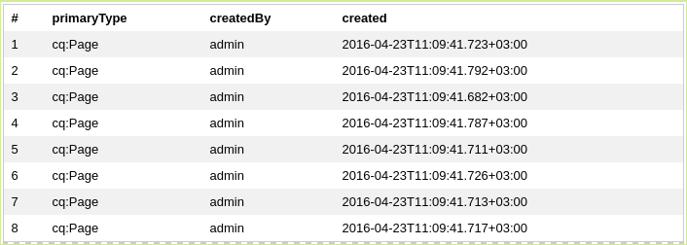
Column and Table View
SELECT p.[jcr:primaryType] AS primaryType, p.[jcr:createdBy] AS createdBy, p.[jcr:created] AS created FROM [cq:Page] AS p WHERE ISCHILDNODE(p, '/content/geometrixx/en/toolbar')

Slide 17
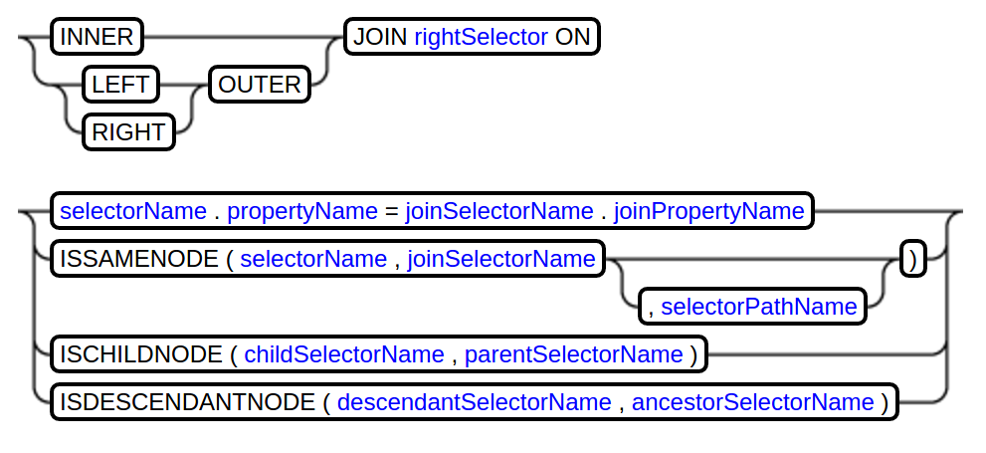
Grammar:Join

Slide 18
Grammar:Join
http://www.day.com/specs/jcr/2.0/6_Query.html#6.7.5 Join
If left evaluates to L, a set of m-tuples, and right evaluates to R, a set of n-tuples, then the join evaluates to J, a set of (m + n)-tuples. The members of J depend on thejoinType and joinCondition.
Let L x R be the Cartesian product of L and R as a set of (m + n)-tuples
L x R = { ℓ  r : ℓ  L, r  R }
and c(A) be the selection over A of its members satisfying joinCondition c
c(A) = { a : a  A, c(a) }
Then if joinType is Inner:
J = c(L x R)
Otherwise, if joinType is LeftOuter:
J = c(L x R)  (L – πL(c(L x R)))
where πL(c(L x R)) is the projection of the m-tuples contributed by L from the (m + n)-tuples of c(L x R).
Otherwise, if joinType is RightOuter:
J = c(L x R)  (R – πR(c(L x R)))
where πR(c(L x R)) is the projection of the n-tuples contributed by R from the (m + n)-tuples of c(L x R).
The query is invalid if left is the same source as right.

Slide 19

Grammar:Join
If left evaluates to L, a set of m-tuples, and right evaluates to R, a set of n-tuples, then the join evaluates to J, a set of (m + n)-tuples. The members of J depend on thejoinType and joinCondition.
Let L x R be the Cartesian product of L and R as a set of (m + n)-tuples
L x R = { ℓ  r : ℓ  L, r  R }
and c(A) be the selection over A of its members satisfying joinCondition c
c(A) = { a : a  A, c(a) }
Then if joinType is Inner:
J = c(L x R)
Otherwise, if joinType is LeftOuter:
J = c(L x R)  (L – πL(c(L x R)))
where πL(c(L x R)) is the projection of the m-tuples contributed by L from the (m + n)-tuples of c(L x R).
Otherwise, if joinType is RightOuter:
J = c(L x R)  (R – πR(c(L x R)))
where πR(c(L x R)) is the projection of the n-tuples contributed by R from the (m + n)-tuples of c(L x R).
The query is invalid if left is the same source as right.

Slide 20
Grammar:Join
If left evaluates to L, a set of m-tuples, and right evaluates to R, a set of n-tuples, then the join evaluates to J, a set of (m + n)-tuples. The members of J depend on thejoinType and joinCondition.
Let L x R be the Cartesian product of L and R as a set of (m + n)-tuples
L x R = { ℓ  r : ℓ  L, r  R }
and c(A) be the selection over A of its members satisfying joinCondition c
c(A) = { a : a  A, c(a) }
Then if joinType is Inner:
J = c(L x R)
Otherwise, if joinType is LeftOuter:
J = c(L x R)  (L – πL(c(L x R)))
where πL(c(L x R)) is the projection of the m-tuples contributed by L from the (m + n)-tuples of c(L x R).
Otherwise, if joinType is RightOuter:
J = c(L x R)  (R – πR(c(L x R)))
where πR(c(L x R)) is the projection of the n-tuples contributed by R from the (m + n)-tuples of c(L x R).
The query is invalid if left is the same source as right.

Slide 21
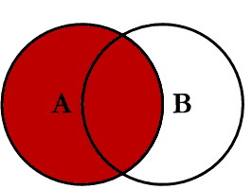
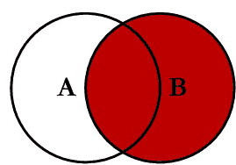
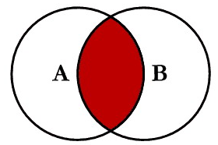
Grammar:Join
… FROM [nt:base] AS A LEFT OUTER JOIN [nt:base] AS B ON ...
… FROM [nt:base] AS A RIGHT OUTER JOIN [nt:base] AS B ON ...
… FROM [nt:base] AS A INNER JOIN [nt:base] AS B ON ...

Slide 22
Grammar:Join

Slide 23
Grammar:Join:ISSAMENODE
… [cq:Page] AS selectorName INNER JOIN [nt:base] AS joinSelectorName ON ISSAMENODE(selectorName, joinSelectorName) ...
selectorNode.isSame(joinSelectorNode);
… [cq:Page] AS selectorName INNER JOIN [nt:base] AS joinSelectorName ON ISSAMENODE(selectorName, joinSelectorNam, 'selectorPathName') ...
selectorNode.isSame(joinSelectorNode.getNode(selectorPathName));

Slide 24
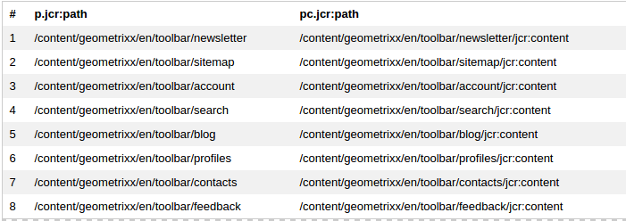
Grammar:Join:ISSAMENODE
SELECT p.[jcr:path], pc.[jcr:path] FROM [cq:Page] AS p INNER JOIN [nt:base] AS pc ON ISSAMENODE(pc, p, 'jcr:content') WHERE ISCHILDNODE(p, '/content/geometrixx/en/toolbar')

Slide 25
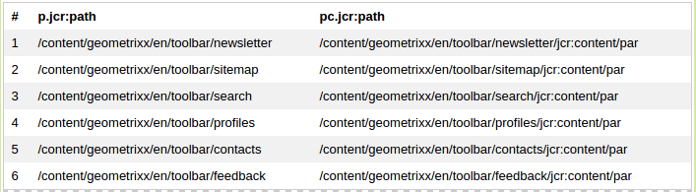
Grammar:Join:ISSAMENODE
SELECT p.[jcr:path], pc.[jcr:path] FROM [cq:Page] AS p INNER JOIN [nt:base] AS pc ON ISSAMENODE(pc, p, 'jcr:content/par') WHERE ISCHILDNODE(p, '/content/geometrixx/en/toolbar')

Slide 26
Grammar:Join:ISCHILDNODE
… [cq:Page] AS selectorName INNER JOIN [nt:base] AS joinSelectorName ON ISCHILDNODE(childSelectorName, parentSelectorName) ...
childSelectorNode.getParent().isSame(parentSelectorNode)

Slide 27
Grammar:Join:ISDESCENDANTNODE
… [cq:Page] AS ancestorSelectorName INNER JOIN [nt:base] AS descendantSelectorName ON ISDESCENDANTNODE(descendantSelectorName, ancestorSelectorName) ...
descendantSelectorNode.getAncestor(n).isSame(ancestorSelectorNode) &&
descendantSelectorNode.getDepth() > n

Slide 28
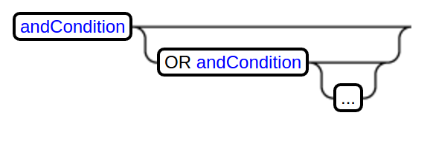
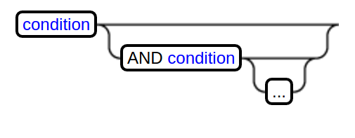
Grammar:Constraint, And Condition

Slide 29
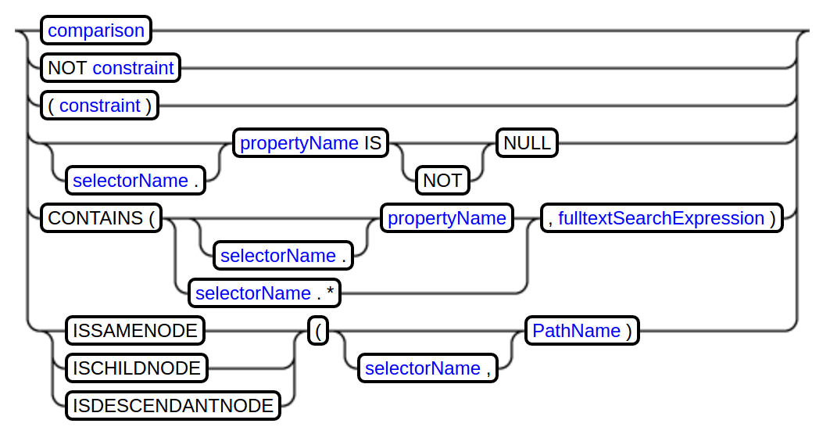
Grammar:Condition

Slide 30
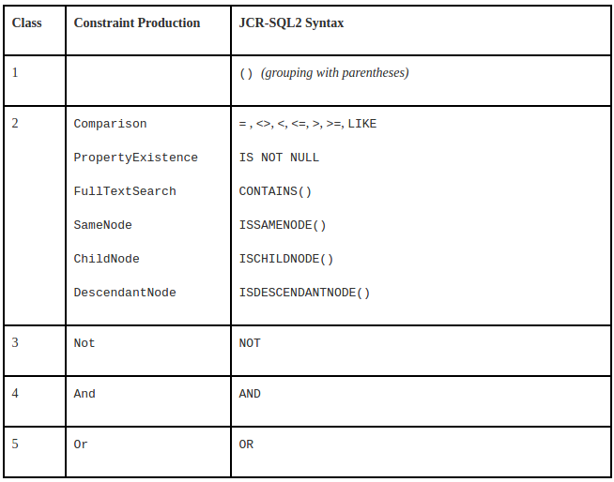
Grammar:Condition

Slide 31
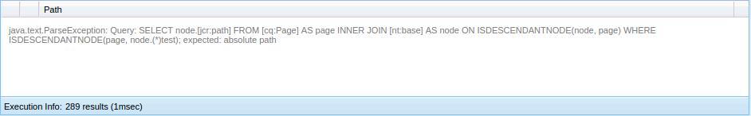
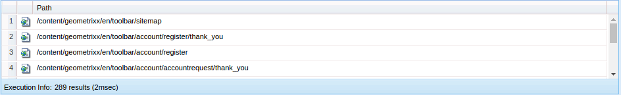
Grammar:Condition
SELECT * FROM [cq:Page] AS page INNER JOIN [nt:base] AS node ON ISDESCENDANTNODE(node, page) WHERE ISDESCENDANTNODE(page, node.test)
SELECT * FROM [cq:Page] AS page INNER JOIN [nt:base] AS node ON ISDESCENDANTNODE(node, page) WHERE ISDESCENDANTNODE(page, '/content/geometrixx/en/toolbar')

Slide 32
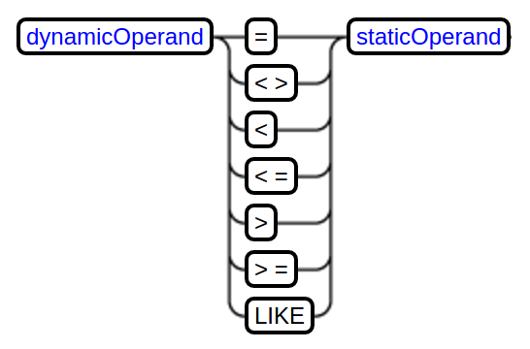
Grammar:Comparison

Slide 33
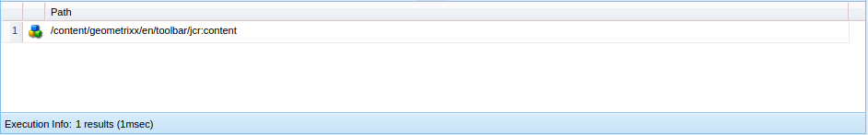
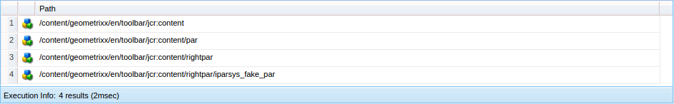
Grammar:Comparison
SELECT * FROM [nt:base] WHERE ISDESCENDANTNODE('/content/geometrixx/en/toolbar') AND [jcr:path] LIKE '/content/geometrixx/en/toolbar/jcr_content'
SELECT * FROM [nt:base] WHERE ISDESCENDANTNODE('/content/geometrixx/en/toolbar') AND [jcr:path] LIKE '/content/geometrixx/en/toolbar/jcr_content'
SELECT * FROM [nt:base] WHERE ISDESCENDANTNODE('/content/geometrixx/en/toolbar') AND [jcr:path] LIKE '/content/geometrixx/en/toolbar/jcr_content%'

Slide 34
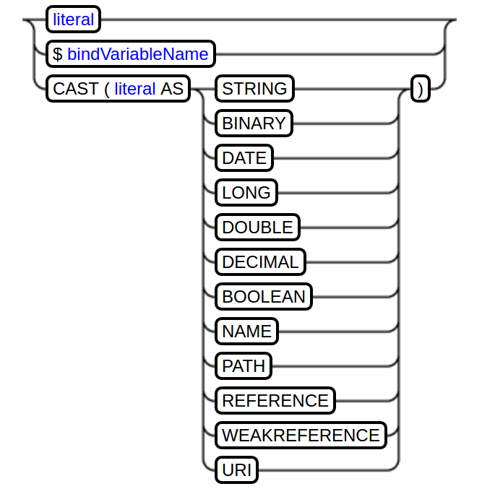
Grammar:Static Operands

Slide 35
Grammar:Static Operands
SELECT * FROM [nt:base] WHERE ISDESCENDANTNODE('/content/geometrixx/en/toolbar') AND [cq:lastModified] > CAST('2016-04-26T23:51:02.000+03:00' AS DATE)

Slide 36

Grammar:Static Operands
SELECT * FROM [nt:base] WHERE ISDESCENDANTNODE('/content/geometrixx/en/toolbar') AND [cq:lastModified] > CAST('2016-04-26T23:51:02.000+03:00' AS DATE)
YYYY-MM-DDTHH:mm:ss.SSSZ

Slide 37
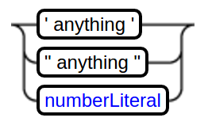
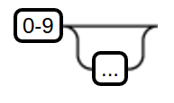
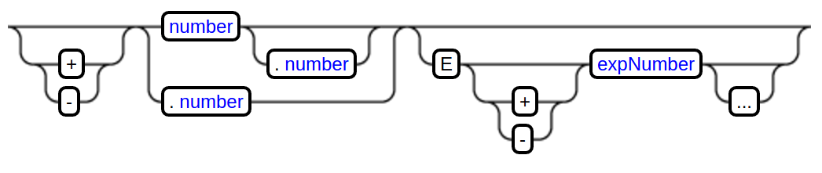
Grammar:Literals

Slide 38
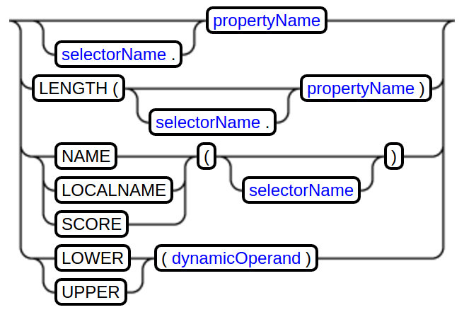
Grammar:Dynamic Operand

Slide 39
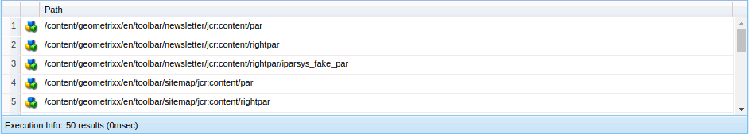
Grammar:Dynamic Operand
SELECT * FROM [nt:base] WHERE ISDESCENDANTNODE('/content/geometrixx/en/toolbar') AND NAME() LIKE '%par%'

Slide 40
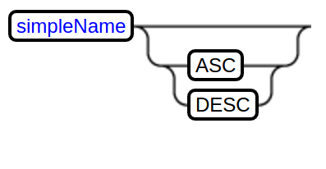
Grammar:Ordering

Slide 41
AEM Specific
http://wiki.apache.org/jackrabbit/Search
http://wiki.apache.org/jackrabbit/ExcerptProvider
http://wiki.apache.org/jackrabbit/SpellChecker
http://wiki.apache.org/jackrabbit/SynonymSearch
http://wiki.apache.org/jackrabbit/SimilaritySearch
https://jackrabbit.apache.org/oak/docs/query/query-engine.html
https://jackrabbit.apache.org/oak/docs/query/lucene.html
https://jackrabbit.apache.org/oak/docs/query/solr.html
http://help-forums.adobe.com/content/adobeforums/en/experience-manager-forum/adobe-experience-manager.topic.html/forum__de4v-hi_does_aem61.html

Slide 42
rep:excerpt()
* AEM5.6.1 and before, but sinse Jackrabbit 1.3
* disabled by default, see:http://wiki.apache.org/jackrabbit/ExcerptProvider
SELECT [excerpt(.)] FROM [nt:resource] WHERE CONTAINS(., 'jackrabbit')
* AEM6.x
* https://issues.apache.org/jira/browse/OAK-3580
* https://issues.apache.org/jira/browse/OAK-818
* https://issues.apache.org/jira/browse/OAK-318
* https://issues.apache.org/jira/browse/OAK-262
Seems it shuold work :)!
SELECT a.[jcr:path] as [jcr:path], a.[jcr:score] as [jcr:score], a.[rep:excerpt] as [rep:excerpt] from [nt:base] as a where contains(a.*, 'jackrabbit')

Slide 43
rep:spellcheck()
* AEM5.6.1 and before
* disabled by default, see:http://wiki.apache.org/jackrabbit/SpellChecker
SELECT [rep:spellcheck()] FROM [nt:base] WHERE [jcr:path] = '/' AND SPELLCHECK('jackrabit')
* AEM6.x but since @since Oak 1.1.17, 1.0.13
* https://jackrabbit.apache.org/oak/docs/query/query-engine.html
* https://jackrabbit.apache.org/oak/docs/query/lucene.html#Spellchecking
* https://jackrabbit.apache.org/oak/docs/query/solr.html#Spellchecking
Seems it shuold work, but should be configured first :)!
SELECT [rep:spellcheck()] FROM [nt:base] WHERE [jcr:path] = '/' AND SPELLCHECK('jackrabit')

Slide 44
rep:similar()
* AEM5.6.1 and before
* disabled by default, see:http://wiki.apache.org/jackrabbit/SimilaritySearch
SELECT * FROM [nt:file] WHERE SIMILAR(., '/my:content/readme.txt/jcr:content')
* AEM6.x
* https://jackrabbit.apache.org/oak/docs/query/query-engine.html
Seems it shuold work, but lucene or solr indexes should be configured first :)!
SELECT * FROM [nt:file] WHERE SIMILAR(., '/my:content/readme.txt/jcr:content')

Slide 45
Searching with synonyms
* AEM5.6.1 and before
* disabled by default, see:http://wiki.apache.org/jackrabbit/SynonymSearch
SELECT * FROM [nt:resource] WHERE CONTAINS(., '~food')
* AEM6.x but since Oak 1.2.x ???
* http://help-forums.adobe.com/content/adobeforums/en/experience-manager-forum/adobe-experience-manager.topic.html/forum__de4v-hi_does_aem61.html
Seems it shuold work, but lucene indexes should be configured first and not all going good all the time:)!
SELECT * FROM [nt:resource] WHERE CONTAINS(*, '~food')

Slide 46
rep:suggest()
* AEM5.6.1 not supported at all
* AEM6.x but since Oak 1.1.17, 1.0.15
* https://jackrabbit.apache.org/oak/docs/query/query-engine.html
* https://jackrabbit.apache.org/oak/docs/query/lucene.html#Suggestions
* https://jackrabbit.apache.org/oak/docs/query/solr.html#Suggestions
Seems it shuold work, but lucene or solr indexes should be configured first :)!
SELECT [rep:suggest()] FROM [nt:base] WHERE SUGGEST('in')

Slide 47
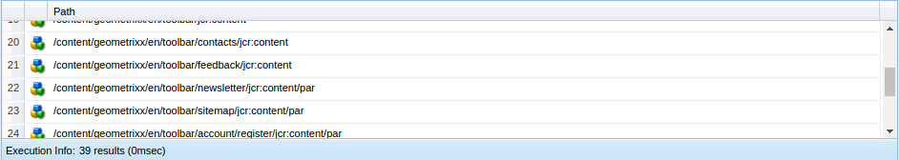
IN
* AEM5.6.1 not supported at all
* AEM6.x supported
SELECT * FROM [nt:base] WHERE ISDESCENDANTNODE('/content/geometrixx/en/toolbar') AND NAME() IN ('par', 'jcr:content') ORDER BY NAME()

Slide 48
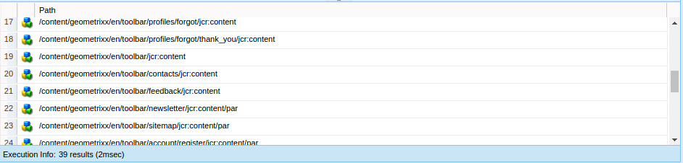
UNION
* AEM5.6.1 not supported at all
* AEM6.x supported
SELECT * FROM [nt:base] WHERE ISDESCENDANTNODE('/content/geometrixx/en/toolbar') AND NAME() LIKE 'jcr_content' UNION SELECT * FROM [nt:base] WHERE ISDESCENDANTNODE('/content/geometrixx/en/toolbar') AND NAME() LIKE 'par'

Slide 49
native
* AEM5.6.1 not supported at all
* AEM6.x supported
SELECT [jcr:path] FROM [nt:base] WHERE NATIVE('solr', 'mlt?q=id:UTF8TEST&mlt.fl=manu,cat&mlt.mindf=1&mlt.mintf=1')

Slide 50
Thank you!

