Slide 1

AEVON H4 · STUDENT PLANNER WEBSITE
StudyPilot
Your study engine for real student time.
Plan smarter. Stay locked in.

Slide 2

01 · THE PROBLEM
College planning is a time game
The hard part is not knowing what matters. It is finding the right hour to act.
Everything competes for the same hours
01
Deadlines, syllabus topics, and real life collide in one calendar.
The right study window disappears
02
Students often miss the moment to start until pressure spikes.
03
The gap is a planning cockpit
StudyPilot brings the moving parts into one focused place.

Slide 3



02 · THE SOLUTION
One dashboard.
Zero deadline surprises.
StudyPilot connects the student's timetable, syllabus, and deadlines into one daily view.
A single study engine turns scattered planning into the next clear move.

Slide 4




03 · WHO IT IS FOR
Built for students with full calendars
StudyPilot is for college students balancing multiple courses, commitments, and changing priorities.
Multiple courses
Real commitments
Keep every syllabus and exam in view.
Plan around work, commute, sleep, and breaks.

Slide 5




Frontend
Backend
04 · THE BUILD
React-based responsive web interface.
Node.js / Express services for schedules and reminders.
Technology that keeps the planner lightweight
Final stack status: proposed. The architecture is designed for a responsive, student-controlled web experience.
Data
Tools
Firebase or SQLite for planner records.
Browser notifications and Figma for interface design.

Slide 6

05 · HOW IT WORKS
From scattered inputs to a next-best study move
A simple feedback loop keeps the plan current as the student's day changes.
Refresh
Act
Completion data updates the next study recommendation.
Organize
See today's plan, countdowns, reminders, and progress in one dashboard.
Capture
Prioritize work against available hours, urgency, and time left.
Student enters timetable, syllabus topics, exam dates, and assignment deadlines.

Slide 7


06 · KEY FEATURES
Make the right hour count
Exam awareness
Add dates, attach a syllabus, and receive real-time countdown updates.
Smart ordering
Prioritize by urgency, difficulty, and time left.
Right-sized blocks
Fit tasks to the student's real day, not an idealized schedule.
Availability view
Surface open hours after classes, commute, work, sleep, and breaks.

Slide 8



07 · AI POLICY
AI can assist the build.
The student stays in control.
StudyPilot's baseline planner is rule-based, transparent, and independent of institute ERP-LMS systems.
Baseline core
The planner works without an AI tool.
Separate disclosure
Any AI-assisted prototyping or content generation is disclosed in the final demo.
Student-controlled
The plan remains personal, practical, and user-directed.

Slide 9
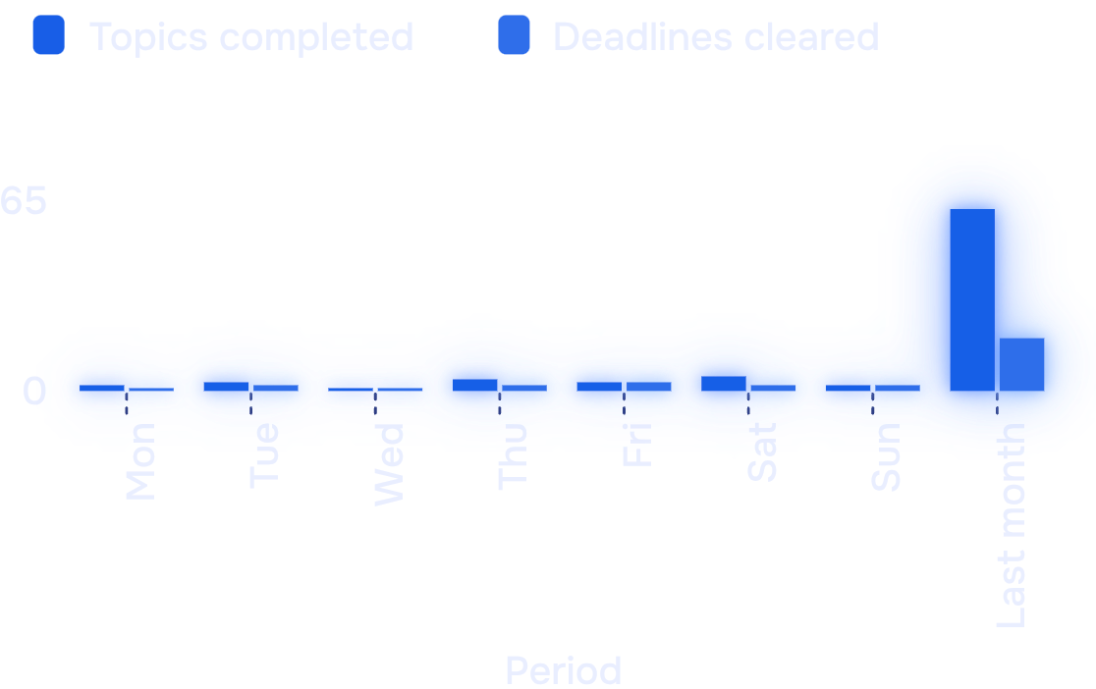
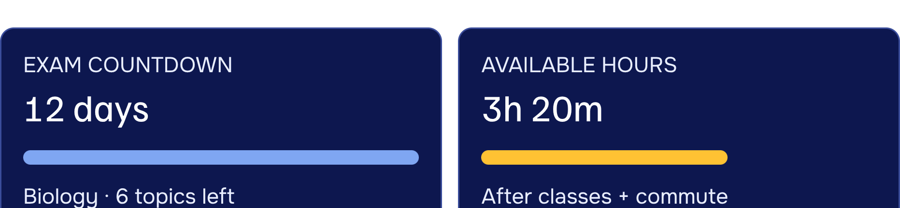

08 · OUTPUT
The demo makes progress visible
Working website flow: timetable, syllabus tracker, exam countdown, available-hours view, and progress dashboard.
Illustrative progress data · switch between a last-week pulse and a last-month trend.
StudyPilot is not an ERP-LMS of any educational institute.

Slide 10

AEVON H4 · FINAL TAKEAWAY
Less tab-hopping.
More “locked in.”
StudyPilot keeps planning personal, practical, and built around real student time.
Future scope
Adaptive plans · peer study groups · resource recommendations · focus analytics
1-KAVYAANSH SHARMA · 2-ARPIT SRIVASTAVA · 3-HIMANSHU HARIT

