Slide 1

Green Pace
Security Policy Presentation
Developer: Andrew Emilio Di Stefano

Slide 2

OVERVIEW: DEFENSE IN DEPTH
The following security policy is designed to minimize the chance of a successful attack as much as possible, while fostering adherence to security standards and best practices within our organization.
The following security policy adheres to the principles of Defense In Depth, which refers to a combination of multiple defense strategies of different types and natures to address and mitigate a wide variety of potential attacks (National Institute of Standards and Technology, n. d.).
Such an approach is needed in order to create a comprehensive and redundant system of security measures which will make it incredibly difficult for malicious actors to perpetuate successful attacks on our systems.

Slide 3
THREAT MATRIX
STD-007-CPP
Exceptions
STD-004-CPP
SQL Injection
STD-008-CPP
Object Oriented Programming
STD-006-CPP
Assertions
STD-009-CPP
Input/Output
STD-005-CPP
Memory Protection
STD-003-CPP
String Correctness
STD-002-CPP
Data Value
STD-010-CPP
Espressions
STD-001-CPP
Data Type
The following matrix shows the priority level and likelihood of a security vulnerability resulting from non-adherence to each of our security standards, with priority level depicted from left (low priority) to right (high priority), and likelihood from bottom (low likelihood) to top (high likelihood)
L
I
K
E
L
I
H
O
O
D
P R I O R I T Y L E V E L

Slide 4
10 PRINCIPLES
1. Validate Input Data
Applicable Standards:
STD-001-CPP, STD-003-CPP, STD-004-CPP, STD-009-CPP
2. Heed Compiler Warnings
Applicable Standards:
STD-002-CPP, STD-008-CPP
3. Architect and Design for Security Policies
Applicable Standards:
STD-001-CPP
4. Keep it Simple
Applicable Standards:
STD-001-CPP
5. Default Deny
Applicable Standards:
STD-003-CPP, STD-004-CPP, STD-009-CPP
6. Adhere to the Principle of Least Privilege
Applicable Standards:
STD-004-CPP, STD-009-CPP
7. Sanitize Data Sent to Other Systems
Applicable Standards:
STD-003-CPP, STD-004-CPP, STD-009-CPP
8. Practice Defense in Depth
Applicable Standards:
STD-001-CPP, STD-002-CPP, STD-003-CPP, STD-004-CPP, STD-005-CPP, STD-006-CPP, STD-007-CPP, STD-008-CPP, STD-009-CPP,
STD-010-CPP
9. Use Effective Quality Assurance Techniques
Applicable Standards:
STD-001-CPP, STD-002-CPP, STD-003-CPP, STD-004-CPP, STD-005-CPP, STD-006-CPP, STD-007-CPP, STD-008-CPP, STD-009-CPP,
STD-010-CPP
10. Adopt a Secure Coding Standard
Applicable Standards:
STD-001-CPP, STD-002-CPP, STD-003-CPP, STS-004-CPP, STD-005-CPP, STD-006-CPP, STD-007-CPP, STD-008-CPP, STD-009-CPP, STD-010-CPP

Slide 5
CODING STANDARDS
This list of our coding standards is arranged in order of priority:
STD-001-CPP - Use Appropriate Data Types
STD-002-CPP - Always Initialize Variables
STD-003-CPP - Always Validate Strings to Prevent Buffer Overflows
STD-004-CPP - Always Validate Input to Prevent SQL Injections
STD-005-CPP - Refrain from Accessing Dangling Pointers
STD-006-CPP - Use Assertions to Diagnose Errors
STD-007-CPP - Use ‘try,’ ‘catch,’ and ‘throw’ statements to catch exceptions
STD-008-CPP - Do Not Invoke Virtual Functions from Constructors and Destructors
STD-009-CPP - Prevent User Input Format String Vulnerabilities
STD-010-CPP - Do Not Access an Object Outside of its Lifetime

Slide 6
ENCRYPTION POLICIES
The encryption of data is an important part of data security, and systems where data is not encrypted should not be trusted with potentially sensitive data. In order to ensure data security throughout our systems, data should be encrypted while it is at rest, while it is in flight, and while it is in use.
ENCRYPTION AT REST:
ENCRYPTION IN FLIGHT:
ENCRYPTION IN USE:
‘Encryption at rest’ refers to the encryption of data while it is being stored (IBM, 2025) in a data store or database.
‘Encryption in flight’ refers to the encryption of data when it is sent from one place to another (IBM, 2025).
‘Encryption in use’ refers to the encryption of data which is in memory at runtime (Google Cloud, n. d.).

Slide 7
TRIPLE-A POLICIES
Triple a is “a security framework that controls access to computer resources, enforces policies, and audits usage…its combined processes play a major role in…cybersecurity by screening users and keeping in track of their activity while they are connected (Fortinet, 2025). The three As in Triple-A stand for authentication, authorization, and accounting.
AUTHENTICATION:
AUTHORIZATION:
ACCOUNTING:
Authentication involves prompting system users for information which proves that they are who they say that they are (Fortinet, 2025).
“Authorization dictates what a user is allowed to do” (Fortinet, 2025).
“Accounting keeps track of user activity…such as how long they were logged in, the data they sent or received, their…(IP) address…and the different services they accessed” (Fortinet, 2025).

Slide 8
Unit Testing
“Unit Testing is a software testing technique in which individual units or components of a software application are tested in isolation” (GeeksForGeeks, 2024).
By comprehensively unit testing small components of our system, we can assure a constant adherence to our security policy which will help us to increase the security of our systems.
This is especially important when writing in C++ for optimized memory management.

Slide 9
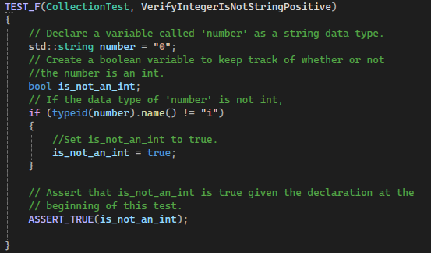
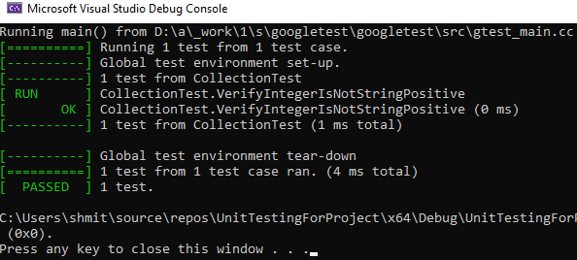
VerifyIntegerIsNotStringPositive
This positive unit test checks for adherence to Standard 1: Use Appropriate Data Types (STD-001-CPP) by declaring a variable called ‘number’ as a string data type when the name of the variable implies that it was meant to be used as an int data type.
We use a boolean variable called ‘is_not_an_int’ which is set to ‘true’ if the ‘number’ variable is not of int data type.
We then assert that ‘is_not_an_int’ has been set to true.
In practice, the value of this boolean variable could be used to determine whether or not user input is allowed to be set as the value of a variable.

Slide 10
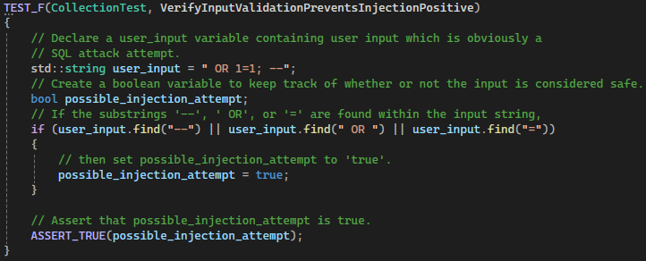
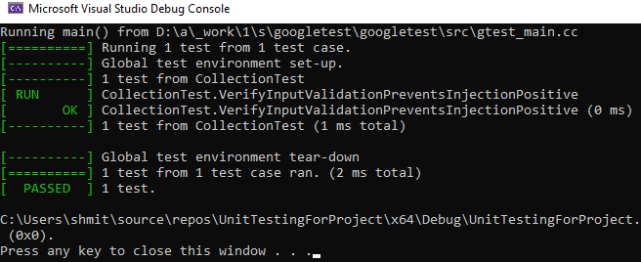
VerifyInputValidationPreventsInjectionPositive
This positive unit test checks for adherence to Standard 4: Always Validate Input to Prevent SQL Injections (STD-004-CPP) by declaring a variable called ‘user_input’ which contains an obvious SQL injection attempt.
We use a boolean variable called ‘possible_injection_attempt’ which is set to ‘true’ if the variable contains characters or character combinations which indicate a possible SQL injection attack.
We then assert that ‘possible_injection_attempt’ has been set to true given the suspicious value of the ‘user_input’ string.

Slide 11
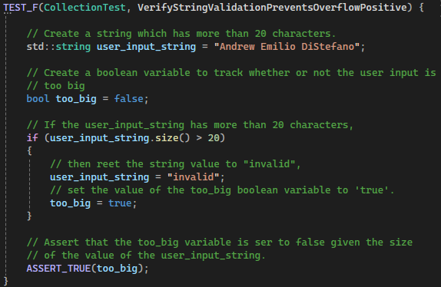
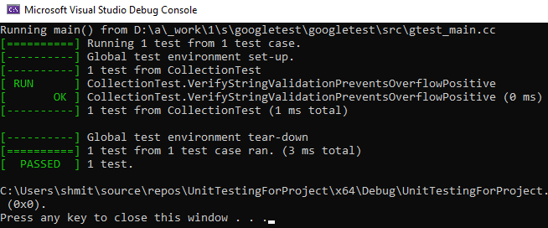
VerifyStringValidationPreventsOverflowPositive
This positive unit test checks for adherence to Standard 3: Always Validate Strings to Prevent Buffer Overflows (STD-003-CPP) by declaring a variable called ‘user_input_string’ which holds a string with 21 characters.
We use a boolean variable called ‘too_big’ which is set to ‘true’ if the ‘user_input_string’ variable is longer than 20 characters.
We then assert that, given the size of the string value of the ‘input_string’ variable, the value of the boolean ‘too_big’ variable is set to ‘true’.

Slide 12
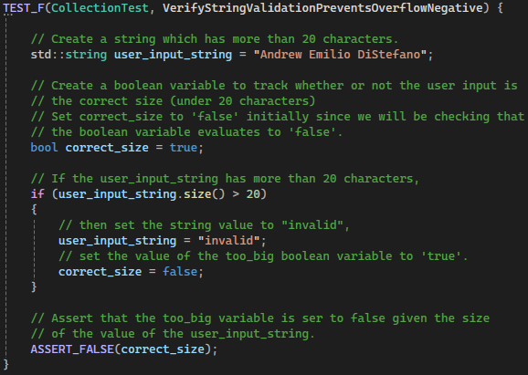
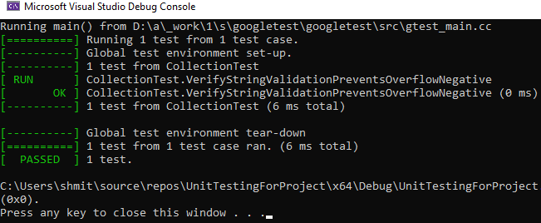
VerifyStringValidationPreventsOverflowNegative
This negative unit test checks for adherence to Standard 3: Always Validate Strings to Prevent Buffer Overflows (STD-003-CPP) by declaring a variable called ‘user_input_string’ which holds a string with 21 characters.
We use a boolean variable called ‘correct_size’ which is initialized with a value of ‘true’.
We then assert that, given the size of the string value of the ‘input_string’ variable, the value of the boolean ‘correct_size’ variable is set to ‘false’.
You may notice the similarities between this test and our VerifyStringValidationPreventsOverflowPositive test. The addition of a parallel negative test covers this test case from an additional angle makes our testing efforts more comprehensive for this test case.

Slide 13
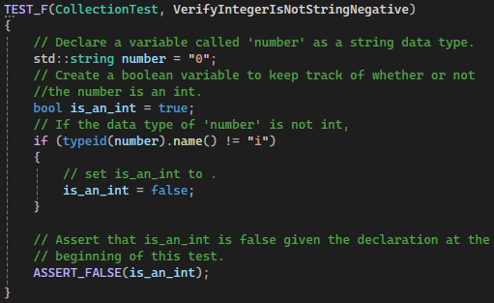
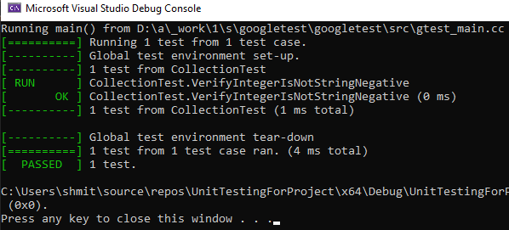
VerifyIntegerIsNotStringNegative
This negative unit test checks for adherence to Standard 1: Use Appropriate Data Types (STD-001-CPP) by declaring a variable called ‘number’ as a string data type when the name of the variable implies that it was meant to be used as an int data type.
We use a boolean variable called ‘is_an_int’ which is set to ‘false’ if the ‘number’ variable is not of int data type.
We then assert that ‘is_an_int’ has been set to false.

Slide 14
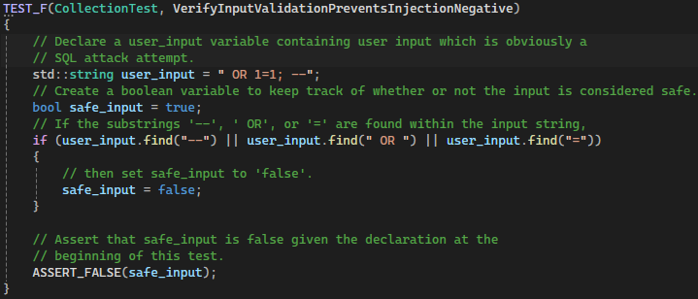
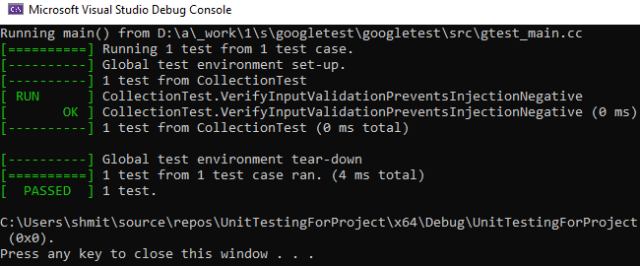
VerifyInputValidationPreventsInjectionNegative
This negative unit test checks for adherence to Standard 4: Always Validate Input to Prevent SQL Injections (STD-004-CPP) by declaring a variable called ‘user_input’ which contains an obvious SQL injection attempt.
We use a boolean variable called ‘safe_input’ which is set to ‘false’ if the variable contains characters or character combinations which indicate a possible SQL injection attack. We initialize this variable with the value ‘true’.
We then assert that ‘safe_input’ has been set to false given the suspicious substrings found in the value of the ‘user_input’ string.

Slide 15

AUTOMATION SUMMARY

Slide 16
TOOLS (1)
The following static testing tools will be used for the enforcement of this security policy:
Astrée
Axivion Bauhaus Suite
CodeSonar
“Not only a reliable debugging aid…[but]...a rigorous formal veriﬁer which can be included in a stringent certiﬁcation process”
(Cousot et al., 2007).
A highly robust static testing solution which is made to handle large software projects with complex system architectures (QT Group, 2025).
Known for focusing on critical defects such as memory leaks, system crashes, and security vulnerabilities (GrammaTech, n. d.).

Slide 17
TOOLS (2)
The following static testing tools will be used for the enforcement of this security policy:
Coverity
CppCheck
Parasoft
Highly comprehensive variety of static code analysis capabilities and is known for its low false-positive rate (PeerSpot, 2025).
“A popular, open-source, free, cross-platform static code analysis tool dedicated to C and C++. It is known for being easy to use and its simplicity” (Sibony, 2021).
Known for its comprehensive testing tool known for its integration of static testing with unit testing, security testing, and advanced analytics (Parasoft, 2025).

Slide 18
RISKS AND BENEFITS (1)
It is critical that we all remain in sync with principles and best practices. The solutions discussed in this presentation and in our new Security Policy will not only help to ensure the quality of our code, but will also condition our teams to rapidly adjust to the levels of company growth which we expect to see in the near future.
ACTING NOW
WAITING UNTIL LATER
If we act now, we can assure that company growth does not cause us to fall behind in terms of assuring the quality of our systems. The costs associated with making these changes is much less than the costs which could be incurred by not taking these issues seriously.
The more we wait, the further our current security and quality assurance measures will lag behind the trajectory of our organization’s growth. There is no benefit to putting these changes on hold and allowing our organization to become a producer of sub-standard systems and system components.

Slide 19
RECOMMENDATIONS (1)
The issues which should be addressed first are:
STD-004-CPP
STD-009-CPP
Adherence to Standard 4 (Always validate input to prevent SQL injection attacks) should be addressed immediately due to the level of control which attackers could gain over our SQL databases and the data stored within. The Foxton Group’s 2020 data breach, which resulted in “over 16,000 customer records, including sensitive financial data” (Radware, 2025) serves as a sobering example of what can happen when user input validation methods are insufficient.
Adherence to Standard 9 (Prevent User Input Format String Vulnerabilities) should also be addressed immediately due to the level of control which attackers could gain over entire systems through the passing of malicious user input into format strings. Since Tymm Twillman’s identification of this vulnerability in one of his clients’ systems back in 1999, the addressing of this potentially devastating vulnerability has been a top priority for organizations (Beschokov, n. d.). This vulnerability could lead to “unexpected crashing of code…unauthorized access to stack data…execution of an arbitrary code for an application…[and]...successful Denial of Service (DoS) (Beschokov, n. d.).

Slide 20
RECOMMENDATIONS (2)
The issues which should be addressed first are:
STATIC TESTING
UNIT TESTING
Throughout this presentation we have explored the power of static testing in the development of secure and high-quality systems. The implementation of a robust combination of static testing tools will help us to ensure the quality of our code and to enforce the standards and principles of this Security Policy. For these reasons, we believe that the implementation of static testing is one of the issues which we should address first.
The use of a unit testing framework such as GTest to test each component of our code as it is developed will help us to make sure that our C++ projects are made up of sustainable and manageable code, and to get rid of “stupid bugs” (NDC Conferences, 2018) before they become bigger issues later along in development process.

Slide 21
CONCLUSIONS (1)
What current gaps in the security policy still need to be addressed?
The addition of more principles and standards as our organization continues to grow will even further improve our ability to write secure code, ensuring that our systems minimize the possibility of successful attacks as much as possible. As we add new standards to our security policy, the addition of more static testing tools will likely become necessary. Additional static testing tools would enhance our ability to write system-specific tests (Kienle et al., 2012) which meet the current needs of our organization, and the addition of other static testing tools as any gaps in our security policy reveal themselves.
The use of threat response automation and threat intelligence opens up a wide variety of different security capabilities such as the ability to set up automatic alerts when system penetration attempts are suspected, (Chuvakin, 2021), and to set up response playbooks so that the system can automatically defend itself or even attempt to gain information which could lead to the apprehension of the attackers by law enforcement (Winston, 2021). These measures relate to Accounting, the third A of the Triple-A framework, since both types of tools rely on the comprehensive accounting of data from known and unknown users and their interactions with the system.

Slide 22
CONCLUSIONS (2)
What standards should be adopted to prevent future problems?
Principle 3 (Architect and Design for Security Policies) highlights the importance of taking secure coding practices into consideration during early stages of the development process (or of an iteration of the process). Although code is written during the ‘Build’ and the ‘Verify and Test’ phases of development, decisions which are made during the ‘Assess and Plan’ and the ‘Design’ stages of iterative development must take secure coding practices into consideration. For example, design documents such as UML class diagrams should adhere to best practices related to data type selection in adherence to standard STD-001-CPP (Use Appropriate Data Types).
Additional standards which could be added in the future include making sure that files are closed when they are not being used, such as the use of ‘std::ifstream::close’ after performing operations on a file with ifstream (GeeksForGeeks, 2023) in order to protect the contents of the file. Assuring that all iterator ranges are valid is another standard which could be added to our policy in the interest of avoiding (Britton & Long, 2023).

Slide 23
REFERENCES (1)
Britton, J., & Dewhurst, S. C. (2023, April 20). OOP50-CPP. Carnegie Mellon University.
https://wiki.sei.cmu.edu/confluence/pages/viewpage.action?pageId=88046570
Britton, J., & Mohindra, D. (2024, June 11). IDS06-J. Carnegie Mellon University.
https://wiki.sei.cmu.edu/confluence/pages/viewpage.action?pageId=88487836
Britton, J., & Long, F. (2023, April 20). CTR53-CPP. Use valid iterator ranges.
Carnegie Mellon University.
https://wiki.sei.cmu.edu/confluence/display/cplusplus/CTR53-CPP.+Use+
valid+iterator+ranges
Britton, J., & Pincar, J. (2023, April 20). Do Not Access Freed Memory. Carnegie
Mellon University.
https://wiki.sei.cmu.edu/confluence/display/cplusplus/MEM50-CPP.+Do+not+
access+freed+memory

Slide 24
REFERENCES (2)
Britton, J., & Seacord, R. C. (2018,December 11). DCL03-C. Carnegie Mellon
University. https://wiki.sei.cmu.edu/confluence/pages/viewpage.action?pageId=87152090
Beschokov, M. (n. d.). Format String Vulnerability. Wallarm.
https://www.wallarm.com/what/format-string-vulnerability
Chuvakin, A. (2021, March 19). 2021 Threat Intelligence Use Cases. Anton on Security.
https://medium.com/anton-on-security/2021-threat-intelligence-use-cases-
8f4423e250c5
Cousot, P., Cousot, R., Ferret, J., Mauborgne, L., Monniaux, D., Mine,
A., & Rival, X. (2007). Varieties of Static Analyzers: A Comparison
with ASTREE. Conference: Theoretical Aspects of Software
Engineering, 2007.
http://dx.doi.org/10.1109/TASE.2007.55

Slide 25
REFERENCES (3)
Fortinet. (2025). IEC-62443 Standard.
https://www.fortinet.com/resources/cyberglossary/iec-62443
Fortinet. (2025). What Is Authentication, Authorization, And Accounting
(AAA) Security?
https://www.fortinet.com/resources/cyberglossary/aaa-security
GeeksForGeeks. (2023, November 2). std::fstream::close() in C++.
https://www.geeksforgeeks.org/std-fstream-close-in-cpp/
Google Cloud. (n. d.). Confidential Computing.
https://cloud.google.com/security/products/confidential-computing?hl=en
Google Cloud. (n. d.). Encryption in Transit.
https://cloud.google.com/docs/security/encryption-in-transit

Slide 26
REFERENCES (4)
GeeksForGeeks. (2024, October 22). Unit Testing - Software Testing.
https://www.geeksforgeeks.org/unit-testing-software-testing/
GrammaTech. (n. d.). Codesonar.
https://www.verifysoft.com/GrammaTechCodeSonarDatasheet.pdf
IBM. (2023, January 24). What Is Penetration Testing? https://www.ibm.com/think/topics/penetration-testing
IBM. (2025, January 6). Content Encryption: In Flight and At Rest.
https://www.ibm.com/docs/en/aspera-on-cloud?topic=encryption-
content-in-flight-rest

Slide 27
REFERENCES (5)
Kienle, H. M., Kraft, J., & Nolte, T. (2012). System-specific static code analyses:
a case study in the complex embedded systems domain.
Software Quality Journal 20, 337–367.
https://doi.org/10.1007/s11219-011-9138-7
National Institute of Standards and Technology. (n. d.). Defense-in-Depth.
https://csrc.nist.gov/glossary/term/defense_in_depth
NDC Conferences. (2018, October 2). C++ Unit testing - the
good, the bad & the ugly - Dror Helper [Video]. YouTube.
https://www.youtube.com/watch?v=gCQDBz-TMIE
Parasoft. (2025). Static Code Analysis Solutions & Tools for Compliance.
https://www.parasoft.com/solutions/static-code-analysis

Slide 28
REFERENCES (6)
PeerSpot. (2025). What is Coverity?
https://www.peerspot.com/products/coverity-reviews
QT Group. (2025). Axivion Static Code Analysis.
https://www.qt.io/product/quality-assurance/axivion-static-code-analysis
Radware. (2025). SQL Injection: Examples, Real Life Attacks & 9 Defensive Measures
https://www.radware.com/cyberpedia/application-security/sql-injection/
Sibony, J, (2021, June 30). Top 9 C++ Static Code Analysis Tools. IncredibleBuild.
https://www.incredibuild.com/blog/top-9-c-static-code-analysis-tools

Slide 29
REFERENCES (7)
Winston, T. (2021, September 9). Cyber Threat Intelligence in ICS Sectors:
Context is Everything. Global Cybersecurity Alliance.
https://gca.isa.org/blog/cyber-threat-intelligence-in-ics-sectors-context-
is-everything

