Slide 1
Implementing FIXatdlSM
FIX TEACHING STREAM
Scott Atwell Co-Chair FPL Global Steering Committee American Century Investments
FPL Americas Trading Conference October 21, 2010

Slide 2
Agenda
FIXatdl Introduction
Inside FIXatdl
Demonstration
Additional Features and Common Issues

Slide 3
What is FIXatdl?
FIXatdl = FIX Algoritmic Trading
Definition Language
FIXatdl is a FIX Protocol standard
to define the interface
for algorithmic orders

Slide 4


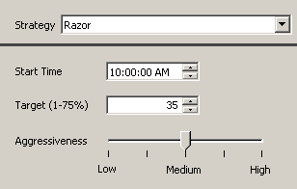
How Does FIXatdl Work?
Brokers create a FIXatdl XML file describing its algos:
Parameters
FIX tags
OMS vendors load the FIXatdl files into their trading app, eliminating the need for custom programming
Screen layout
Validation rules
Broker FIX Specification
FIXatdl File
Algo Screen

Slide 5



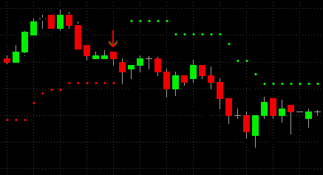

FIX Certification – The Old Way
Sell-side | Vendor | Buy-side
Repeat
for every Vendor and Client…
Send to Vendor
Meetings
Wait in Development Queue…
FIX Spec
Emails and Phone calls
Review and Correct
Implement…
z
z
z
…Re-implement
Certification Test
4 months later…

Slide 6


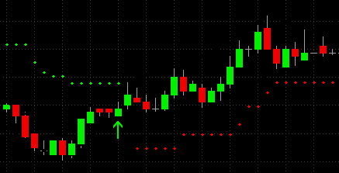

FIX Certification – The FIXatdl Way
Sell-side | Vendor | Buy-side
Write FIXatdl file once, deploy anywhere supported
+
1
Upload
Email or Web
FIX Spec FIXatdl File
2
Verify
3
Deploy

Slide 7

FIX Protocol + FIXatdl
FIXatdl is 100% compatible with the FIX Protocol messaging standard versions 4.0+ and 5.0+
No changes required to existing FIX engine & network
Supports user-defined custom FIX tags
Supports parameter validation rules, for example:
Example: “Max Volume Rate must be greater than Min Volume Rate”
One file may contain all broker algos globally
Show/hide algos based on order country, exchange, or asset class

Slide 8
FIXatdl – A Win, Win, Win for the Industry
Sellside Algo Providers
Release new algos to customers faster
Reduced vendor coordination effort
Better return on investment in algo development
OMS/EMS Vendors
Certify more algorithms in less time and at reduced cost
Significantly less re-programming effort to support changes
Buyside Firms
Faster access to new trading strategies, enabling more effective response to changing market conditions
End Result: Faster time-to-market with less effort and cost

Slide 9
Inside FIXatdl

Slide 10
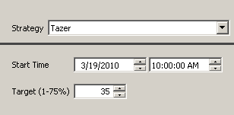
Inside FIXatdl
FIXatdl XML File
Algo Screen
<Strategy name="Tazer" uiRep="Tazer"
wireValue="3000" fixMsgType="D">
<!-- FIX Message -->
<Parameter name="EffectiveTime"
xsi:type="UTCTimestamp_t"
fixTag="168"/>
<Parameter name="VolTarget“
xsi:type="Percentage_t"
fixTag="7641" minValue="0.01"
maxValue="0.75"/>
<!-- Screen Layout -->
<lay:StrategyLayout>
<lay:StrategyPanel>
<lay:Control xsi:type="lay:Clock_t"
ID="StartTimeClock"
label="Start Time"
parameterRef="EffectiveTime"/>
<lay:Control xsi:type="lay:SingleSpinner_t"
ID="VolSpinner"
label="Target (1-75%)"
parameterRef="VolTarget"/>
</lay:StrategyPanel>
</lay:StrategyLayout>
</Strategy>
FIX Order Message
847=3000
7641=0.35
168=20100319-01:00:00
(an algo trade instruction
from client to broker)

Slide 11




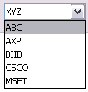



FIXatdl Widget Library
Choose from an expressive set of user-input types
Platform-neutral: Java, C#, C++, and web-compatible
Clock | TextField | SingleSpinner | DoubleSpinner
CheckBox | CheckBoxList | RadioButton | RadioButtonList
DropDownList | EditableDropDownList | SingleSelectList | MultiSelectList
Slider |  | Label

Slide 12
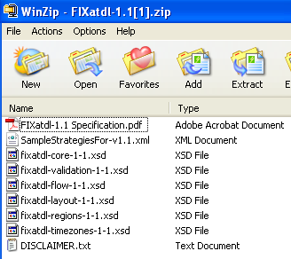
FIXatdl schema and specification
www.fixprotocol.org/FIXatdl
Specification document
Sample XML instance file
XML Schema Files
XML Schema file / namespace | Purpose
fixatdl-core-1-1.xsd | Data: Defines attributes and elements that are used to describe the data content of the algorithm and the parameters.
fixatdl-validation-1-1.xsd | Data: Defines attributes and elements used to author rules that are applied to the parameter values as a validation check. These rules can be simple where boundary conditions are checked, or complex where compound boolean expressions involving several parameters are evaluated.
fixatdl-layout-1-1.xsd | GUI: XML constructs to describe how a parameter should be rendered within a user interface – this includes recommendations about GUI controls and their relative location within the interface.
fixatdl-flow-1-1.xsd | GUI: Provides the ability to dynamically affect the behavior of a GUI control. Rules can be created to enable or disable parameters based on values entered by the user in other parameters.
fixatdl-regions-1-1.xsd | Data: Enumeration values for countries within three regions: TheAmericas, EuropeMiddleEastAfrica and AsiaPacificJapan.
fixatdl-timezones-1-1.xsd | Data: Lists enumeration values for world timezones based on zoneinfo database.

Slide 13
FIXatdl file structure
<Strategy>
<Parameter>
<Parameter>
. . .
<Parameter>
<StrategyLayout>
<StrategyEdit>
<StrategyEdit>
. . .
<StrategyEdit>
</Strategy>
<Strategies>
<Strategy>
… strategy definition …
</Strategy>
<Strategy>
… strategy definition …
</Strategy>
</Strategies>

Slide 14
Demonstration

Slide 15
Broker’s Existing Specification – The Starting Point
Strategy: “Strike Force Delta” (tag 847, value “Z”)
Description: “Seeks public and non-public liquidity without displaying the order in the book”
Parameters:
Start Time aka Effective Time (optional, tag 168, UTCTimestamp)
End Time aka Expire Time (optional, tag 126, UTCTimestamp)
Participation Rate (optional, tag 849, Percentage, 0.01 - 0.70)
I Would Price (optional, tag 9999, Price, > 0)
Execution Style (required, tag 9998, Int)
1 = Very Passive, 2 = Passive, 3 = Neutral, 4 = Aggressive, 5 = Very Aggressive
Include Auctions (required, tag 9997, Int)
0 = None, 1 = Open, 2 = Close, 3 = Open and Close
Rules:
If both are specified, Start Time must be less than End Time

Slide 16
Sketch Out Proposed Layout
Strike Force Delta
Seeks public and non-public liquidity without displaying the order in the book
I Would Price
Volume Limit
Execution Style
Very Passive
Passive
Neutral
Aggressive
Very Aggressive
Include Auctions
None
Open
Close
Both
Start Time
End Time
Now
End of Day
10/21/2010
2:30:00 PM
10/21/2010
2:30:00 PM

Slide 17
Build the shell of the FIXatdl XML file
<?xml version="1.0" encoding="utf-8"?>
<Strategies
xmlns="http://www.fixprotocol.org/FIXatdl-1-1/Core"
xmlns:val="http://www.fixprotocol.org/FIXatdl-1-1/Validation"
xmlns:lay="http://www.fixprotocol.org/FIXatdl-1-1/Layout"
xmlns:flow="http://www.fixprotocol.org/FIXatdl-1-1/Flow"
xmlns:xsi="http://www.w3.org/2001/XMLSchema-instance"
xsi:schemaLocation="http://www.fixprotocol.org/FIXatdl-1-1/Core"
strategyIdentifierTag="847"
versionIdentifierTag="958">
</Strategies>
Tag number for all strategies
Optional, can convey in FIX msg your “version”
We will add our Strategy definitions here…

Slide 18
Add Strategy and Parameters (without Layout / Edits)
Unique name, no spaces
Name trader sees
847=Z
<Strategy name="StrikeForceDelta" uiRep="Strike Force Delta" wireValue="Z" providerID="BrokerX">
<Parameter name="EffectiveTime" xsi:type="UTCTimestamp_t" fixTag="168" use="optional"/>
<Parameter name="ExpireTime" xsi:type="UTCTimestamp_t" fixTag="126" use="optional"/>
<Parameter name="ParticipationRate" xsi:type="Percentage_t" fixTag="849" use="optional" minValue="0.01" maxValue="0.70"/>
<Parameter name="IWouldPrice" xsi:type="Price_t" fixTag="9999" use="optional" minValue="0"/>
Parameters:
Start Time aka Effective Time (optional, tag 168, UTCTimestamp)
End Time aka Expire Time (optional, tag 126, UTCTimestamp)
Participation Rate (optional, tag 849, Percentage, 0.01 - 0.70)
I Would Price (optional, tag 9999, Price, > 0)

Slide 19
Continued… Add Strategy and Parameters (without Layout / Edits)
<Parameter name="ExecutionStyle" xsi:type="Int_t" fixTag="9998" use="required">
<EnumPair enumID="Very Passive" wireValue="1"/>
<EnumPair enumID="Passive" wireValue="2"/>
<EnumPair enumID="Neutral" wireValue="3"/>
<EnumPair enumID="Aggressive" wireValue="4"/>
<EnumPair enumID="Very Aggressive" wireValue="5"/>
</Parameter>
<Parameter name="IncludeAuctions" xsi:type="Int_t" fixTag="9997" use="required">
<EnumPair enumID="None" wireValue="0"/>
<EnumPair enumID="Open" wireValue="1"/>
<EnumPair enumID="Close" wireValue="2"/>
<EnumPair enumID="OpenAndClose" wireValue="3"/>
</Parameter>
</Strategy>
Parameters:
Execution Style (required, tag 9998, Int)
1 = Very Passive, 2 = Passive, 3 = Neutral,
4 = Aggressive, 5 = Very Aggressive
Include Auctions (required, tag 9997, Int)
0 = None, 1 = Open, 2 = Close, 3 = Open and Close
We will add Layout and Strategy Rules here…

Slide 20

Add an empty Layout
Element within <Strategy>
<lay:StrategyLayout>
<lay:StrategyPanel title="Strategy Parameters" collapsible="false" orientation="VERTICAL">
</lay:StrategyPanel>
</lay:StrategyLayout>

Slide 21
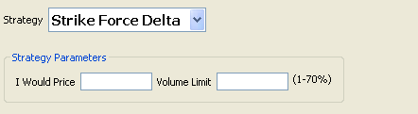
Add I Would Price and Volume Limit controls
<lay:StrategyPanel collapsible="false" orientation="HORIZONTAL">
<lay:Control ID="IWouldPriceField" xsi:type="lay:TextField_t" label="I Would Price" parameterRef="IWouldPrice"/>
<lay:Control ID="ParticipationRateField" xsi:type="lay:TextField_t" label="Volume Limit" parameterRef="ParticipationRate"/>
<lay:Control ID="ParticipationRateLabel" xsi:type="lay:Label_t" initValue="(1-70%)"/>
</lay:StrategyPanel>
Element within main <StrategyPanel>
Controls are ‘bound’ to Parameters via parameterRef -> Parameter/@name

Slide 22
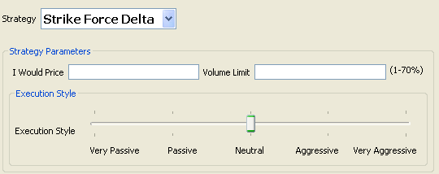
Add Execution Style (Aggressiveness) Slider
<lay:StrategyPanel title="Execution Style" collapsible="false" orientation="HORIZONTAL">
<lay:Control ID="ExecutionStyleSlider" xsi:type="lay:Slider_t" initValue="Neutral" label="Execution Style" parameterRef="ExecutionStyle">
<lay:ListItem uiRep="Very Passive" enumID="Very Passive"/>
<lay:ListItem uiRep="Passive" enumID="Passive"/>
<lay:ListItem uiRep="Neutral" enumID="Neutral"/>
<lay:ListItem uiRep="Aggressive" enumID="Aggressive"/>
<lay:ListItem uiRep="Very Aggressive" enumID="Very Aggressive"/>
</lay:Control>
</lay:StrategyPanel>
Element within main <StrategyPanel>
Control’s ListItem/@enumID ties to Parameter’s EnumPair/@enumID

Slide 23
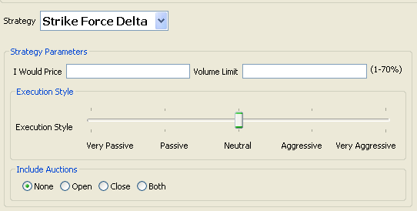
Add Include Auction Radio Buttons
<lay:StrategyPanel title="Include Auctions" collapsible="false" orientation="HORIZONTAL">
<lay:Control ID="IncludeAuctionsField" xsi:type="lay:RadioButtonList_t" initValue="None" orientation="HORIZONTAL" label="" parameterRef="IncludeAuctions">
<lay:ListItem uiRep="None" enumID="None"/>
<lay:ListItem uiRep="Open" enumID="Open"/>
<lay:ListItem uiRep="Close" enumID="Close"/>
<lay:ListItem uiRep="Both" enumID="OpenAndClose"/>
</lay:Control>
</lay:StrategyPanel>
Element within main <StrategyPanel>
Control’s ListItem/@enumID ties to Parameter’s EnumPair/@enumID

Slide 24
Add Start Time……
<lay:StrategyPanel collapsible="false" orientation="HORIZONTAL">
<lay:StrategyPanel collapsible="false" orientation="VERTICAL" title="Start Time">
<lay:StrategyPanel collapsible="false" orientation="HORIZONTAL">
<lay:Control ID="c_NoStartTime" xsi:type="lay:RadioButton_t" label="Now" initValue="true" radioGroup="StartTimeRB"/>
</lay:StrategyPanel>
<lay:StrategyPanel collapsible="false" orientation="HORIZONTAL">
<lay:Control ID="c_EnableStartTime" xsi:type="lay:RadioButton_t" label="" radioGroup="StartTimeRB"/>
<lay:Control ID="StartTimeClock" xsi:type="lay:Clock_t" label="" parameterRef="EffectiveTime">
<flow:StateRule enabled="false" value="{NULL}">
<val:Edit field="c_EnableStartTime" operator="EQ" value="false"/>
</flow:StateRule>
</lay:Control>
</lay:StrategyPanel>
</lay:StrategyPanel>
Element within main <StrategyPanel>
Radio Button
Radio Button
Clock
State Rule
Enables Clock when c_EnableStartTime Radio Button is selected
Will continue (blue StrategyPanel) on next slide

Slide 25
Add End Time……
<lay:StrategyPanel collapsible="false" orientation="VERTICAL" title="End Time">
<lay:StrategyPanel collapsible="false" orientation="HORIZONTAL">
<lay:Control ID="c_NoEndTime" xsi:type="lay:RadioButton_t" label="End of Day" initValue="true" radioGroup="EndTimeRB"/>
</lay:StrategyPanel>
<lay:StrategyPanel collapsible="false" orientation="HORIZONTAL">
<lay:Control ID="c_EnableEndTime" xsi:type="lay:RadioButton_t" label="" radioGroup="EndTimeRB"/>
<lay:Control ID="EndTimeClock" xsi:type="lay:Clock_t" label="" parameterRef="ExpireTime">
<flow:StateRule enabled="false" value="{NULL}">
<val:Edit field="c_EnableEndTime" operator="EQ" value="false"/>
</flow:StateRule>
</lay:Control>
</lay:StrategyPanel>
</lay:StrategyPanel>
</lay:StrategyPanel>
Continued (blue StrategyPanel) from previous slide
Radio Button
Radio Button
Clock
State Rule
Enables Clock when c_EnableEndTime Radio Button is selected

Slide 26
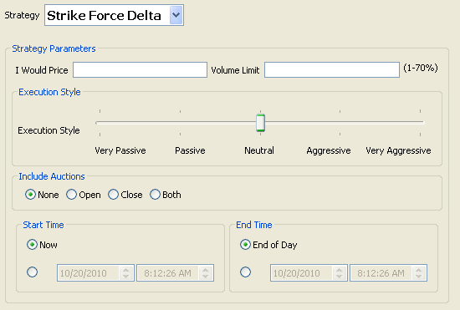

Render
Defaults: 847=Z 9998=3 9997=0

Slide 27
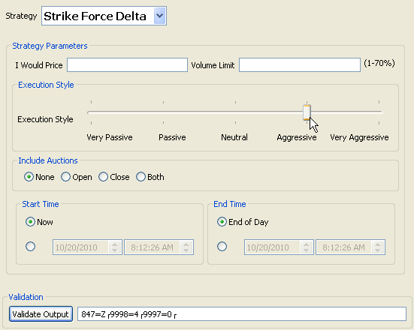
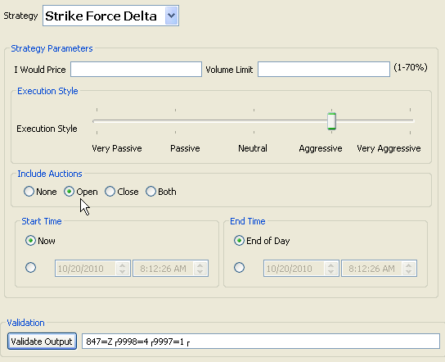
Test Different Combinations
Aggressive results in 9998=4
Include Open results in 9997=1

Slide 28
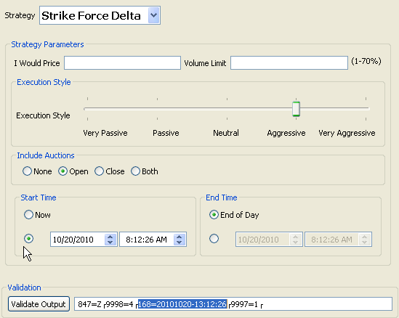
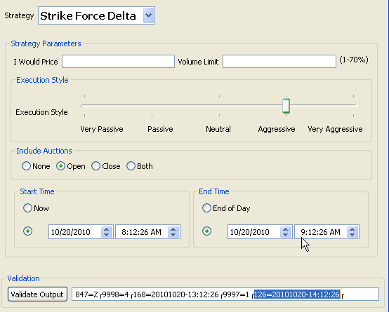
Test Different Combinations
StartTime results in 168=20101020-13:12:26
EndTime (+1 hr) results in 126=20101020-14:12:26

Slide 29
Add StrategyEdit Validation Rules
<val:StrategyEdit errorMessage="Start time must be less than end time.">
<val:Edit logicOperator="OR">
<val:Edit field="ExpireTime" operator="NX"/>
<val:Edit field="EffectiveTime" operator="NX"/>
<val:Edit field="ExpireTime" operator="GT" field2="EffectiveTime"/>
</val:Edit>
</val:StrategyEdit>
Element within <Strategy> and after <StrategyLayout> section
“OR” – at least one in list must be true
“NX” – Null/Not Set
“GT” – Greater Than
StrategyEdit is an ‘assertion’. The errorMessage will be generated if it is NOT TRUE.
This rule reads: (ExpireTime IS NULL OR EffectiveTime IS NULL OR ExpireTime > EffectiveTime)
The IS NULL checks are necessary because the parameters are optional.

Slide 30
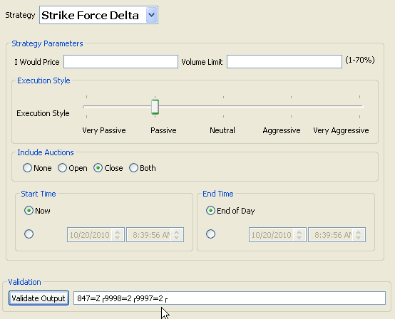
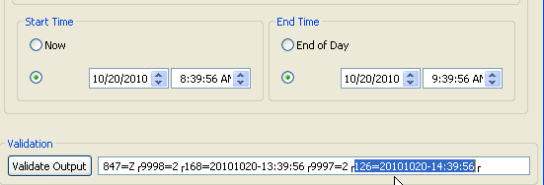
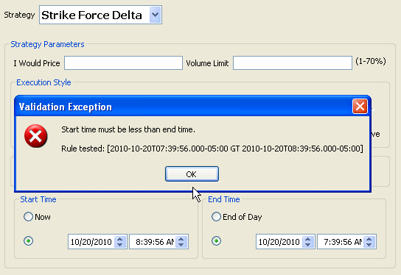
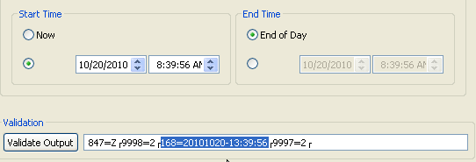
Test Strategy Rules
EndTime > StartTime
StartTime and EndTime are not set
StartTime only is set

Slide 31
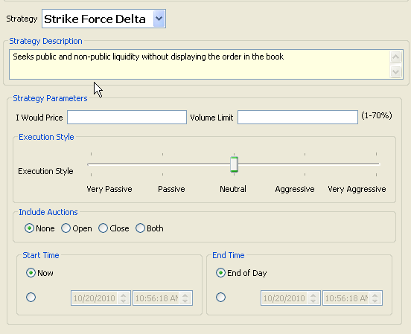
Add Descripton to Strategy
<Strategy name="StrikeForceDelta" uiRep="Strike Force Delta" wireValue="Z" providerID="BrokerX">
<Description>Seeks public and non-public liquidity without displaying the order in the book</Description>
<Parameter name="EffectiveTime" xsi:type="UTCTimestamp_t" fixTag="168" use="optional"/>
<Parameter name="ExpireTime" xsi:type="UTCTimestamp_t" fixTag="126" use="optional"/>
<Description> is an optional element of <Strategy>
Description can appear on screen

Slide 32
Additional Features and Common Issues

Slide 33


Common Issue: Clock control’s Parameter is optional
Need ‘helper’ control to disable it. Choices: Checkbox or Radio Button
<lay:StrategyPanel collapsible="false" orientation="VERTICAL" title="Start Time">
<lay:StrategyPanel collapsible="false" orientation="HORIZONTAL">
<lay:Control ID="c_NoStartTime" xsi:type="lay:RadioButton_t" label="Now" initValue="true" radioGroup="StartTimeRB"/>
</lay:StrategyPanel>
<lay:StrategyPanel collapsible="false" orientation="HORIZONTAL">
<lay:Control ID="c_EnableStartTime" xsi:type="lay:RadioButton_t" label="" radioGroup="StartTimeRB"/>
<lay:Control ID="StartTimeClock" xsi:type="lay:Clock_t" label="" parameterRef="EffectiveTime">
<flow:StateRule enabled="false" value="{NULL}">
<val:Edit field="c_EnableStartTime" operator="EQ" value="false"/>
</flow:StateRule>
</lay:Control>
</lay:StrategyPanel>
</lay:StrategyPanel>
<lay:StrategyPanel collapsible="false" orientation="HORIZONTAL" title="Start Time">
<lay:Control ID="c_EnableStartTime" xsi:type="lay:CheckBox_t" label="" initValue="false"/>
<lay:Control ID="StartTimeClock" xsi:type="lay:Clock_t" label="" parameterRef="EffectiveTime">
<flow:StateRule enabled="false" value="{NULL}">
<val:Edit field="c_EnableStartTime" operator="EQ" value="false"/>
</flow:StateRule>
</lay:Control>
</lay:StrategyPanel>
CheckBox
State Rule
Enables Clock when c_EnableStartTime CheckBox is selected

Slide 34

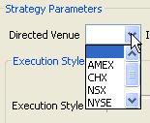
Common Issue: Drop Down List’s parameter is optional
<Parameter fixTag="100" name="DirectedVenue" use="optional" xsi:type="String_t">
<EnumPair enumID="e_NotSet" wireValue="{NULL}"/>
<EnumPair enumID="e_AMEX" wireValue="A"/>
<EnumPair enumID="e_CHX" wireValue="MW"/>
<EnumPair enumID="e_NSX" wireValue="C"/>
<EnumPair enumID="e_NYSE" wireValue="N"/>
<EnumPair enumID="e_PHLX" wireValue="PH"/>
</Parameter>
EnumPair with wireValue = “{NULL}”
<lay:Control ID="c_DirectedVenue" label="Directed Venue" parameterRef="DirectedVenue" xsi:type="lay:DropDownList_t">
<lay:ListItem enumID="e_NotSet" uiRep=""/>
<lay:ListItem enumID="e_AMEX" uiRep="AMEX"/>
<lay:ListItem enumID="e_CHX" uiRep="CHX"/>
<lay:ListItem enumID="e_NSX" uiRep="NSX"/>
<lay:ListItem enumID="e_NYSE" uiRep="NYSE"/>
<lay:ListItem enumID="e_PHLX" uiRep="PHLX"/>
</lay:Control>
ListItem with uiRep = “”

Slide 35
Using Strategy Filters – Region/Country Filtering
<Strategy name="EuropeAndAsiaOnly" uiRep="Europe and Asia Only" wireValue="3“>
<Regions>
<Region name="AsiaPacificJapan" inclusion="Include"/>
<Region name="EuropeMiddleEastAfrica" inclusion="Include"/>
</Regions>
AsiaPacificJapan OR EMEA
<Strategy name="USOnly" uiRep="U.S. Only" wireValue="3”>
<Regions>
<Region name="TheAmericas" inclusion="Include">
<Country inclusion="Include" CountryCode="US"/>
</Region>
</Regions>
United States ONLY
<Strategy name="AsiaExJapan" uiRep="Asia Excluding Japan" wireValue="3”>
<Regions>
<Region name="AsiaPacificJapan" inclusion="Include">
<Country inclusion="Exclude" CountryCode="JP"/>
</Region>
</Regions>
Asia/Pac EXCLUDING Japan

Slide 36
Using Strategy Filters – Security Type Filtering
<Strategy name="EquitiesOnly" uiRep="Equities Only" wireValue="3">
<SecurityTypes>
<SecurityType name="CS" inclusion="Include"/>
</SecurityTypes>
Equities ONLY (“CS” = Equities)
<Strategy name="FuturesOnly" uiRep="Futures Only" wireValue="3">
<SecurityTypes>
<SecurityType name="FUT" inclusion="Include"/>
</SecurityTypes>
Futures ONLY
<Strategy name="ExcludeFX" uiRep="Exclude FX" wireValue="3">
<SecurityTypes>
<SecurityType name="FXSPOT" inclusion="Exclude"/>
<SecurityType name="FXFWD" inclusion="Exclude"/>
</SecurityTypes>
EXCLUDE FX (FXSPOT, FXFWD)

Slide 37
Using “Input Data” within Layout or as StrategyEdit
OMS can provide non algo-specific FIX field values. Use “FIX_<fieldname>”
<lay:Control ID="PriceField" xsi:type="lay:TextField_t" initValue="" initFixField="FIX_Price" initPolicy="UseFixField">
Initialize TextField with Price (tag 44)
<val:StrategyEdit errorMessage="FIX Limit Price is required.">
<val:Edit field="FIX_Price" operator="EX" />
</val:StrategyEdit>
Validation rule: FIX Price (tag 44) must be set (“EX”)

Slide 38
Easy: Use the Strategy Parameter repeating group vs. UDFs
<Strategies
xmlns="http://www.fixprotocol.org/FIXatdl-1-1/Core"
xmlns:val="http://www.fixprotocol.org/FIXatdl-1-1/Validation"
xmlns:lay="http://www.fixprotocol.org/FIXatdl-1-1/Layout"
xmlns:flow="http://www.fixprotocol.org/FIXatdl-1-1/Flow"
xmlns:xsi="http://www.w3.org/2001/XMLSchema-instance"
xsi:schemaLocation="http://www.fixprotocol.org/FIXatdl-1-1/Core” imageLocation="/images/banner.gif"
strategyIdentifierTag="847"
versionIdentifierTag="958"
tag957Support="true">
Specify tag957Support=true at <Strategies> level and any Parameter with a fixTag will go in standard repeating group
<Strategy name="StrikeForceDelta" uiRep="Strike Force Delta" wireValue="Z" providerID="BrokerX">
<Parameter name="IWouldPrice" xsi:type="Price_t" use="optional" minValue="0"/>
<Parameter name="ExecutionStyle" xsi:type="Int_t" use="required">
<EnumPair enumID="Very Passive" wireValue="1"/>
<EnumPair enumID="Passive" wireValue="2"/>
<EnumPair enumID="Neutral" wireValue="3"/>
<EnumPair enumID="Aggressive" wireValue="4"/>
<EnumPair enumID="Very Aggressive" wireValue="5"/>
</Parameter>
<Parameter name="IncludeAuctions" xsi:type="Int_t" use="required">
<EnumPair enumID="None" wireValue="0"/>
<EnumPair enumID="Open" wireValue="1"/>
<EnumPair enumID="Close" wireValue="2"/>
<EnumPair enumID="OpenAndClose" wireValue="3"/>
</Parameter>
No wireValue
847=Z
957=3
958=ExecutionStyle
959=1
960=3
958=IncludeAuctions
959=1
960=0
958=IWouldPrice
959=8
960=12.34

Slide 39
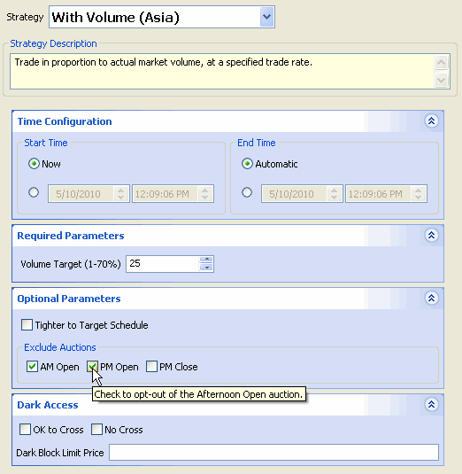
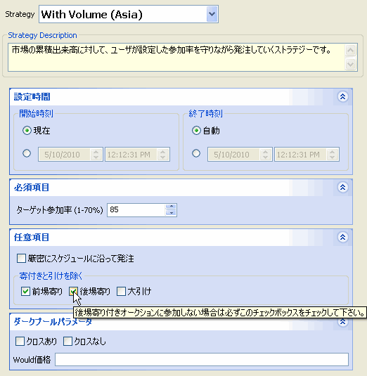
FIXatdl Multi-language Support
Publishers can provide files in any language
English and Japanese versions of Nomura’s “With Volume” strategy as displayed on atdl4j open source tool

Slide 40
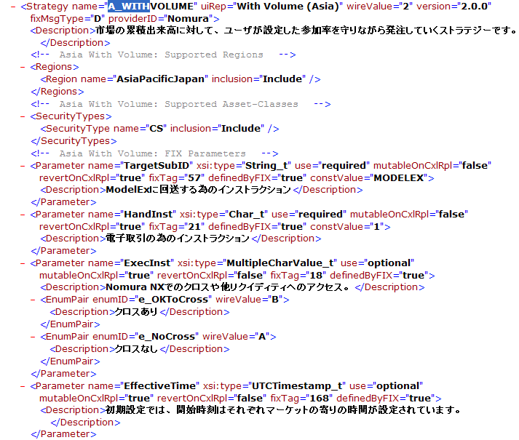
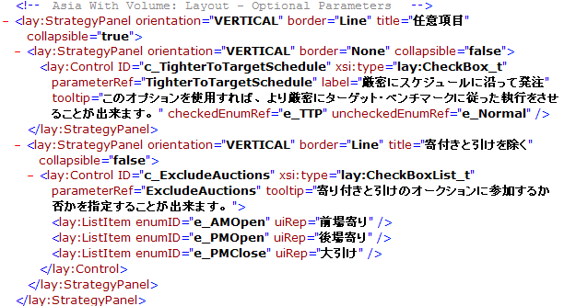
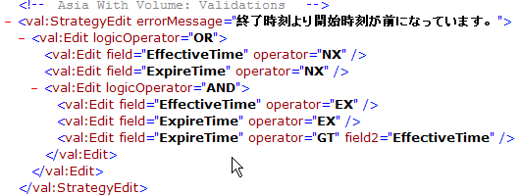
FIXatdl –Multi-language support (ex English/Japanese)
Simply substitute non-English for the values displayed on screen to user

Slide 41
FIXatdl - Summary
Revolutionizes the algorithmic trading deployment process
Complements the FIX Protocol messaging standard
A “Triple Win” providing key benefits to:
Buyside
Sellside
Vendors
End result is Faster Time-to-Market for the algo provider with
Less Effort and Cost for the customer and customer’s vendors
www.fixprotocol.org/FIXatdl

