Slide 1


High-level Overview
As of: November 29, 2010
Core developers: Scott Atwell, John Shields
Founding developers: Danilo Tuler, Renato Gallart

Slide 2
Contents
Overview of atdl4j Project
Can Serve Two Functions
Standalone Testing Tool
Embedded “Pop-Up” within an OMS
Package Structure
GUI Composition
Listeners
Configuration

Slide 3
Overview of atdl4j Project

Slide 4
Overview
atdl4j is an open source and not-for-profit JavaTM implementation of FIXatdlSM, the FIX ProtocolSM Algorithmic Trading Definition Language standard developed by FIX Protocol Limited (FPL).
atdl4j is a collaboration between Buy-side and Sell-side innovators within the Electronic Trading industry, and is integrated within the trading systems of several major investment banks and FIX providers. The atdl4j project is intended to promote open source standards within finance, and to increase the adoption rate of the FIXatdl standard itself.
While the atdl4j open source effort encourages the use of and implementation of the FIXatdl standard, it is an independent effort and not directly affiliated with the FIX Protocol Limited organization.

Slide 5
Features
Displays algo input screens based on the latest industry-standard FIXatdl 1.1 XML schema
Reads and generates algorithm-specific FIX message content
Can be integrated into a trading system, or run as a standalone testing/validation tool.
Supports the full set of UI widgets defined in FIXatdl 1.1
Support for message validation and widget state rules (such as show/hide and enable/disable.)
Supports strategy filtering, customizable settings, and context-specific views (for example Cancel/Replace mode)
Written in the Java language using standard libraries
Source code can be modified to support in-house FIXatdl schema extensions

Slide 6
Open Source License
atdl4j is licensed under the MIT License.
The MIT License permits reuse within proprietary software on the condition that the license is distributed with that software, making it ideal for use within the legal guidelines of most financial firms.
Please consult the Legal and Compliance department at your firm before adopting atdl4j or other open source software.

Slide 7
Key Contributors
Scott Atwell, American Century
John Shields, Nomura
Danilo Tuler, Investtools
Renato Gallart, Investtools

Slide 8
Community
We kindly ask that those who do get value from the atdl4j platform contribute back to the community.
If you wish to contribute code to atdl4j, please fork the atdl4j project on GitHub.

Slide 9
Can Serve Two Functions
Standalone Testing Tool
Embedded “Pop-Up” within an OMS

Slide 10
Standalone Testing Tool

Slide 11
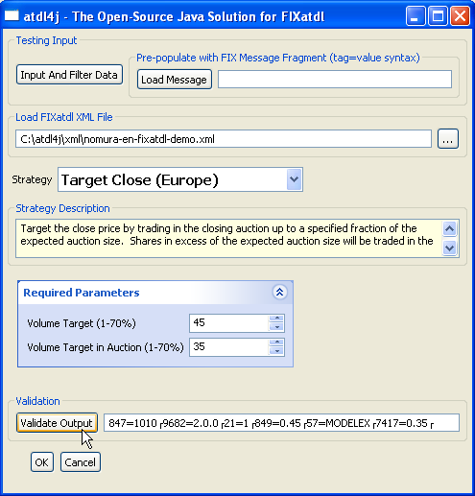
As Standalone Testing Tool (SWT) SWTAtdl4jTesterApp
Simulate OMS order-specific input
Populate with FIX msg fragment
Select and Load FIXatdl XML file
Main Content Pane
(embeddable within OMS)
Atdl4jCompositePanel
Perform Validation and View
Resulting FIX tag=value message

Slide 12
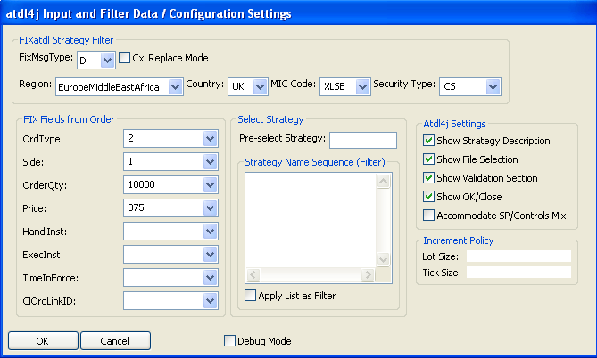
As Standalone Testing Tool (SWT) Simulate OMS order-specific input and control configuration
Drives FIXatdl’s Strategy Filtering
Msg Type, Cxl Replace Mode
Region, Country, MIC, Sec Type
Control atdl4j-specific settings
Specify default Lot and/or Tick Size
Control/@incrementPolicy=“LotSize”
Control/@incrementPolicy=“Tick”
Debug logging
Strategy Selection
Pre-select a Strategy
Control sequence of Strategy List display
Ability to filter out ‘other’ strategies
Order Input that can be referenced via StateRule or StrategyEdit
as “FIX_OrdType”, “FIX_Side”, “FIX_OrderQty”, “FIX_Price”, etc
eg, Buy 10,000 Limit of 375

Slide 13
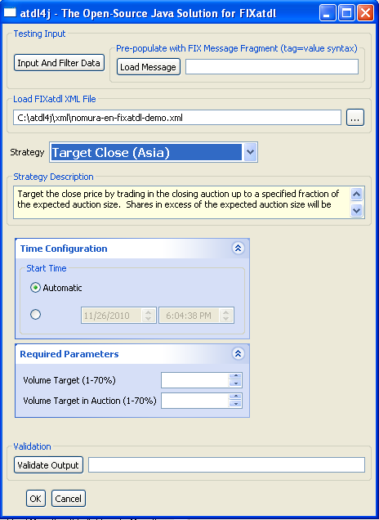
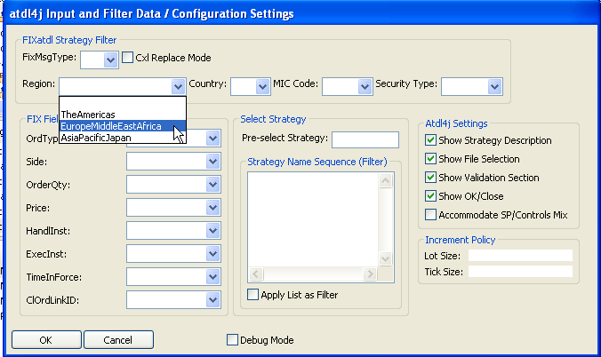
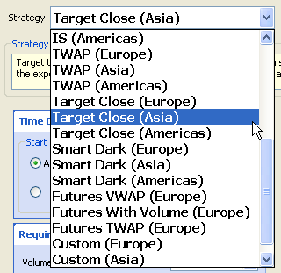
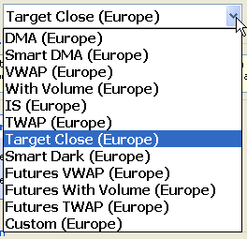
As Standalone Testing Tool (SWT) Simulate OMS order-specific input – Strategy Filtering
FILTER
FOR
REGION

Slide 14
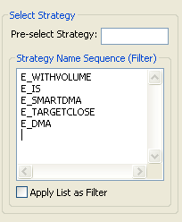
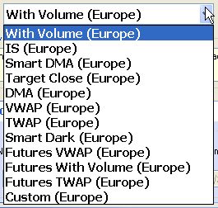
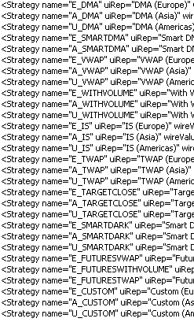
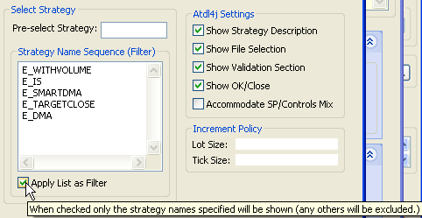
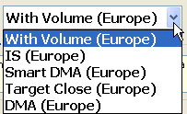
As Standalone Testing Tool (SWT) Externally Configure Strategy List Display Sequence
OMS could make these file/broker-specific config settings
(without altering the broker-provided FIXatdl file)
CHANGE ORDER
OTHERS APPEAR
IN FILE’S ORDER
‘AS FILTER’
EXCLUDES
OTHERS

Slide 15
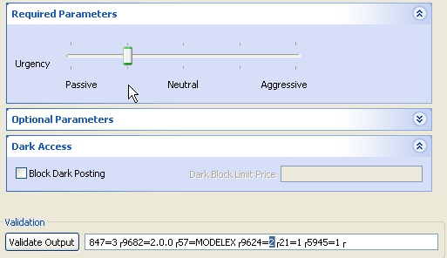
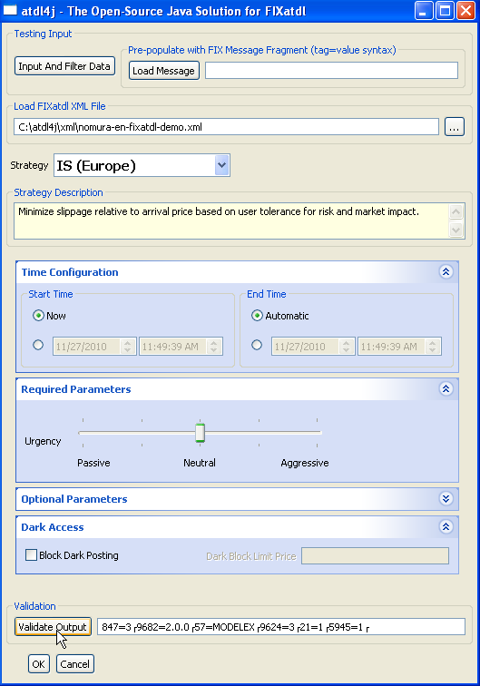
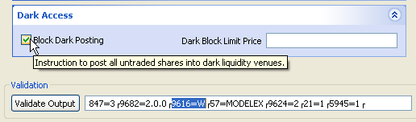
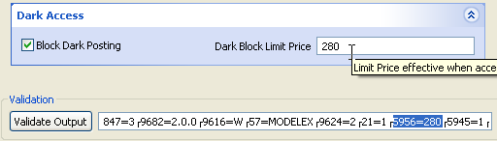
As Standalone Testing Tool (SWT) Repetitive Unit Testing – Output
847=3 9682=2.0.0 57=MODELEX 9624=2 21=1 5945=1
847=3 9682=2.0.0 9616=W 57=MODELEX 9624=2 21=1 5945=1
847=3 9682=2.0.0 57=MODELEX 9624=3 21=1 5945=1
847=3 9682=2.0.0 9616=W 57=MODELEX 9624=2 21=1 5956=280 5945=1

Slide 16
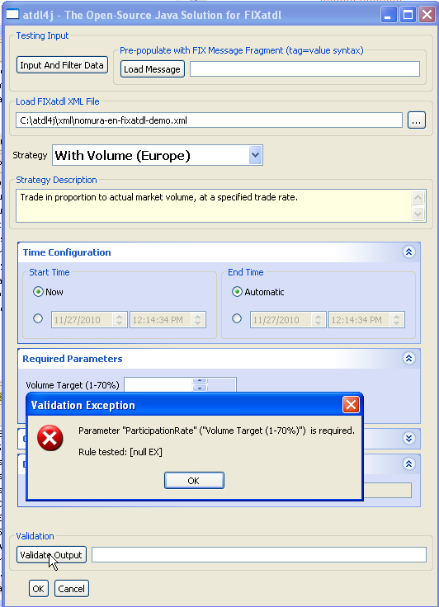
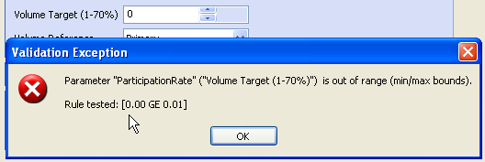
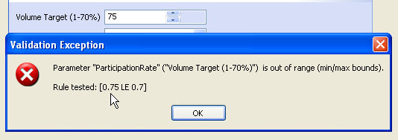
As Standalone Testing Tool (SWT) Repetitive Unit Testing – Required parameters, ranges, etc

Slide 17
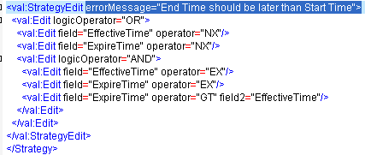
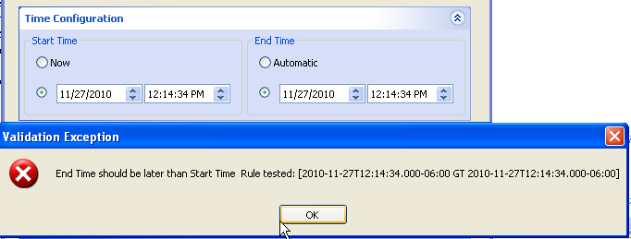
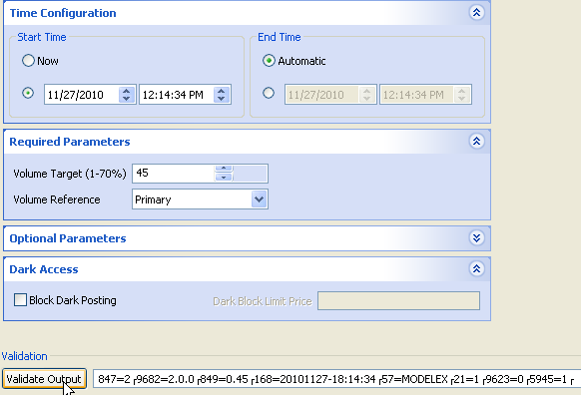
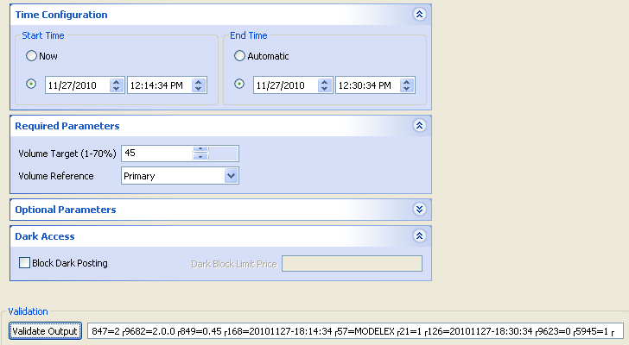
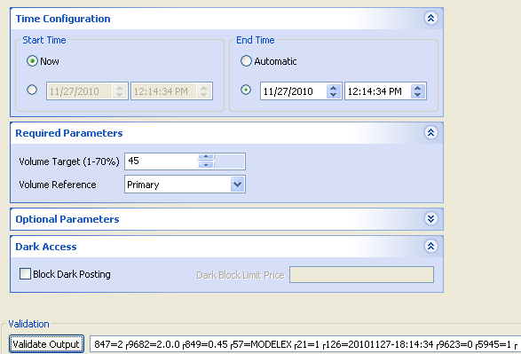
As Standalone Testing Tool (SWT) Repetitive Unit Testing – Validation Rules (StrategyEdit)
OK:
No End
OK: End > Start
OK:
No Start

Slide 18
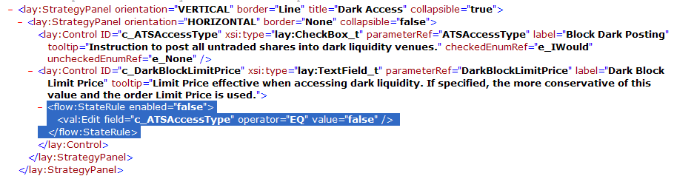
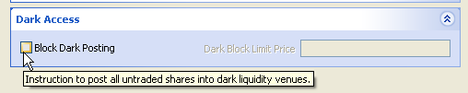

As Standalone Testing Tool (SWT) Test StateRule execution
Unchecked: Disabled
Checked: Enabled

Slide 19
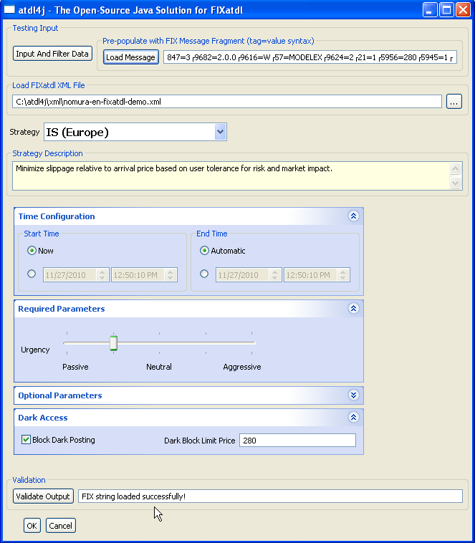
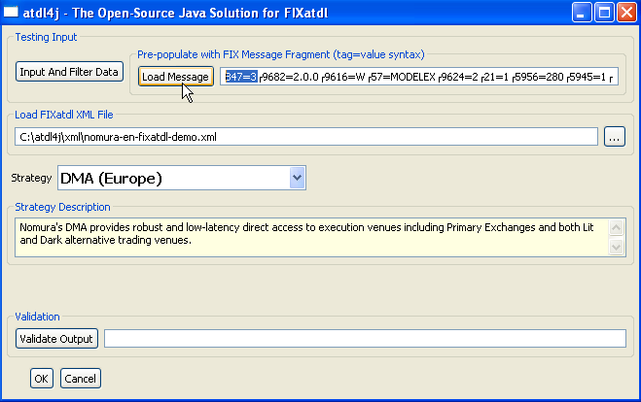
As Standalone Testing Tool (SWT) Simulate Re-loading screen (eg for Cancel/Replace)
847=3 9682=2.0.0 9616=W 57=MODELEX 9624=2 21=1 5956=280 5945=1
Load Message button:
Selects appropriate strategy
Populates controls with parameter values
And fires StateRule events if applicable

Slide 20
Embedded “Pop-Up” within an OMS

Slide 21
Embedded “Pop-up” within an OMS Atdl4jCompositePanel

Slide 22
Package Structure

Slide 23
Package Structure
FIXatdl schema:
org.atdl4j.fixatdl.core | JAXB-generated classes for FIXatdl spec's core schema
org.atdl4j.fixatdl.flow | JAXB-generated classes for FIXatdl spec's flow schema
org.atdl4j.fixatdl.layout | JAXB-generated classes for FIXatdl spec's layout schema
org.atdl4j.fixatdl.regions | JAXB-generated classes for FIXatdl spec's regions schema
org.atdl4j.fixatdl.timezones | JAXB-generated classes for FIXatdl spec's timezones schema
org.atdl4j.fixatdl.validation | JAXB-generated classes for FIXatdl spec's validation schema
Data/Validation Rule handling:
org.atdl4j.data | ValidationRule interface, ControlTypeConverter<E>, ParameterTypeConverter<E>. StrategyRuleset, etc
org.atdl4j.data.converter | AbstractTypeConverter<E>, type-specific Converter classes
org.atdl4j.data.exception | ValidationException
org.atdl4j.data.fix | PlainFIXMessageBuilder, Tag959Helper
org.atdl4j.data.validation | ValidationRuleFactory, Length, Logical, Parameter, Pattern, Value, etc Rule classes

Slide 24
Package Structure
Config:
org.atdl4j.config | Atdl4jConfiguration interface, Atdl4jConfig (contains static Atdl4jConfiguration), AbstractAtdl4jConfiguration, InputAndFilterData, StrategyFilterInputData
Base UI Infrastructure:
org.atdl4j.ui | FIXatdl Layout interfaces: StrategiesUI, StrategyUI, Atdl4jWidget<E>, etc
org.atdl4j.ui.impl | Base/Abstract UI classes implementing interfaces
org.atdl4j.ui.app | Interfaces: Atdl4jTesterPanel, Atdl4jCompositePanel, StrategySelectionPanel, etc plus Listeners
org.atdl4j.ui.app.impl | Abstract UI classes implementing interfaces
SWT-specific UI:
org.atdl4j.ui.swt.config | SWTAtdl4jConfiguration
org.atdl4j.ui.swt | SWTWidget<E> interface
org.atdl4j.ui.swt.impl | SWTStrategiesUI, SWTStrategyUI, etc
org.atdl4j.ui.swt app.impl | SWTAtdl4jTesterApp, SWTAtdl4jCompositePanel, etc
org.atdl4j.ui.swt.widget | FIXatdl’s Control: AbstractSWTWidget<E>, SWTTextFieldWidget, SWTClockWidget, SWTDropDownListWidget, SWTSliderWidget, etc
org.atdl4j.ui.swt.util org.atdl4j.ui.swt.test | SWTMenuHelper, SWTNullableSpinner, SWTNumberFormatVerifyListener, SWTParameterListenerWrapper, SWTDebugMouseTrackListener, SWTSideListener

Slide 25
Package Structure
Interfaces | Base/Abstract | GUI system-specific
org.atdl4j.config |  | org.atdl4j.swt.config
org.atdl4j.ui | org.atdl4j.ui.impl | org.atdl4j.ui.swt.impl org.atdl4j.ui.swt.widget
org.atdl4j.app | org.atdl4j.app.impl | org.atdl4j.swt.app.impl

Slide 26
GUI Composition

Slide 27
GUI Composition Nesting - Overall
SWTAtdl4jTesterApp
main()
Atdl4jTesterAppPanel
SWTAtdl4jTesterAppPanel
Atdl4jCompositePanel
SWTAtdl4jCompositePanel

Slide 28
GUI Composition ui.app.Atdl4jTesterAppPanel, ui.swt.app.SWTAtdl4jTesterAppPanel
ui.Atdl4jInputAndFilterDataSelectionPanel
ui.app.impl.AbstractAtdl4jInputAndFilterDataSelectionPanel
ui.swt.app.impl.SWTAtdl4jInputAndFilterDataSelectionPanel
popup
ui.Atdl4jInputAndFilterDataPanel
ui.app.impl.AbstractAtdl4jInputAndFilterDataPanel
ui.swt.app.impl.SWTAtdl4jInputAndFilterDataPanel
ui.app.FixMsgLoadPanel
ui.app.impl.AbstractFixMsgLoadPanel ui.swt.app.impl.SWTFixMsgLoadPanel
ui.app.FixatdlFileSelectionPanel
ui.app.impl.AbstractFixatdlFileSelectionPanel
ui.swt.app.impl.SWTFixatdlFileSelectionPanel
ui.app.Atdl4jCompositePanel
ui.swt.app.SWTAtdl4jCompositePanel
Atdl4jTesterPanel
setVisibleTestingInputSection()
setVisibleFileSelectionSection()
setVisibleValidateOutputSection()
setVisibleOkCancelButtonSection()

Slide 29
GUI Composition ui.app.Atdl4jCompositePanel, ui.swt.app.SWTAtdl4jCompositePanel
ui.app.StrategySelectionPanel
ui.app.impl.AbstractStrategySelectionPanel
ui.swt.app.impl.SWTStrategySelectionPanel
ui.app.StrategyDescriptionPanel
ui.app.impl.AbstractStrategyDescriptionPanel
ui.swt.app.impl.SWTStrategyDescriptionPanel
ui.app.Atdl4jCompositePanel
ui.swt.app.SWTAtdl4jCompositePanel
Atdl4jCompositePanel’s own OK / Cancel buttons
Atdl4jCompositePanel
setVisibleOkCancelButtonSection()

Slide 30
Listeners

Slide 31
Listeners
Listener | Methods
ui.app.Atdl4jTesterPanelListener | okButtonSelected() cancelButtonSelected()
ui.app.Atdl4jCompositePanelListener | okButtonSelected() cancelButtonSelected()
ui.app.StrategiesUIListener | strategySelected()
ui.app.FixatdlFileSelectionPanelListener | fixatdlFileSelected()
ui.app.FixMsgLoadPanelListener | fixMsgLoadSelected()
ui.app.StrategySelectionPanelListener | strategySelected()
ui.app.StrategyEventListener | strategyNotValidated() strategySelected() strategyValidated() strategyValidationFailed()
ui.app.Atdl4jInputAndFilterDataPanelListener | inputAndFilterDataSpecified()

Slide 32
Configuration

Slide 33
Configuration Atdl4jConfiguration – static / global settings
Interface config.Atdl4jConfiguration
getClassNameAtdl4jWidgetFor___()
is/setDebugLoggingLevel()
is/setCatchAll___Exceptions()
is/setShow___()
config.Atdl4jConfig – static data member/methods
Atdl4jConfiguration get/setConfig()
createAtdl4jCompositePanel()
createAtdl4jTesterPanel()

Slide 34
Configuration SWTAtdl4jConfiguration – SWT-specific class names
ui.swt.config.SWTAtdl4jConfiguration extends AbstractAtdl4jConfiguration
private static String PACKAGE_PATH_ORG_ATDL4J_UI_SWT = "org.atdl4j.ui.swt.";
protected String getDefaultClassNameAtdl4jTesterPanel() {
return PACKAGE_PATH_ORG_ATDL4J_UI_SWT + "app.impl.SWTAtdl4jTesterPanel" ; }
protected String getDefaultClassNameAtdl4jCompositePanel() {
return PACKAGE_PATH_ORG_ATDL4J_UI_SWT + "app.impl.SWTAtdl4jCompositePanel" ; }
protected String getDefaultClassNameStrategiesUI() {
return PACKAGE_PATH_ORG_ATDL4J_UI_SWT + "impl.SWTStrategiesUI" ; }
protected String getDefaultClassNameStrategyUI() {
return PACKAGE_PATH_ORG_ATDL4J_UI_SWT + "impl.SWTStrategyUI" ; }
protected String getDefaultClassNameStrategySelectionPanel() {
return PACKAGE_PATH_ORG_ATDL4J_UI_SWT + "app.impl.SWTStrategySelectionPanel" ; }
protected String getDefaultClassNameAtdl4jInputAndFilterDataPanel() {
return PACKAGE_PATH_ORG_ATDL4J_UI_SWT + "app.impl.SWTAtdl4jInputAndFilterDataPanel" ; }
protected String getDefaultClassNameAtdl4jUserMessageHandler() {
return PACKAGE_PATH_ORG_ATDL4J_UI_SWT + "app.impl.SWTAtdl4jUserMessageHandler" ; }
protected String getDefaultClassNameAtdl4jWidgetForCheckBoxListT() {
return PACKAGE_PATH_ORG_ATDL4J_UI_SWT + "widget.SWTCheckBoxListWidget" ; }
protected String getDefaultClassNameAtdl4jWidgetForClockT() {
return PACKAGE_PATH_ORG_ATDL4J_UI_SWT + "widget.SWTClockWidget“; }
………

Slide 35
Configuration Atdl4jOptions – Non-static input and behavior overrides
config.Atdl4jOptions
config.InputAndFilterData
get/setStrategyListUsingInputStrategyNameListFilter(List<StrategyT>)
Spinner-specific behavior
get/setDefaultDigitsForSpinner___()
get/setDefault___IncrementValue()
Clock-specific behavior
get/setClockControlStart / EndTimeIDValueFragmentList()
get/setClockStart / EndTimeSetFIXValueWithPastTimeRule()
get/setClock___PastTimeSetFIXValueRule()
get/setClockUnknownSetFIXValueWithPastTimeRule()
is/setClockControlStart / EndTime()
Behavior overrides
is/setAccommodateMixOfStrategyPanelsAndControls()
is/setRestoreLastNonNullStateControlValueBehavior()
is/setShowEnabledCheckboxOnOptionalClockControl()
is/setTreatControl___FalseAsNull()

Slide 36
Configuration InputAndFilterData – broker file/order-centric settings
config.InputAndFilterData
List<StrategyFilterInputData>
eg multiple orders to be assigned same algo settings
Strategy name list / filter control
get/setInputStrategyNameList()
get/setApplyInputStrategyNameListAsFilter()
Cancel/Replace
get/setInputCxlReplaceMode()
get/setInputSelectStrategyName()
is/setStrategySupported()
Input Hidden Field Map
addMapToInputHiddenFieldNameValueMap()
get/setInputHiddenFieldNameValueMap()
getInputHiddenFieldValue()
Increment Policy size
get/setInputIncrementPolicy_LotSize()
get/setInputIncrementPolicy_Tick()

Slide 37
Configuration StrategyFilterInputData – order-specific data for filter
config.StrategyFilterInputData
get/setRegion_name()
get/setCountry_CountryCode()
get/setMarket_MICCode()
get/setSecurityType_name()
get/setFixMsgType()
isFixMsgTypeSupportedForStrategy()
isMarketSupportedForStrategy()
isRegionCountrySupportedForStrategy()
isSecurityTypeSupportedForStrategy()
isStrategySupported()

