Slide 1
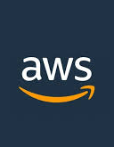
Task Management System on AWS
Project Implementation Overview
Members:
Ahmed Fouad – 10004004
Roshdy Essam

Slide 2
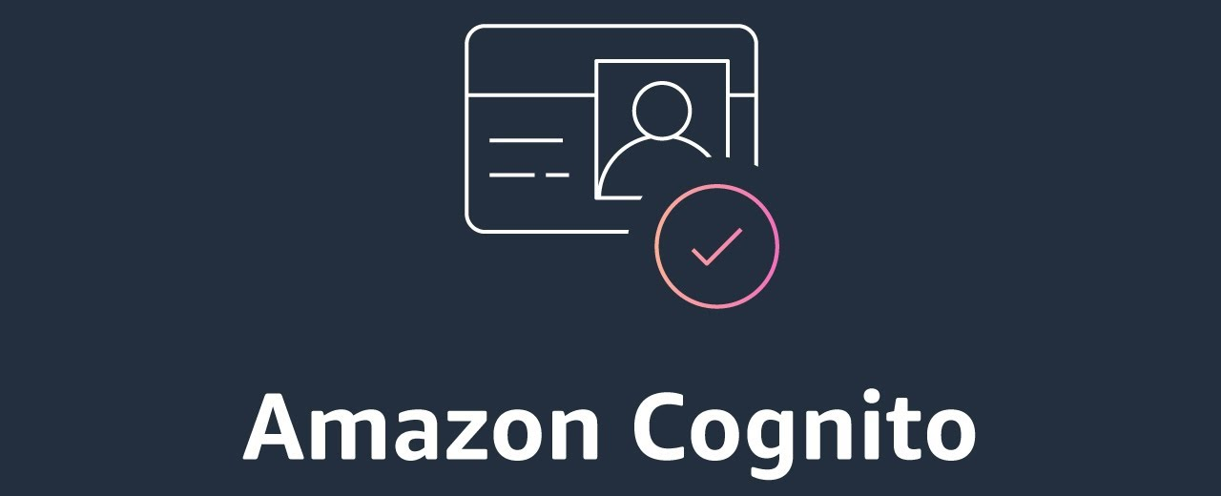
Tool Used: AWS Cognito
Purpose: Manage user sign-up, sign-in, and token-based sessions.
Steps Taken:
Configured Cognito user pools
Integrated hosted UI for registration/login
Retrieved JWT tokens and attached to frontend API requests
Tokens validated in Lambda functions via headers
Why Cognito?
It provided secure authentication without building a custom backend.

Slide 3
Database Design – RDS + DynamoDB
Structured Data: Amazon RDS (PostgreSQL)
• Stores user profiles and task-owner relationships
Task-owner relationships persisted here
Unstructured Metadata: Amazon DynamoDB
• Stores task attributes (title, priority, status, timestamps)
Enabled fast access and flexible schema
Integration:
• Lambda accessed RDS with pg client
• DynamoDB SDK used for NoSQL operations
• Environment variables stored credentials securely

Slide 4
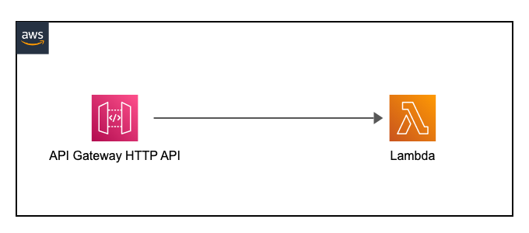
Backend Logic – API Gateway + Lambda
API Structure:
Amazon API Gateway exposed endpoints (/tasks, /tasks/{id})
/tasks – list or create
/tasks/{id} – update or delete
Lambda Functions:
Performed validation, database interaction, and logic
Used Cognito tokens for auth
Accessed both RDS and DynamoDB depending on the operation
Outcome: Fully serverless, auto-scaling, Free Tier optimized

Slide 5
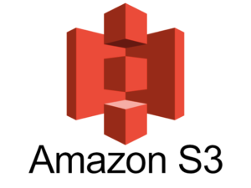
File Upload Handling Amazon S3
Workflow:
Files uploaded with task creation
Stored in Amazon S3 under folders named by taskId
Lambda generated pre-signed URLs for secure upload
File URLs saved in DynamoDB for reference
Storage Reference:
File URL stored in DynamoDB under corresponding task item

Slide 6
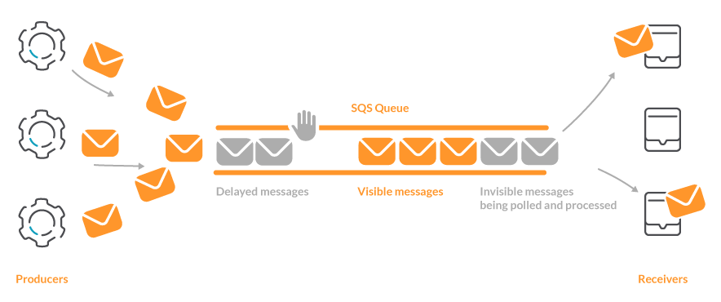
Notifications - SQS + Nodemailer
Flow:
On task update, Lambda sends a message to Amazon SQS
Another Lambda polls the queue and sends an email
Email Integration:
Used Nodemailer inside Lambda
SMTP setup with Gmail account
Credentials stored in environment variables
Result: Async notifications without external services

Slide 7
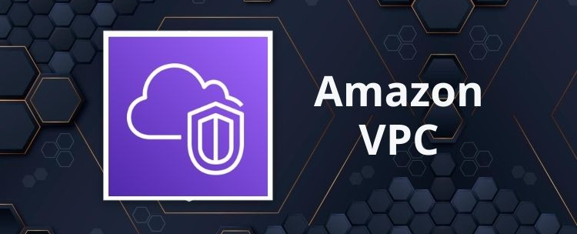
VPC, Internet Gateway, and Routing
Created a Virtual Private Cloud (VPC) to isolate and secure network infrastructure
Configured a public subnet for the EC2 instance
Attached an Internet Gateway (IGW) to the VPC to enable internet access
Updated the Route Table to direct 0.0.0.0/0 traffic through the IGW
Assigned a public IP to EC2 and allowed traffic via Security Groups
This setup ensured the frontend on EC2 was publicly accessible while keeping the backend isolated

Slide 8
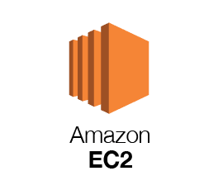
Hosting and Access Control
Frontend Hosting:
Deployed web app on an EC2 instance inside a VPC (public subnet)
Access Management:
IAM roles granted scoped permissions to Lambda and EC2
Access configured for:
  S3 (file upload)
  DynamoDB (task metadata)
  RDS (user-task mappings)
Environment Security:
Used .env files to store secrets like DB URIs and email credentials

Slide 9
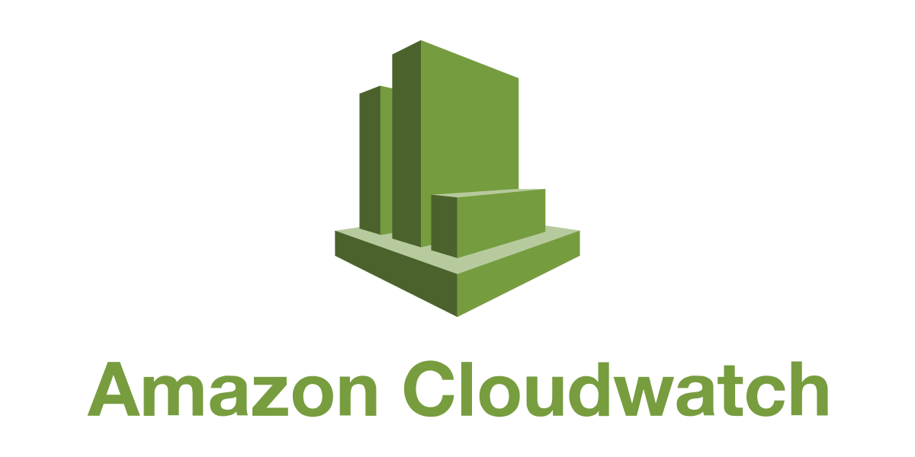
Monitoring – CloudWatch
Tracked Logs:
Lambda executions
API Gateway errors
SQS failures and delivery attempts
Setup:
Enabled log groups per function
Created basic dashboards for performance and errors
Helped resolve CORS issues, upload delays, and permission errors

Slide 10

System Integration Overview
Full Flow:
  User signs up via Cognito
Frontend (EC2) sends requests with tokens
API Gateway routes to Lambda
Lambda performs logic using DynamoDB + RDS
File uploads go to S3, linked by taskId
Updates trigger SQS, which sends email via Nodemailer
Logs and metrics handled via CloudWatch
IAM ensures secure cross-service communication

Slide 11
Final Result
• Cognito: Secure Auth
Fully integrated, modular, Free Tier optimized
• API Gateway + Lambda: Backend Logic
• IAM: Access Control
• DynamoDB + RDS: Storage
• CloudWatch: Monitoring
• S3: File Upload
• EC2: Hosting
• SQS + Nodemailer: Notifications

Slide 12
Thank You

