Slide 1
Self-Driving Car Racing Game
CSE 440
Presented by -
Abdullah Al Afique
Israt Jahan Asha
Tanha Ahmed Nijhum

Slide 2
Project Objective
Develop an autonomous driving simulation where a virtual car learns to navigate through a track.
The car should progressively improve its ability to avoid collisions and optimize its driving behavior.
The learning process should be dynamic, allowing the car to adapt to complex environments over time.

Slide 3
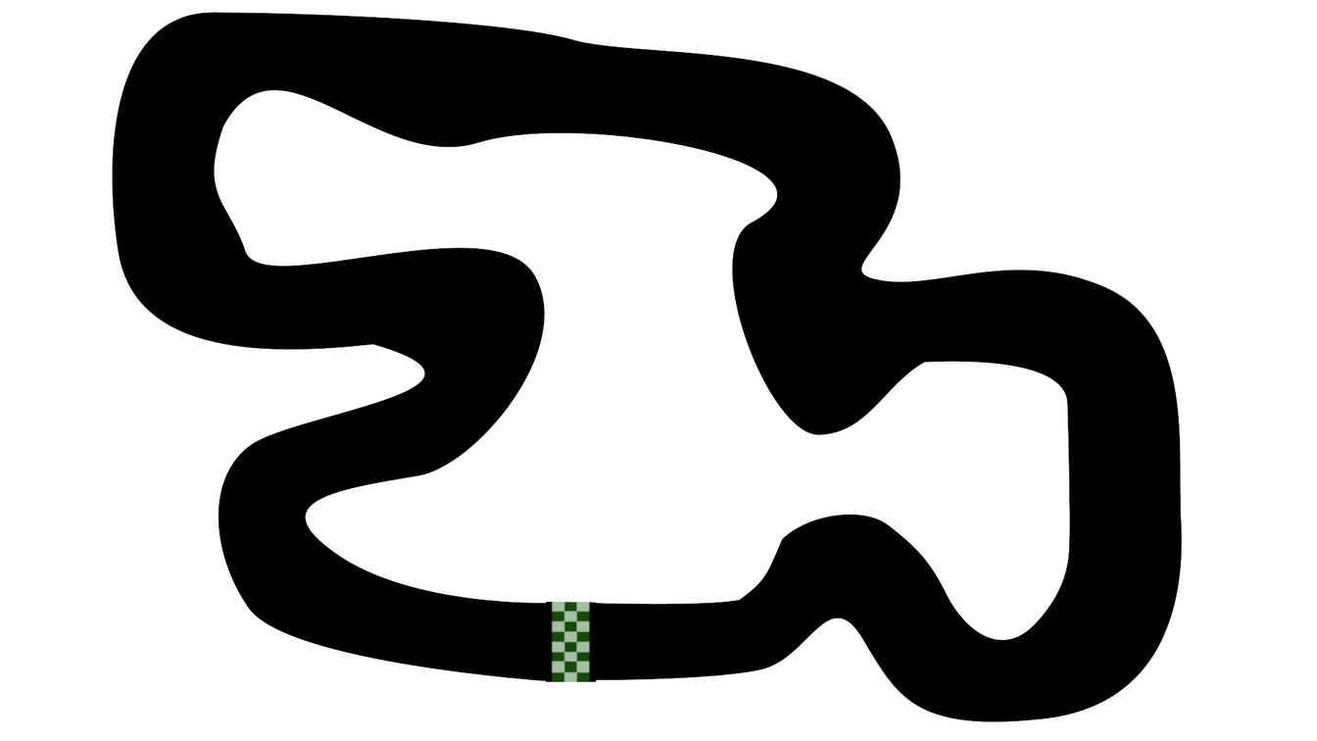
Our strategy
Create a virtual environment with a track and a vehicle.

Slide 4
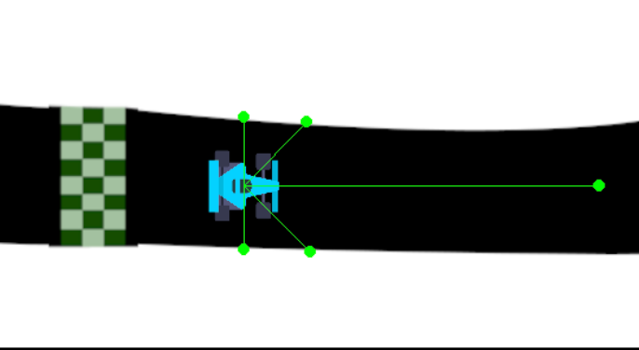
Strategy cont
Enable the vehicle to receive input from its surroundings, such as distances to obstacles.

Slide 5
Strategy cont
Implement a learning mechanism that allows the car to trial different driving strategies.
Utilize a feedback system to reinforce successful driving behaviors and diminish ineffective ones.
Iterate this process over many trials to refine the car’s navigation skills.

Slide 6
The Proposed Solution
Technological Approach:
Simulation Environment: Pygame will provide a real-time visual interface for the simulation.
Autonomous Driving Logic: Neural Networks will be the "brain" of the car, deciding how it should move based on sensor inputs.
Learning Methodology:
NEAT (NeuroEvolution of Augmenting Topologies)
Evolves neural networks using an evolutionary algorithm.
No need for labeled data—learns through trial and error.
Adapts both network structure and weights for flexibility.
Avoids overfitting and enables generalization to diverse driving scenarios.

Slide 7
Expected Outcomes
Component Interaction:
Input (Sensors) → Neural Network (Decision Making) → Car Movement → Performance Evaluation → Evolution (NEAT) → Repeat
What We Aim to Achieve:
The car learns to drive autonomously without human input.
Improved driving efficiency with each generation.
Demonstration of how machine learning techniques can mimic real-world learning processes.

Slide 8
Conclusion
The project aims to build a self-sustaining learning agent capable of mastering autonomous driving.
By combining simulation with evolutionary learning, we can observe how AI can develop complex behaviors through experimentation.
This project not only serves as an educational tool but also as a foundational experiment in the field of autonomous systems and artificial intelligence.

