Slide 1
Introduction
Group 10 (Abdullah Al Afique, Tanha Ahmed, Nijhum, Israt Asha)

Slide 2



Abdullah Al Afique
Israt Asha
Tanha Ahmed Nijhum
2031117642
1921758042
2031523642
Group 10 (Abdullah Al Afique, Tanha Ahmed, Nijhum, Israt Asha)

Slide 3
Project
AI Self-Driving Car Racing Game
Group 10 (Abdullah Al Afique, Tanha Ahmed, Nijhum, Israt Asha)

Slide 4
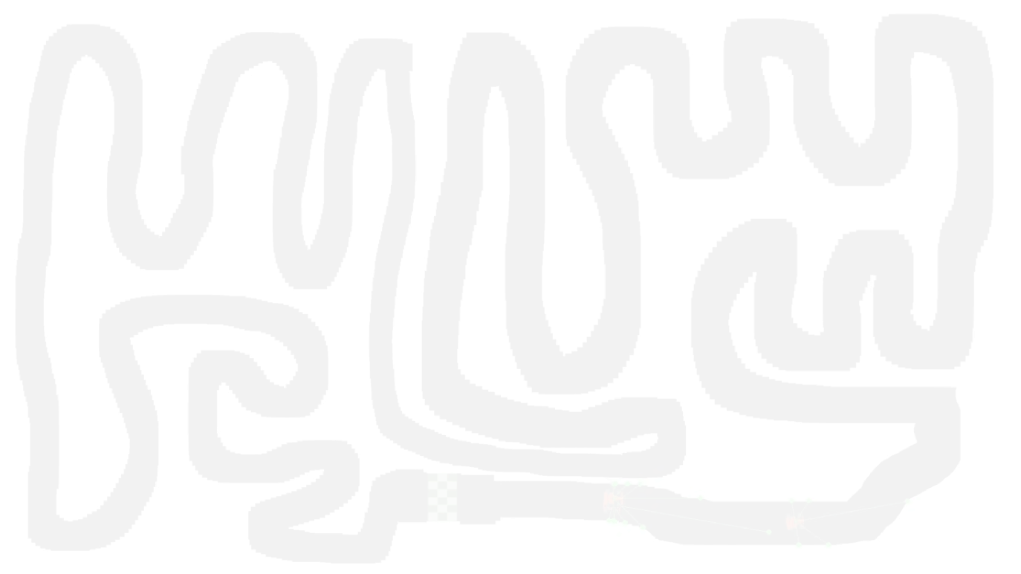
Objective
The goal of this project is to create an autonomous self-driving car simulation that learns to navigate a 2D track without human input. Using virtual sensors, the car improves its driving decisions—such as steering and speed control—through trial and error, aiming to complete tracks efficiently while avoiding collisions.
Group 10 (Abdullah Al Afique, Tanha Ahmed, Nijhum, Israt Asha)

Slide 5
Problem statement
Manually collecting labeled training data for self-driving behavior is time-consuming, rigid, and often impractical. This project addresses the challenge of enabling an autonomous car to learn how to navigate complex tracks without supervision, using adaptive neural networks that evolve through interaction with the environment.
Group 10 (Abdullah Al Afique, Tanha Ahmed, Nijhum, Israt Asha)

Slide 6
Challenges in Learning to Drive Autonomously
Designing a self-driving car requires real-time decision-making in a dynamic environment. The car must learn to navigate unpredictable tracks, avoid collisions, and adapt to various conditions without predefined rules or external guidance. These challenges make it difficult to apply traditional logic-based approaches effectively.
Group 10 (Abdullah Al Afique, Tanha Ahmed, Nijhum, Israt Asha)

Slide 7
Why Traditional Methods Fall Short
Rule-based systems and supervised learning depend on predefined logic or large labeled datasets, which are impractical in this setting. They fail to generalize across different tracks and require extensive human input. As environments become more complex, such methods become rigid and ineffective for developing adaptive driving behavior.
Group 10 (Abdullah Al Afique, Tanha Ahmed, Nijhum, Israt Asha)

Slide 8
Our approach
We used an evolutionary learning approach where each car is controlled by a neural network that takes distance sensor inputs and outputs driving actions like steering or acceleration. These networks are evaluated based on how far the car travels without crashing. Over generations, the best-performing networks are selected, mutated, and recombined to evolve smarter driving behavior without any manual training data.
Group 10 (Abdullah Al Afique, Tanha Ahmed, Nijhum, Israt Asha)

Slide 9
Implementation of NEAT
Group 10 (Abdullah Al Afique, Tanha Ahmed, Nijhum, Israt Asha)

Slide 10
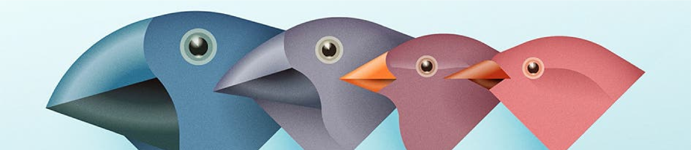
What is NEAT
NEAT, or NeuroEvolution of Augmenting Topologies, is an algorithm that evolves neural networks over time, inspired by natural selection. Instead of training with labeled data, it uses a genetic approach—networks that perform better are "selected" to reproduce, while their structure and weights undergo random mutations and crossovers. Just like in nature, this process gradually produces more capable and complex behaviors through generations.
Group 10 (Abdullah Al Afique, Tanha Ahmed, Nijhum, Israt Asha)

Slide 11
Why Use NEAT Instead of Supervised Learning?
Unlike supervised learning, NEAT doesn’t require labeled datasets or predefined input-output mappings. In a self-driving simulation, collecting accurate training data is time-consuming and often unrealistic. NEAT learns purely through interaction with the environment, adapting its neural network structures over time based on performance. This makes it ideal for complex, dynamic tasks like driving, where behavior must be discovered rather than taught.
Group 10 (Abdullah Al Afique, Tanha Ahmed, Nijhum, Israt Asha)

Slide 12
Fitness
Measures how well a neural network performs (e.g., how far the car drives without crashing).
Mutation
Randomly alters network connections or structure to introduce new behaviors.
Components of NEAT
Crossover
Combines parts of two parent networks to create a new child network.
Speciation
Groups similar networks into species to preserve innovation and maintain diversity.
Group 10 (Abdullah Al Afique, Tanha Ahmed, Nijhum, Israt Asha)

Slide 13
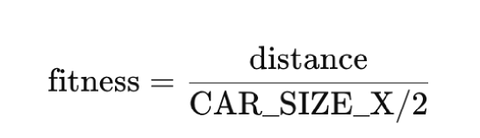
Fitness
Each car's performance is measured by how far it travels without crashing. This distance is used to calculate the fitness score, which guides the evolution of better neural networks over generations.
Fitness Function:
A higher fitness score increases the likelihood of a network being selected for reproduction.
Group 10 (Abdullah Al Afique, Tanha Ahmed, Nijhum, Israt Asha)

Slide 14
Mutation
Mutation introduces random changes in the neural networks to promote exploration and innovation. In our simulation, this results in:
New connections forming between sensor inputs and outputs
Small tweaks in weight values affecting how the car turns or accelerates
Entirely new hidden nodes being added, allowing more complex driving logic
For example, a car that initially veers into a wall might, through mutation, gain a connection that helps it respond more effectively to radar input — keeping it on track longer in the next generation.
Group 10 (Abdullah Al Afique, Tanha Ahmed, Nijhum, Israt Asha)

Slide 15
Crossover
Crossover is like breeding in nature — NEAT takes two high-performing neural networks and combines their structures to produce a new child network. This allows the offspring to potentially inherit the best traits of both parents.
In the car simulation, one parent might be good at turning, while the other might be better at controlling speed. Through crossover, a new network may emerge that can do both — improving performance in the next generation of races.
Group 10 (Abdullah Al Afique, Tanha Ahmed, Nijhum, Israt Asha)

Slide 16
Speciation
Speciation prevents all networks from converging too quickly on a single strategy. It works by grouping similar neural networks into species based on their structure and genes. Each species evolves independently, so unique strategies have time to develop and mature without being eliminated too soon.
For example, one species might evolve aggressive, fast-driving behaviors that take risks on straight paths, while another evolves cautious, slow-turning drivers better suited for narrow corners. This diversity helps NEAT avoid getting stuck in local optima and improves the chances of discovering highly effective driving strategies.
Group 10 (Abdullah Al Afique, Tanha Ahmed, Nijhum, Israt Asha)

Slide 17
System Architecture
The system is composed of two core components: the autonomous car and the simulated track environment. The car interacts with the map using sensor inputs and neural network outputs, while the environment provides the structure, constraints, and feedback necessary for learning. Together, they form a closed loop of perception, decision-making, and real-time response.
Group 10 (Abdullah Al Afique, Tanha Ahmed, Nijhum, Israt Asha)

Slide 18
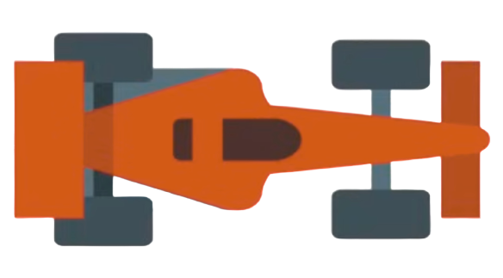
Car
Each car is an autonomous agent equipped with virtual sensors that measure distances to nearby walls. These sensor readings act as inputs to a neural network that determines the car’s driving behavior. The car maintains information about its position, angle, speed, and collision status. As it moves through the environment, it constantly updates its center position, checks for collisions, and recalculates sensor data in real-time.
Group 10 (Abdullah Al Afique, Tanha Ahmed, Nijhum, Israt Asha)

Slide 19
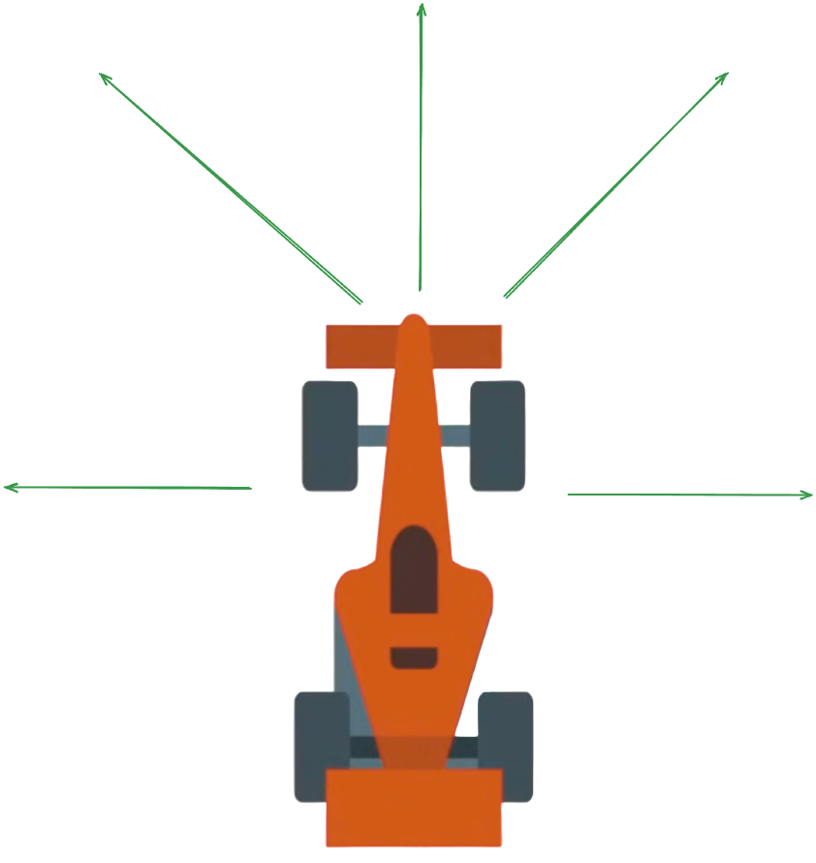
Radars sensors
Each car is controlled by a neural network that takes in inputs from 5 radar sensors, which detect distances to nearby walls at various angles.
Group 10 (Abdullah Al Afique, Tanha Ahmed, Nijhum, Israt Asha)

Slide 20

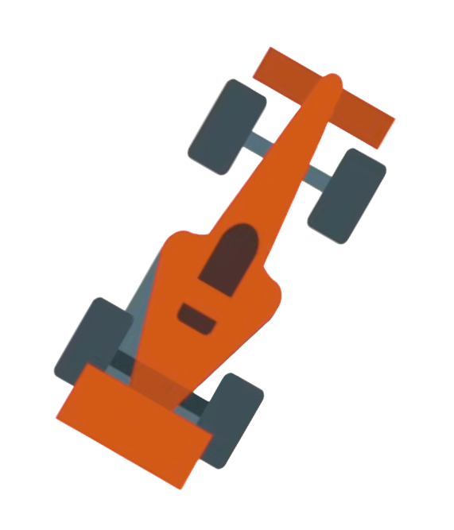

Right
Moves to the right
Left
Moves to the left
Speed +
Accelerate and increases the velocity
Speed -
Deacelerate and decreases the velocity
Group 10 (Abdullah Al Afique, Tanha Ahmed, Nijhum, Israt Asha)

Slide 21
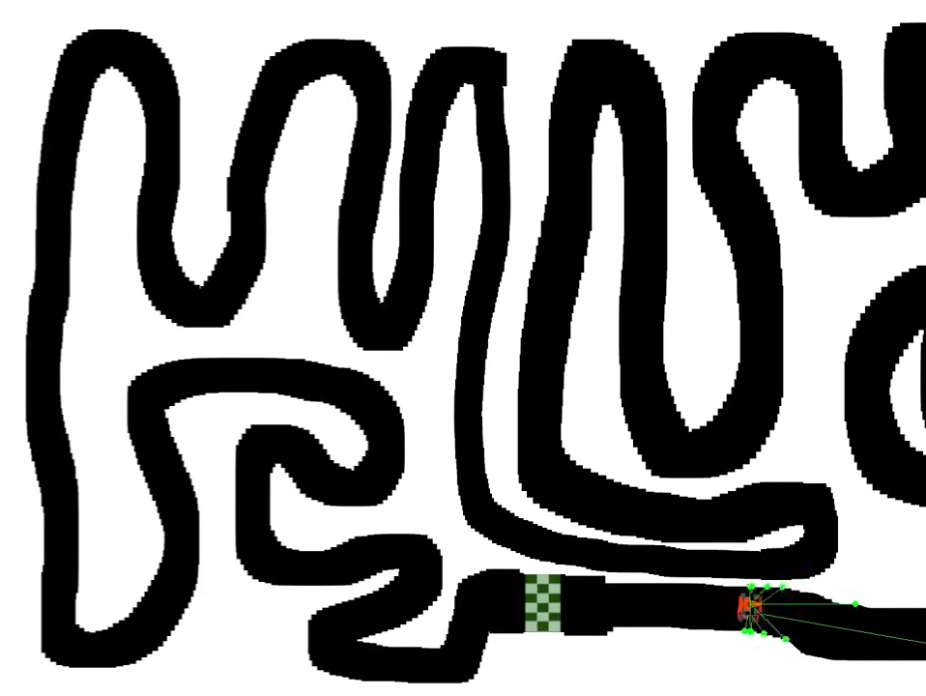
Map
The environment is a 2D track loaded from an image file, where white pixels represent wall boundaries. The simulation uses this image to detect collisions: if any corner of the car touches a white pixel, the car is marked as crashed. The map serves as the fixed layout against which all cars are evaluated. It plays a critical role in shaping the difficulty of the task and acts as the challenge the neural networks must learn to overcome through navigation and survival.
Group 10 (Abdullah Al Afique, Tanha Ahmed, Nijhum, Israt Asha)

Slide 22
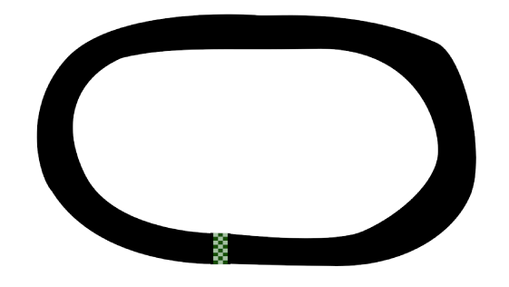
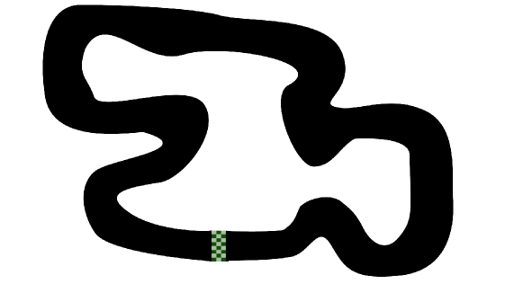
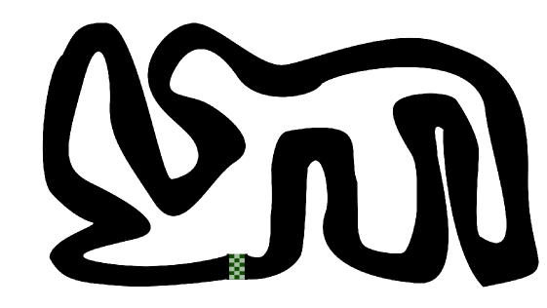
Levels
To introduce progressive difficulty and encourage more generalized learning, the simulation includes different track layouts across levels.
Group 10 (Abdullah Al Afique, Tanha Ahmed, Nijhum, Israt Asha)

Slide 23
Methodology
How NEAT works
Group 10 (Abdullah Al Afique, Tanha Ahmed, Nijhum, Israt Asha)

Slide 24
NEAT allows the car to learn through experience by evolving neural networks over time. Each car is driven by a neural network that makes decisions based on sensor input. After evaluating performance, NEAT evolves the best-performing networks using principles inspired by natural selection.
Methodology
Group 10 (Abdullah Al Afique, Tanha Ahmed, Nijhum, Israt Asha)

Slide 25
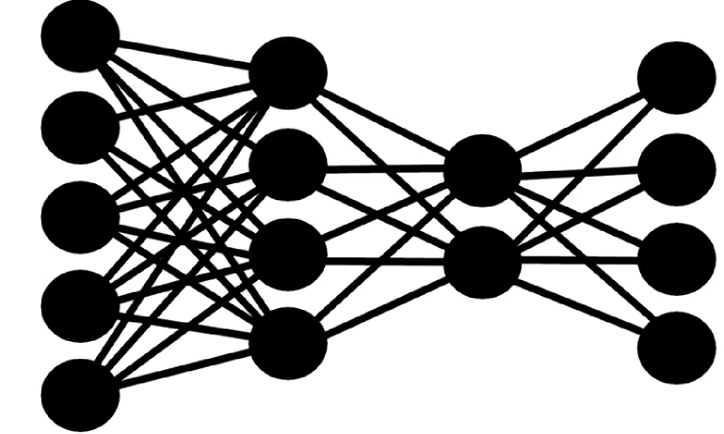
NEAT Starts with Simple Neural Networks
NEAT begins with a population of minimal neural networks, each containing only input and output layers with no hidden nodes. In our simulation, these networks receive 5 radar sensor inputs and produce 4 outputs: steer left, steer right, accelerate, and brake. All connections are initially sparse and random, allowing the system to grow complexity only as needed.
Group 10 (Abdullah Al Afique, Tanha Ahmed, Nijhum, Israt Asha)

Slide 26
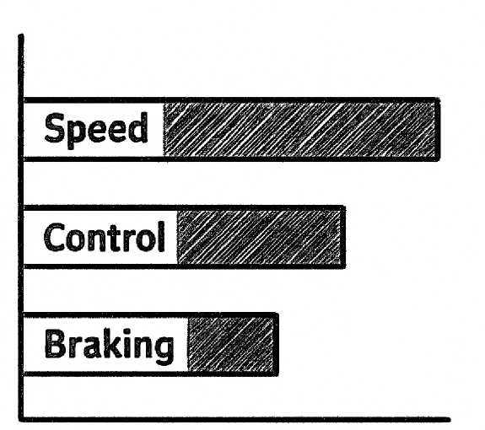
Evaluating Each Car’s Performance
Each neural network controls a car in the simulation. The car’s survival depends on how well it can drive without hitting a wall. The performance is measured using a fitness function based on distance traveled. Networks that result in cars driving farther without crashing receive higher fitness scores and are more likely to be selected for the next generation.
Group 10 (Abdullah Al Afique, Tanha Ahmed, Nijhum, Israt Asha)

Slide 27

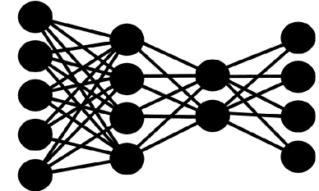
Selecting and Reproducing the Fittest Networks
After evaluation, the networks with the highest fitness scores are selected as parents. NEAT uses a selection process to ensure the best-performing networks have a greater chance of producing offspring, while poorly performing networks are discarded. This encourages the retention and improvement of successful driving behaviors.
+
=
Group 10 (Abdullah Al Afique, Tanha Ahmed, Nijhum, Israt Asha)

Slide 28
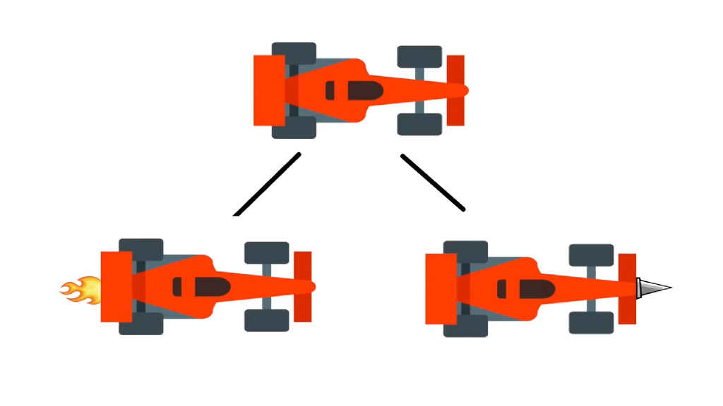
Crossover: Combining Two Networks to Create Offspring
Crossover merges two parent networks by combining their structure and weights. Matching connections (based on innovation numbers) are inherited from either parent, while excess or disjoint genes are usually inherited from the more successful one. This creates a new child network that may inherit useful traits from both parents—for example, better turning from one and better speed control from the other.
Group 10 (Abdullah Al Afique, Tanha Ahmed, Nijhum, Israt Asha)

Slide 29
Deep dive
Diving into the Neural Network
Group 10 (Abdullah Al Afique, Tanha Ahmed, Nijhum, Israt Asha)

Slide 30
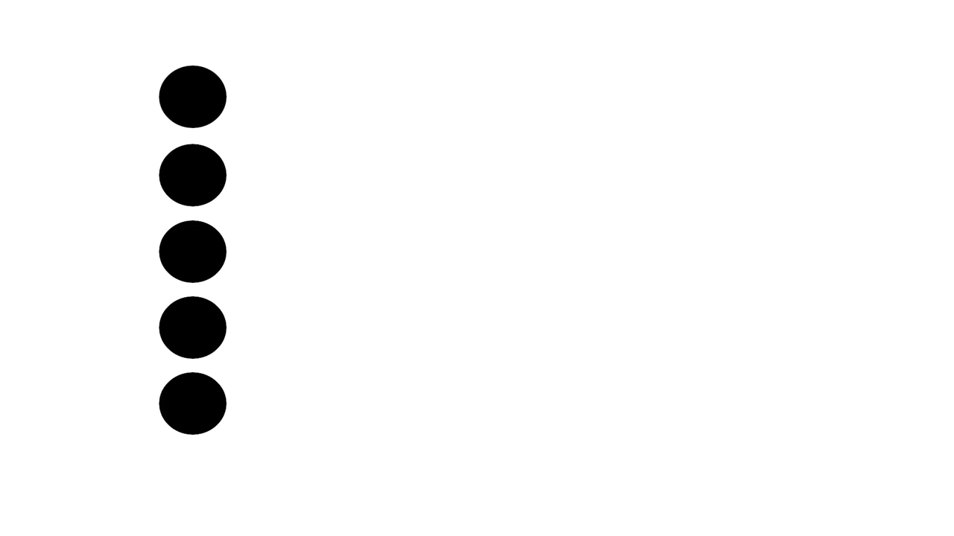
Group 10 (Abdullah Al Afique, Tanha Ahmed, Nijhum, Israt Asha)

Slide 31

Group 10 (Abdullah Al Afique, Tanha Ahmed, Nijhum, Israt Asha)

Slide 32
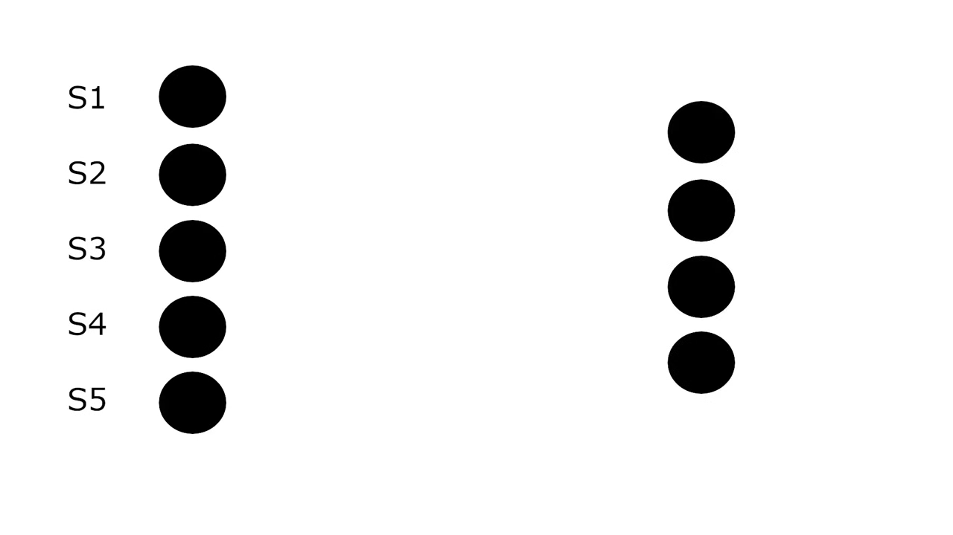
Group 10 (Abdullah Al Afique, Tanha Ahmed, Nijhum, Israt Asha)

Slide 33
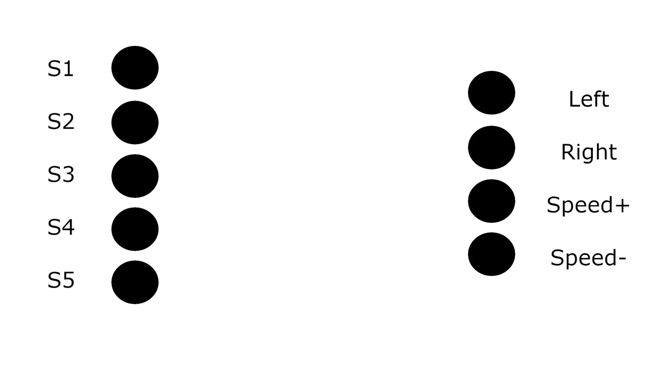
Group 10 (Abdullah Al Afique, Tanha Ahmed, Nijhum, Israt Asha)

Slide 34
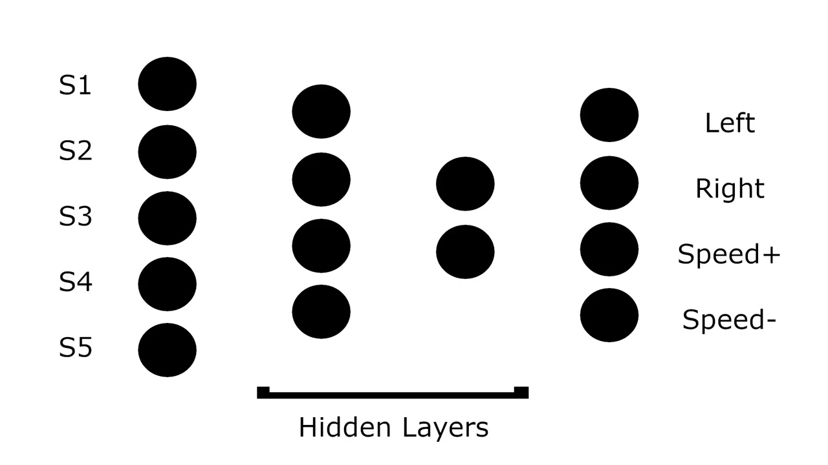
Group 10 (Abdullah Al Afique, Tanha Ahmed, Nijhum, Israt Asha)

Slide 35
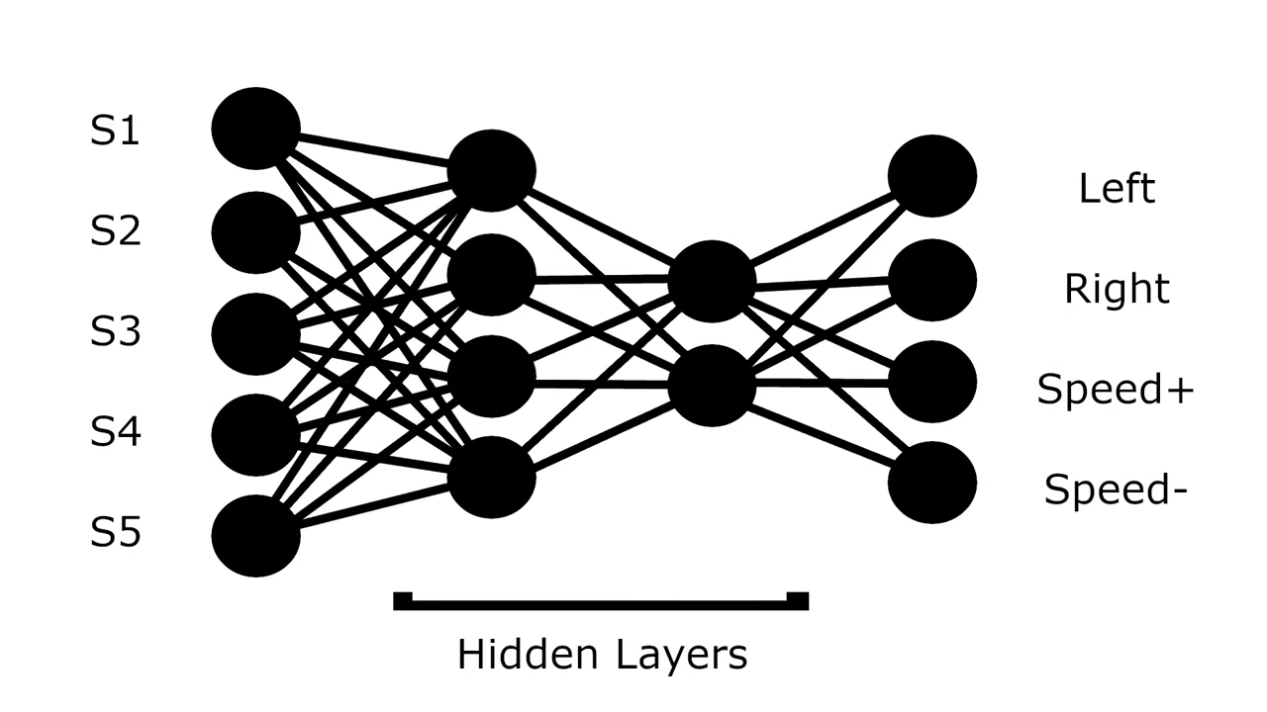
Group 10 (Abdullah Al Afique, Tanha Ahmed, Nijhum, Israt Asha)

Slide 36
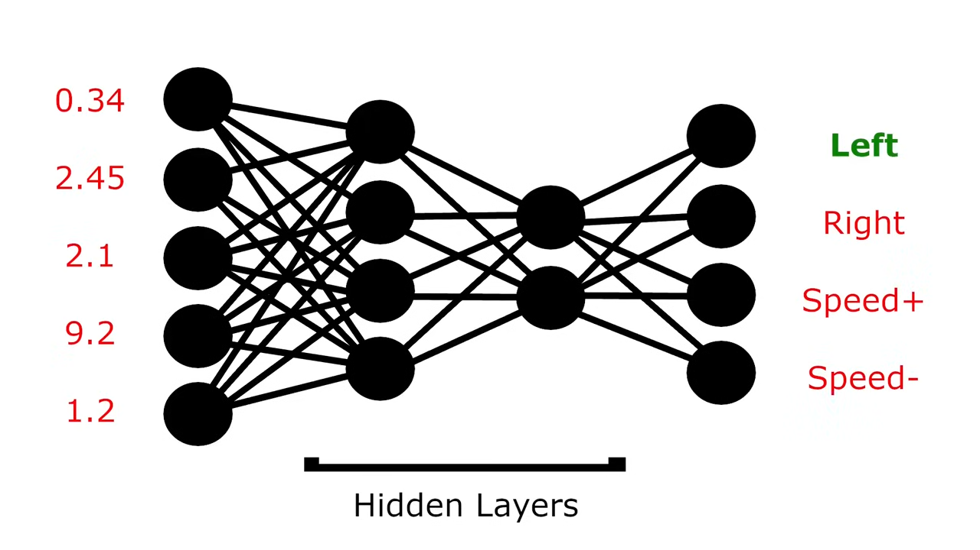
Group 10 (Abdullah Al Afique, Tanha Ahmed, Nijhum, Israt Asha)

Slide 37
Let’s watch the AI Learn to Drive
This demo showcases how the AI car improves over generations—from crashing early on to successfully navigating the track with smooth steering, speed control, and collision avoidance. It highlights the power of neural evolution and the effectiveness of learning through interaction with the environment.
https://www.loom.com/share/40853bc7ec8d4da2a355e12201a5ce50?sid=ececffff-3eaf-449c-8866-50ea5f12581d
https://drive.google.com/file/d/11RerMiTTyfYPRrwaJoeut4c0kK51gZ4C/view?usp=sharing
Group 10 (Abdullah Al Afique, Tanha Ahmed, Nijhum, Israt Asha)

Slide 38
Thank you!
Group 10 (Abdullah Al Afique, Tanha Ahmed, Nijhum, Israt Asha)

