Slide 1
Cryptography Ciphers Vulnerabilities and Assurances By: Alexis Daniel Ortega (A20435250)
DEPARTMENT OF COMPUTER SCIENCE Data Privacy and Security - CS 528
Instructor: yuan hong

Slide 2


The Team
The project design, implementation, testing, and documentation is brought forth by a solo Illinois Institute of Technology 3rd Semester Master of Computer Science student, Alexis Ortega. Alexis completed a Bachelor of Arts degree in Political Science at Northern Illinois University on track to attend Law School, but decided to instead make a career change toward Computer Science. He began his academic career at IIT in 2020, and although he has little background in Data Science, he has a curiosity and enthusiasm for Information Security. Alexis is projected to graduate from IIT this summer with specializations in Information Security and Assurance and Software Engineering.

Slide 3
Motivation & Application
There exists a growing need for data protection and security as the world rapidly and inevitably moves toward being totally digital. Data and encryption and protection is used in most aspects of the digital world. It can be used to secure military communications where messages, images, and other files can be safely sent back and forth between allies with little worry that an adversary can acquire the sensitive information. More locally and perhaps more commonly it is also used to protect user information in databases such as account information, medical history, browser history, etc.
Cryptographic Encryption can be used to Encrypt various forms of files from images, files, text, and video. To ensure the privacy and safety of such files there exists various ciphers that can be applied as well as some different protocols. A few will be displayed in this project.

Slide 4
Goal and Design
This project shows the encryption, decryption, and potential attacks through various ciphers (Caesar's, AES, RSA, MD5, symmetric, and asymmetric cryptosystems) and file types (text input, text file, images, and large data files)

Slide 5
Caesar's Cipher(Substitution)
Assurance
Encryption will hide plaintext
Easier to solve with key
Vulnerabilities
Easy to decipher without key
Even easier with background knowledge
Knowing the language makes it susceptible to Frequency Analysis
Ex) English most common letters are (a,e,i,o,u, t, h), pairs of letters that appear together most often are (th, ch, sh, etc.)

Slide 6
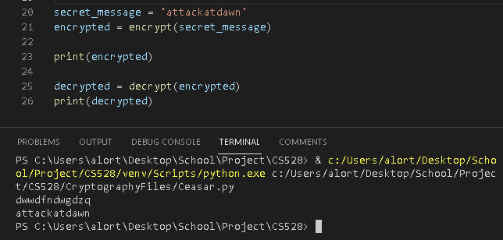
Caesar's Cipher(Substitution) - Attack
Frequency Analysis
Background Knowledge
Knowing the language makes the encryption more vulnerable to Frequency Analysis attacks
Brute force trial and error until the plaintext is recognized with certainty
Known plaintext then leads to retrieval of the key

Slide 7
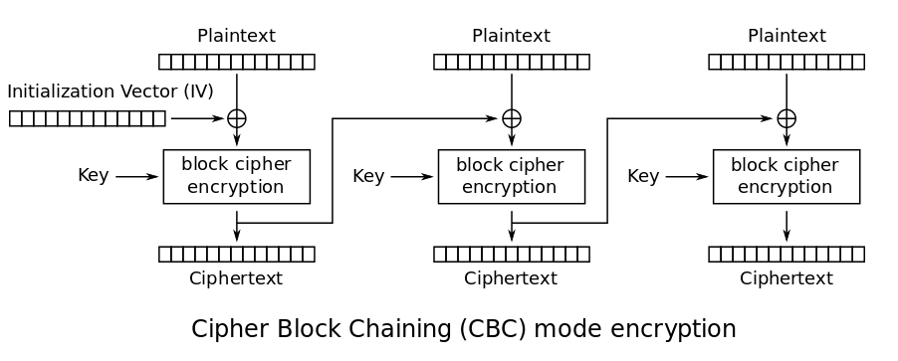
AES
Symmetric Encryption System
E(k, m) encrypts message using key to produce ciphertext
D(k, c) decrypts ciphertext c using k to produce a message m
Alice and Bob share a secret key K
AES
Block size 128 bits
Key size 128, 192, 256 bits
XOR operations
Easy and Secure

Slide 8
AES CBC Model
Protocol
Alice and Bob share a common secret Key
Alice computes c = E_{K}(m) and sends c to Bob
Bob receives c’ and computes m’ = D_{K}(c’) and gets Alice’s Message
Assumptions
Eve(attacker) learns nothing except for c during the protocol
The channel accurately has c’ = c
Eve cannot modify the text
Requirements
K cannot be easily guessed
Given c it is hard to find m without knowing k

Slide 9
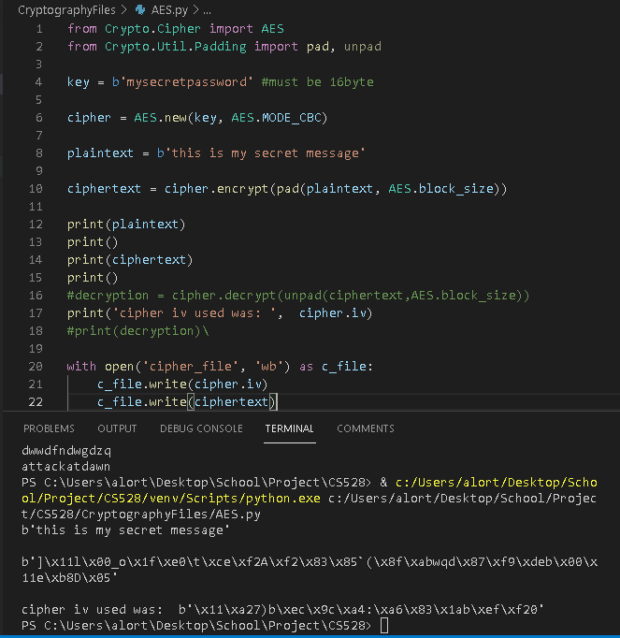
AES – Encrypt Text
Encryption of message
Ciphertext
Initial Value (should only be used once)
Padding – since AES is a block cipher extra bytes must be added as ‘padding’ to make sure the message fits limit of Block Size

Slide 10
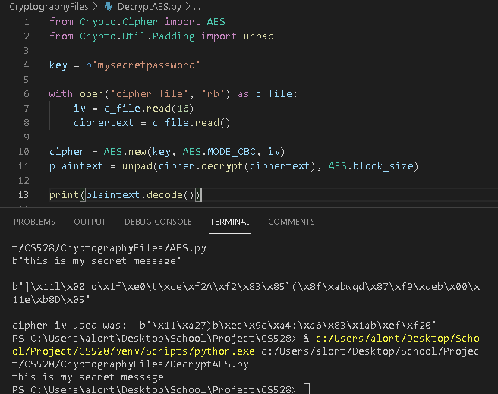
AES – Decrypt Text
Same secret key used to decrypt the text
m = D_{K}(c) ⊕ IV

Slide 11
AES – image files
Encryption & Decryption of image
Alfred (my dog) is a good boy who loves Data Security

Slide 12
AES – attacks
Brute Force
Unlikely: Key sizes too big to guess
Side Channel Attack
Attacks the implementation of the algorithm by gained knowledge

Slide 13
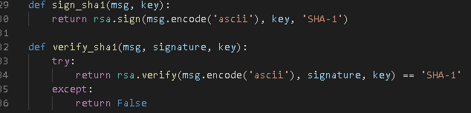

RSA – asymmetric cryptosystem
Solves shortcomings of Symmetric algorithms (Key distribution and management)
RSA – uses two keys
Public Key
Private Key
Key generation
Uses exponentiation of integers modulo prime can be very large integers
Ex. Let p and q be two large prime numbers chosen at random. Let N = pq. Choose e relatively prime to Φ(N) = Φ(p) Φ(q) = (p-1) (q-1) Select the public exponent e ∈[2, Φ(N) -1] such that gcd(e, Φ(N)) =1 Find d ∈[2, Φ(N)-1) s.t. e.d ≡ 1 mod (p-1)(q-1)
Public Key is (e, N)
Private Key is (d, N)
Signatures Provide Authentication

Slide 14
RSA- attacks & problems
Attacks
Only High effort, negligible probability attacks exist
Brute force, mathematical calculation
Exploitation of implementation
Problems
Key exchange can be tough – requires some communication

Slide 15
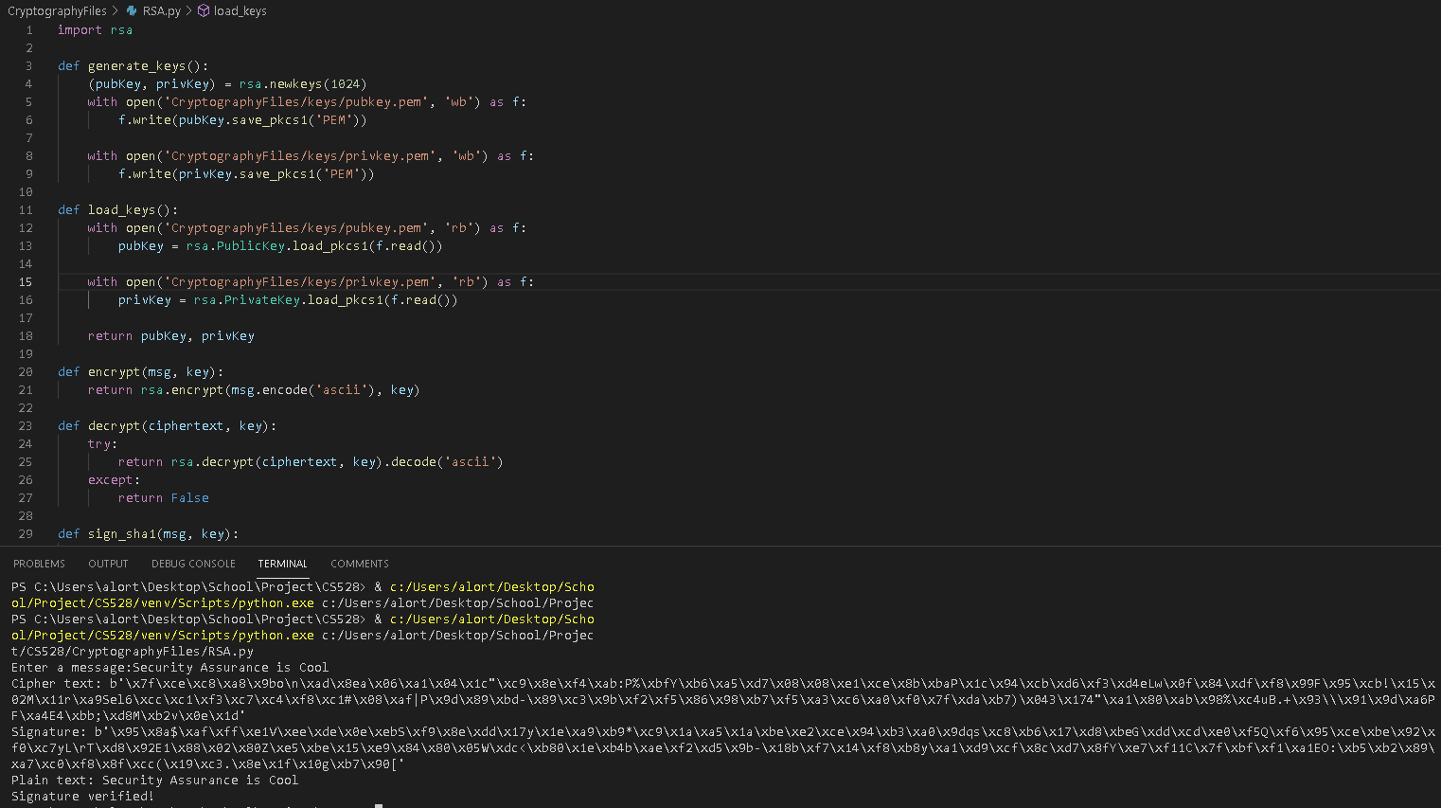
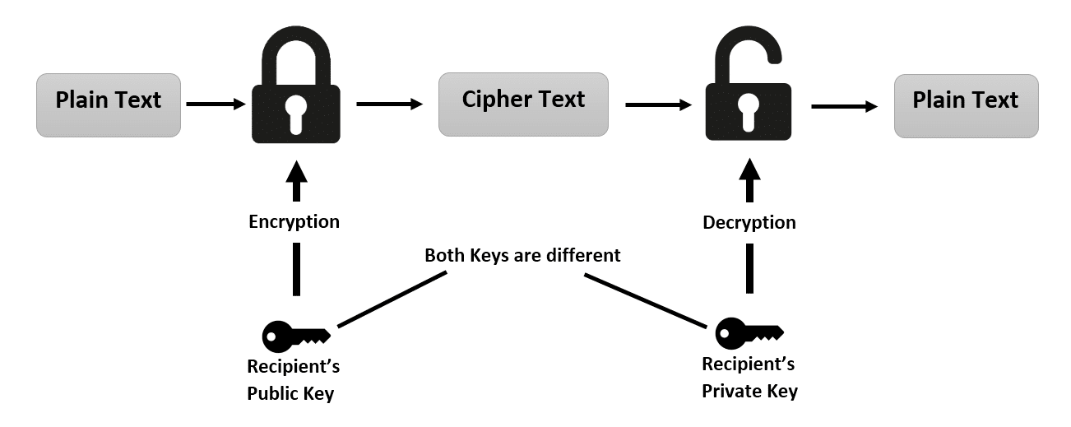
RSA – Encryption & Decryption

Slide 16
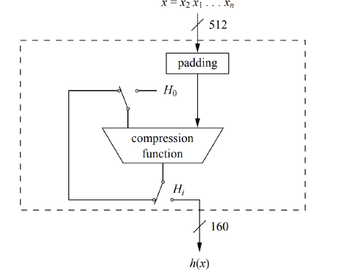
Hash Functions – MD5 & SHA
MD5
Generates 128 bit hash
Commonly used for passwords in the past
Collision attack and other common knowledge tools – no longer viable
SHA
SHA-1 is the most commonly used
Also no longer viable

Slide 17
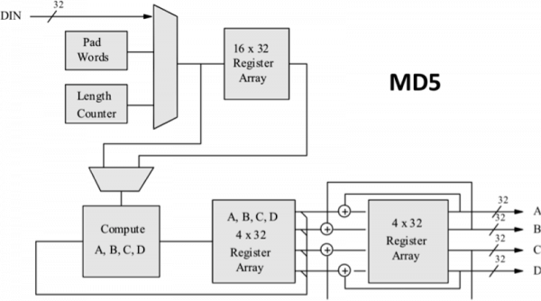

Slide 18
References & Special Thanks
References
Inspired by SEED Laboratory
Computer Security: Principles and Practice
Special thanks
to Alfred for his support

