Slide 1
Management Information Systems
Prasad Padalkar
Module 2: Data and Knowledge Management

Slide 2
Topics
Database Approach
Big Data

Slide 3
Business Case and Data that Grows “Bigger”
Human Resources. Employee benefits, particularly healthcare, represent a major business expense.
For example a organization with and employees strength of 65,000 with medical emergency center, in order to understand and answer some of the following questions:
1) How many employees are using medical emergency center ?
2) Are they from any particular department ?
3) Are there any specific employees revisit / frequent visit?
4) How does safety relate to this data ?

Slide 4
Business Case and Data that Grows “Bigger”
Marketing: Marketing managers have used data to better understand their customers and to target their marketing efforts more directly.
E.g. United Kingdom’s InterContinental Hotels Group (IHG; www.ihg .com) has gathered details about the 71 million members of its Priority Club rewards program, such as income levels and whether members prefer family-style or business-traveler accommodations. Where previous marketing campaigns generated, on average, between 7 and 15 customized marketing messages, the new campaign generated more than 1,500.

Slide 5
Data, Information and Knowledge
Data , Information and Knowledge example - https://www.youtube.com/watch?v=QsP5WGv0aQc

Slide 6
Difficulties in Managing Data
Problem 1: The amount of data increases exponentially with time. Also The data is spread across multiple computers, servers and devices.
e.g. To support millions of customers, large retailers such as Walmart have to manage petabytes of data.

Slide 7
Difficulties in Managing Data
Problem 2: Data are generated from multiple sources: internal sources (e.g.,corporate databases and company documents), personal sources (e.g., personal thoughts, opinions, and experiences), and external sources (e.g., commercial databases, government reports and corporate Web sites).
Data are also subject to data rot. Data rot refers to problems of data retrieval from media on which the data are stored due to media aging and becoming worthless.

Slide 8
Difficulties in Managing Data
Problem 3: Siloed Information and processing systems
e.g. If HR uses HRMS software, Accounts uses Tally and Operation uses Spreadsheets, we will not be able to see "Big picture" of the organizational data.

Slide 9
Difficulties in Managing Data
Problem 4: Majority of the Corporate Governance is centered around the Finance and the Accounts, thus the information systems pertaining to the F&A are more developed as against the others.

Slide 10
Data Governance
Data governance is an approach to managing information across an entire organization. It involves a formal set of business processes and policies that are designed to ensure that there are unambiguous rules for creating, collecting, handling, and protecting its information.
The objective is to make information available, transparent, and useful for the people who are authorized to access it, from the moment it enters an organization until it is outdated and deleted.

Slide 11
Strategy for Data Governance
Creating a Structured Data Storage:
Master Data: Master data are a set of core data, such as customer, product, employee, vendor, geographic location, and so on, that span the enterprise information systems.
Transaction data: Transaction data is generated and captured by operational systems, describe the business’s activities, or transactions.

Slide 12
Strategy for Data Governance
E.g. Mary Jones purchase one Samsung 42-inch plasma television, part number 1234, from Bill Roberts at Best Buy, for $2,000, on April 20, 2013.
The master data are “product sold,” “vendor,” “salesperson,” “store,” “part number,” “purchase price,” and “date.” (Database Schema)
Transaction data would be, respectively, “42-inch plasma television,” “Samsung,” “Best Buy,” “Bill Roberts,” “1234,” “$2,000,” and “April 20, 2013.” (Values in each field)

Slide 13
What is Big Data (from Business Perspective)?
Big Data as vast data sets that:
Exhibit variety;
Include structured, unstructured, and semi-structured data;
Are generated at high velocity with an uncertain pattern;
Do not fit neatly into traditional, structured, relational databases
Can be captured, processed, transformed, and analyzed in a reasonable amount of time only by sophisticated information systems.

Slide 14
What type of Data do Business Generates as Big Data?
Traditional enterprise data:—examples are customer information from customer relationship management systems, transactional enterprise resource planning data, Web store transactions, operations data, and general ledger data.
Machine-generated/sensor data—examples are smart meters; manufacturing sensors; sensors integrated into smartphones, automobiles, airplane engines, and industrial machines;equipment logs; and trading systems data.

Slide 15
What type of Data do Business Generates as Big Data?
Social data—examples are customer feedback comments; microblogging sites such as Twitter; and social media sites such as Facebook, YouTube, and LinkedIn.
Images captured by billions of devices located throughout the world, from digital cameras and camera phones to medical scanners and security cameras.

Slide 16
What is Big Data ?
Big data refers to extremely large and diverse collections of structured, unstructured, and semi-structured data that continues to grow exponentially over time. These datasets are so huge and complex in volume, velocity, and variety, that traditional data management systems cannot store, process, and analyze them.

Slide 17
3 Vs of big data
Volume
This is the most common characteristic associated with big data is its high volume. This describes the enormous amount of data that is available for collection and produced from a variety of sources and devices on a continuous basis.
Velocity
Big data velocity refers to the speed at which data is generated. Today, data is often produced in real time or near real time, and therefore, it must also be processed, accessed, and analyzed at the same rate to have any meaningful impact.

Slide 18
3 Vs of big data
Variety
Data is heterogeneous, meaning it can come from many different sources and can be structured, unstructured, or semi-structured.

Slide 19
More V’s of Big Data
Veracity (Accuracy):
Big data can be messy, noisy, and error-prone, which makes it difficult to control the quality and accuracy of the data. Large datasets can be unwieldy and confusing, while smaller datasets could present an incomplete picture. The higher the veracity of the data, the more trustworthy it is.

Slide 20
More V’s of Big Data
Variability:
The meaning of collected data is constantly changing, which can lead to inconsistency over time.
e.g. A coffee shop may offer six different blends of coffee, but if you get the same blend every day and it tastes different every day, that is variability. The same is true of data. If the meaning constantly changes, it can significantly impact your data homogenization.
e.g. Lack of calibration of sensors giving random errors.

Slide 21
More V’s of Big Data
Value: It’s essential to determine the business value of the data you collect. Big data must contain the right data and then be effectively analyzed in order to yield insights that can help drive decision-making.

Slide 22


Slide 23
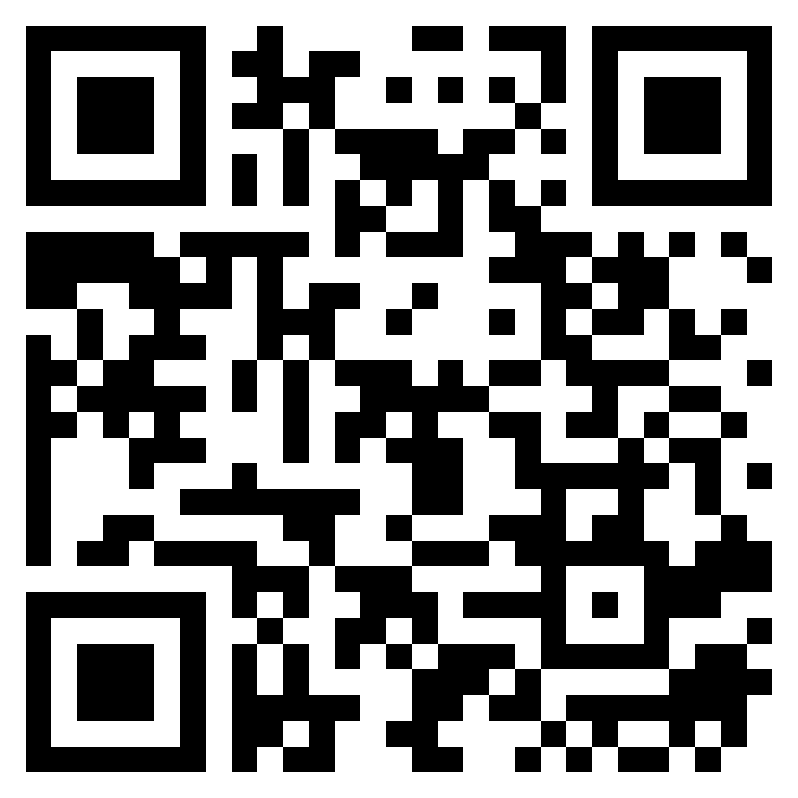
Attendance
https://forms.gle/j5zMdNDFTs9QX3Qj7

