Slide 1
Management Information Systems
Prasad Padalkar
Module 1: Introduction To Information Systems (IS)

Slide 2
Topics
Organizational Strategy
Competitive Advantages and IS

Slide 3

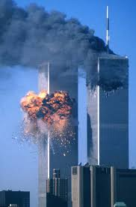
Case Study
September 11, 2001
Unfortunately for thousands of workers in the World Trade Center, those clues were located
in different databases scattered across many government agencies.
No tool to integrate and analysis data

Slide 4
Case Study
PayPal engineers who had worked on the software and Stanford computer scientists formed a startup company to develop PayPal’s fraud-detection tool Palantir.(https://www.palantir.com/).
Palantir’s customer list currently includes the U.S. Department of Defense, the CIA, the FBI, the Army, the Marines, the Air Force, the police departments of New York and Los Angeles, and an increasing number of financial institutions that have an interest in detecting bank fraud.

Slide 5
Competitive Advantage
Competitive advantage refers to any assets that provide an organization with an edge against its competitors in some measure such as cost, quality, or speed.
A competitive advantage helps an organization to control a market and to accrue larger-than-average profits.
Palantir to make sense of a rapidly changing environment and demonstrates that any information system can be strategic, that it can provide a competitive advantage if it is used properly.

Slide 6
Business Process
Organizations achieve competitive advantage by managing their business processes more profitable than their competitors do.
A business process is an ongoing collection of related activities that create a product or a service of value to the organization, its business partners, and/or its customers.
A process is comprised of three fundamental elements:
Inputs: Materials, services, and information that flow through and are transformed as a result of process activities
Resources: People and equipment that perform process activities
Outputs: The product or a service created by the process

Slide 7
Business Process
Input
Process
Output
Resources

Slide 8
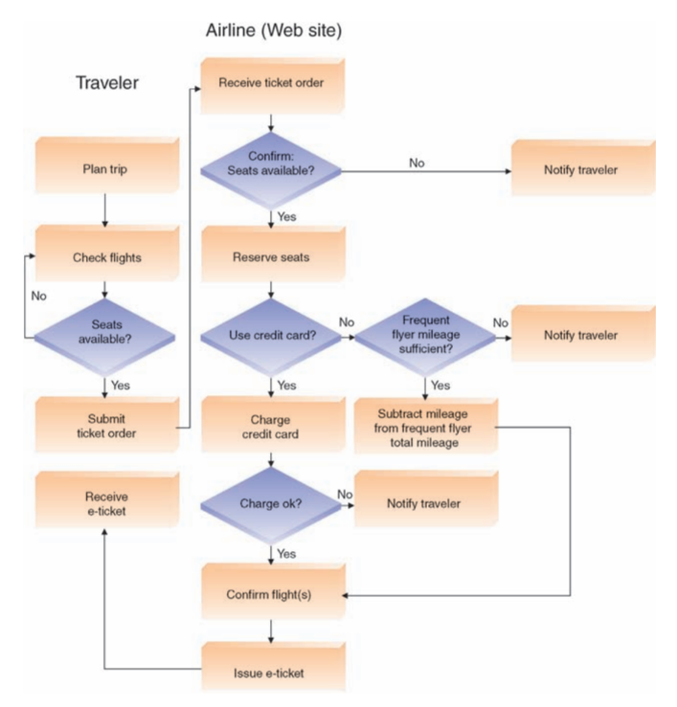
Business Process (e.g.)
Input: Travelers provide inputs to the process: the desired travel parameters to begin the search, the frequent flyer miles number, and their credit card information.
Output: E-ticket
Resources: Airline’s Website and computer system

Slide 9
Business Process
What is Business Process ?
https://www.youtube.com/watch?v=NXbGIilFidA

Slide 10
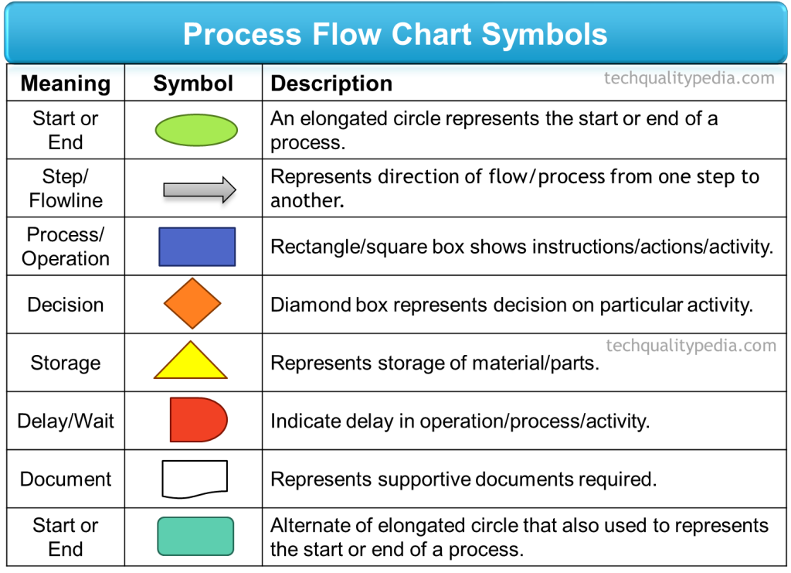
Symbols used in PROCESS diagram (chart)

Slide 11
Business Process
Internal Customer v/s External Customer
Website Development Company
ABC College Website (External Customer)
IT Infrastructure Management
Web Developer
IT Infrastructure Management
Manages internal network and oversee internal services for internal customer
For external customer creates provision for hosting
Content Developer (Internal Customer)
Graphics Designer

Slide 12
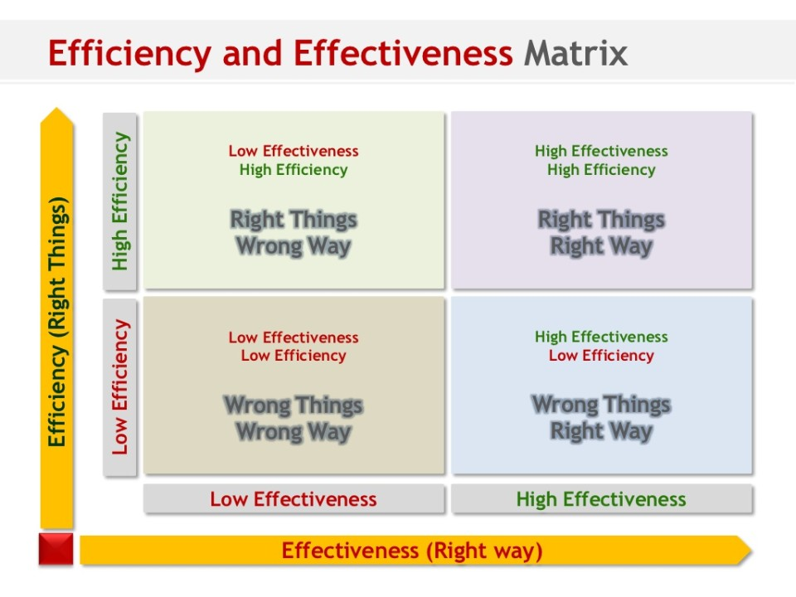
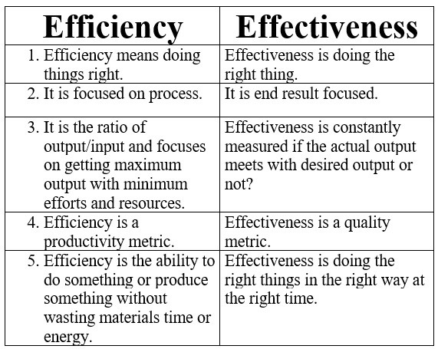
Efficacy v/s Effectiveness
Example of Efficiency & Effectiveness:
https://www.youtube.com/watch?v=Brkcj6ie7ic

Slide 13
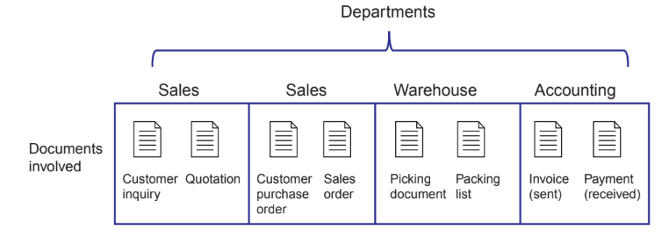
Cross-Functional Processes
Cross-functional business processes, meaning that no single functional area is responsible for their execution but, multiple functional areas collaborate to perform the process.

Slide 14
Cross Functional Business Process
What is cross functional process ?
https://www.youtube.com/watch?v=iLfKjmaa_Sg

Slide 15
Business Process
Amazon Fulfillment center
https://www.youtube.com/watch?v=8nKPC-WmLjU

Slide 16
Information Systems and Business Processes
Information systems facilitate communication and coordination among different functional areas, and allow easy exchange of, and access to, data across processes.
Following are the important IS areas
• Executing the process
• Capturing and storing process data
• Monitoring process performance

Slide 17
Information Systems and Business Processes
Executing the process:
IS help execute processes by informing people when it is time to complete a task, by providing the necessary data to complete the task, and, in some cases, by providing the means to complete the task.
IS and processes are usually intertwined.

Slide 18
Information Systems and Business Processes
Capturing and Storing Process Data.
Processes create data such as dates, times, product numbers, quantities, prices, and addresses, as well as who did what, when, and where.
IS capture and store these data, commonly referred to as process data or transaction data.
Some of these data are generated and automatically captured by the IS.
This data entry can occur in various ways, ranging from manual entry to automated methods involving data in forms such as barcodes and RFID tags that can be read by machines.

Slide 19
Information Systems and Business Processes
Monitoring Process Performance.
IS indicates how well a process is executing.
The IS performs this role by evaluating information about a process.
This information can be created either at the instance level (i.e., a specific task or activity) or the process level (i.e., the process as a whole).
Monitoring business processes, then, helps detect problems with these processes.

Slide 20
Business Process Re-engineering (BPR)
Business process reengineering is redesigning a business process to enhance product output, improve product quality, enhance speed or reduce costs.
Business process reengineering involves eliminating unnecessary and inefficient aspects of the workflow or aspects that add little value.

Slide 21
Business Process Re-engineering
Example of Business Process Reengineering (4:30 - 9:00)
https://www.youtube.com/watch?v=RrYRum-tA0Y

Slide 22
Business Process Improvement
A less radical, less disruptive, and more incremental approach, called business process improvement (BPI).
BPI focuses on reducing variation in the process outputs by searching for root causes of the variation in the process itself (such as a broken machine on an assembly line) or among the process inputs (such as a decline in the quality of raw materials purchased from a certain supplier).
BPI is usually performed by teams of employees that include a process expert usually the process owner (the individual manager who oversees the process)—as well as other individuals who are involved in the process.

Slide 23
Business Process Improvement
Video on Business Process Improvement
https://www.youtube.com/watch?v=q-y8KG1Lpa8
Six sigma a tool for business improvement
https://www.youtube.com/watch?v=4EDYfSl-fmc

Slide 24
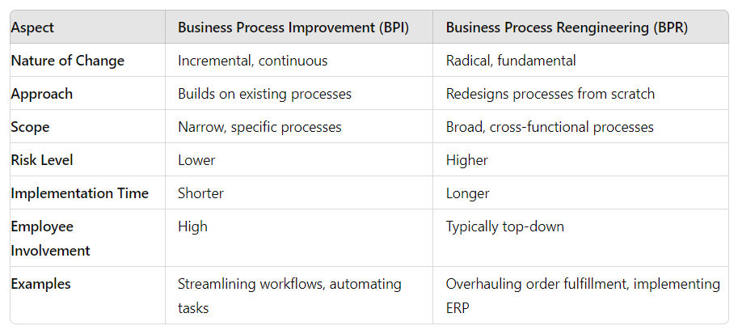
BPI v/s BPR

Slide 25
Business Pressures
Business Pressures
The business environment is the combination of social, legal, economic, physical, and political factors in which businesses conduct their operations.
Significant changes in any of these factors are likely to create business pressures on organizations.

Slide 26
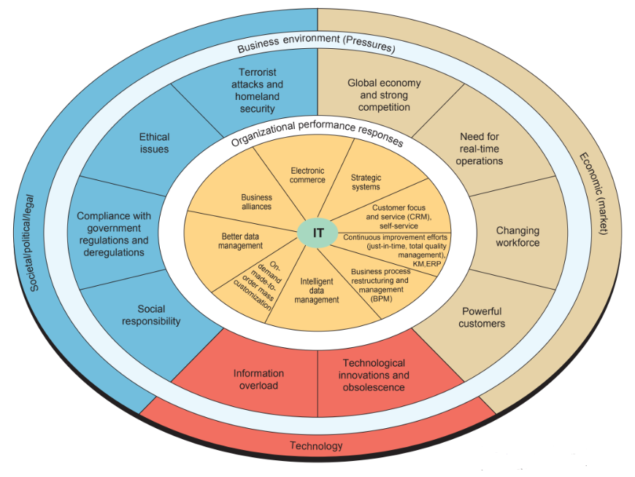
Business Pressures
Three kinds of pressure:
Market pressures
Technology pressures
Societal pressures

Slide 27
Business pressures
Market Pressures:-
Market pressures are generated by the global economy, intense competition, the changing nature of the workforce, and powerful customers.
Globalization:
Globalization was the emergence of multinational companies; that is, companies that had their headquarters in one country but operated in several countries.

Slide 28
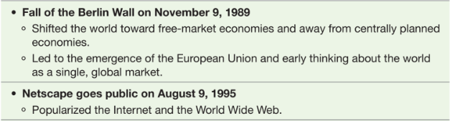
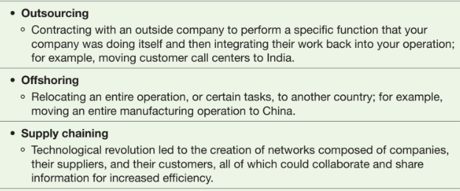
Business pressures
E.g. of Drivers for Globalization

Slide 29
Business pressures
The Changing Nature of the Workforce.
The workforce in developed countries, is becoming more diversified with increasing numbers of women, single parents, minorities, and persons with disabilities are now employed in all types of positions.
IT is easing the integration of these employees into the traditional workforce.
IT is also enabling people to work from home

Slide 30
Business pressures
Powerful Customers.
Consumer have become more knowledgeable about the products and services they acquire.
Customers can use the Internet to find detailed information about products and services, to compare prices, and to purchase items at electronic auctions.
Modern firms strive to learn about their customers to better anticipate and address their needs.
This process, called customer intimacy, is an important component of customer relationship management (CRM), an organization-wide effort toward maximizing the customer experience.

Slide 31
Business pressures
Technology Pressures
Two major technology-related pressures are technological innovation and information overload.
Technological Innovation and Obsolescence.
Few and improved technologies rapidly create or support substitutes for products, alternative service options, and superb quality.
e.g.electronic versions of books, magazines, and newspapers replacing traditional hard copy versions
Information Overload.
The amount of information available on the Internet doubles approximately every year, and much of it is free.

Slide 32
Business pressures
Societal/Political/Legal Pressures.
This includes social responsibility, government regulation / deregulation, spending for social programs, spending to protect against terrorism, and ethics.
Social Responsibility.
Social issues that affect businesses and individuals range from the state of the physical environment, to company and individual philanthropy, to education.
Some corporations and individuals are willing to spend time and/or money to address various social problems.
e.g. Certification for Building Infrastructure - U.S. Green Building Council, Environment Management Certification - ISO 14001, Energy Management Certification -- ISO 50001, Support NGO initiatives

Slide 33
Business pressures
Compliance with Government Regulations.
Major source of business pressures is government regulations regarding health, safety, environmental protection, and equal opportunity.
Businesses tend to view government regulations as expensive constraints on their activities.
The process of becoming and remaining compliant is expensive and time consuming.

Slide 34
Business pressures
Protection against Terrorist Attacks:-
Since 9/11 and 26/11 attacks, organizations have been under increased pressure to protect themselves against terrorist attacks.
Ethical Issues:-
Ethics relates to general standards of right and wrong.
Information ethics relates specifically to standards of right and wrong in information-processing practices.

Slide 35
Organization Response to the Business Pressures
Organizations are responding to the various pressures by:
Implementing IT such as strategic systems,
Customer focus,
Make-to-order and mass customization
E-business.
Production Strategies (0:00 to 4:00 mins)
https://www.youtube.com/watch?v=WwD5HIPtNjs

Slide 36
Organization Response to the Business Pressures
Strategic Systems:
Strategic systems provide organizations with advantages that enable them to increase their market share and/or profits, to better negotiate with suppliers, and to prevent competitors from entering their markets.
For example,P&G utilizes virtual reality models to test design ideas for the next breakthroughs in products such as diapers and cosmetics.

Slide 37
Organization Response to the Business Pressures
Customer Focus
Organizational attempts to provide superb customer service can make the difference between attracting and retaining customers versus losing them to competitors.
For example, Dell guides you through the process of purchasing a computer by providing information and choices that help you make an informed buying decision.

Slide 38
What is Competitive Strategy
A competitive strategy is a statement that identifies a business’s approach to compete, its goals, and the plans and policies that will be required to carry out those goals.
A competitive strategy focuses on achieving a desired outcome when competitors want to prevent you from reaching your goal.

Slide 39
Porter’s Competitive Force Model
Porter’s Competitive Forces Model, also known as Porter's Five Forces Model, is a framework for analyzing the competitive forces within an industry.
Developed by Michael E. Porter in 1979, that helps businesses understand the intensity of competition and the profitability of an industry.
The model identifies five key forces that shape competitive dynamics and influence strategic decisions.

Slide 40
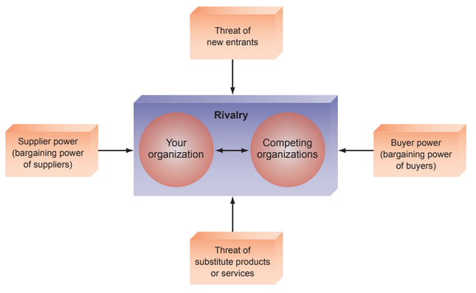
Porter’s Competitive Force Model

Slide 41
Porter’s Competitive Force Model
Threat of New Entrants:
This force examines how easy or difficult it is for new competitors to enter the industry.
Factors affecting this force include barriers to entry such as economies of scale, brand loyalty, capital requirements, and regulatory policies.
High barriers to entry can protect existing firms and reduce competition.

Slide 42
Porter’s Competitive Force Model
Bargaining Power of Suppliers:
This force looks at how much power suppliers have over the industry.
If there are few suppliers or if they offer unique inputs, they can exert more power.
Strong supplier power can affect the cost of inputs and impact profitability.

Slide 43
Porter’s Competitive Force Model
Bargaining Power of Buyers:
This force assesses the influence that customers have on the industry.
When buyers have significant power, they can demand lower prices, higher quality, or more services.
This is often influenced by factors such as the number of buyers, the availability of alternative products, and the importance of each buyer to the business.

Slide 44
Porter’s Competitive Force Model
Threat of Substitute Products or Services:
This force evaluates the likelihood of customers finding alternative solutions that fulfill the same need.
High threat from substitutes can limit an industry’s profitability as customers may switch to alternatives if they offer better value or performance.

Slide 45
Porter’s Competitive Force Model
Industry Rivalry:
This force examines the intensity of competition among existing players in the industry.
High rivalry can result from factors such as a large number of competitors, slow industry growth, high fixed costs, and lack of differentiation.
Intense rivalry can drive prices down and increase marketing costs, reducing overall profitability.

Slide 46
PORTER’s Competitive Forces
Case Study : Tesla (Self - Study ) https://www.youtube.com/watch?v=5F0dI8zaotU

Slide 47
Porter’s Value Chain Model
Porter competitive forces model is used to design general strategies.
Porter Value Chain model is used to decide specific activities where they can use competitive strategies for greatest impact

Slide 48
Porter’s Value Chain Model
A value chain is a sequence of activities through which the organization’s inputs, are transformed into more valuable outputs.
The value chain model identifies points where an organization can use information technology to achieve competitive advantage

Slide 49
Porter’s Value Chain Model
According to Porter’s value chain model, the activities conducted in any organization can be divided into two categories: primary activities and support activities.
Primary activities are related to the production and distribution of the firm’s products and services. These activities create value for which customers are willing to pay.
Support Activities: The primary activities are supported by support activities. These activities do not add value directly to the firm’s products or services.

Slide 50
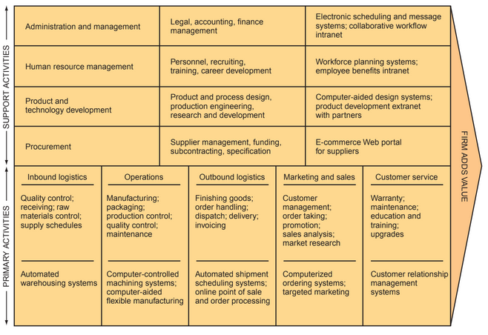
Porter’s Value Chain Model

Slide 51
Strategies for Competitive Advantage
Cost leadership strategy.
Produce products and/or services at the lowest cost in the industry.
e.g. Walmart’s automatic inventory replenishment system, which enables Walmart to reduce inventory storage requirements. As a result, Walmart stores use floor space only to sell products, and not to store them, thereby reducing inventory costs.

Slide 52
Strategies for Competitive Advantage
Differentiation strategy.
Offer different products, services, or product features than your competitors.
e.g. Dell has differentiated itself in the personal computer market through its mass-customization strategy.

Slide 53
Strategies for Competitive Advantage
Innovation strategy.
Introduce new products and services, add new features to existing products and services, or develop new ways to produce them.
A classic example is the introduction of automated teller machines (ATMs) by Citibank.

Slide 54
Strategies for Competitive Advantage
Operational effectiveness strategy.
Improve the manner in which a firm executes its internal business processes so that it performs these activities more effectively than its rivals.
e.g. Introduction of productivity tools (Rapid Application Development) in software development, reduced the development time.

Slide 55
Strategies for Competitive Advantage
Customer-orientation strategy.
Concentrate on making customers happy.
e.g. Relationship manager to connect and communicate with customer.
Chatbot Assistant to help search information on the Website

Slide 56
ELearn Moodle – Course
Batch 2024 - 2025
Enrollment Key : ILO7013

Slide 57


Slide 58
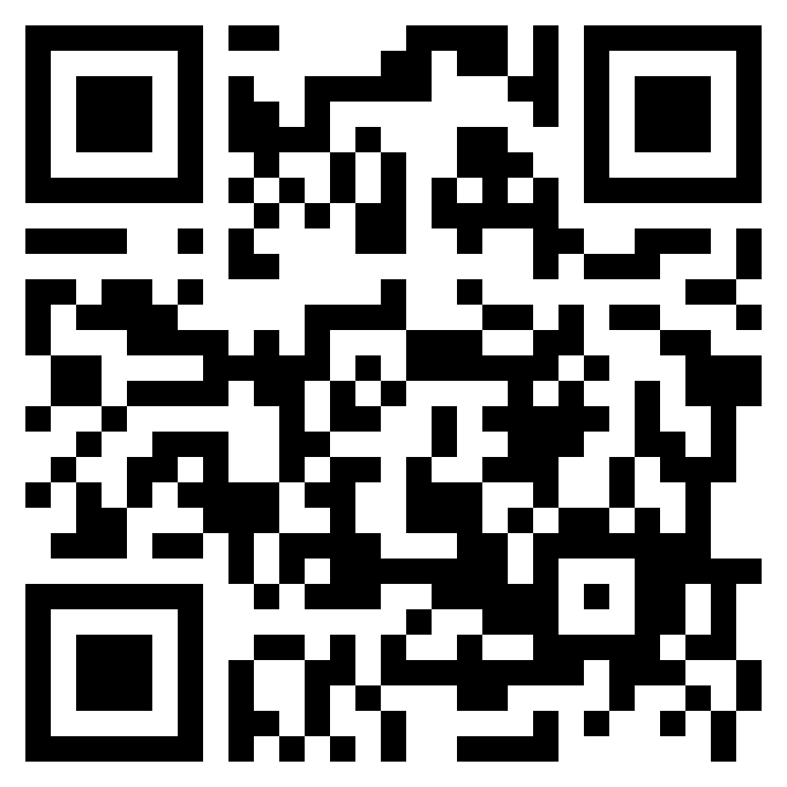
Attendance
https://forms.gle/N1ZTLW1p6mwCoWwt5

