Slide 1
Management Information Systems
Prasad Padalkar
Module 5: Computer Network

Slide 2
Topics
Computer Networks Wired and Wireless technology

Slide 3
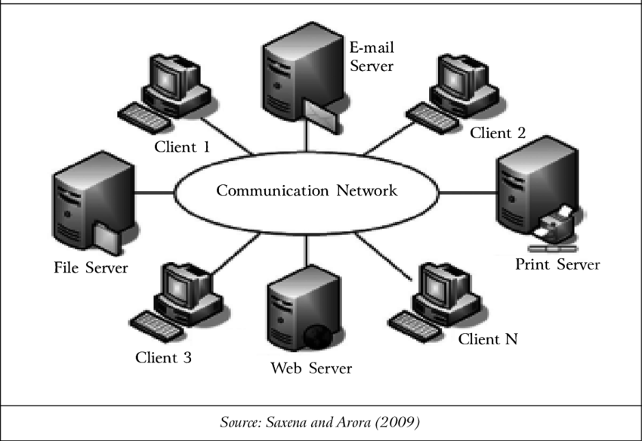
What is Computer Network?
A computer network is a group of interconnected devices that can exchange data and share resources. These devices can be computers, servers, smartphones, tablets, cameras,etc.
Bandwidth refers to the transmission capacity of a network; it is stated in bits per second.

Slide 4
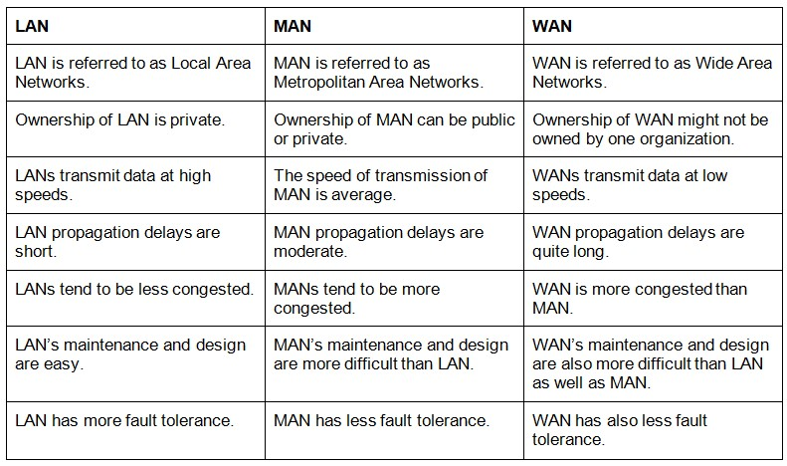
LAN, MAN, WAN

Slide 5
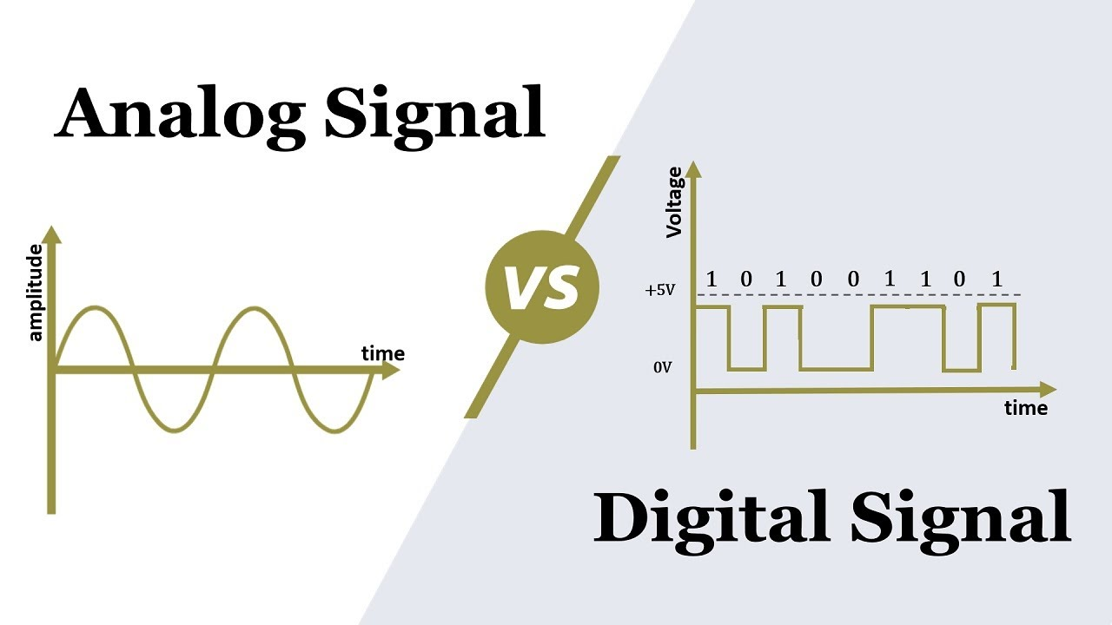
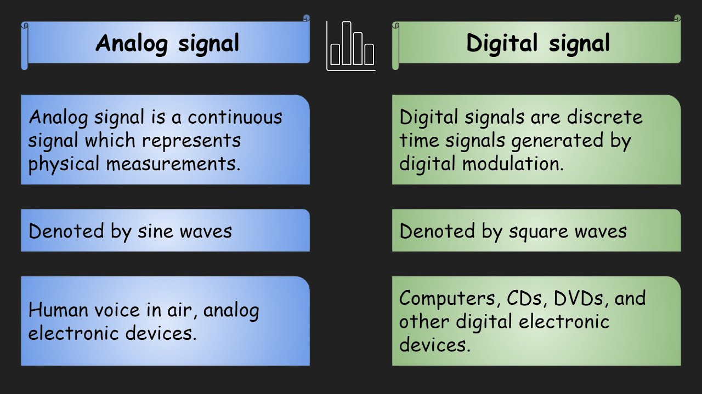
Analog v/s Digital Signal

Slide 6
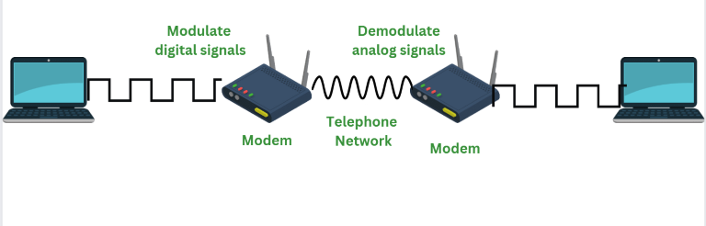
What is Modem?
A modem is a device that connects a computer or other device to the internet by converting digital signals into analog signals that can be transmitted over telephone lines or cable networks.
The term modem stands for "modulator-demodulator".

Slide 7
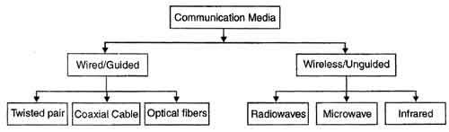
Communication Media
Communication media in a computer network is the physical path that data travels between a source and a destination.

Slide 8
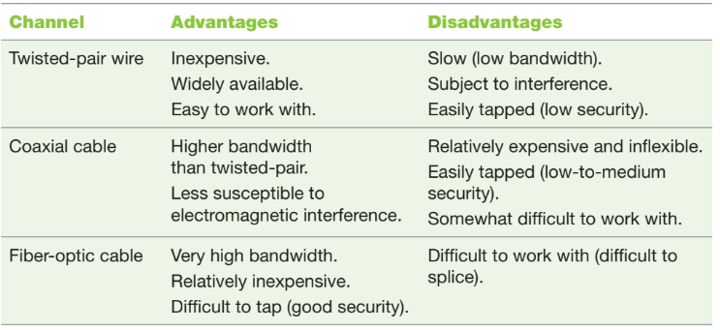
Communication Media (Channel)

Slide 9
Computer Network Protocol
A computer network protocol is a set of rules and conventions that govern communication between devices on a network.
It defines the format of data, how it is transmitted, and how errors are handled.
Protocols ensure that different devices can understand and communicate with each other effectively, even if they have different hardware or software.
Example of common network protocols:
TCP/IP (Transmission Control Protocol/Internet Protocol): The foundation of the internet, providing reliable data transmission and addressing.

Slide 10
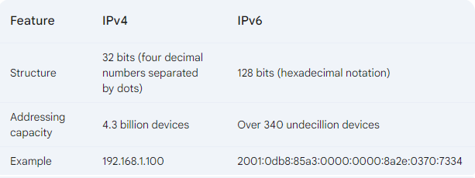
IP Address
IP Address (Internet Protocol Address) is a unique numerical label assigned to each device connected to a computer network that uses the Internet Protocol.
It serves as a network address for identifying and locating devices on the internet.

Slide 11
Explain the impact that networks have had on business and everyday life for each of the major categories of network applications.
Discovery involves browsing and information retrieval, and provides users the ability to view information in databases, download it, and/or process it.
Discovery tools include search engines, directories, and portals. Discovery tools enable business users to efficiently find needed information.
Networks provide fast, inexpensive communications, via e-mail, call centers, chat rooms, voice communications, and blogs.
Communications tools provide business users with a seamless interface among team members, colleagues, business partners, and customers.

Slide 12
Explain the impact that networks have had on business and everyday life for each of the major categories of network applications.
Collaboration refers to mutual efforts by two or more entities (individuals, groups, or companies) who work together to accomplish tasks.
Collaboration is enabled by workflow systems.
Collaboration tools enable business users to collaborate with colleagues, business partners, and customers.
E-learning refers to learning supported by the Web.
Distance learning refers to any learning situation in which teachers and students do not meet face-to-face.
E-learning provides tools for business users to enable their lifelong learning.

Slide 13
Explain the impact that networks have had on business and everyday life for each of the major categories of network applications.
Telecommuting is the process whereby knowledge workers are able to work anywhere and anytime.
Telecommuting provides flexibility for employees, with many benefits and some drawbacks.

Slide 14
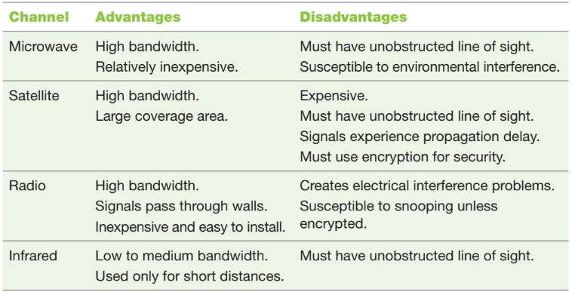
Types of Wireless Transmission Media

Slide 15
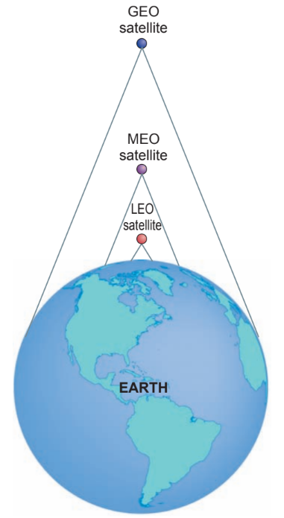
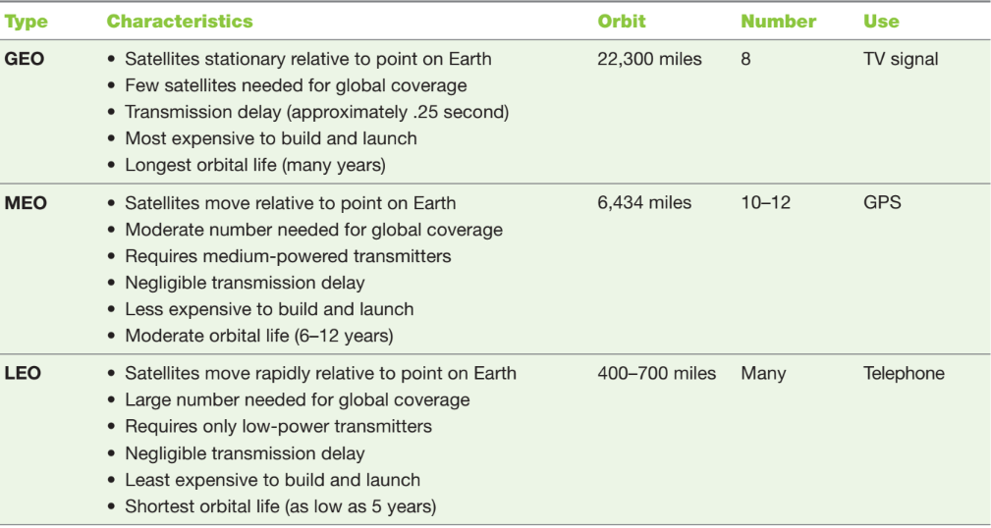
Types of Telecommunication Satellite

Slide 16
Wireless Computer Networks
Short-range wireless networks are wireless communication systems that operate over relatively short distances, typically up to a few meters or tens of meters.
These networks allow devices to connect and communicate without physical wires.
They are commonly used for applications like file transfers, peripheral connections, and mobile payment systems.

Slide 17
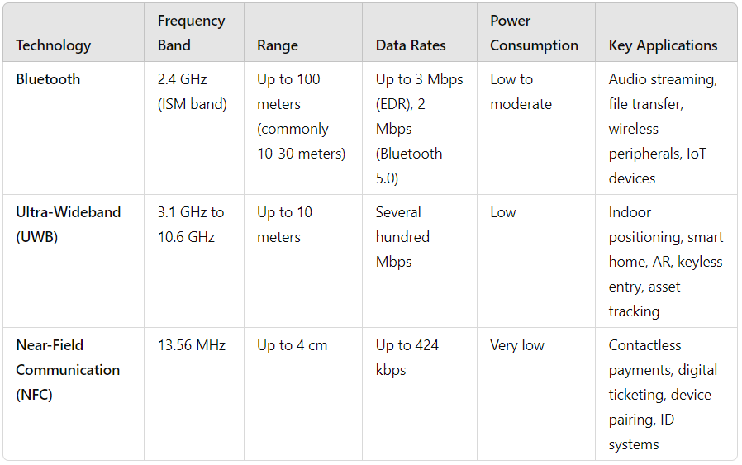
Wireless Computer Networks

Slide 18
Wireless Computer Networks
Medium-range wireless networks are wireless communication technologies designed distances ranging from tens of meters to a few kilometers. These networks offer more robust connectivity and are commonly used for home networks, public hotspots, and even mobile internet connections.

Slide 19
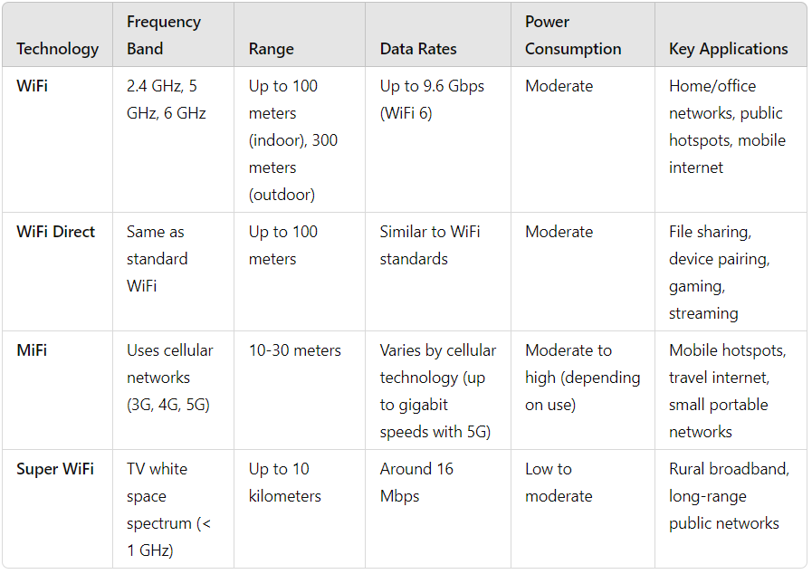
Wireless Computer Networks

Slide 20
Wireless Computer Networks
Wide Area Wireless Networks (WANs) provide wireless connectivity over large geographic areas, typically ranging from several kilometers to even hundreds of kilometers. These networks are designed for broad coverage and are used for mobile communications, internet access, and data transmission over large regions.

Slide 21
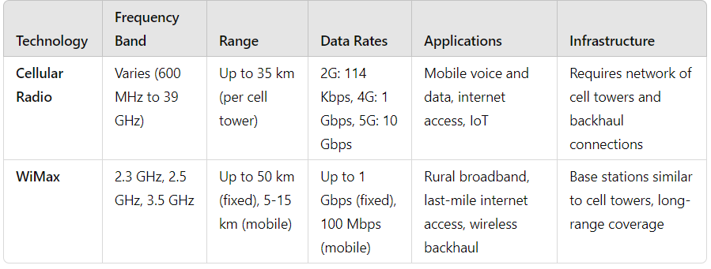
Wireless Computer Networks

Slide 22


