Slide 1

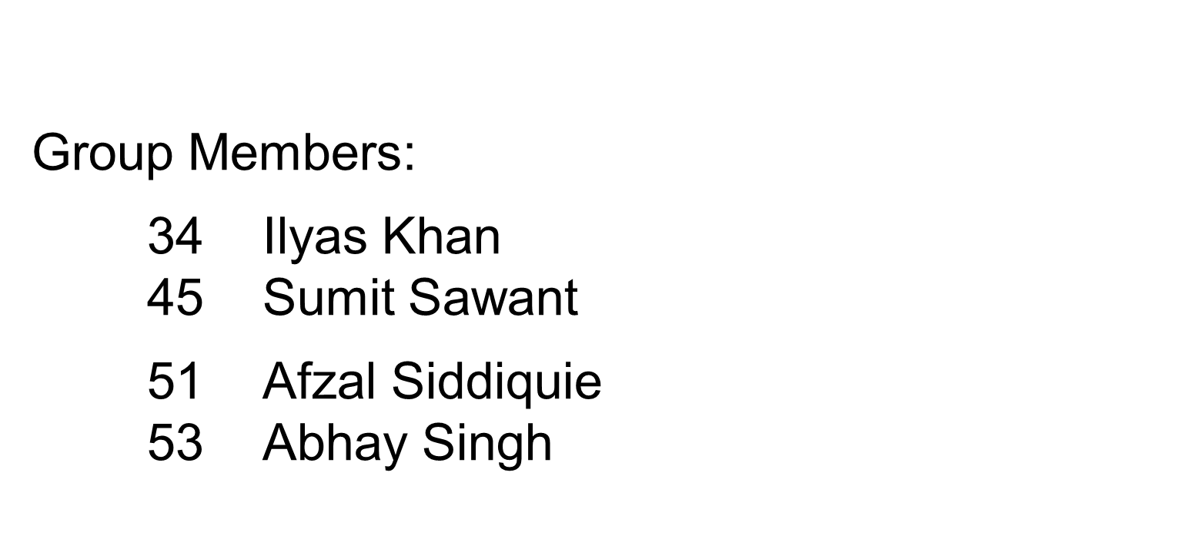
6

Slide 2

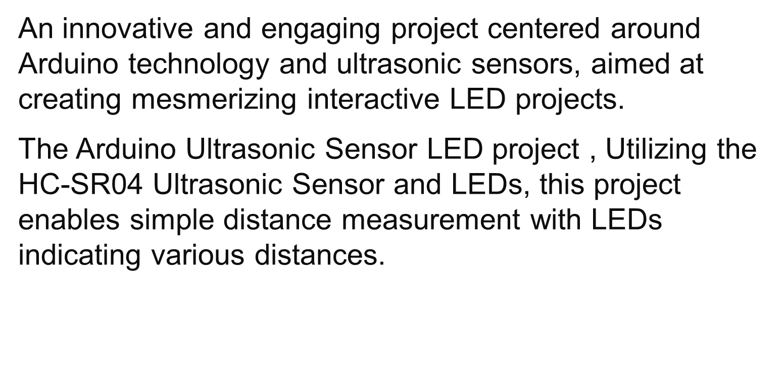
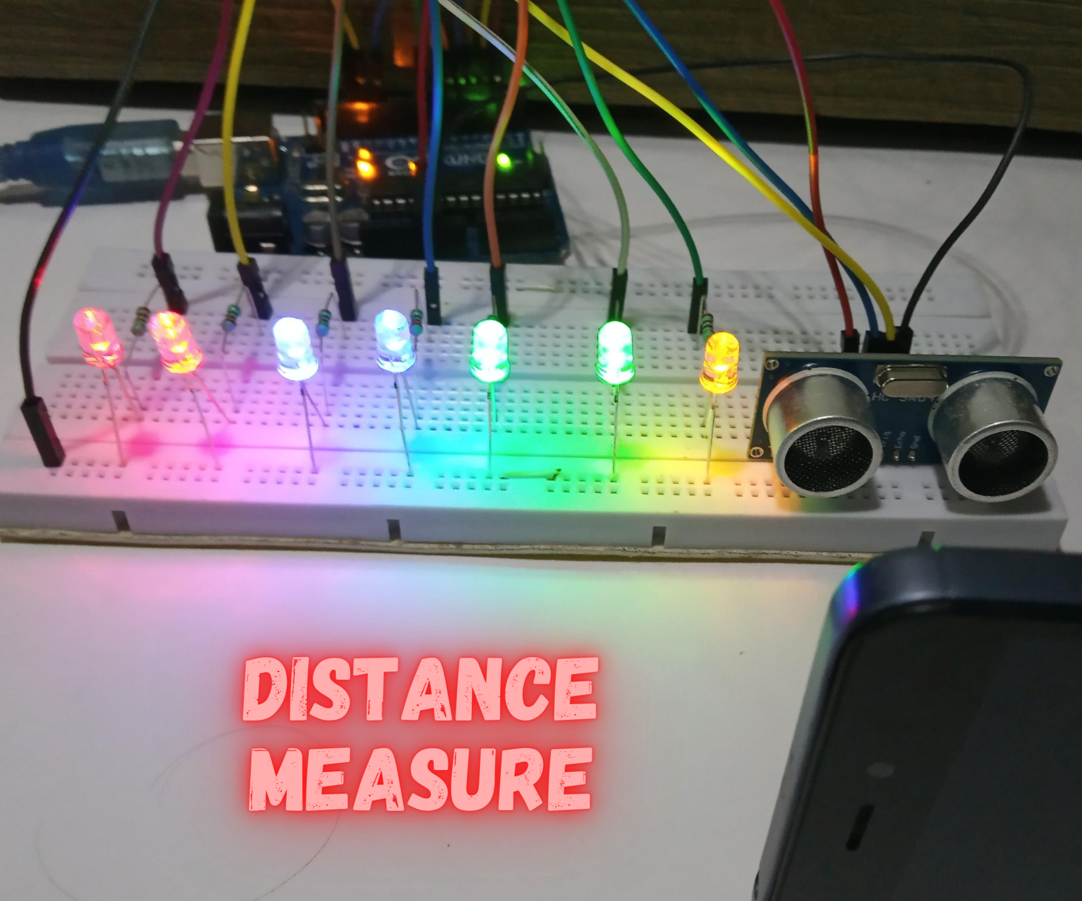

Slide 3

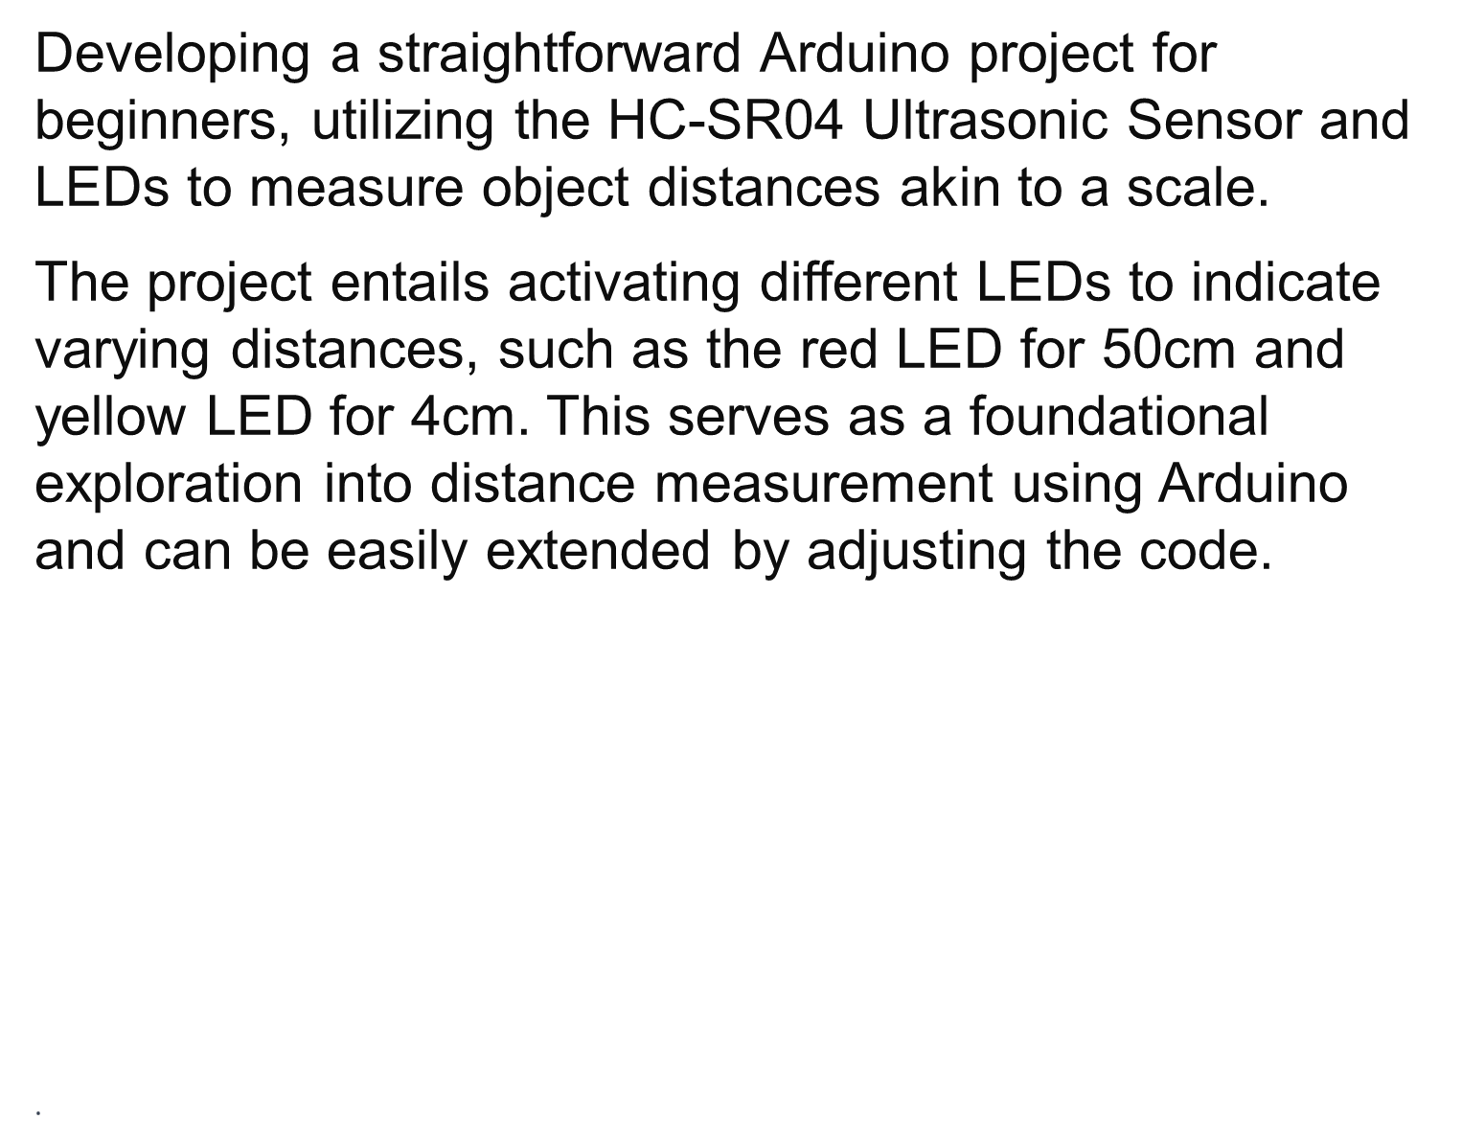


Slide 4

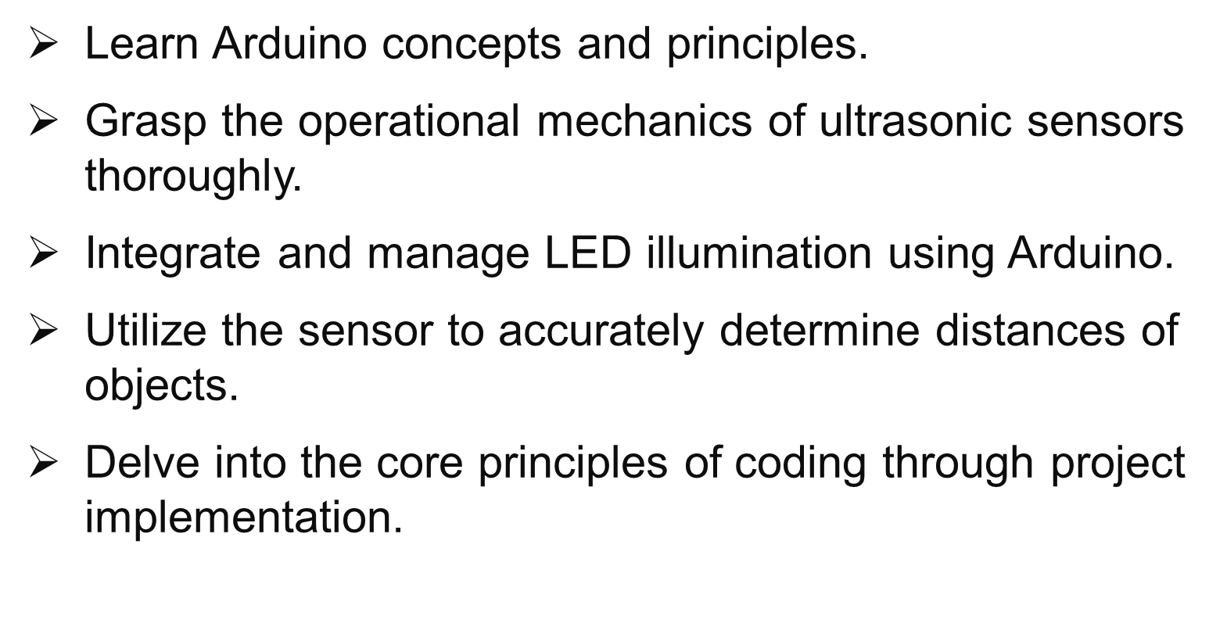

Slide 5

Core | Result | Gap
The paper investigates the application of Arduino microcontrollers and ultrasonic sensors to create interactive distance measurement systems. It delves into the integration of these technologies to develop tools for measuring distances in various contexts. | The study successfully demonstrates the feasibility and effectiveness of utilizing Arduino and ultrasonic sensors for distance measurement , the paper showcases the accuracy and reliability of the system in providing real-time distance information. | The study lacks exploration of scalability and robustness in complex environments. Future work should address challenges like interference, accuracy, and sensor integration for enhanced functionality.

Slide 6
Core | Result | Gap
Investigates Arduino and ultrasonic sensor integration, emphasizing precise distance calculations through algorithm implementation for data processing and interpretation. | Demonstrates Arduino system's accuracy in distance measurement across diverse environmental conditions, with minimal errors observed within specified ranges through rigorous experimentation and testing. | Acknowledges functional distance measurement system, yet gaps persist in assessing adaptability to dynamic environments and addressing potential limitations with obstacles.

Slide 7

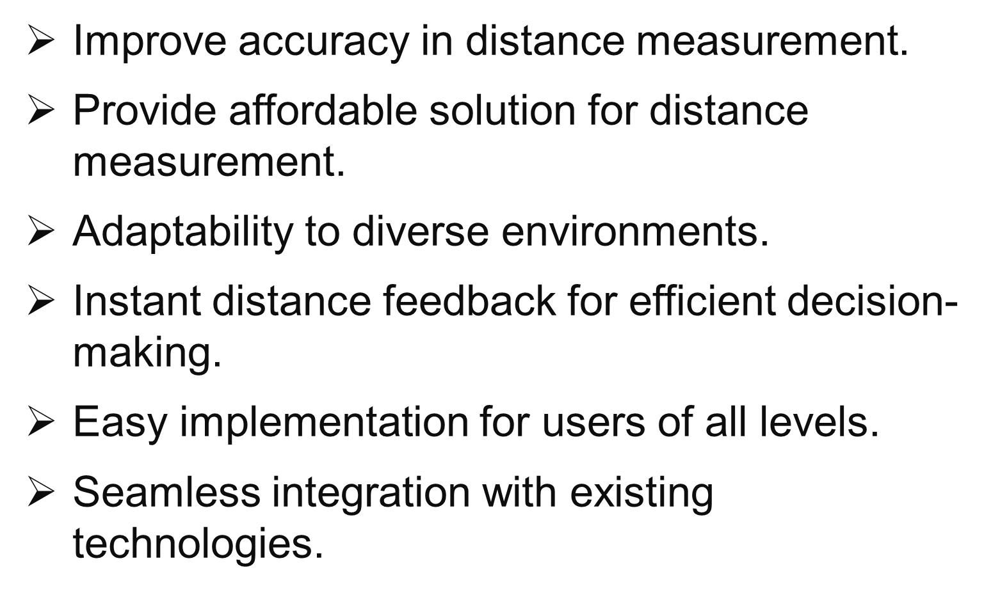

Slide 8

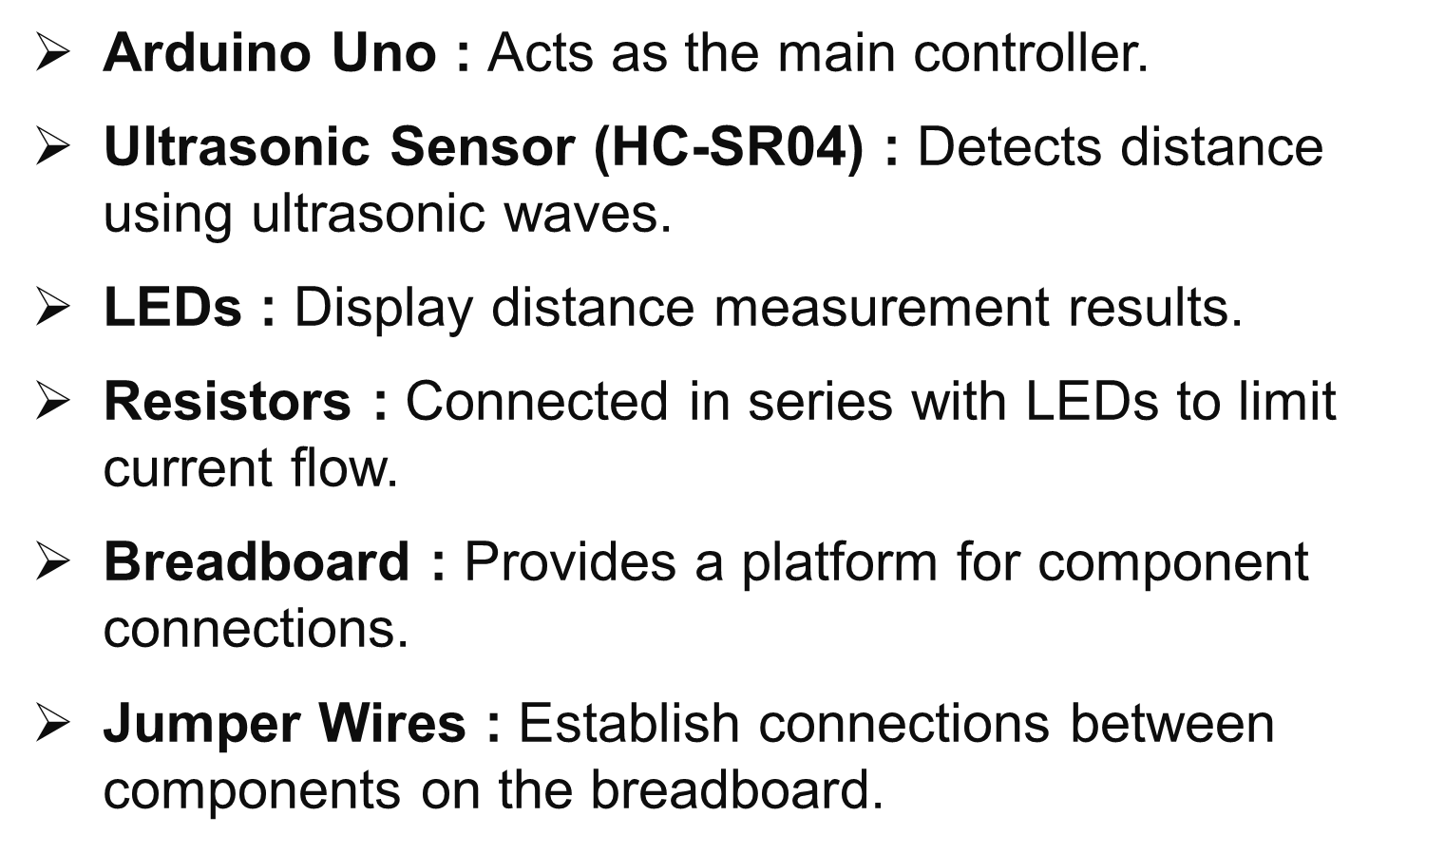


Slide 9

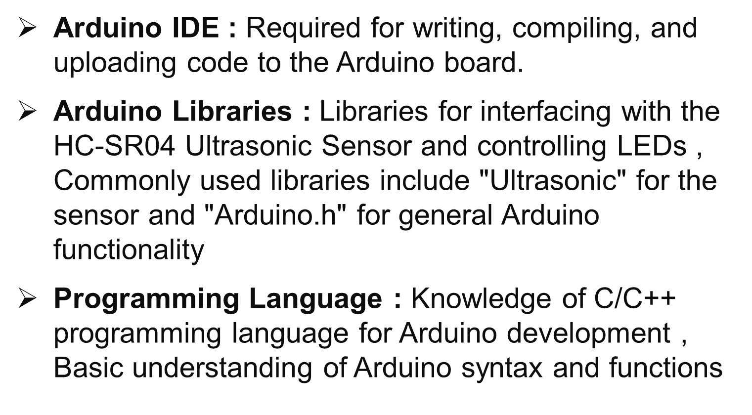

Slide 10

Arduino Board : Any Arduino board compatible with the Arduino IDE.
HC-SR04 Ultrasonic Sensor : Ultrasonic sensor module for measuring distances.
LEDs : Light-emitting diodes (LEDs) for visual feedback.
Resistors : Current-limiting resistors for the LEDs to prevent overcurrent and protect the Arduino pins.
Breadboard and Jumper Wires : Breadboard for prototyping and connecting components.

Slide 11

Arduino Uno: ₹600 - ₹1500
Ultrasonic sensor HC-SR04: ₹150 - ₹350
7 x LEDs: ₹5 - ₹25 each
7 x 220 ohm resistor: ₹1 - ₹5 each
Breadboard: ₹300 - ₹600
Jumper wires: ₹200 - ₹400 for a pack
Total estimated cost: ₹1265 - ₹3480

Slide 12

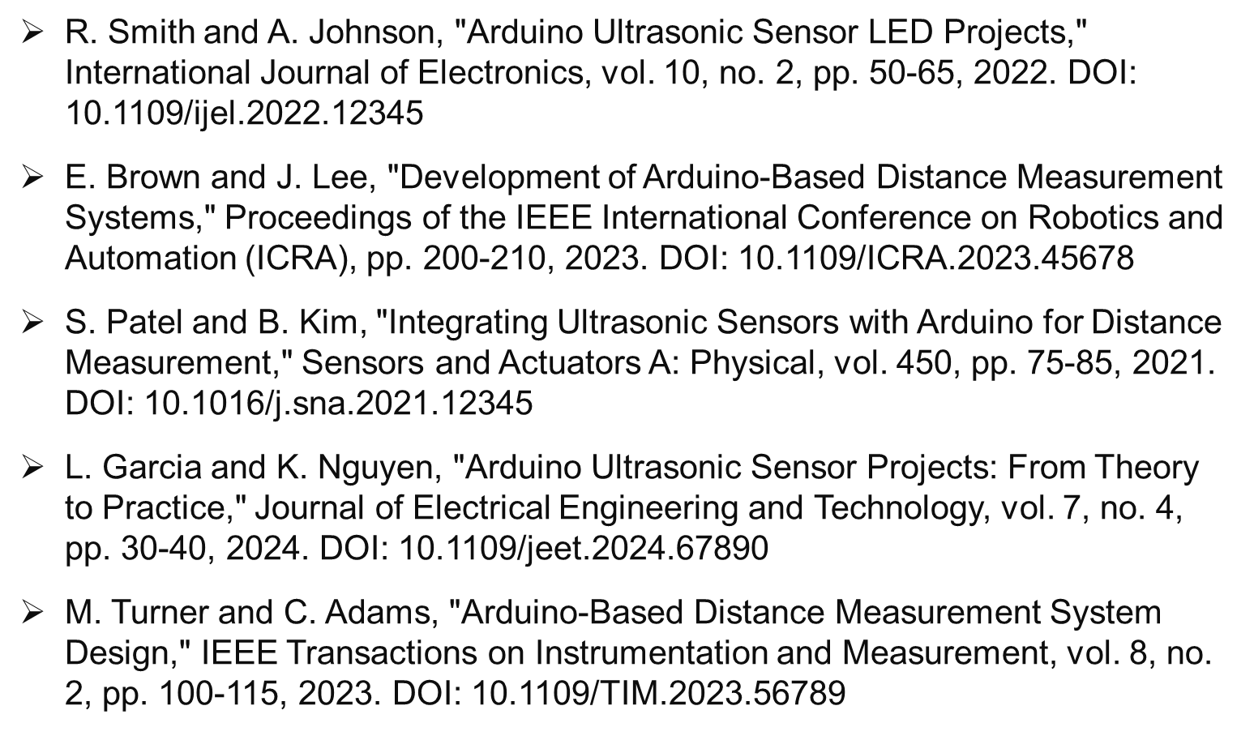

Slide 13


