Slide 1







Data Engineering with Spatially Enabled DataFrame and ArcGIS API for Python
Mohit Aggarwal
Andrew Chapkowski
2021 ESRI DEVELOPER SUMMIT

Slide 2


What is the ArcGIS API for Python
Kubernetes
ArcGISServer
Mission Server
Enterprise
Notebooks
widgets
GIS
Schematics
Dashboards
env
GeoAnalytics
Mapping
apps
Geoprocessing
Geocoding
Charting
Geoenrichment
Features
learn
Geometry
Raster
SeDF
Network
Realtime

Slide 3
Overview
Pandas
makes working with structured or tabular data fast, easy, and expressive.
provides sophisticated indexing functionality.
used to reshape, slice and dice data.
provides capabilities for handling missing data and creating plots.

Slide 4
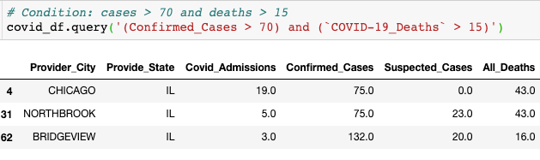
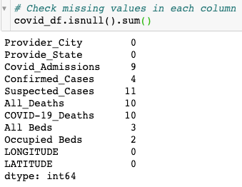
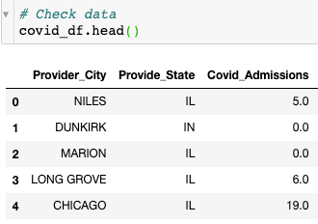
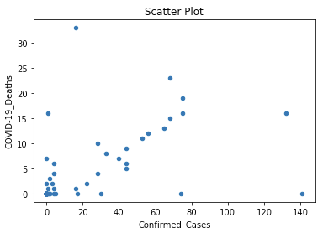
Introduction to Pandas
Working with a Series
Creating a series and accessing its elements
Working with a DataFrame
Creating a DataFrame
Importing data into a DataFrame
Navigating a DataFrame
Operating on a DataFrame
Working with Missing Data
Plotting Data

Slide 5







Spatially Enabled DataFrame
Andrew Chapkowski

Slide 6
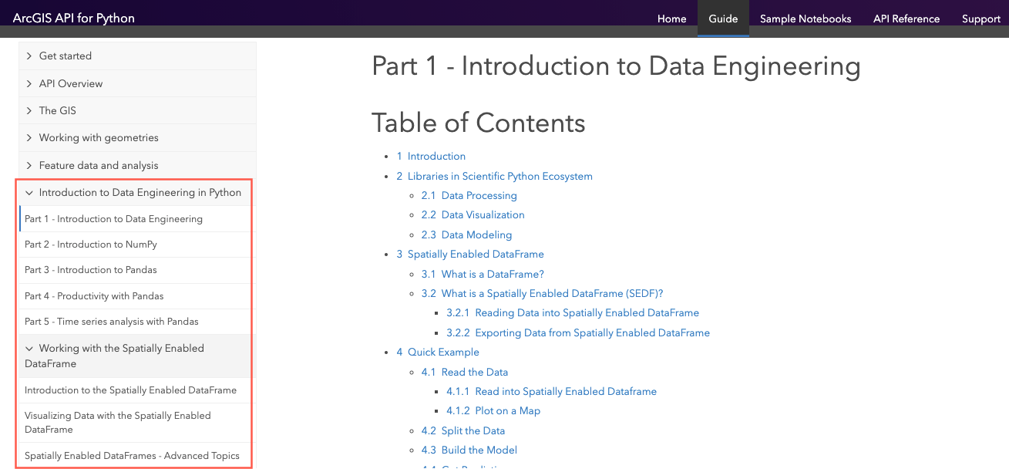
Link to Guide Series: https://developers.arcgis.com/python/guide/part1-introduction-to-dataengineering/

Slide 7
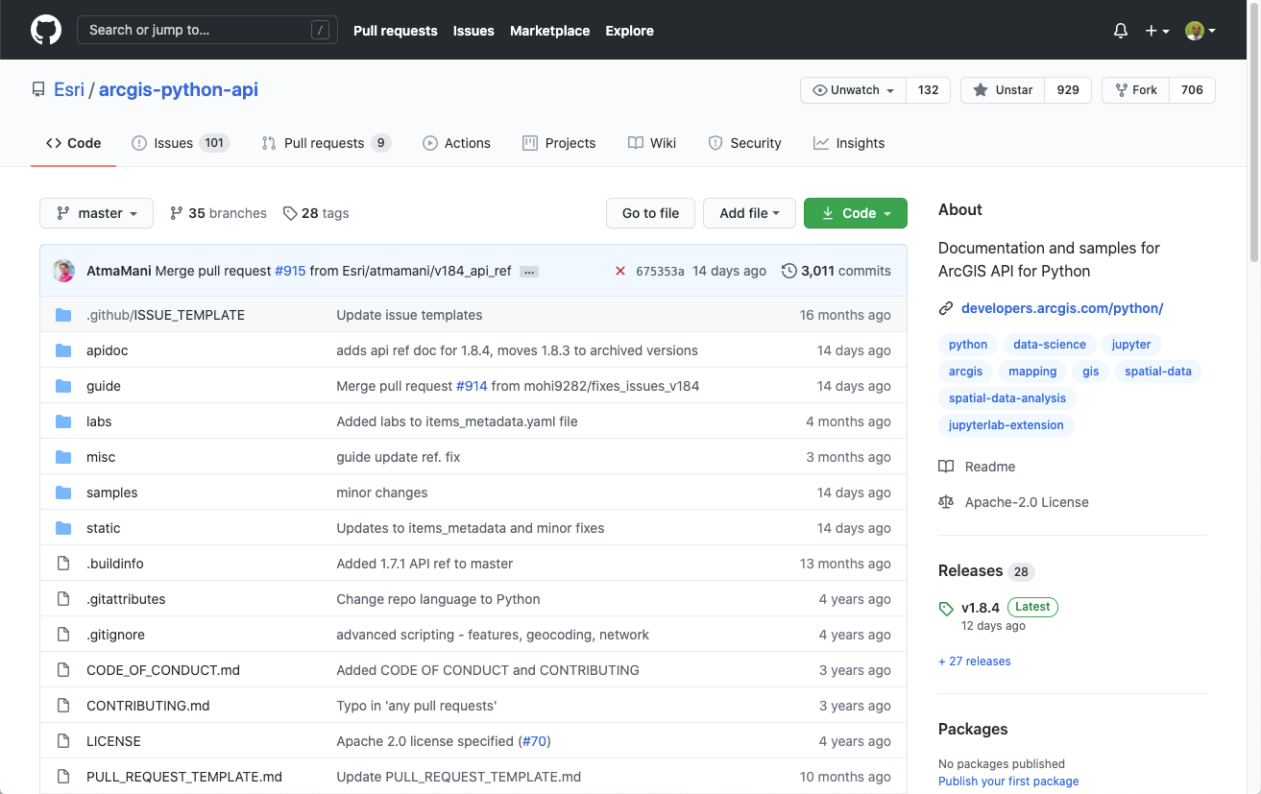
Link to GitHub: https://github.com/Esri/arcgis-python-api

Slide 8









Copyright © 2021 Esri. All rights reserved.

