Slide 1
FlashR: Parallelize and Scale R Machine Learning Libraries with Extreme Efficiency for Big Data
Da Zheng
Johns Hopkins University

Slide 2
Introduction
What FlashR is?
An R package that redefines R matrix functions to process big data.
How to use it?
Program with the API of the “base” package.
What benefits?
Automatic parallelization
Automatic out-of-core execution to scale to large datasets.

Slide 3
FlashR programming interface
R base package
Override 69 functions so far.
R
FlashR
+, -, *, /, %*%, ==, !=, >, >=, <, <=
sum, mean, min, max
abs, sqrt, ceiling, floor, round, log,
rowSums, colSums, rowMeans, colMeans
…
+, -, *, /, %*%, ==, !=, >, >=, <, <=
sum, mean, min, max
abs, sqrt, ceiling, floor, round, log,
rowSums, colSums, rowMeans, colMeans
…
Matrix creation and loading:
fm.runif, fm.runif.matrix
…
Generalized matrix operations (GenOps).
fm.inner.prod
fm.mapply
…

Slide 4
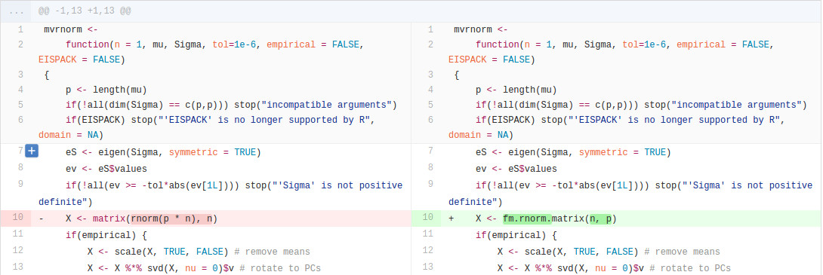
Generate Multivariate Normal Distribution (mvrnorm in MASS)
Modify only one line
Notes:
With this programming interface, we can execute existing machine learning libraries without much modification.

Slide 5
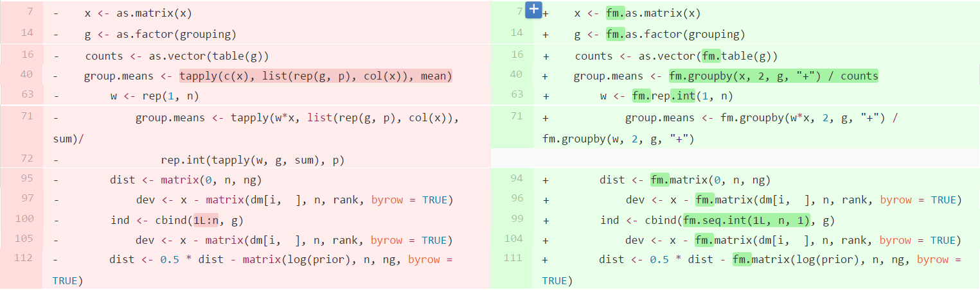
Linear Discriminant Analysis (LDA in MASS)
Modify 11 lines out of 140 lines

Slide 6
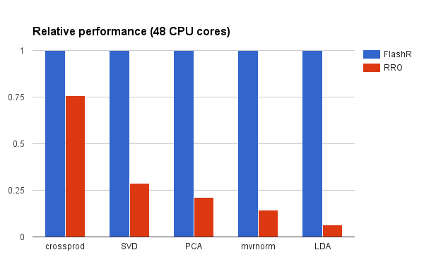
FlashR vs. RRO
FlashR significantly outperforms RRO.
Performance gap is larger in more complex algorithms.

Slide 7
Conclusion
FlashR is an R package to parallelize and scale machine learning libraries.
FlashR is easy to use and have high efficiency.

Slide 8
Thank you!
Email: dzheng5@jhu.edu
Github: https://github.com/flashxio/FlashX
FlashX: http://flashx.io/

