Slide 1
Player Agent (Decision Making, Behavior and Control)
Douglas D. Hodson 3 March 2013

Slide 2
Player Control – Different Levels
Simple player dynamics
Basic functionality
Advanced player dynamics
Direct stick input
Auto pilot functionality
Pilot / auto pilot

Slide 3
Player Structures (Implementation of Functionality)

Slide 4
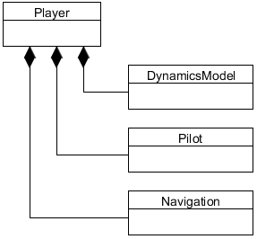
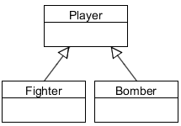
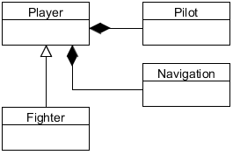
Player Structures (Implementation)
Player functionality can be implemented several ways
Composite: components attached to a generic Player class
Subclass: a new derived Player implements functionality
Mixture: partial implementation of functionality in subclass
Subclass
Subclass and Composite
Composite

Slide 5
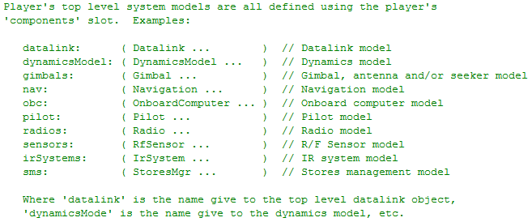
Composite Structure
General purpose interface to those sub-systems
from Player.h

Slide 6
Simple Player Dynamics (DynamicModel not required)

Slide 7
Simple Player Dynamics
Every Player can do the following
Set position
North/East/Down (NED) (x, y, altitude)
Geodetic (lat, long, altitude)
Geocentric (ECEF) (x, y, z)
Set roll, pitch & heading
Initial velocity
Player has a built-in dynamics model for simple movement
Simple player dynamics model useful for testing

Slide 8
Direct Stick Input (assumes DynamicsModel or Subclassing)

Slide 9
Composite Structure
General purpose interface to those sub-systems
Required
from Player.h

Slide 10
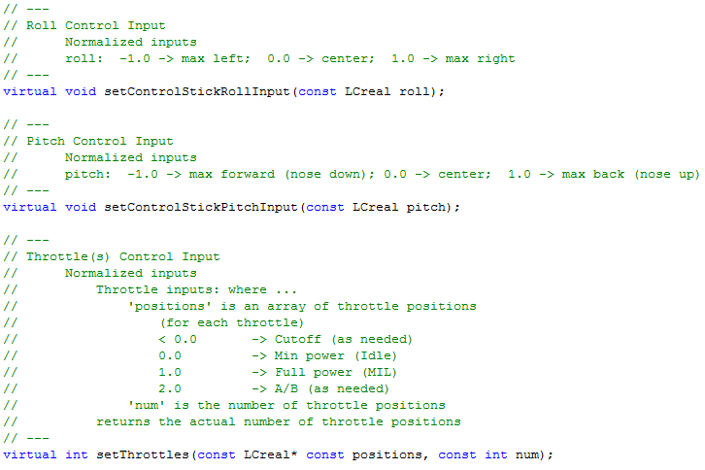
Direct Stick Input
from Player.h

Slide 11
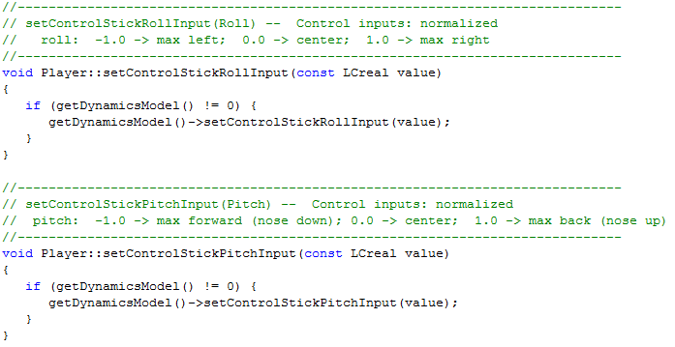
Direct Stick Input
Requires a DynamicsModel to do anything meaningful
Functionality can be implemented in subclass
from Player.cpp

Slide 12
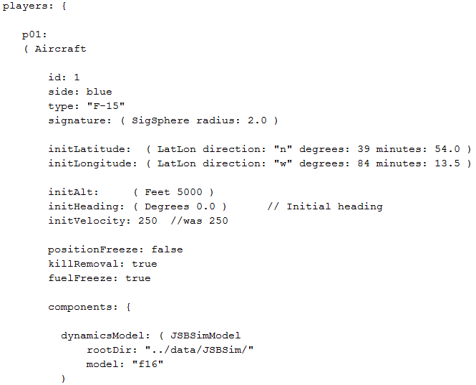
Input File Example

Slide 13
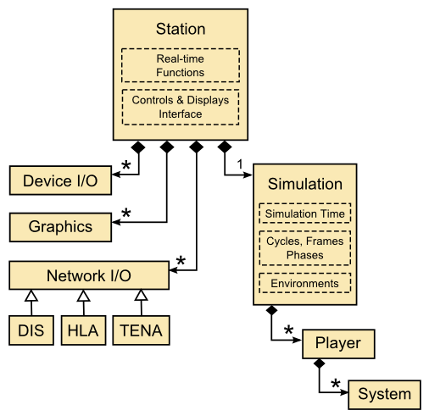

Human Input to Player
Stick & Throttle Inputs Arrive Here

Slide 14

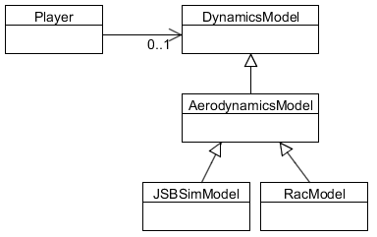
Player w/DynamicsModel
Player may or may not have an attached dynamics model
If attached, then stick and throttle inputs are forwarded to the dynamics model
Physics

Slide 15
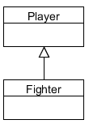
Subclassed Player
Stick and throttle functionality implemented in subclass

Slide 16
Dynamics Model “Auto Pilot” (assumes DynamicModel or subclassing that includes an autopilot)

Slide 17
Composite Structure
General purpose interface to those sub-systems
Must contain an auto pilot
from Player.h

Slide 18
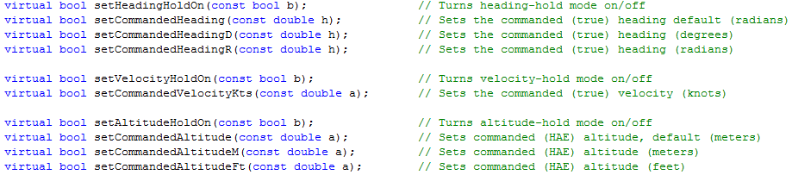
Dynamics Model “Auto Pilot”
Player interface to DynamicsModel “auto pilot” is driven by “commands”
from Player.h

Slide 19
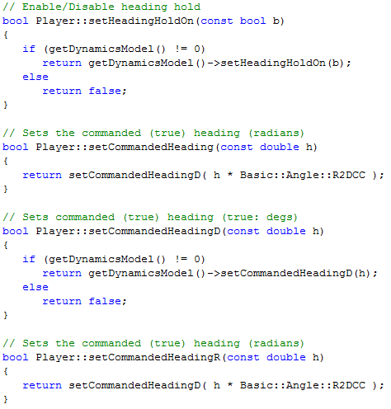
Dynamics Model “Auto Pilot”
from Player.cpp

Slide 20
Dynamics Model “Auto Pilot”
Player may or may not have an attached dynamics model
If attached, then stick and throttle inputs are forwarded to the dynamics model – some dynamics models do not include an autopilot!
If overridden in subclass, subclass will receive inputs
May or may not include autopilot
Includes an autopilot

Slide 21
Pilot / AutoPilot (Not associated with a DynamicModel)

Slide 22
Composite Structure
General purpose interface to those sub-systems
from Player.h

Slide 23
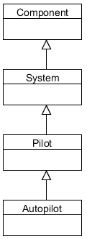
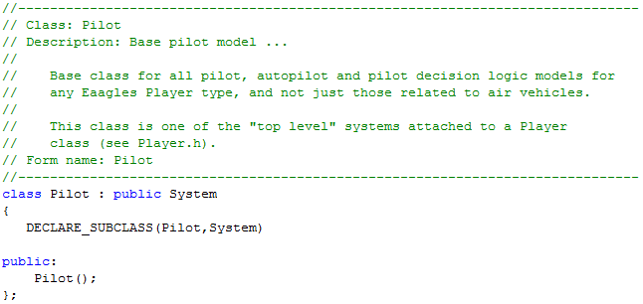
Pilot / AutoPilot
NOT part of DynamicsModel!
Provides “higher level” functions than a dynamics model autopilot
Base pilot class does nothing interesting, AutoPilot class adds functionality

Slide 24
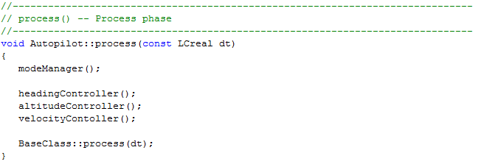
Pilot / AutoPilot
Defined Autopilot functionality called in each frame
Remember “process” is 4th phase in each frame
Decision Making
Control

Slide 25
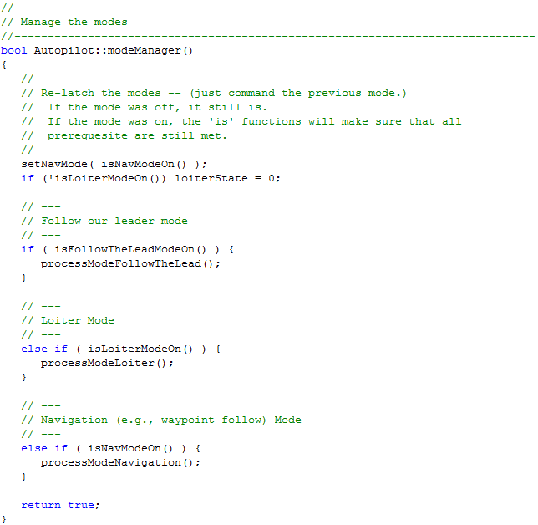
Pilot / AutoPilot
Decision making, (e.g., follow routes,
loiter, follow another player, etc)

Slide 26
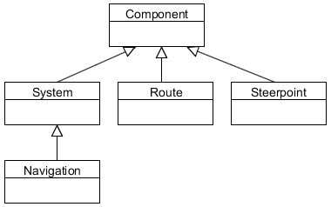
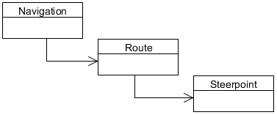
Navigation
AutoPilot uses Navigation
Navigation contains routes, which contain steerpoints
Steerpoints can contain Actions!

Slide 27
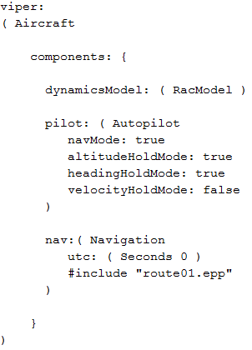
Example Input File
RacModel has a auto pilot within its dynamic model
Auto pilot that follows the defined route within navigation system
Attached navigation system that includes a defined route

Slide 28
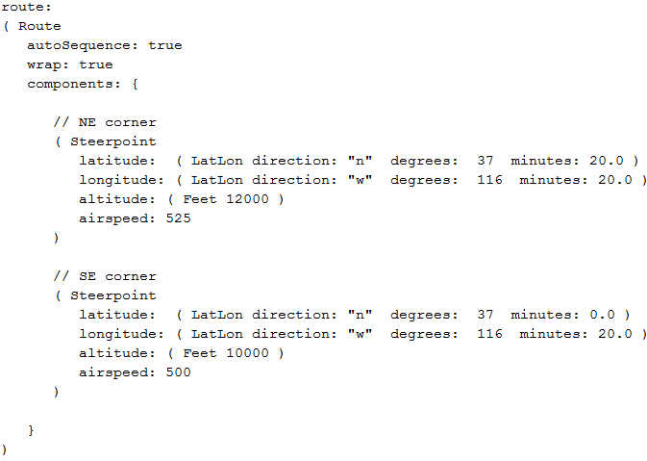
Example Input File
Steerpoints define position and desired airspeed, etc

Slide 29
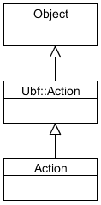
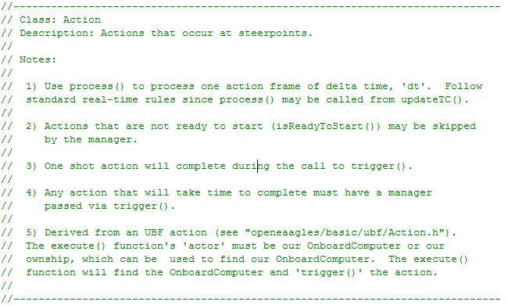
Steerpoint Actions
Steerpoint can have an associated Action
Examples: Take SAR image, release weapon, release decoy, etc

Slide 30
Flow of Decisions and Actions
AutoPilot determines “high level” things to do, and how to do it via commands to “dynamic model auto pilot” or even direct control in some cases
Onboard computer could be used to determine “what to do” and allow AutoPilot to carry out decisions

Slide 31
Pilot Structures (Implementation of Functionality)

Slide 32
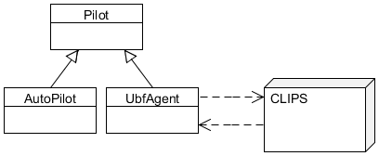

Pilot Structures (Implementation)
Pilot functionality can be implemented several ways
Direct subclassing (e.g., AutoPilot, UBF Agent, etc)
Indirect interface to external software system (e.g., Soar, CLIPS, etc)
Maybe a scripting system
Control
Behavior
Decision Making

Slide 33
Summary
Lots of places to add “intelligent” behaviors
AutoPilot
Onboard Computer
Could act as the “Actor” for UBF

