Slide 1
Player Control Logic

Slide 2
Player Controls – Different Levels
Simple player dynamics
Basic functionality
Player with a dynamics model
Direct stick input
Auto pilot functionality
Pilot / auto pilot

Slide 3
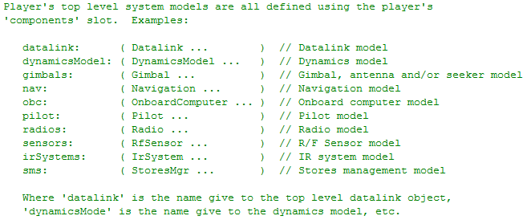
Player Top-Level System Models
Container of sub-systems
General purpose interface to those sub-systems
from Player.h

Slide 4
Simple Player Dynamics (DynamicModel not required)

Slide 5
Simple Player Dynamics
Every Player can do the following
Set position
North/East/Down (NED) (x, y, altitude)
Geodetic (lat, long, altitude)
Geocentric (ECEF) (x, y, z)
Set roll, pitch & heading
Initial velocity
Player has a built-in dynamics model for simple movement
Simple player dynamics model useful for testing

Slide 6
Direct Stick Input (assumes a DynamicModel)

Slide 7
Player Top-Level System Models
Container of sub-systems
General purpose interface to those sub-systems
Required
from Player.h

Slide 8
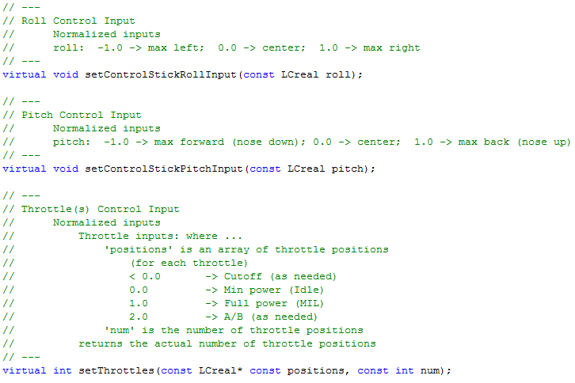
Direct Stick Input
from Player.h

Slide 9
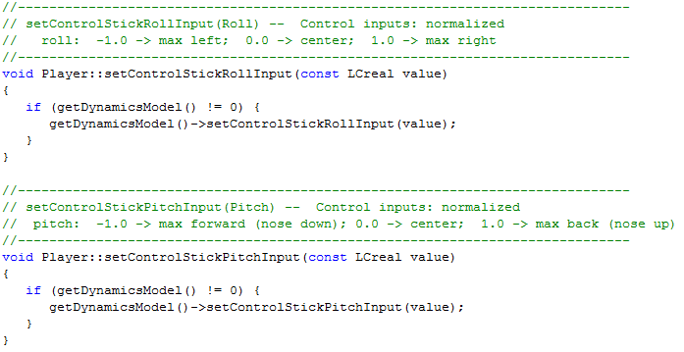
Direct Stick Input
Requires a DynamicsModel to do anything meaningful
from Player.cpp

Slide 10
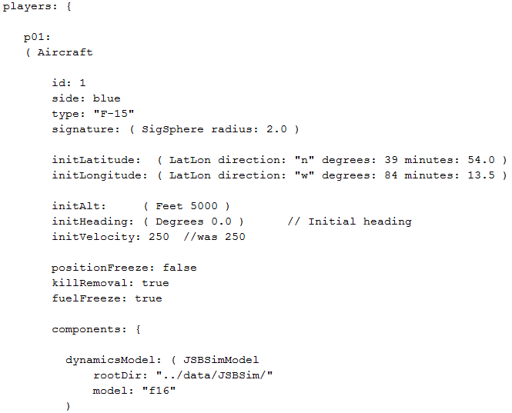
Input File Example

Slide 11
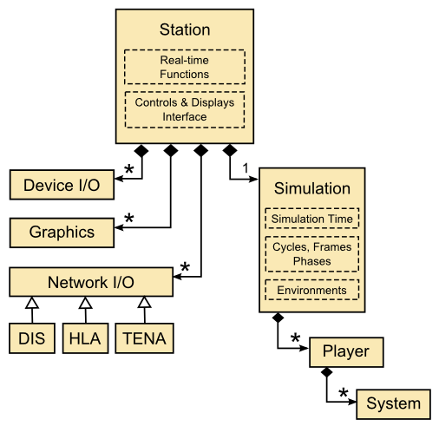

Human Input to Player
Stick & throttle inputs arrive here

Slide 12
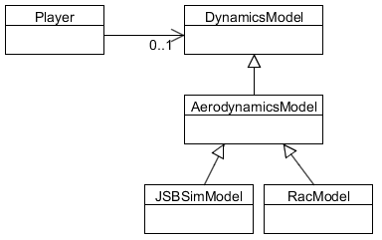
Player / DynamicsModel
Player may or may not have an attached dynamics model
If attached, then stick and throttle inputs are forwarded to the dynamics model

Slide 13
DynamicsModel “Auto Pilot” (assumes a DynamicModel that includes an autopilot)

Slide 14
Player Top-Level System Models
Container of sub-systems
General purpose interface to those sub-systems
Must contain an auto pilot
from Player.h

Slide 15
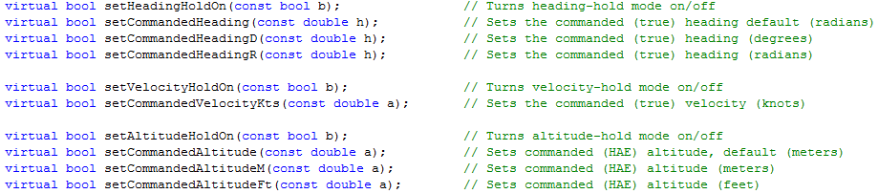
DynamicsModel “Auto Pilot”
Player interface to DynamicsModel “auto pilot” is driven by “commands”
from Player.h

Slide 16
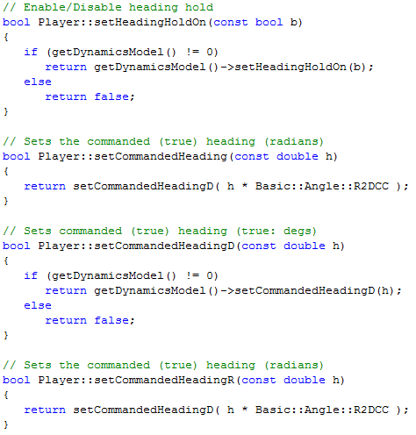
DynamicsModel “Auto Pilot”
from Player.cpp

Slide 17
Player / DynamicsModel
Player may or may not have an attached dynamics model
If attached, then stick and throttle inputs are forwarded to the dynamics model – some dynamics models do not include an autopilot!
May or may not include an autopilot (depends on input files)
Includes an autopilot

Slide 18
Pilot / AutoPilot (Not associated with a DynamicModel)

Slide 19
Player Top-Level System Models
Container of sub-systems
General purpose interface to those sub-systems
from Player.h

Slide 20
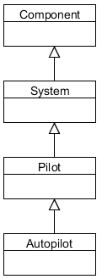
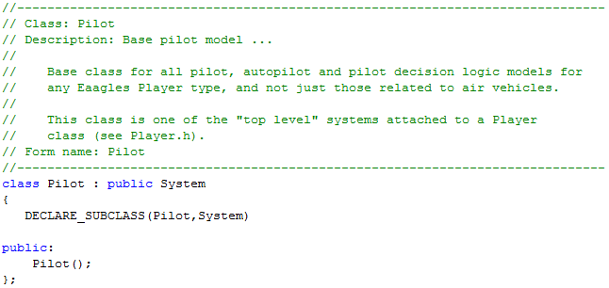
Pilot / AutoPilot
NOT part of DynamicsModel!
Provides “higher level” functions than a dynamics model autopilot
Base pilot class does nothing interesting, AutoPilot class adds functionality

Slide 21
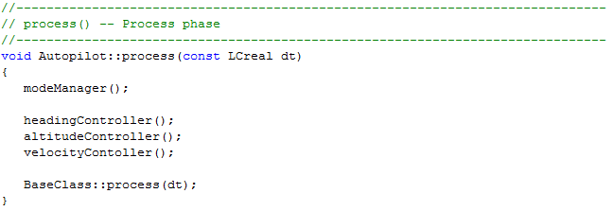
Pilot / AutoPilot
Defined Autopilot functionality called in each frame
Remember “process” is 4th phase in each frame
Determine what to do
Do it

Slide 22
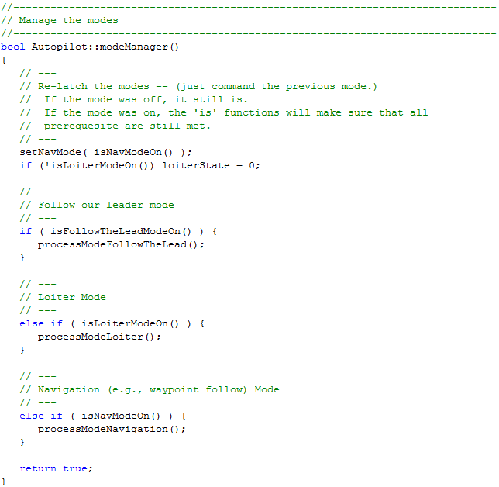
Pilot / AutoPilot
Determines what to do, (e.g., follow routes,
loiter, follow another player, etc)

Slide 23
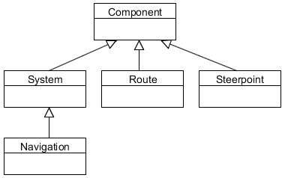
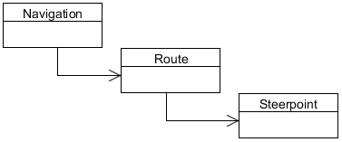
Navigation
AutoPilot uses Navigation
Navigation contains routes, which contain steerpoints
Steerpoints can contain Actions!

Slide 24
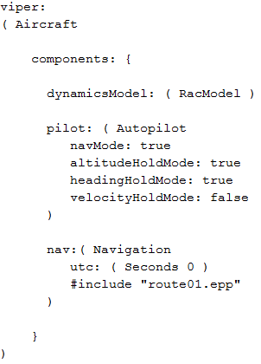
Example Input File
RacModel has a auto pilot within its dynamic model
Auto pilot that follows the defined route within navigation system
Attached navigation system that includes a defined route

Slide 25
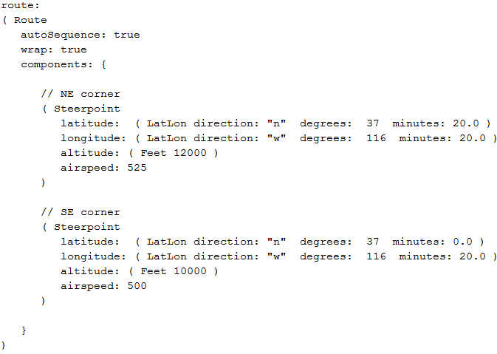
Example Input File
Steerpoints define position and desired airspeed, etc

Slide 26
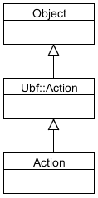
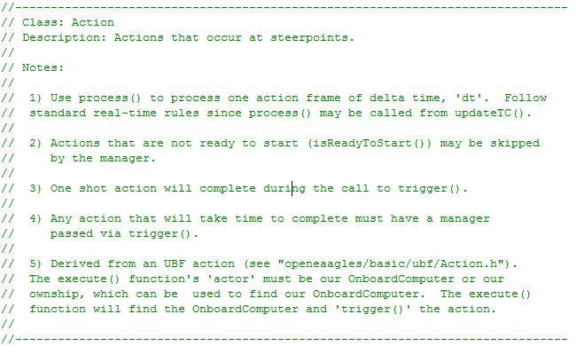
Steerpoint Actions
Steerpoint can have an associated Action
Examples: Take SAR image, release weapon, release decoy, etc

Slide 27
Flow of Decisions and Actions
AutoPilot determines “high level” things to do, and how to do it via commands to “dynamic model auto pilot” or even direct control in some cases
Onboard computer could be used to determine “what to do” and allow AutoPilot to carry out decisions

Slide 28
Summary
Lots of places to add “intelligent” behaviors
AutoPilot
Onboard Computer
Could act a the “Actor” for UBF

