Slide 1
Player Agent (Decision Making, Behavior and Control)
Douglas D. Hodson 3 March 2013

Slide 2
Player Control – Layers of Functionality
Simple player dynamics
Basic functionality
Advanced player dynamics
Direct stick input
Autopilot functionality
Pilot
AutoPilot

Slide 3
Player Structures (Implementation of Functionality)

Slide 4
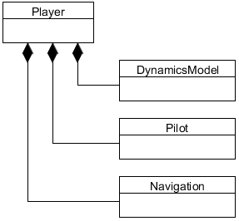
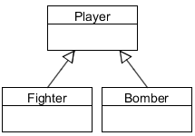
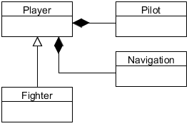
Player Structures (Implementation)
Player functionality can be implemented several ways
Composite: components attached to a generic Player class
Subclass: a new derived Player implements functionality
Mixture: partial implementation of functionality in subclass
Subclass
Subclass and Composite
Composite

Slide 5
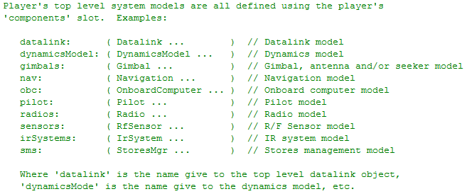
Composite Structure
General purpose interface to those sub-systems
from Player.h

Slide 6
Generalized 6-DOF Aero Model
Pilot
Engine(s)
Coefficients
Lift
Aircraft
State
Autopilot
Flight
Control
System
Control
Surfaces
Drag
Forces
And
Moments
EOM
F = m*a
Side
Roll
Pitch
Features and capabilities of the autopilot vary. Because of that, different “layers” of control exist.
Yaw
Wt & CG
Ground
Reactions

Slide 7
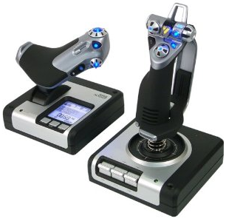
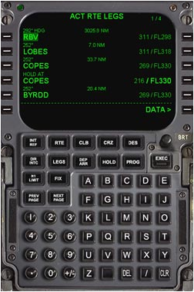
FCS / Autopilot / FMS Relationships
Flight Control System (FCS)
The direct (mechanical or fly by wire) connection between pilot stick and throttle inputs to aerodynamic surfaces
Autopilot
System used to guide a vehicle without assistance from a human being
Often an integral component of a Flight Management System
Flight Management System (FMS)
FMS controlled through a CDU
Guide aircraft along with flight plan, includes navigation database, waypoints, routes, etc
Saitek X52 Flight Control System
Functionality of each system component is not always this clear cut.
Example FMS Control Display Unit (CDU)

Slide 8
Simple Player Dynamics (DynamicsModel not required)

Slide 9
Simple Player Dynamics
Every Player can do the following
Set position
North/East/Down (NED) (x, y, altitude)
Geodetic (lat, long, altitude)
Geocentric (ECEF) (x, y, z)
Set roll, pitch & heading
Initial velocity
Player has a built-in dynamics model for simple movement
Simple player dynamics model useful for testing

Slide 10
Direct Stick Input (assumes DynamicsModel or Subclassing)

Slide 11
Composite Structure
General purpose interface to those sub-systems
Required
from Player.h

Slide 12
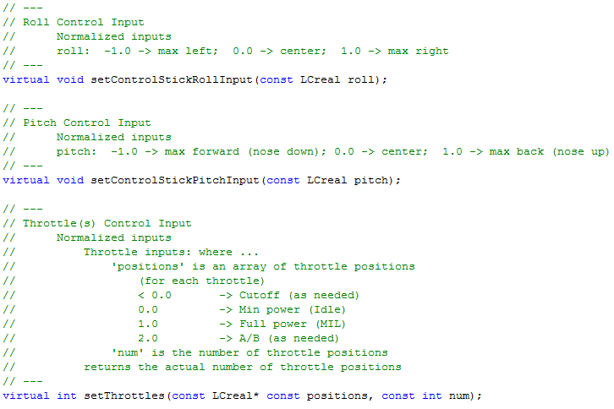
Direct Stick Input
from Player.h

Slide 13
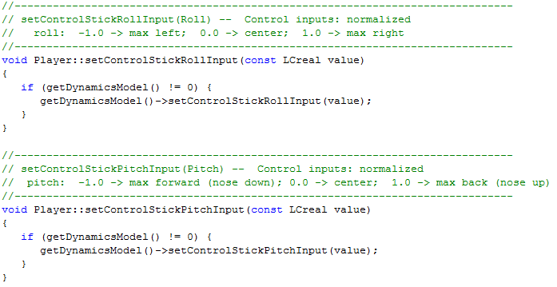
Direct Stick Input
Requires a DynamicsModel to do anything meaningful
Functionality can be implemented in subclass
from Player.cpp

Slide 14
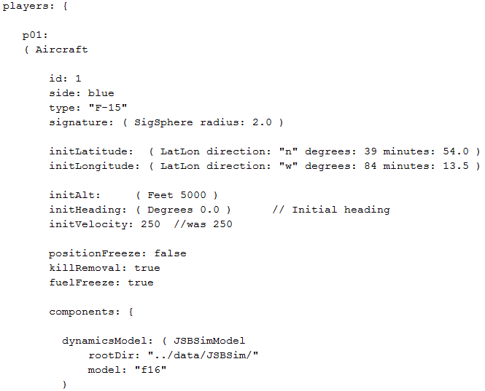
Input File Example

Slide 15
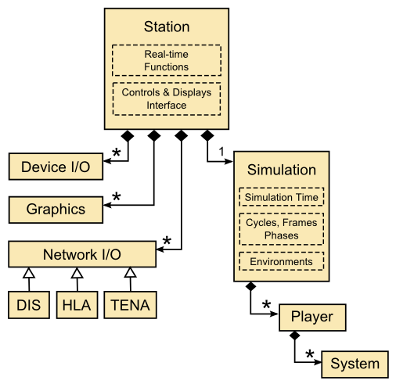

Human Input to Player
Stick & Throttle Inputs Arrive Here

Slide 16

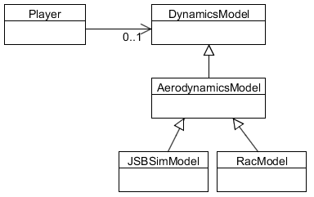
Player w/DynamicsModel
Player may or may not have an attached dynamics model
If attached, then stick and throttle inputs are forwarded to the dynamics model
Physics

Slide 17
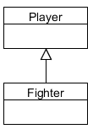
Subclassed Player
Stick and throttle functionality implemented in subclass

Slide 18
Dynamics Model Autopilot (assumes DynamicsModel or sub-classing that includes an autopilot)

Slide 19
Composite Structure
General purpose interface to those sub-systems
Must contain an auto pilot
from Player.h

Slide 20
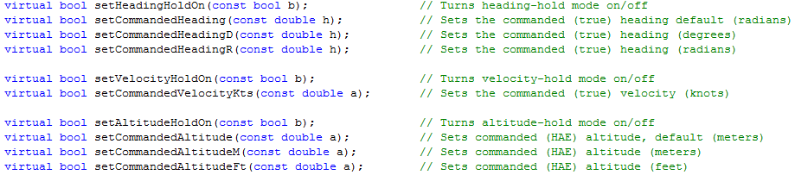
Dynamics Model Autopilot
Player interface to DynamicsModel autopilot is driven by “commands”
from Player.h

Slide 21
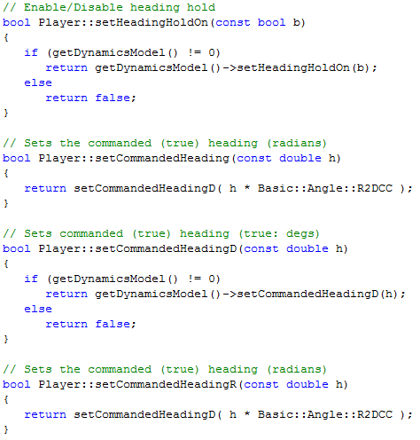
Dynamics Model Autopilot
from Player.cpp

Slide 22
Dynamics Model Autopilot
Player may or may not have an attached dynamics model
If attached, then stick and throttle inputs are forwarded to the dynamics model – some dynamics models do not include an autopilot!
If overridden in subclass, subclass will receive inputs
May or may not include autopilot
Includes an autopilot

Slide 23
Pilot (Not associated with a DynamicsModel)

Slide 24
Composite Structure
General purpose interface to those sub-systems
from Player.h

Slide 25
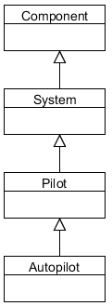
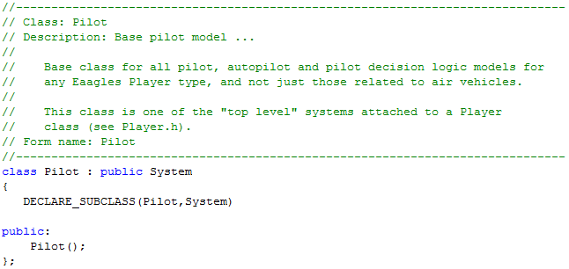
Pilot
NOT part of DynamicsModel!
General interface class to implement pilot decision logic
Base pilot class does nothing interesting, AutoPilot class adds functionality

Slide 26
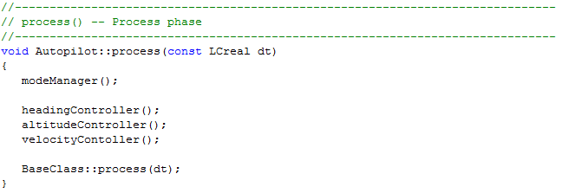
AutoPilot
AutoPilot complements the functionality of the DynamicsModel autopilot or subclassed Player features (Flight Management System level capabilities)
Defined functionality is called in each frame (process phase)
As currently defined, it doesn’t make decisions
Behavior
Control

Slide 27
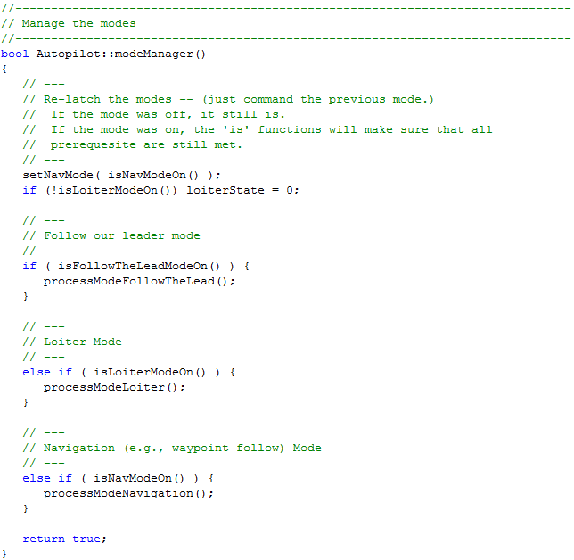
AutoPilot
Behavior (e.g., follow routes,
loiter, follow another player)

Slide 28
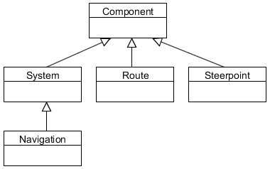
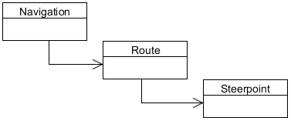
Navigation
AutoPilot uses Navigation
Navigation contains routes, which contain steerpoints
Steerpoints can contain Actions!

Slide 29
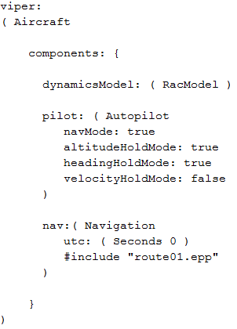
Example Input File
RacModel has a auto pilot within its dynamic model
Auto pilot that follows the defined route within navigation system
Attached navigation system that includes a defined route

Slide 30
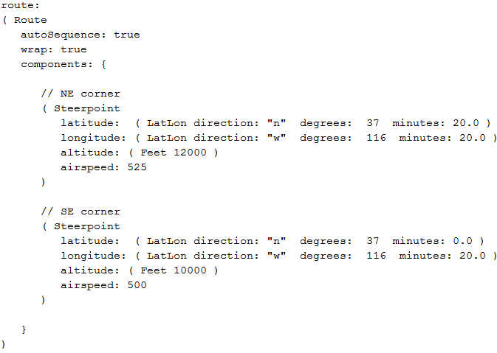
Example Input File
Steerpoints define position and desired airspeed, etc

Slide 31
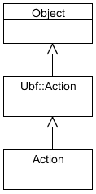
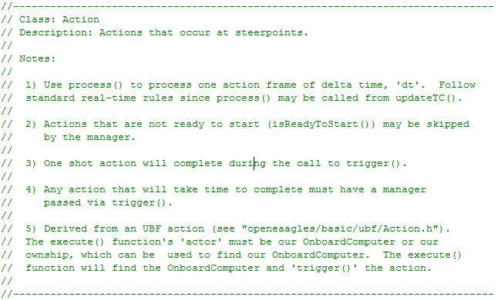
Steerpoint Actions
Steerpoint can have an associated Action
Examples: Take SAR image, release weapon, release decoy, etc

Slide 32
Flow of Decisions and Actions
AutoPilot determines “high level” things to do, and how to do it via commands to “dynamic model auto pilot” or even direct control in some cases
Onboard computer could also be used to perform related functions

Slide 33
Pilot Structures (Implementation of Functionality)

Slide 34
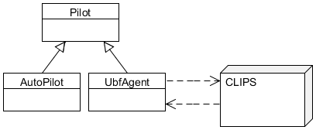

Pilot Structures (Implementation)
Pilot functionality can be implemented several ways
Direct subclassing (e.g., AutoPilot, UBF Agent, etc)
Indirect interface to external software system (e.g., Soar, CLIPS, etc)
Maybe a scripting system
Control
Behavior
Decision Making

Slide 35
EOF

