Slide 1
Player Control Logic

Slide 2
Player Controls – Different Levels
Simple player dynamics
Basic functionality
Player with a dynamics model
Direct stick input
Auto pilot functionality
Pilot / auto pilot

Slide 3
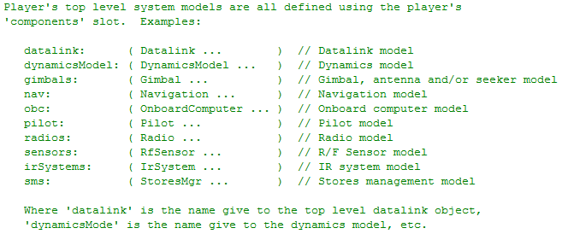
Player Top-Level System Models
Container of sub-systems
General purpose interface to those sub-systems
from Player.h

Slide 4
Simple Player Dynamics (DynamicModel not required)

Slide 5
Simple Player Dynamics
Every Player can do the following
Set position
North/East/Down (NED) (x, y, altitude)
Geodetic (lat, long, altitude)
Geocentric (ECEF) (x, y, z)
Set roll, pitch & heading
Initial velocity
Player has a built-in dynamics model for simple movement
Simple player dynamics model useful for testing

Slide 6
Direct Stick Input (assumes a DynamicModel)

Slide 7
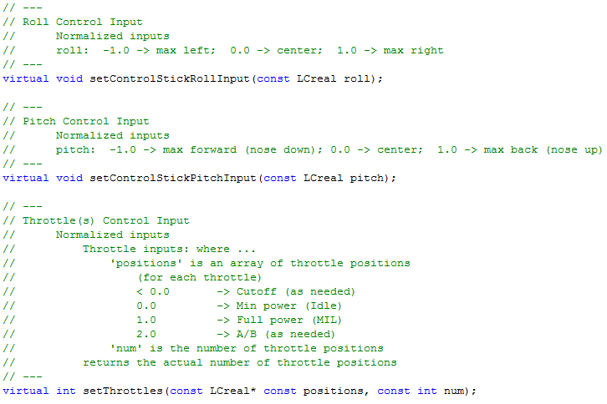
Direct Stick Input
from Player.h

Slide 8
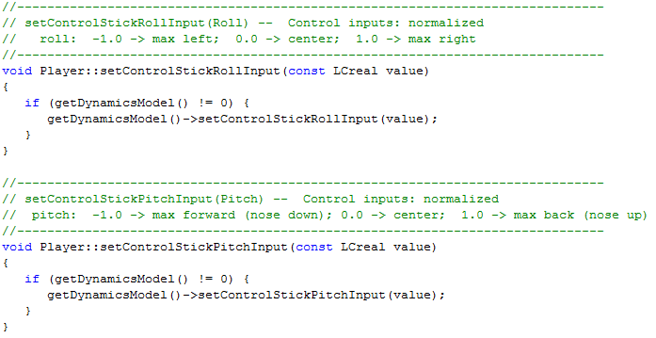
Direct Stick Input
Requires a DynamicsModel to do anything meaningful
from Player.cpp

Slide 9
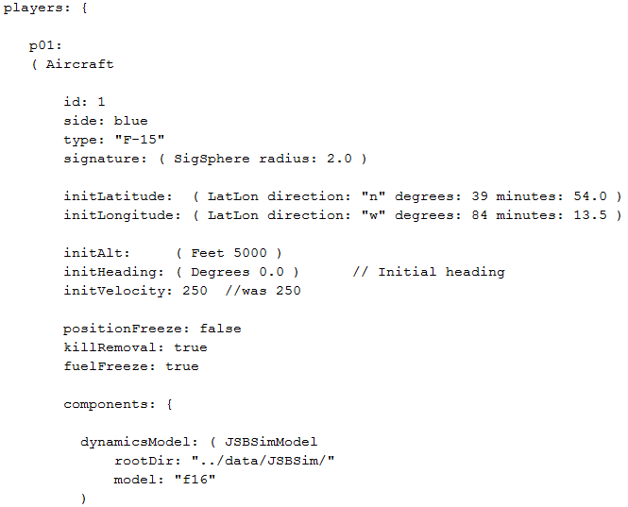
Input File Example

Slide 10
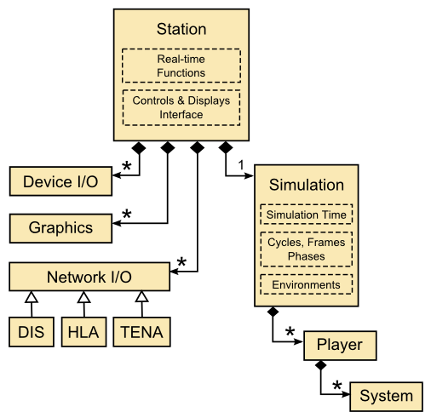

Human Input to Player
Stick & throttle inputs arrive here

Slide 11
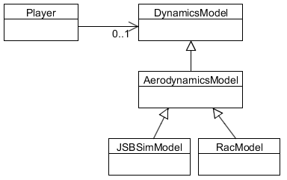
Player / DynamicsModel
Player may or may not have an attached dynamics model
If attached, then stick and throttle inputs are forwarded to the dynamics model

Slide 12
DynamicsModel “Auto Pilot” (assumes a DynamicModel that includes an autopilot)

Slide 13
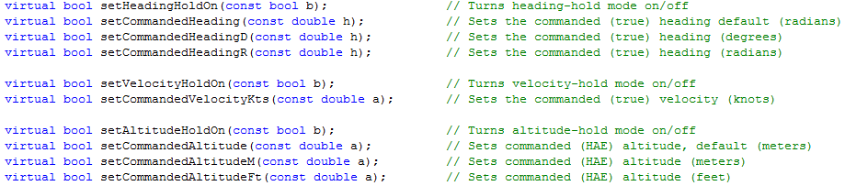
DynamicsModel “Auto Pilot”
Player interface to DynamicsModel “auto pilot” is driven by “commands”
from Player.h

Slide 14
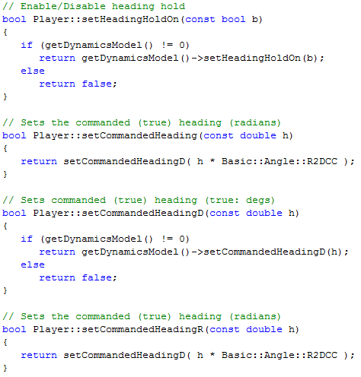
DynamicsModel “Auto Pilot”
from Player.cpp

Slide 15
Player / DynamicsModel
Player may or may not have an attached dynamics model
If attached, then stick and throttle inputs are forwarded to the dynamics model – some dynamics models do not include an autopilot!
May or may not include an autopilot (depends on input files)
Includes an autopilot

Slide 16
Pilot / AutoPilot (Not associated with a DynamicModel)

Slide 17
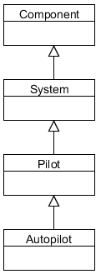
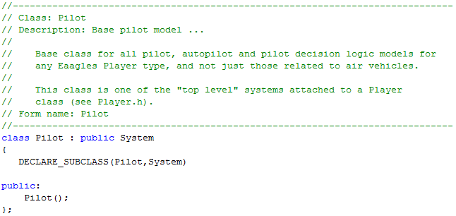
Pilot / AutoPilot
NOT part of DynamicsModel!
Provides “higher level” functions than a dynamics model autopilot
Base pilot class does nothing interesting, AutoPilot class adds functionality

Slide 18
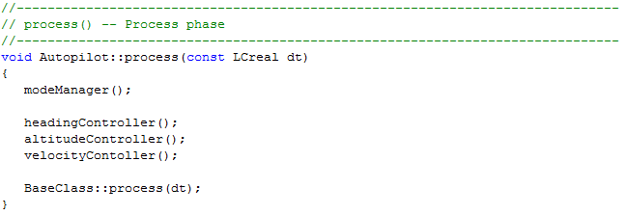
Pilot / AutoPilot
Determine what to do
Do it

Slide 19
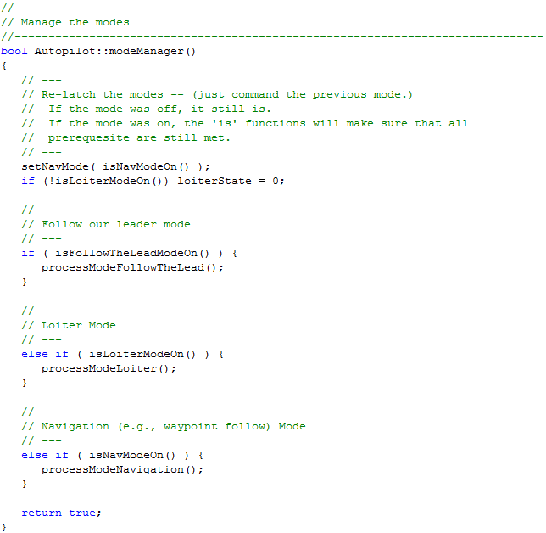
Pilot / AutoPilot
Determines what to do, (e.g., follow routes,
loiter, follow another player, etc)

Slide 20
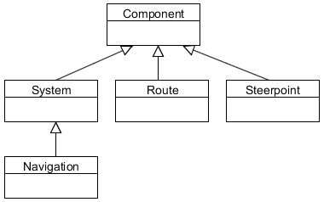
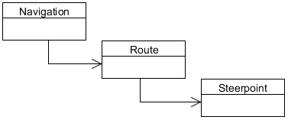
Navigation
AutoPilot uses Navigation
Navigation contains routes, which contain steerpoints

Slide 21
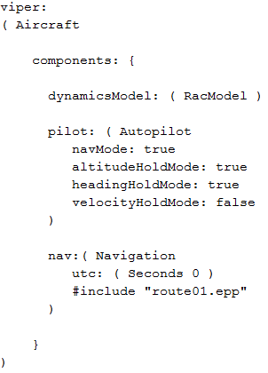
Example Input File
RacModel has a auto pilot within its dynamic model
Auto pilot that is setup to follow the defined route within navigation system
Navigation system that includes a defined route

Slide 22
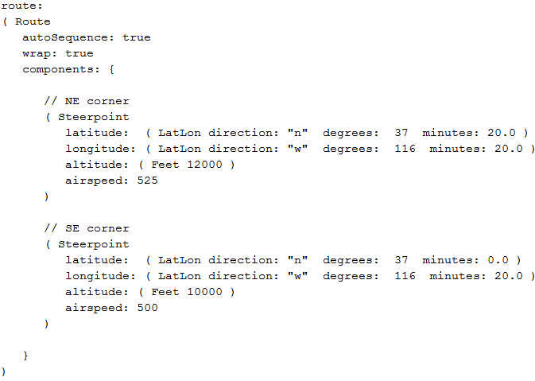
Example Input File
Steerpoints define position and desired airspeed, etc

Slide 23
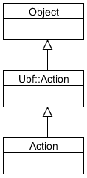
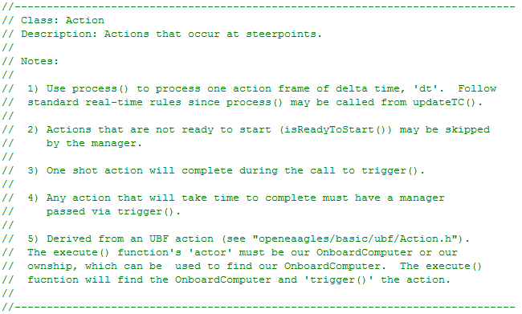
Steerpoint Actions
Steerpoint can have an associated Action
Examples: Take SAR image, release weapon, release decoy, etc

Slide 24
Summary
Lots of places to add “intelligent” behaviors
AutoPilot
Onboard Computer
Could act a the “Actor” for UBF

