Slide 1
R PACKAGE WRITING
Operationalizing your algorithms

Slide 2

what is a package
The fundamental unit of shareable code in R
A collection of functions that is available to the user once the package is installed on the user's device.
Will often include function help files, vignettes, sample data, and more.
A convenient way to organize and automate commands that you use frequently.
packager

Slide 3
why we use packages
Organizing your commonly used code
Standardized conventions lead to standardized tools
Saves time
Sharing code (inside or outside your org)
packager

Slide 4

prerequisites

Slide 5
packages required
Regardless of your operating system, you will need to install some packages to begin your package-writing career:
# make sure that you have the necessary package-writing packages installed
install.packages(c("devtools", "roxygen2", "testthat","knitr"))

Slide 6
proper environment
If you’re using Windows, you will need to install Rtools
After installation, you will need to verify that your system can find Rtools. If your system is set up correctly, the has_devel() function should return TRUE
# make sure that your system knows where to find everything you'll need
devtools::find_rtools()
# make sure that your set up is ready to construct R packages
devtools::has_devel()

Slide 7

Creating the framework
Every R package has the same basic shell

Slide 8
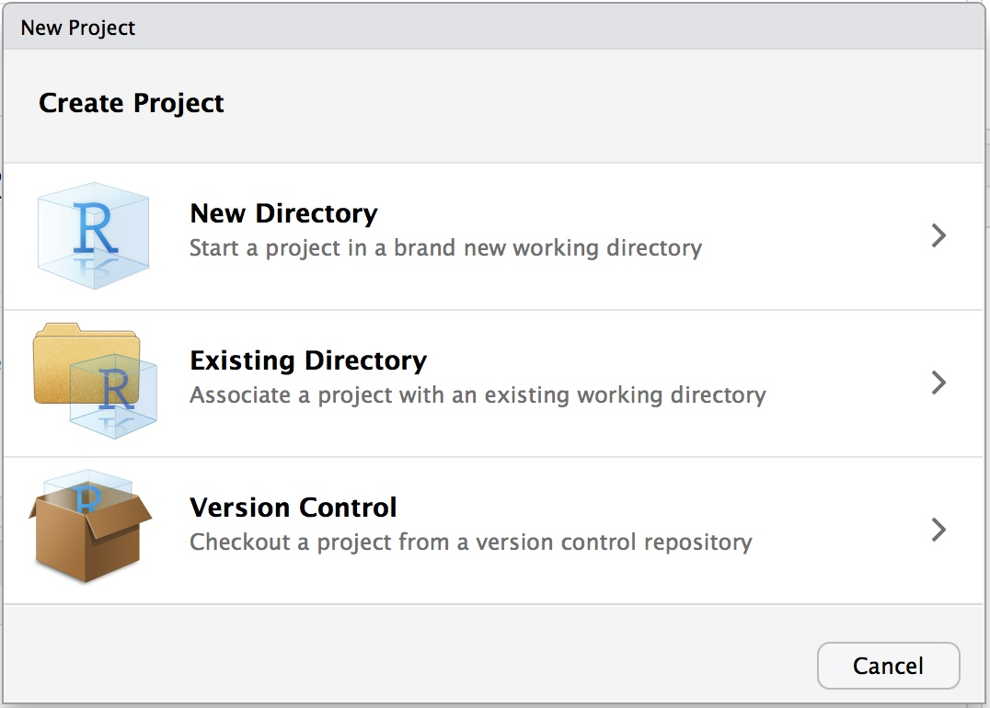
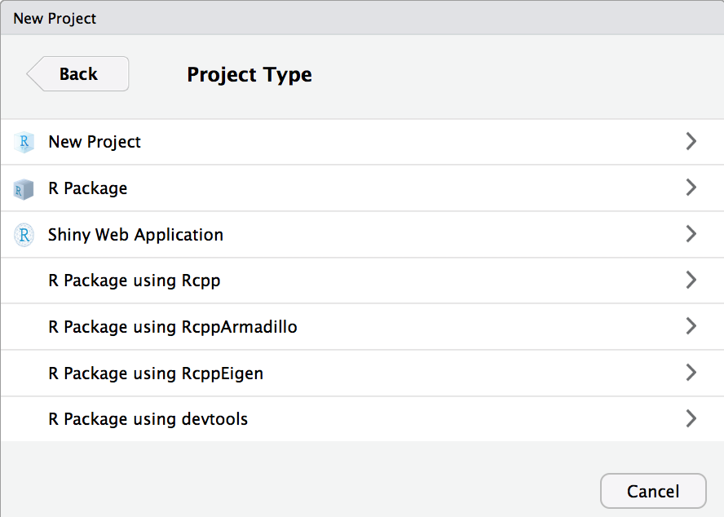
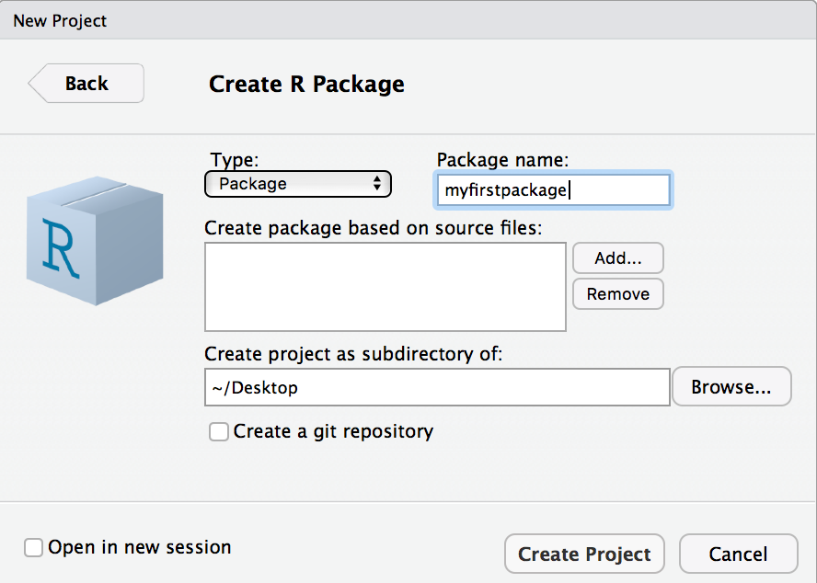
Setting up an r package Project
File >> New Project
Alternatively: devtools::create("path/to/myPackage")
utils::package.skeleton("myPackage")
Rcpp::rcpp.package.skeleton("myPackage")

Slide 9
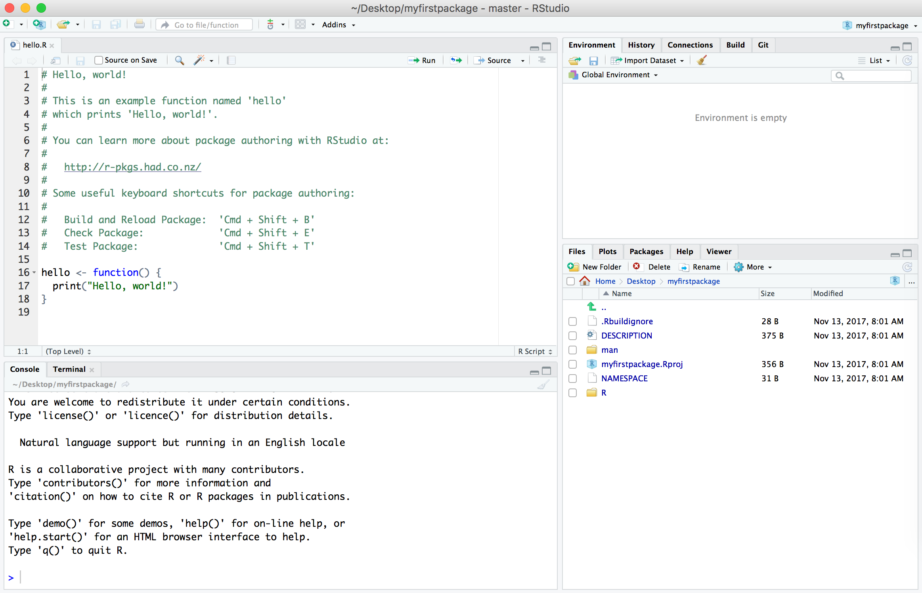
main package components
Every R package has three main components:
DESCRIPTION file
NAMESPACE file
An R/ directory containing R code/functions

Slide 10
Other package components
man/ directory of documentation files for exported functions (becomes the help/ directory after compilation)
src/ directory of compiled code (C++ / C / FORTRAN) (becomes the libs/ directory after compilation)
data/ directory of exported datasets (as .Rdata files)
examples/ directory stand-alone examples
vignettes/ directory of long-form documentation files or research papers
tests/ directory of function tests
inst/ directory of content not contained elsewhere (everything moves up one-level after compilation)

Slide 11

DESCRIPTION & NAMESPACE
Creating your package metadata

Slide 12
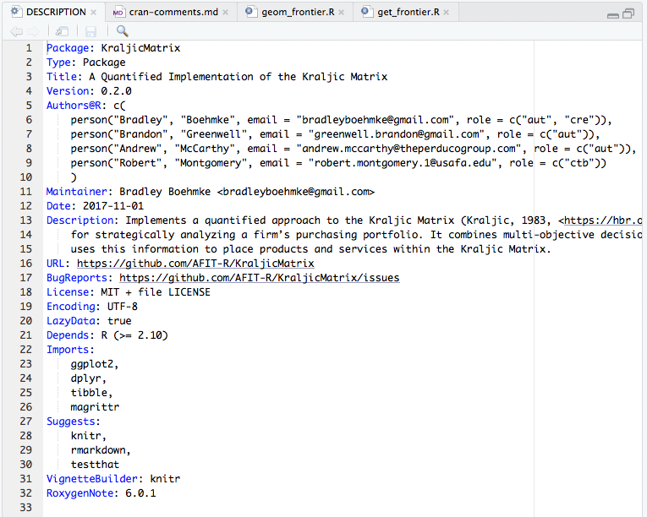
Description File
Must be at the top of the package directory
Contains package metadata: title, description, authors, current version number, etc.
Imports: packages containing functions used by your package. These will be automatically installed when your package is installed
Suggests: packages that will make your set of functions more useful and effective, but aren't necessary
Depends: packages that provide a core capability to your package (these should be kept to a minimum)

Slide 13
WHAT'S IN A NAME(SPACE)?
The NAMESPACE file provides a 'space' for 'names'.
Provides a context for looking up the value of an object associated with a name
Make your packages self-contained via imports and exports
imports: define how functions in your package finds functions in another
exports: specify which functions in your package are available outside of your package to help avoid conflicts
We won't edit the NAMESPACE file directly – the roxygen2 package will allow us to keep everything contained with the function in the .R file

Slide 14
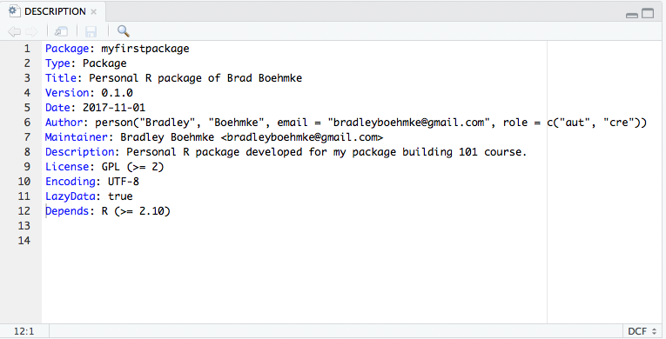
Your turn!
Update and save your DESCRIPTION file to look something like the following:

Slide 15
Packaging Functions
The R/ directory contains the capabilities of your package

Slide 16
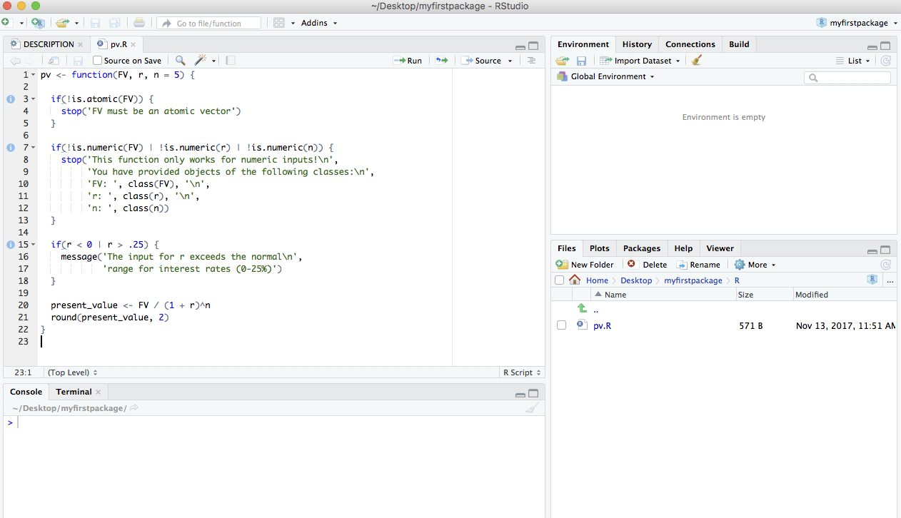
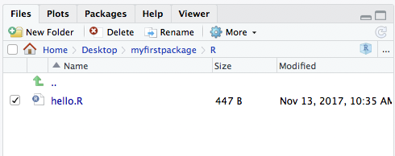
Writing user defined Functions
To have a working R Package you need a set of functions (or data)
We'll create two example functions pv and rescale as examples
Delete the hello.R file in the R directory & the hello.Rd file in the man directory
Create two new .R script files, named pv.R and rescale.R in the R/ directory

Slide 17
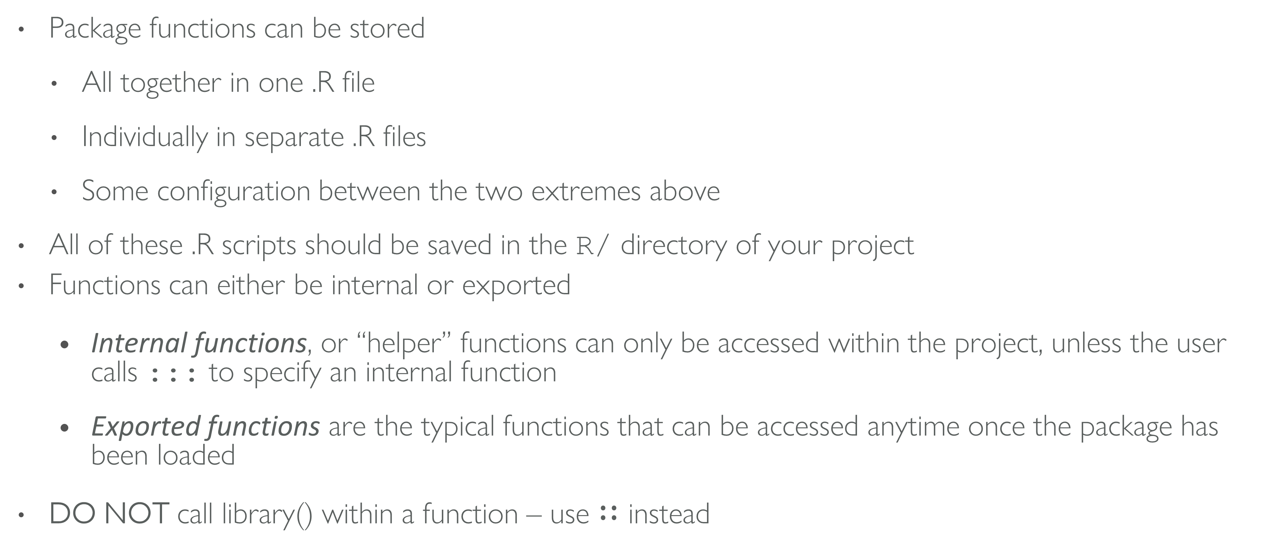
some things to remember
Package functions can be stored
All together in one .R file
Individually in separate .R files
Some configuration between the two extremes above
All of these .R scripts should be saved in the R/ directory of your project
Functions can either be internal or exported
Internal functions, or “helper” functions can only be accessed within the project, unless the user calls ::: to specify an internal function
Exported functions are the typical functions that can be accessed anytime once the package has been loaded
DO NOT call library() within a function – use $∷$ instead

Slide 18

function Fundamentals

Slide 19
when to write functions
df <- data.frame(
a = rnorm(10),
b = rnorm(10),
c = rnorm(10),
d = rnorm(10)
)
df$a <- (df$a - min(df$a, na.rm = TRUE)) /
(max(df$a, na.rm = TRUE) - min(df$a, na.rm = TRUE))
df$b <- (df$b - min(df$b, na.rm = TRUE)) /
(max(df$a, na.rm = TRUE) - min(df$b, na.rm = TRUE))
df$c <- (df$c - min(df$c, na.rm = TRUE)) /
(max(df$c, na.rm = TRUE) - min(df$c, na.rm = TRUE))
df$d <- (df$d - min(df$d, na.rm = TRUE)) /
(max(df$d, na.rm = TRUE) - min(df$d, na.rm = TRUE))
You should consider writing a function whenever you’ve copied and pasted a block of code more than twice.
Can you spot the error?

Slide 20
when to write functions
df <- data.frame(
a = rnorm(10),
b = rnorm(10),
c = rnorm(10),
d = rnorm(10)
)
df$a <- (df$a - min(df$a, na.rm = TRUE)) /
(max(df$a, na.rm = TRUE) - min(df$a, na.rm = TRUE))
df$b <- (df$b - min(df$b, na.rm = TRUE)) /
(max(df$a, na.rm = TRUE) - min(df$b, na.rm = TRUE))
df$c <- (df$c - min(df$c, na.rm = TRUE)) /
(max(df$c, na.rm = TRUE) - min(df$c, na.rm = TRUE))
df$d <- (df$d - min(df$d, na.rm = TRUE)) /
(max(df$d, na.rm = TRUE) - min(df$d, na.rm = TRUE))
You should consider writing a function whenever you’ve copied and pasted a block of code more than twice.
Can you spot the error?

Slide 21
function overview
Functions convert input objects into output objects or plots (graphical objects)
Functions can take any non-graphical object as an argument, even other functions
Functions operate on distinct classes of objects (or functions)
Functions can return objects of the same class as the input objects or create a completely new class of object

Slide 22
defining your own function
my_fun <- function(arg1, arg2) {
body
}
Functions have 3 parts:
formals (aka arguments)
body (code inside the function)
environment

Slide 23
defining your own function
pv <- function(FV, r, n) {
present_value <- FV / (1 + r)^n
round(present_value, 2)
}
Functions have 3 parts:
formals (aka arguments)
body (code inside the function)
environment

Slide 24
anatomy of a function
pv <- function(FV, r, n) {
present_value <- FV / (1 + r)^n
round(present_value, 2)
}
formals(pv)
$FV
$r
$n
body(pv)
{
present_value <- FV/(1 + r)^n
round(present_value, 2)
}
environment(pv)
<environment: R_GlobalEnv>
Functions have 3 parts:
formals (aka arguments)
body (code inside the function)
environment

Slide 25
function output
pv <- function(FV, r, n) {
present_value <- FV / (1 + r)^n
round(present_value, 2)
}
pv(FV = 1000, r = .08, n = 5)
[1] 680.58
pv2 <- function(FV, r, n) {
present_value <- FV / (1 + r)^n
return(present_value)
round(present_value, 2)
}
pv2(1000, .08, 5)
[1] 680.5832
What gets returned from a function is either:
The last expression evaluated
return(value), which forces the function to stop execution and return value

Slide 26
function output
pv <- function(FV, r, n) {
present_value <- FV / (1 + r)^n
round(present_value, 2)
}
pv(FV = 1000, r = .08, n = 5)
[1] 680.58
pv2 <- function(FV, r, n) {
present_value <- FV / (1 + r)^n
return(present_value)
round(present_value, 2)
}
pv2(1000, .08, 5)
[1] 680.5832
What gets returned from a function is either:
The last expression evaluated
return(value), which forces the function to stop execution and return value
Note the differences in how we call these functions. Why do both cases work?

Slide 27
Your turn!
Define a function titled ratio that takes arguments x, y, and digits and returns the value of their ratio, x / y, rounded to a specified number of digits.
Call ratio() with arguments 3, 7, and 4

Slide 28
solution
ratio <- function(x, y, digits) {
round(x / y, digits = digits)
}
ratio(3, 7, 4)
[1] 0.4286

Slide 29
lexical scoping rules
R uses lexical scoping rules to define how functions and objects interact
The code to the right creates two functions called foo( ) and bar()
Observing this code, what value will result if bar(2) is called?
a <- 1
b <- 2
foo <- function(x) {
a * x + b
}
bar <- function(x){
a <- 2
b <- 1
foo(x)
}

Slide 30

handling arguments

Slide 31
Calling arguments in different ways
pv(FV = 1000, r = .08, n = 5)
[1] 680.58
pv(1000, .08, 5)
[1] 680.58
pv(r = .08, FV = 1000, n = 5)
[1] 680.58
pv(.08, 1000, 5)
[1] 0
pv(1000, .08)
Error in pv(1000, 0.08) : argument "n" is missing, with no default
Using argument names
positional matching
must use names if you change order otherwise…
error or incorrect computation will occur
missing arguments results in error

Slide 32
setting default arguments
pv <- function(FV, r, n = 5) {
present_value <- FV / (1 + r)^n
round(present_value, 2)
}
pv(1000, .08)
[1] 680.58
PV(1000, .08, n = 3)
[1] 793.83
We can set default argument values
now if we do not call the argument the default is used
and we can change the default simply by specifying an n value

Slide 33
ordering arguments
Ordering arguments in your functions is important:
positional matching
pipe (%>%) operator
my_fun <- function(data, arg2, arg3 = 5) {
body
}
General rules:
Data argument first
First couple arguments require specifying
Later arguments have defaults

Slide 34
Your turn!
Earlier in these slides you saw the following code duplicated:
(df$a - min(df$a, na.rm = TRUE)) /
(max(df$a, na.rm = TRUE) - min(df$a, na.rm = TRUE))
Can you write a function called rescale that takes argument x and executes this code?
Test your function on the following vector
set.seed(123)
vec1 <- runif(10, min = 5, max = 13)

Slide 35
solution
rescale <- function(x){
rng <- range(x, na.rm = TRUE)
(x - rng[1]) / (rng[2] - rng[1])
}
set.seed(123)
vec1 <- runif(10, min = 5, max = 13)
rescale(vec1)
[1] 0.2704415 0.8299695 0.4060968 0.9358038 1.0000000 0.0000000 0.5392146
[8] 0.9463095 0.5652837 0.4593287

Slide 36
Your turn!
Now add an argument to rescale that allows you to round the output to a specified decimal. Set the default to 2.

Slide 37
solution
rescale <- function(x, digits = 2){
rng <- range(x, na.rm = TRUE)
scaled <- (x - rng[1]) / (rng[2] - rng[1])
round(scaled, digits = digits)
}
set.seed(123)
vec1 <- runif(10, min = 5, max = 13)
rescale(vec1)
[1] 0.27 0.83 0.41 0.94 1.00 0.00 0.54 0.95 0.57 0.46
rescale(vec1, 3)
[1] 0.270 0.830 0.406 0.936 1.000 0.000 0.539 0.946 0.565 0.459

Slide 38
Your turn!
Now let’s move the na.rm = TRUE argument into the function's formals so that the user can specify whether or not they want to remove NAs. Set the default to TRUE.

Slide 39
solution
Showing how many missing values were removed
rescale <- function(x, digits = 2, na.rm = TRUE){
if(isTRUE(na.rm)) x <- na.omit(x)
rng <- range(x)
scaled <- (x - rng[1]) / (rng[2] - rng[1])
round(scaled, digits = digits)
}
vec1 <- c(NA, vec1)
rescale(vec1)
[1] 0.27 0.83 0.41 0.94 1.00 0.00 0.54 0.95 0.57 0.46
attr(,"na.action")
[1] 1
attr(,"class")
[1] "omit"

Slide 40
solution
Hiding how many missing values were removed
rescale <- function(x, digits = 2, na.rm = TRUE){
if(isTRUE(na.rm)) x <- x[!is.na(x)]
rng <- range(x)
scaled <- (x - rng[1]) / (rng[2] - rng[1])
round(scaled, digits = digits)
}
rescale(vec1)
[1] 0.27 0.83 0.41 0.94 1.00 0.00 0.54 0.95 0.57 0.46

Slide 41
Your turn!
Now try to apply the rescale function across each variable in the mtcars data set.
Hint: try using one of the apply or map functions.

Slide 42
solution
You can now apply this function over a data frame, list, matrix with the map function
library(purrr)
mtcars %>%
map_df(rescale)
# A tibble: 32 × 11
mpg cyl disp hp drat wt qsec vs am gear carb
<dbl> <dbl> <dbl> <dbl> <dbl> <dbl> <dbl> <dbl> <dbl> <dbl> <dbl>
1 0.45 0.5 0.22 0.20 0.53 0.28 0.23 0 1 0.5 0.43
2 0.45 0.5 0.22 0.20 0.53 0.35 0.30 0 1 0.5 0.43
3 0.53 0.0 0.09 0.14 0.50 0.21 0.49 1 1 0.5 0.00
4 0.47 0.5 0.47 0.20 0.15 0.44 0.59 1 0 0.0 0.00
5 0.35 1.0 0.72 0.43 0.18 0.49 0.30 0 0 0.0 0.14
6 0.33 0.5 0.38 0.19 0.00 0.50 0.68 1 0 0.0 0.00
7 0.17 1.0 0.72 0.68 0.21 0.53 0.16 0 0 0.0 0.43
8 0.60 0.0 0.19 0.04 0.43 0.43 0.65 1 0 0.5 0.14
9 0.53 0.0 0.17 0.15 0.53 0.42 1.00 1 0 0.5 0.14
10 0.37 0.5 0.24 0.25 0.53 0.49 0.45 1 0 0.5 0.43
# ... with 22 more rows

Slide 43

invalid parameters

Slide 44
invalid parameters
For functions that will be re-used, and especially for those used by someone other than the creator, it is good to check the validity of the arguments.
my_fun <- function(data, arg2, arg3 = 5) {
if(condition) {
message or warning
}
body
}
Common issues:
Making sure data is in the right structure (i.e. df, list, vector)
Are the argument inputs the right class (i.e. numeric, character)
Are the argument inputs within the proper boundary limits

Slide 45
invalid parameters
Our pv function works on a vector of future values, not data frames, lists, or matrices. Let’s add a warning in case a user tries to feed it a non-atomic vector.

Slide 46
invalid parameters
Our pv function works on a vector of future values, not data frames, lists, or matrices. Let’s add a warning in case a user tries to feed it a non-atomic vector.
pv <- function(FV, r, n = 5) {
if(!is.atomic(FV) {
stop('FV must be an atomic vector')
}
present_value <- FV / (1 + r)^n
round(present_value, 2)
}
Check if class of FV is something other than a vector (be careful with is.vector - use is.atomic instead)
If so, stop, return an error, and the specified message

Slide 47
invalid parameters
Our pv function works on a vector of future values, not data frames, lists, or matrices. Let’s add a warning in case a user tries to feed it a non-vector.
fv_l <- list(fv1 = 800,
fv2 = 900,
fv3 = 1100)
pv(fv_l, 0.08)
Error in pv(fv_l, 0.08) : FV must be an atomic vector
Now when we execute pv on a non-atomic vector we get an error output

Slide 48
invalid parameters
Now let’s add tests for the type of class input.
pv <- function(FV, r, n = 5) {
if(!is.atomic(FV)) {
stop('FV must be an atomic vector')
}
if(!is.numeric(FV) | !is.numeric(r) | !is.numeric(n)){
stop('This function only works for numeric inputs!\n',
'You have provided objects of the following classes:\n',
'FV: ', class(FV), '\n',
'r: ', class(r), '\n',
'n: ', class(n))
}
present_value <- FV / (1 + r)^n
round(present_value, 2)
}
Now we test for
data type
argument class
and both of these will provide warnings if violated

Slide 49
invalid parameters
Now let’s add tests for the type of class input.
pv(FV = "1000", .08, n = 5)
Error in pv(FV = "1000", 0.08, n = 5) :
This function only works for numeric inputs!
You have provided objects of the following classes:
FV: character
r: numeric
n: numeric
Now we test for
data type
argument class
and both of these will provide warnings if violated

Slide 50
invalid parameters
What else can you think of?

Slide 51
invalid parameters
What else can you think of? What about abnormal interest rate ranges?
pv <- function(FV, r, n = 5) {
if(!is.atomic(FV)) {
stop('FV must be an atomic vector')
}
if(!is.numeric(FV) | !is.numeric(r) | !is.numeric(n)){
stop('This function only works for numeric inputs!\n',
'You have provided objects of the following classes:\n',
'FV: ', class(FV), '\n',
'r: ', class(r), '\n',
'n: ', class(n))
}
if(r < 0 | r > .25) {
message('The input for r exceeds the normal\n',
'range for interest rates (0-25%)')
}
present_value <- FV / (1 + r)^n
round(present_value, 2)
}
If we add a message() this allows us to:
notify the user of something
while still executing the code

Slide 52
invalid parameters
What else can you think of? What about abnormal interest rate ranges?
pv(FV = 1000, r = .28, n = 5)
The input for r exceeds the normal
range for interest rates (0-25%)
[1] 1292.36
If we add a message() this allows us to:
notify the user of something
while still executing the code

Slide 53
Your turn!
Go back to the rescale function and add conditional statements to check and provide appropriate errors or messages to ensure that:
x is a numeric vector
digits is a numeric vector of one element
na.rm is a single logical input

Slide 54

Questions

