Slide 1
OPER 655 Text Mining
Lt Clarence Williams

Slide 2
Purpose
For this project the script of Star Wars Episode VII : The Force Awakens will be analyzed
Comparison to other first movie in series
What do want to get from this analysis

Slide 3
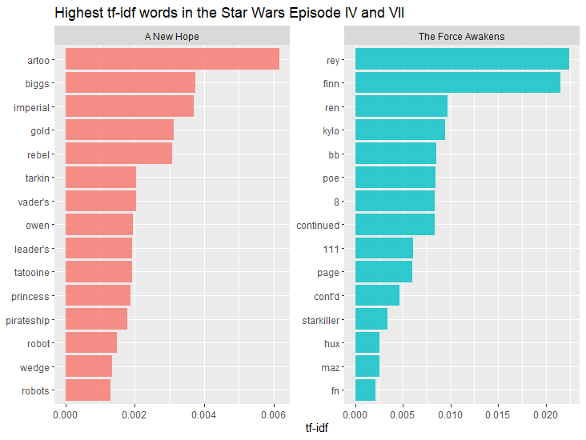

Slide 4
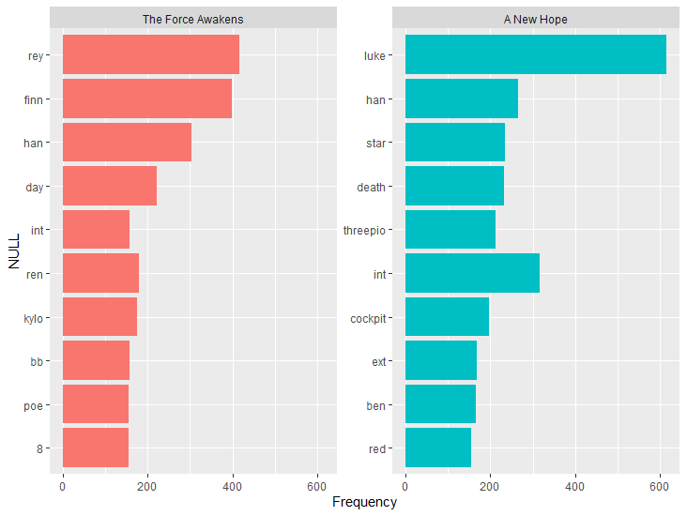

Slide 5
Background
Text Mining is an application of machine learning where feature are extracted from text to do what
Talk about tf-idf

Slide 6
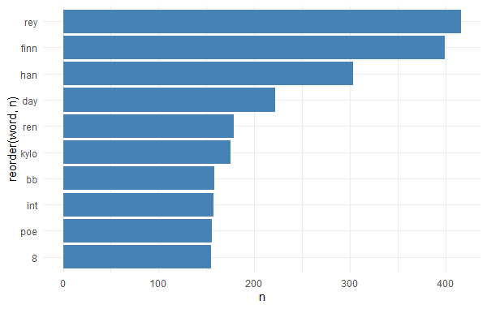
Interim Analysis
The term frequency for the document is given in the figure below

Slide 7
Next Steps
Next more documents will be added to make a corpus and document summarization will be performed.

