Slide 1
OPER 655 Text Mining
Lt Trey Pujats

Slide 2
Purpose
The purpose of this project is to examine the scripts of the entire game of thrones series through a series of text mining techniques.
I plan to draw comparison by seasons as well as episodes within seasons to gain insights and summarizations of the entire series.

Slide 3
Background
The data consists of 72 episodes even though there are a total of 73 in the series. Season 7, episode 1 was not available through the website I scraped.

Slide 4
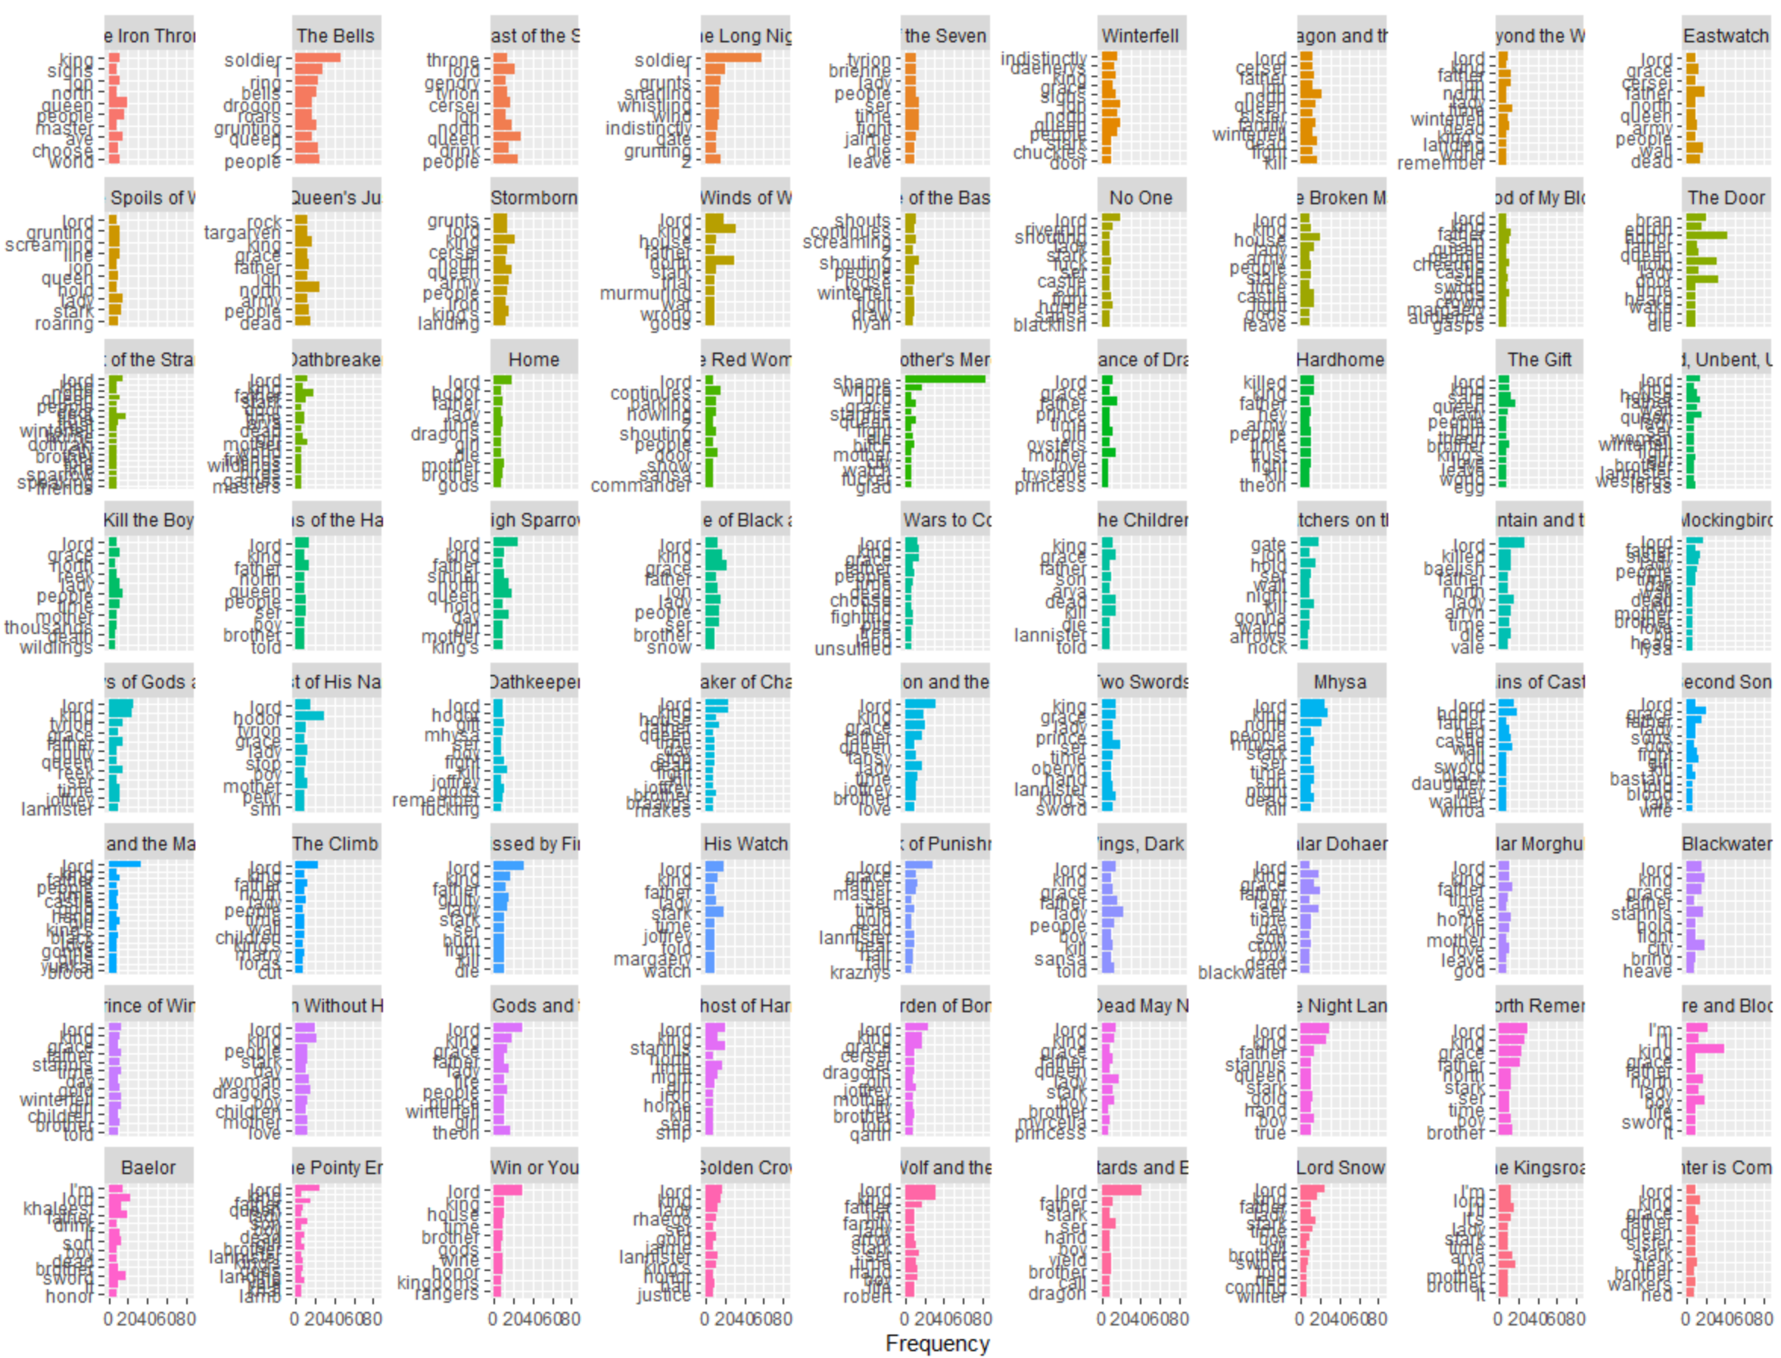
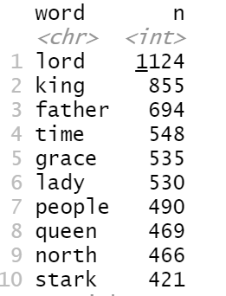
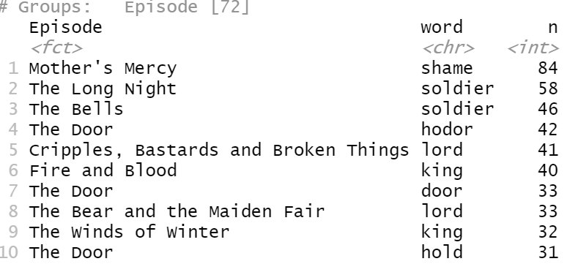
Analysis
I analyzed the breakdown of the most common words in the series, then most common words in the series grouped by episode, and lastly the count of words in each episode.

Slide 5
Interim Analysis
A snippet of document summarization is shown below. I summarized season 3, episode 3 which is the 23 episode in the series.
I summarized this episode in three sentences that best captured the overall summary of the text.
This will be done for each episode giving a quick synopsis. This could also be applied to each season or the entire series.

Slide 6
Next Steps
Next steps included more comparison episode by episode.
The 72+ hours of episodes generated a lot of text and it is taking a lot of computational time to analyze even a single episode or season.
My next method to be used is topic modelling and sentiment analysis for each episode.

