Slide 1
OPER 655 Text Mining
Lt Clarence Williams

Slide 2
Purpose
For the current iteration of this project, the scripts of Star Wars Episodes IV(A New Hope) and VII(The Force Awakens) were made into a corpus.
The initial analysis includes word frequency of each script and the tf-idf for the words in the corpus.
The end goal is to use document summarization to give a summary of each script and use topic modeling to identify topics within each script.

Slide 3
Background
The scripts are searchable pdfs and were downloaded locally.
Each script was read using pdftools and the corpus was created using quanteda.
The tidy text format was used to create the word frequency of each script

Slide 4
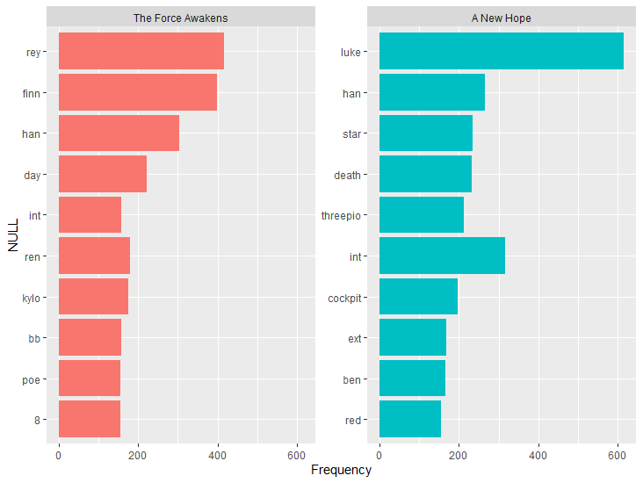
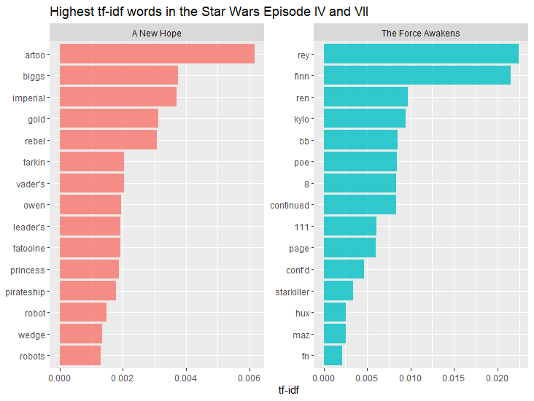
Interim Analysis
Rey and Luke which are the main characters appear the most in the respective script.
Han Solo has the third and second most appearance in The Force Awakens and A New Hope respectively. Therefore, the tf-id for Han Solo will be low since the character appears in frequently in both texts.
The unique characters to the films have the highest tf-idf. While the word Luke appears the most in A New Hope, it appears in both scripts which causes the low tf-idf.

Slide 5
Next Steps
Possibly add episodes I through VI to the corpus
Use regex to change the every occurrence of the word death star to deathstar.
Add 111 to stop words since it is the total number of pages in the document.
Add page to the stop words since it appears at the bottom of each page of the script.
Treat the lines spoken by each character as a document .
Perform document summarization and topic modeling on this new copus to identify the role of each character.

