Slide 1

Objectives
In this session, you will learn to:
Identify data annotations
Implement validation

Slide 2
Introduction to Data Annotations
Enable you to perform validation efficiently by adding one or more data annotation attributes to a model property.
Data annotations
Are available in the System.ComponentModel.DataAnnotations namespace.

Slide 3
Introduction to Data Annotations (Contd.)
Some of the commonly used data annotations are:
Required
StringLength
RegularExpression
Range
Compare
Display
ReadOnly
DataType
ScaffoldColumn

Slide 4
Required
Specifies that the value of the property cannot be left blank.
Example:
[Required]
public string Username { get; set; }
[Required]
public string Password { get; set; }
The Required data annotation attribute
Raises a validation error if the property value is null or empty.

Slide 5
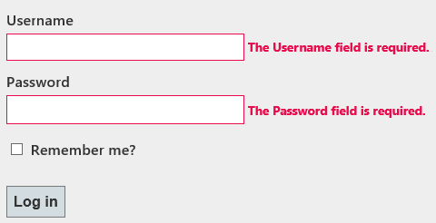
Required (Contd.)
When a field is marked as required by using the Required data annotation and a user leaves the field blank, a default message is displayed to the user, as shown in the following figure.
You can customize the default error messages by using the ErrorMessage parameter, as shown in the following code snippet:
[Required(ErrorMessage = "Please enter the Username")]
public string Username { get; set; }
[Required(ErrorMessage = "Please enter the Password")]
public string Password { get; set; }

Slide 6
StringLength
Is used to specify the minimum and maximum lengths of a string field.
The StringLength data annotation attribute
Raises a validation error, if the user enters a string with more or less number of characters than the specified range.

Slide 7
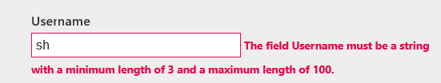
StringLength (Contd.)
Example:
[StringLength(100, MinimumLength = 3)]
public string Username {get; set;}
If a user does not enter the string in the specified range, a default error message is displayed, as shown in the following figure.
You can customize the default error messages by using the ErrorMessage parameter, as shown in the following code snippet:
[StringLength(100,ErrorMessage = "Name cannot be more than 100 characters long")]
public string Username {get; set;}

Slide 8

RegularExpression
The RegularExpression data annotation:
Is used to accept user input in a specific text pattern.
Has the following syntax:
[RegularExpression("pattern")]
Example:
To check the validity of an email address, you can use the following regular expression pattern:
[RegularExpression(@"[A-Za-z0-9._%+-]+@[A-Za-z0-9.-]+\. [A-Za-z]{2,4}")]
public string Email { get; set; }
If a user does not enter the data in specified format, an error message is displayed, as shown in the following figure.

Slide 9

Range
The Range attribute is used to specify the minimum and maximum constraints for a numeric value.
Example:
If you want the user to enter the age between 20 and 35, you can use the Range attribute, as shown in the following code snippet:
[Range (20, 35)]
public int Age { get; set; }
If the user does not enter a value within the specified range, an error message is displayed, as shown in the following figure.

Slide 10
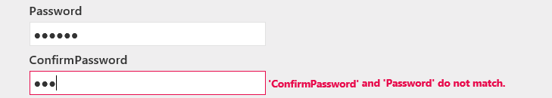
Compare
The Compare attribute is used to match the value of the two fields in a form, such as password and confirm password.
Example:
public string Password { get; set; }
[Compare("Password")]
public string ConfirmPassword { get; set; }
If a user does not enter the same values in the specified fields, an error message is displayed, as shown in the following figure.

Slide 11

Display
The Display attribute allows you to specify a user friendly display name for a model property.
Example:
[Display(Name = "Movie Name")]
public string Movie_Name { get; set; }
The name that will be displayed on the view is Movie Name, as shown in the following figure.

Slide 12
ReadOnly
Is used to display a read-only field on a form to the user.
Example:
[ReadOnly(true)]
public Int32 TotalMarks { get; set; }
The ReadOnly attribute
Ensures that the default model binder will not set the property with a new value from the request.

Slide 13

DataType
The DataType attribute helps you to provide information about the specific purpose of a property at run time.
Example:
[DataType(DataType.Password)]
public string Password { get; set; }
By applying DataType for a Password field as Password, the HTML helpers in ASP.NET MVC will render an input element with a type attribute set to Password.
Therefore, upon entering a value in the Password field, the user sees a special character, such as a dot or star, instead of the original character, as shown in the following figure.

Slide 14
DataType (Contd.)
Password
The commonly -used DataType attributes
Currency
Date
Time
MultilineText

Slide 15
ScaffoldColumn
The ScaffoldColumn attribute is used when you do not want to render a particular field on a view.
Example:
[Required]
[ScaffoldColumn (false)]
public string Age { get; set; }

Slide 16
Just a Minute
Which one of the following attributes is used to match the value of two fields in the same form?
Required
Range
Compare

Slide 17
Just a Minute (Contd.)
Solution:
Compare

Slide 18
Implementing Validation
To avoid round trips to a server, you can implement validation at the client-side.
Client-side validation provides immediate feedback without submitting anything to the server.
It is usually implemented using JavaScript.
The data that the user enters is validated before being sent to the server.
If JavaScript is disabled at the client-side, then the validation is only done at the server-side.
Both the client-and-server side validations, display a default message for an incorrect value.
You can change the default message by using corresponding annotation attribute.
You can summarize the entire validation message at one place, on a Web page.
The error messages can be displayed by using HTML validation
helpers.

Slide 19
Using TAG Helpers to Display Error Messages
To display error messages while implementing validation, MVC provides the following two main helper attributes:
asp-validation-for
asp-validation-summary
HTML HELPER
Html.ValidationMessageFor()
Html.ValidationSummary()
<div asp-validation-summary="ModelOnly" class="text-danger"></div>
<div class="form-group">
<label asp-for="BookID" class="control-label"></label>
<input asp-for="BookID" class="form-control" />
<span asp-validation-for="BookID" class="text-danger"></span>
</div>

Slide 20

Using TAG Helpers to Display Error Messages (Contd.)
The asp-validation-for:
Can be used to display separate error message for each filed, which is marked as required in the model.
Returns HTML markup for a validation-error messages.
Example:
<div class="form-group">
<label asp-for=“Password" class="control-label"></label>
<input asp-for=" Password" class="form-control" />
<span asp-validation-for=" Password" class="text-danger"></span>
</div>
Output:

Slide 21
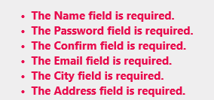
Using HTML Helpers to Display Error Messages (Contd.)
The asp-validation-summary
Can be implemented by using the following code snippet in the view file:
<form asp-action="Create">
<div asp-validation-summary="ModelOnly" class="text-danger"></div>
Is used to summarize all the error messages at one place, as shown in the following figure.

Slide 22
Introduction to ModelState
While using a Web application, when a user enters the data in required format in a field of a Web page, the data is bound to the corresponding property of the model class.
This process is referred to as model binding, which fails if the user does not enter the data in required format.
To determine whether the model binding has failed or completed successfully, you can check the IsValid property of ModelState.

Slide 23
Introduction to ModelState (Contd.)
If the model binding succeeds, the ModelState.IsValid property returns true.
If there is any error in the model state, the ModelState.IsValid property returns false.
Example:
if (ModelState.IsValid)
{
//Code to save the entered data and display an appropriate view
}
else
{
//Code to redisplay the view with errors
}

Slide 24
Introduction to ModelState (Contd.)
MVC also allows server-side validation of the entered data in the corresponding action method.
Inside the action method, you can write the code to check for an error.
If you find any error, you can add an error message in ModelState by using the AddModelError() method.
The AddModelError() method adds a model error to the error collection of the model state dictionary.

Slide 25
Introduction to ModelState (Contd.)
Example:
[HttpPost]
public ActionResult Create(Credentials credentials){
if (usernameAlreadyExists(credentials.Username)){
ModelState.AddModelError("Username", "Username is not available.");
}
if (ModelState.IsValid){
/*Code to save the entered data and display an appropriate view */
}
else{
//Code to redisplay the view with errors
}
}

Slide 26
Just a Minute
Which one of the following tag helper attributes is used to display error messages at one place in an ASP.NET MVC application?
Asp-ValidationMessage
Asp-ValidationSummary
Asp-Validation

Slide 27
Just a Minute (Contd.)
Solution:
asp-ValidationSummary

Slide 28
Demo: Implementing Validation
Problem Statement:
You are a part of the software development team at GlobalIT, located in Houston, the US. The Team Leader has asked you to modify the Registration Page for the Rainbow Entertainment application so that it only accepts the valid data from a customer. Therefore, you decide to implement the following client-side validations on the Registration form:
The following input fields should not be left blank:
Customer_Name
Age
Gender
Email
Password
Confirm_Password
Address
Phone_Number
Customer_Name should be between 5 to 20 characters.
Age should be between 18 to 100 years.

Slide 29
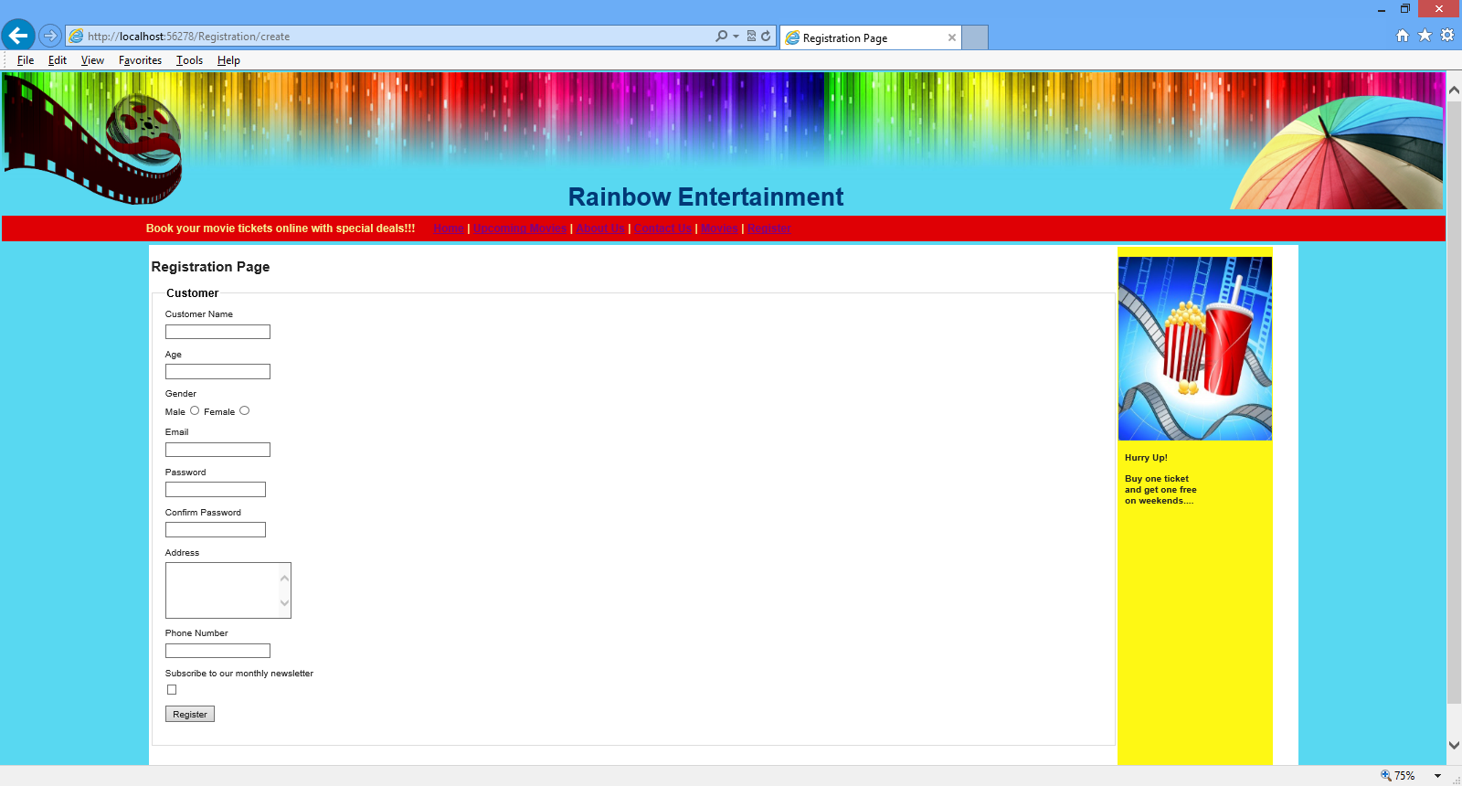
Demo: Implementing Validation (Contd.)
Email should have an appropriate format.
The Password and Confirm_Password values must match.
Phone_Number should be in the (XXX-XXX-XXXX) format.
All the field names should be properly displayed, as shown in the following figure.

Slide 30
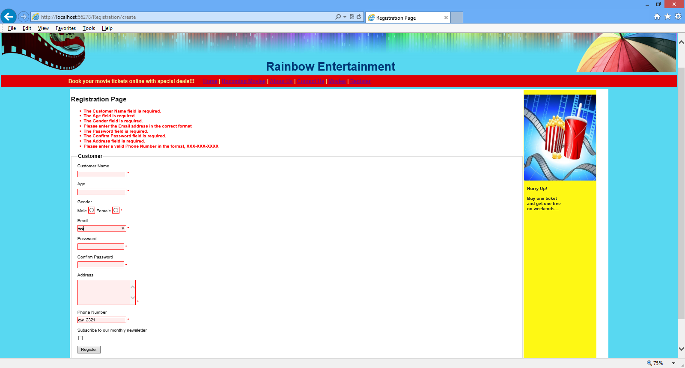
Demo: Implementing Validation (Contd.)
In addition, you decide to use the following custom messages instead of the default messages for Email and Phone_Number, if the validation fails:
Please enter the Email address in the correct format.
Please enter a valid Phone Number in the format, XXX-XXX-XXXX.
Moreover, the error messages due to failed validations should appear together at one place in the Registration page, as shown in the following figure.

Slide 31
Demo: Implementing Validation (Contd.)
Solution:
To solve the preceding problem, you need to perform the following tasks:
Modify the Customer model.
Modify the view for the Registration page.
Execute the application.

Slide 32
Summary
In this session, you learned that:
Validation is the process of checking the input data against certain criteria.
Some of the commonly used data annotations are:
Required
StringLength
RegularExpression
Range
Compare
Display
ReadOnly
DataType
The Required data annotation attribute specifies that the property, with which this annotation is associated, is a required property.
The StringLength data annotation attribute is used to specify the minimum and maximum lengths of a string field.

