Slide 1
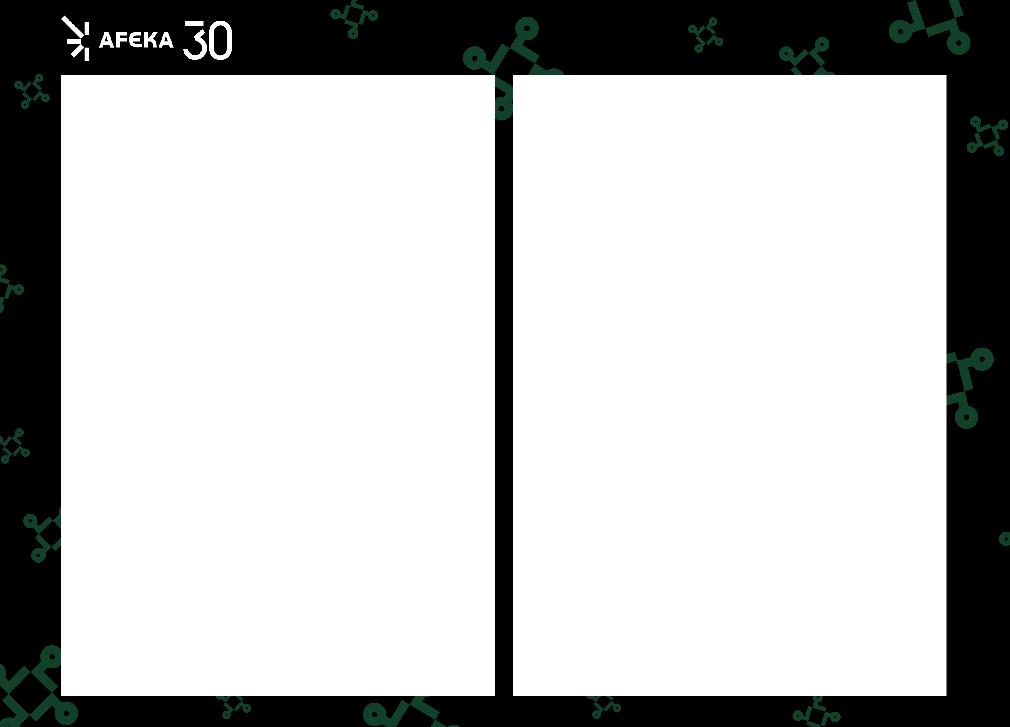
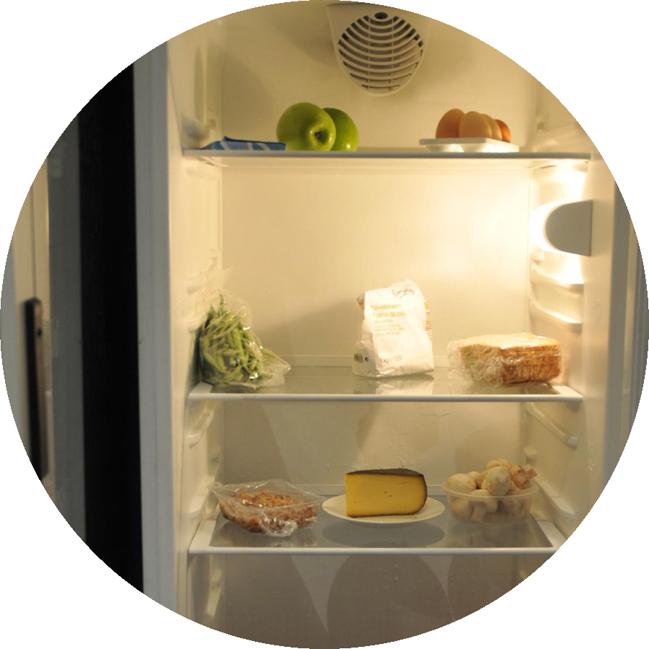
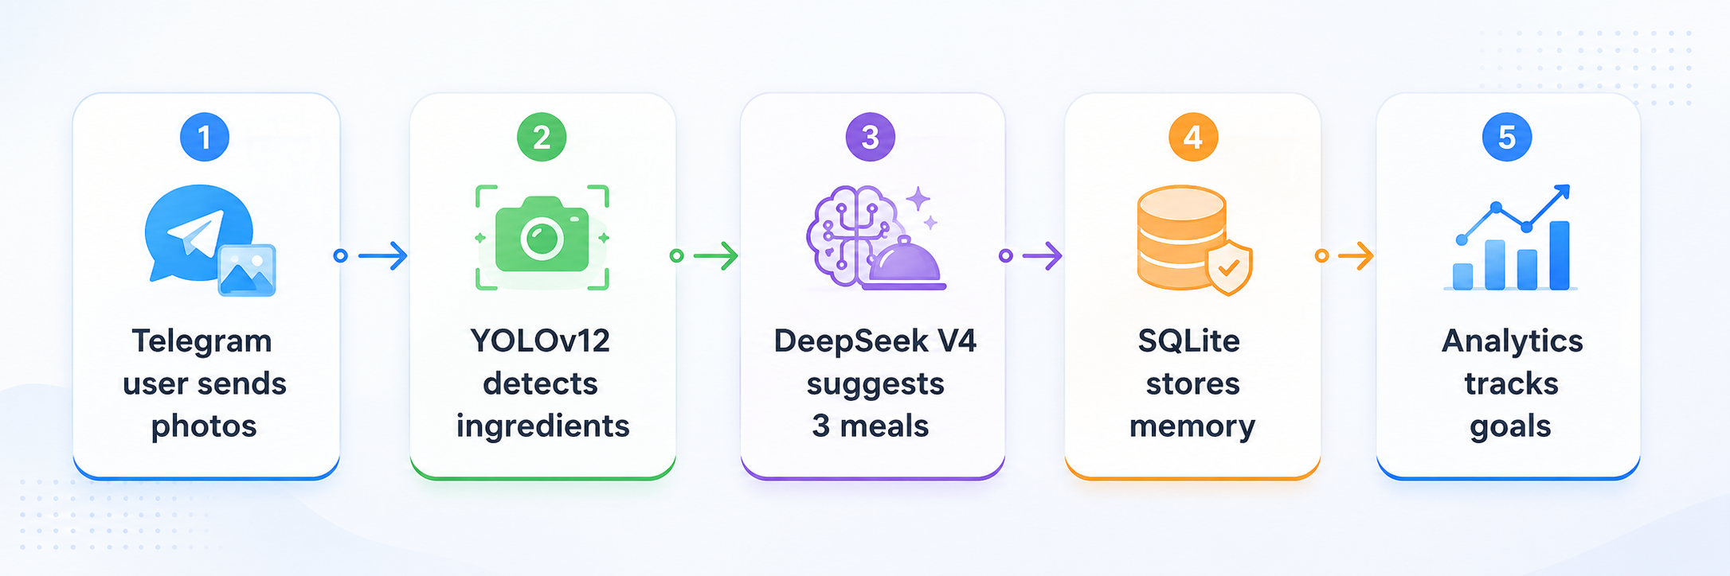


NutriVision
Telegram-Based Intelligent Cooking Assistant
Rane Deeb, Ido Cohen
Advisor: Dr. Sharon Yalov-Handzel
B.Sc. Data Sceince, 2026
1. Problem description
3. The Data
Food-Ingredients
9.7K images
AiCook
516 images
Fridge Object v3
9.9K images
Many users struggle to decide what to cook from the ingredients already available at home. Manual calorie tracking is tedious, beginner cooks need clear guidance, and forgotten ingredients often expire before being used. NutriVision addresses these daily problems by combining fridge image recognition, personalized meal suggestions, and simple nutrition tracking inside Telegram.
Fridge Detection
3.1K images
LVIS Fruits & Veg
8.4K images
Fridge Objects v12
2.4K images
25.8K images | 181 classes | ~160K boxes
4. The Model
2. The Solution
The detector, Which is yolov12 finetuned (25 epocs) on the above datasets, receives a fridge image and outputs ingredient labels with bounding boxes and confidence scores.
Using those ingredients, an LLM will generate 3 suggestions to what to cook. We will use deepseek v4 model for its cheap prices, fast responses and high quality
5. Results
0.605
mAP@50
The assistant turns a short Telegram interaction into a complete cooking flow: detect ingredients, correct the list, receive three diet-aware meals, choose one, and save the result for future analytics.
0.658
Precision
0.579
Recall
Graph shows improvements after each epoc.
GitHub repository

