Slide 1
How to make BLAZINGLY fast applications in python?

Slide 2
What means BLAZINGLY fast?
Written in rust
This is it

Slide 3
The results will be something like this…

Slide 4


Link to my linkedin and the code that I showed
https://www.linkedin.com/in/andriiflama/
https://github.com/AFLLAMA/crab_in_python

Slide 5
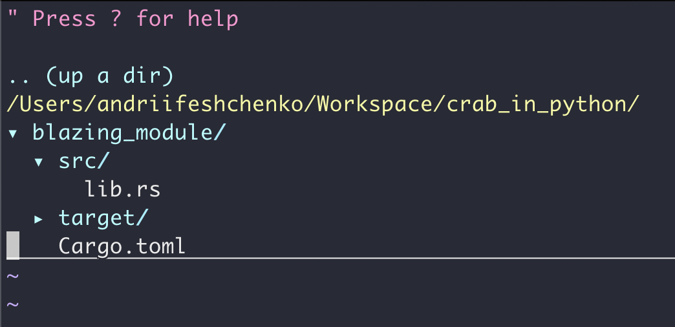
Create a rust module

Slide 6
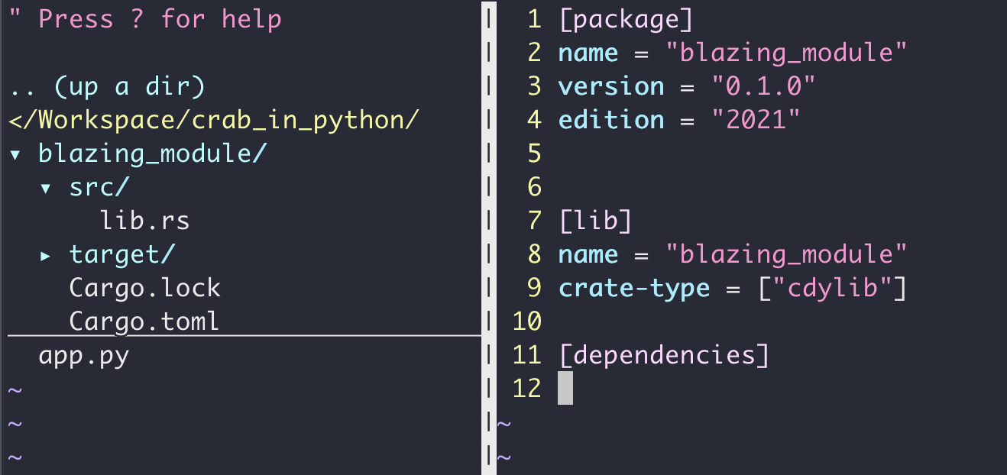
A little change to Cargo.toml

Slide 7
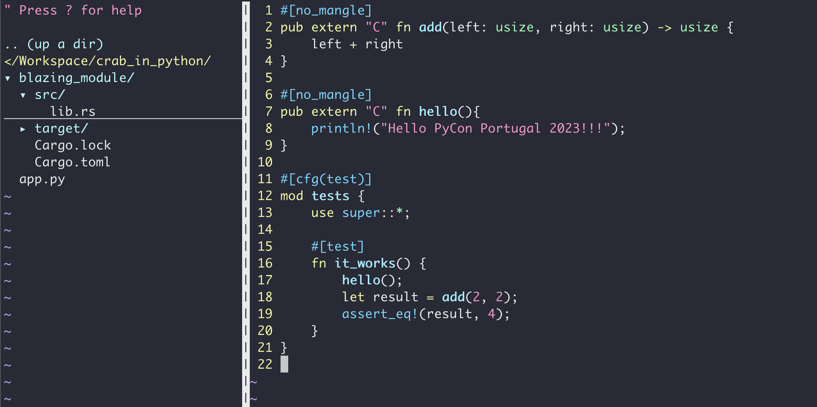
The BLAZINGLY fast code

Slide 8
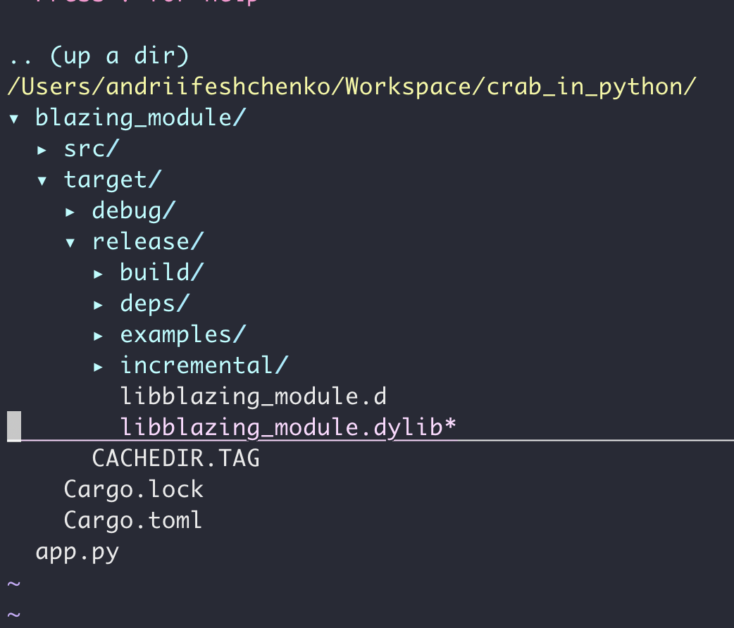
Create dynamic library file

Slide 9
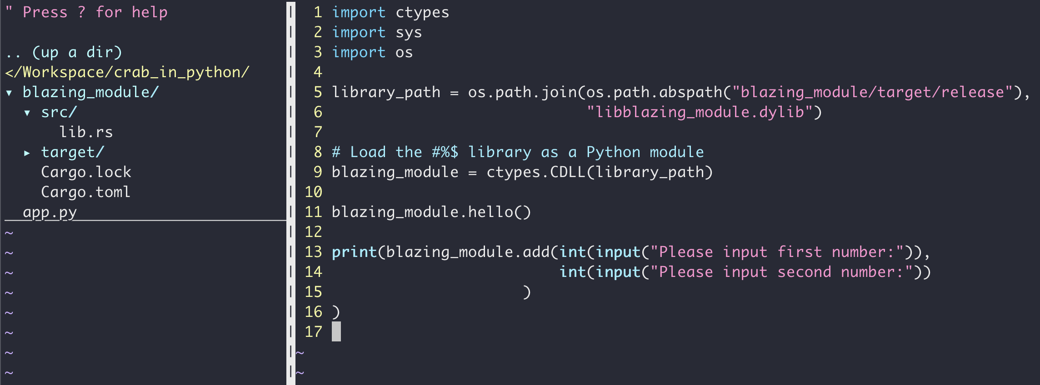
Python app

Slide 10
Done!

Slide 11
Link to my linkedin and the code that I showed
https://www.linkedin.com/in/andriiflama/
https://github.com/AFLLAMA/crab_in_python

