Slide 1
Nanotube Simulation Results
Updated 14/7/2020
Kate Trinkaus

Slide 2

Exponential vs Linear Transmittance Equation
Exponential: $T=e^{−AF∗C_{ext}}$
Linear: $T=1−a_{1}∗AF$
C_{ext}= 4, a₁=3.796 for agreement at T=0.90

Slide 3
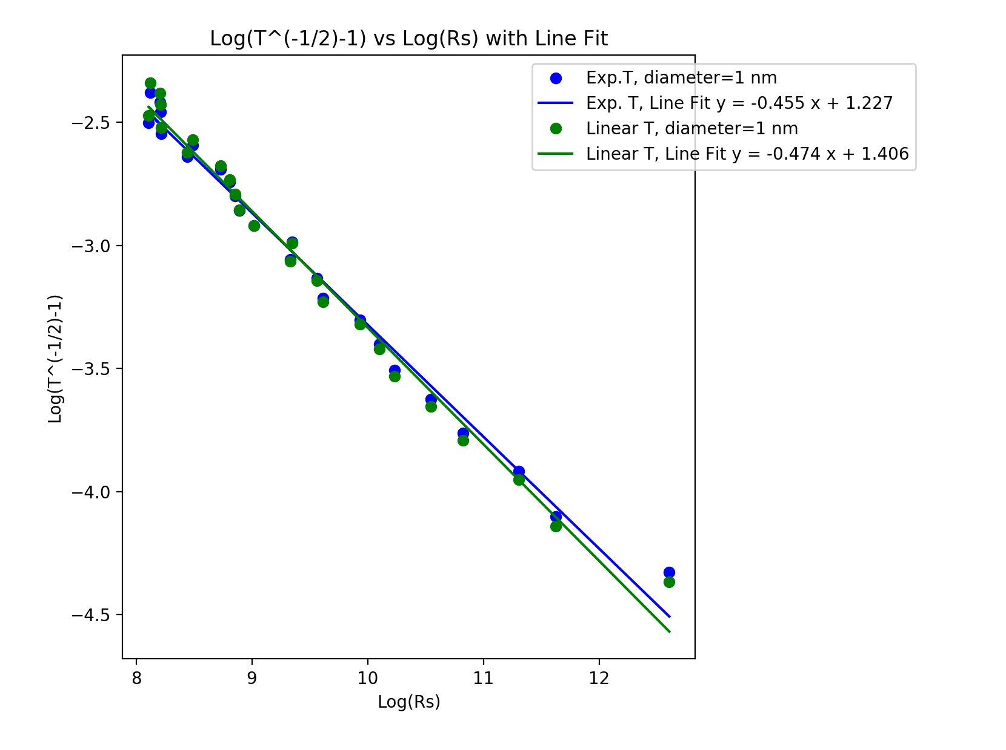
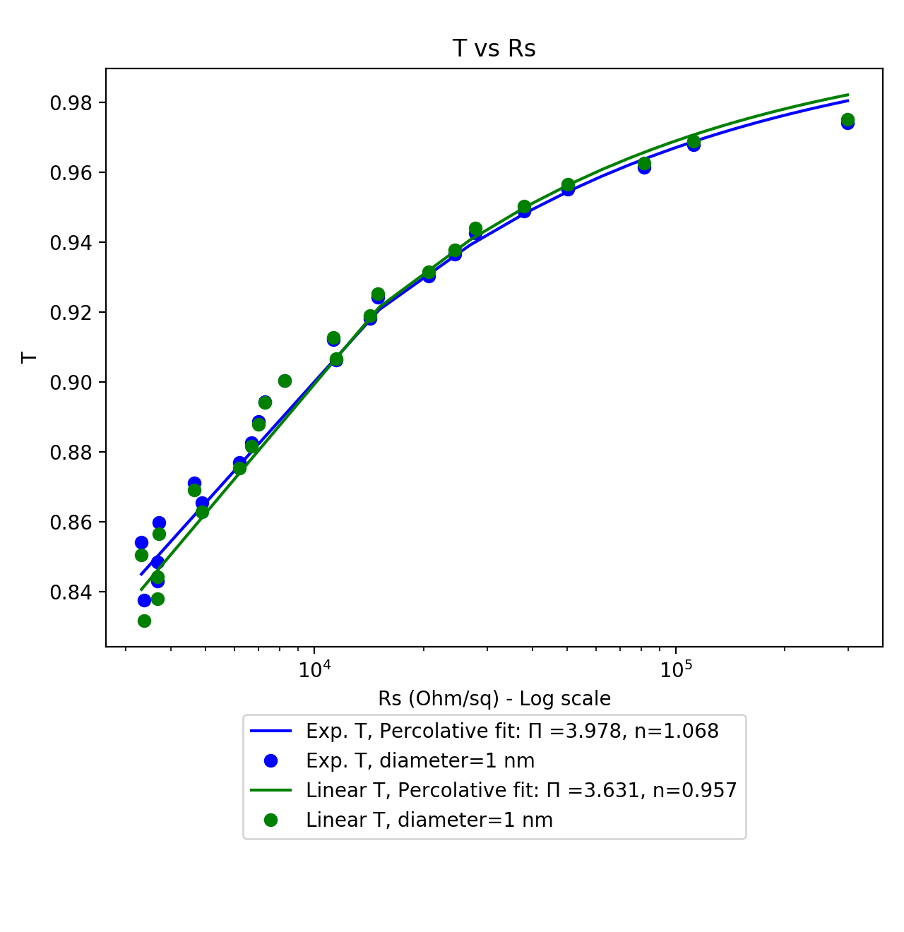
Exponential vs Linear Transmittance Equation
Parameters: d=1nm, l=1um, box length=5um, 1 sample, network density: 6.5644 to 55.7974 wires/um² in steps of 4.9233 wires/um²

Slide 4
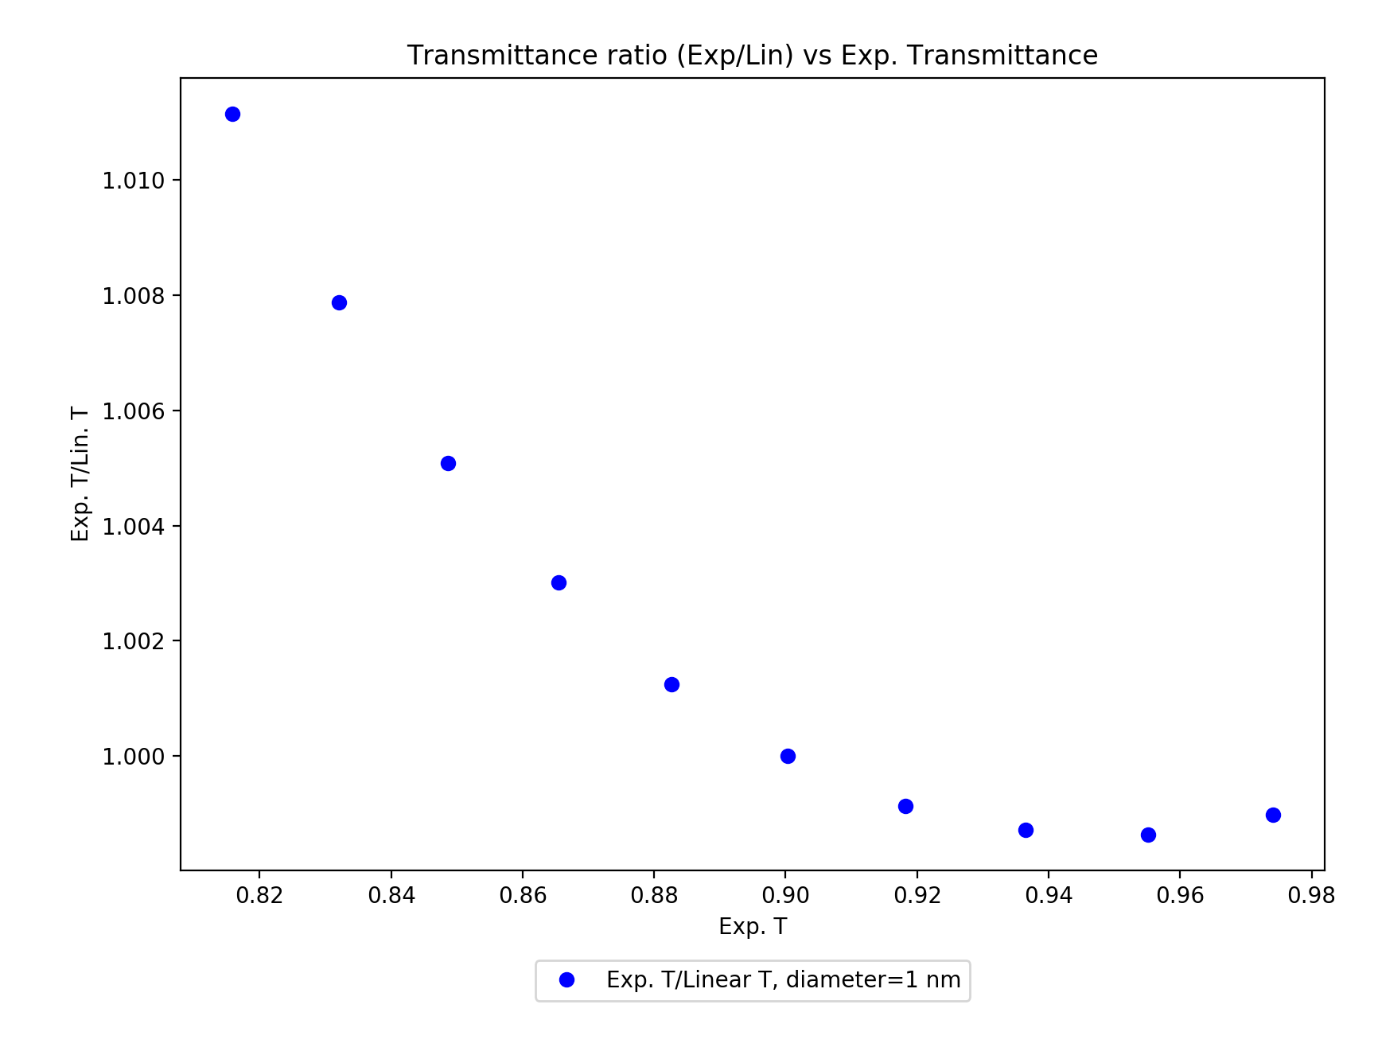
Exponential vs Linear Transmittance Equation
Parameters: d=1nm, l=1um, box length=5um, 1 sample, network density: 6.5644 to 55.7974 wires/um² in steps of 4.9233 wires/um²

Slide 5
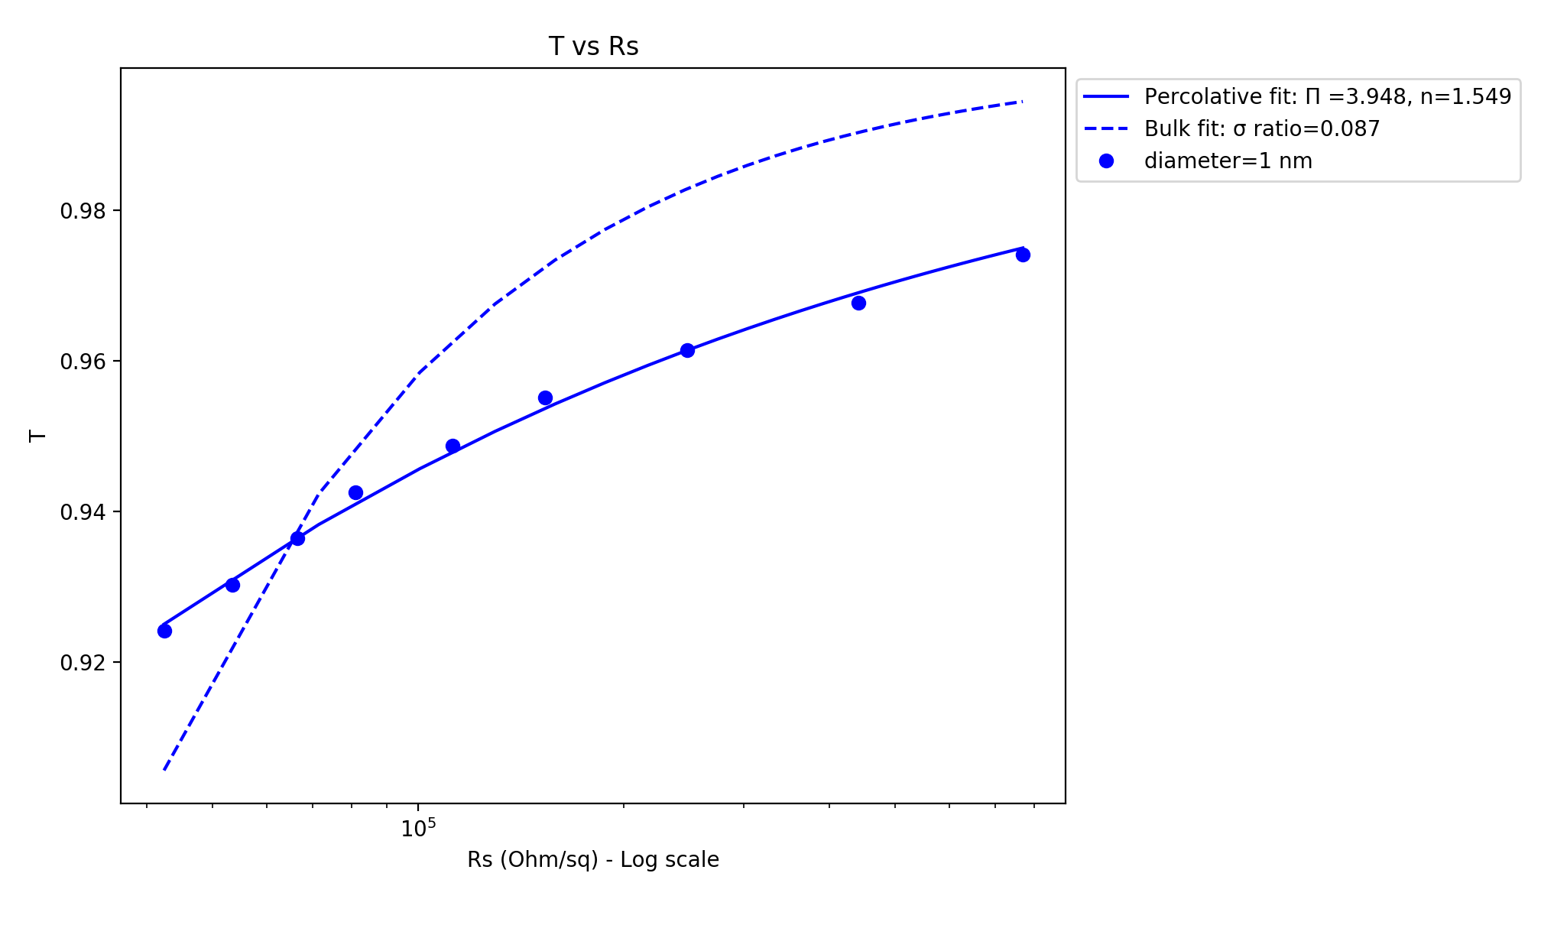
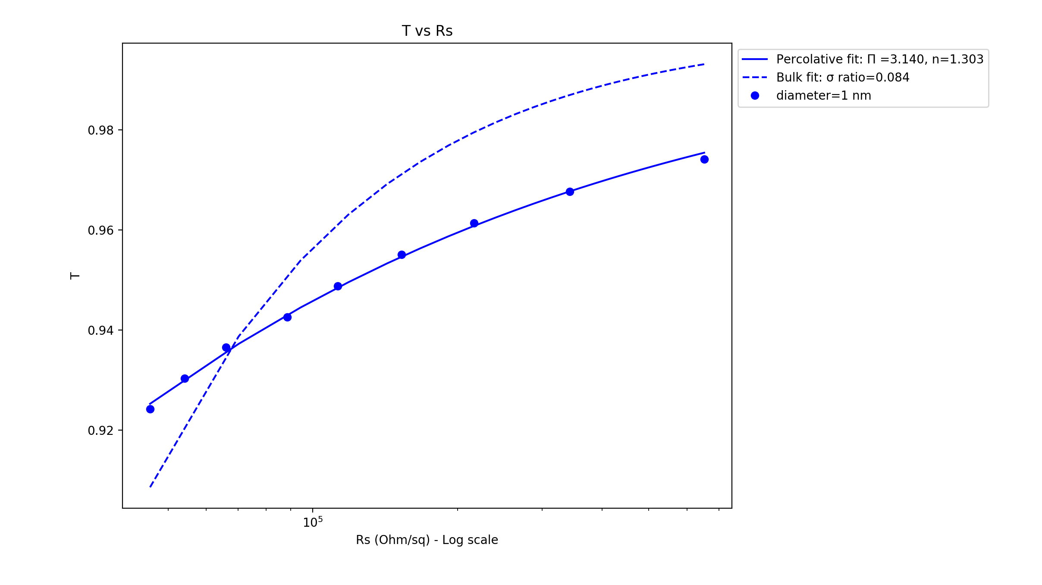
Uniform Wire Length vs Distribution of Wire Lengths
Parameters:
Both: samples=15, length/mean length = 1um, d=1nm, box length=5um, network density: 6.5644 to 19.6932 in 1.6411 wires/um² steps
Distribution of wire lengths: sigma= 0.5um

Slide 6
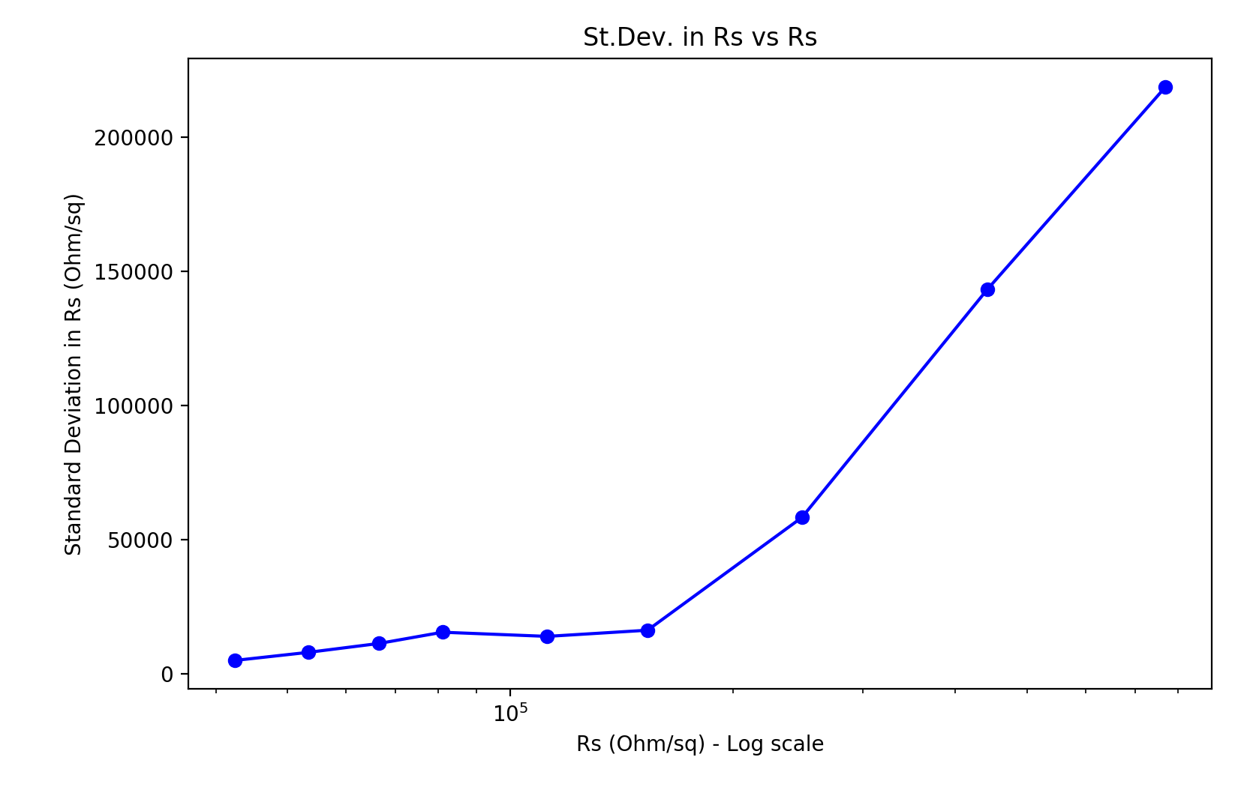
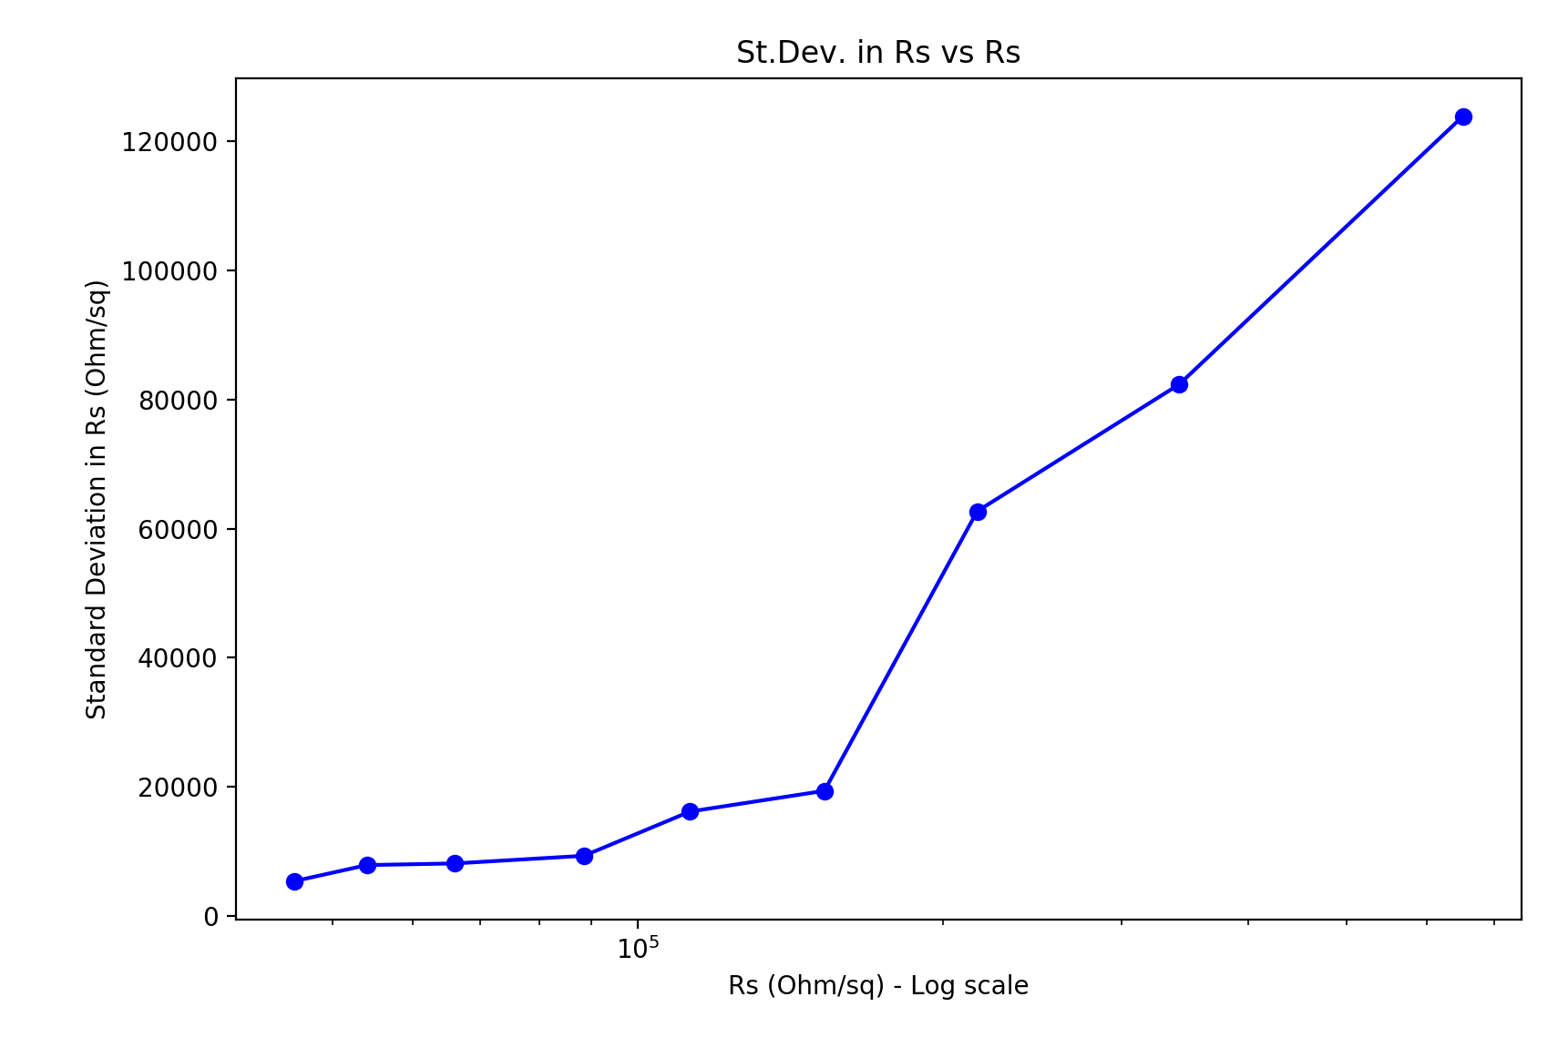
Uniform Wire Length vs Distribution of Wire Lengths
Parameters:
Both: samples=15, length/mean length = 1um, d=1nm, box length=5um, network density: 6.5644 to 19.6932 in 1.6411 wires/um² steps
Distribution of wire lengths: sigma= 0.5um

Slide 7
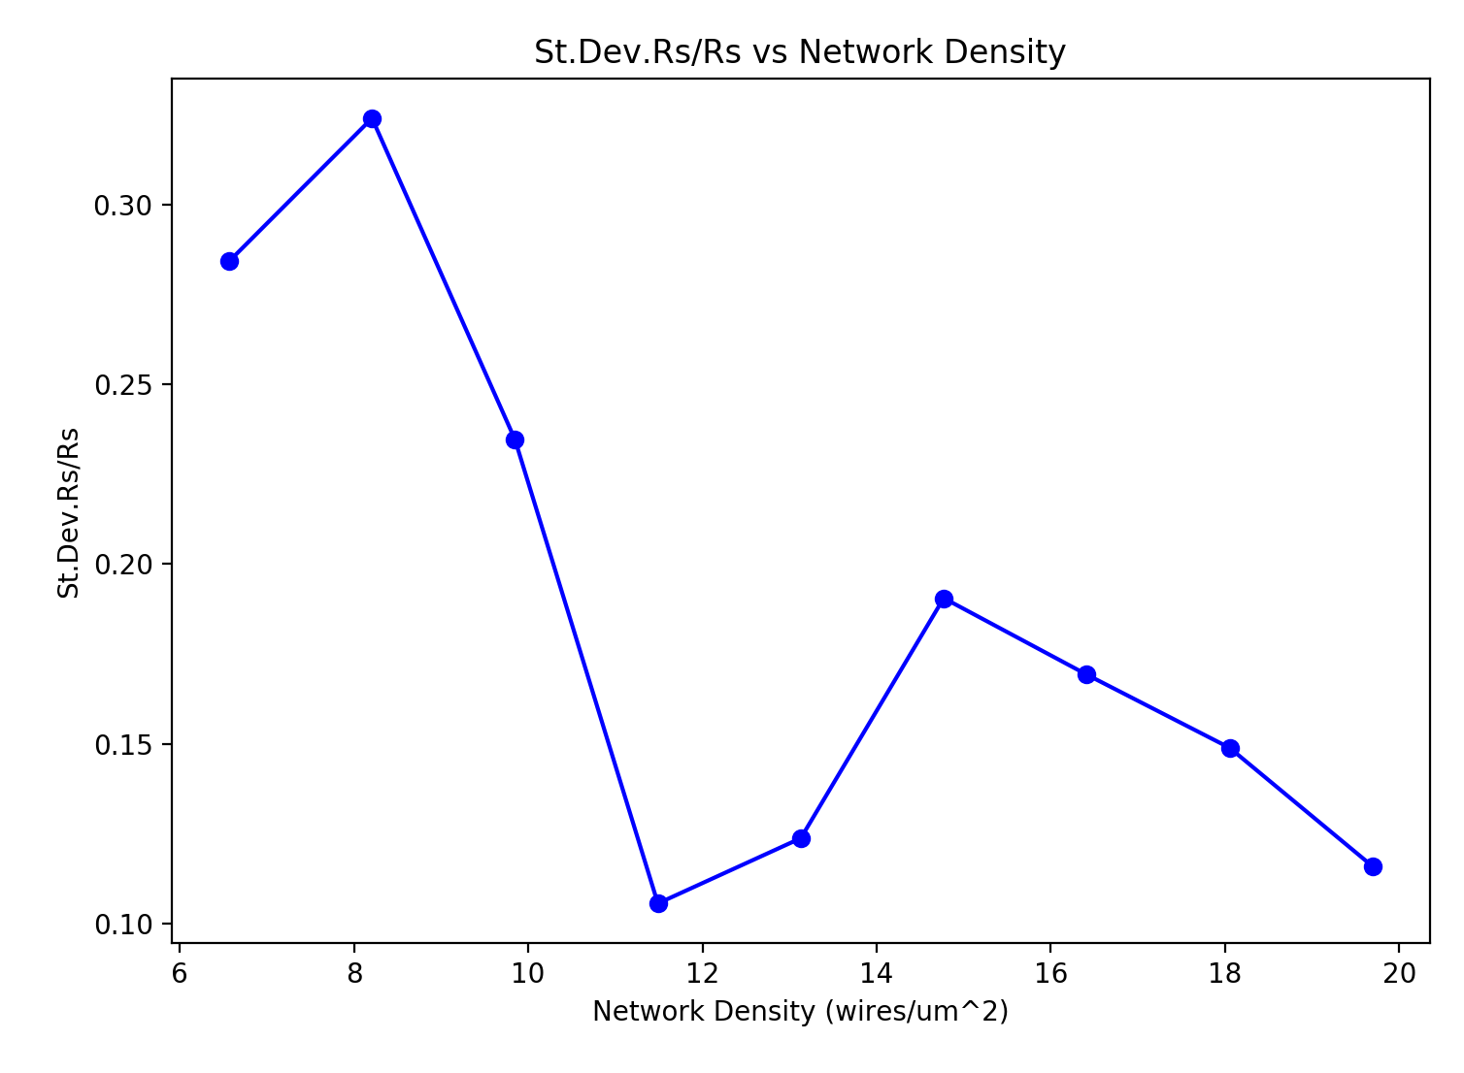
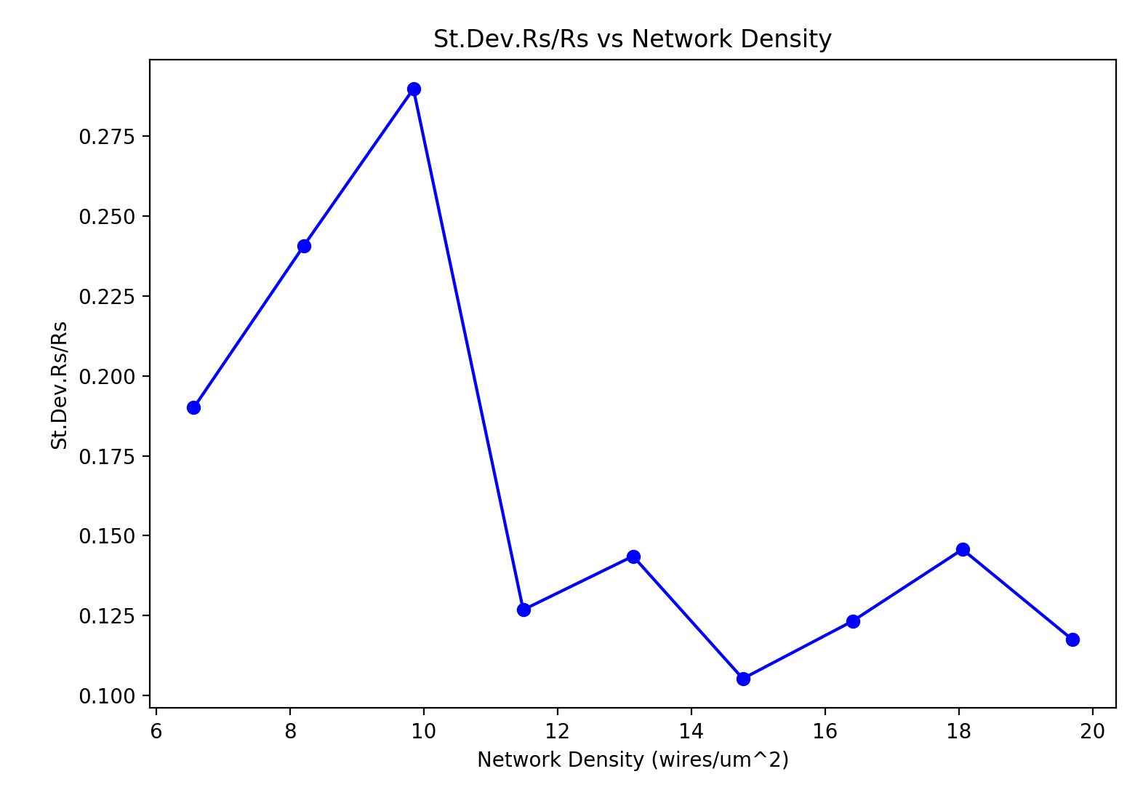
Uniform Wire Length vs Distribution of Wire Lengths
Parameters:
Both: samples=15, length/mean length = 1um, d=1nm, box length=5um, network density: 6.5644 to 19.6932 in 1.6411 wires/um² steps
Distribution of wire lengths: sigma= 0.5um

Slide 8
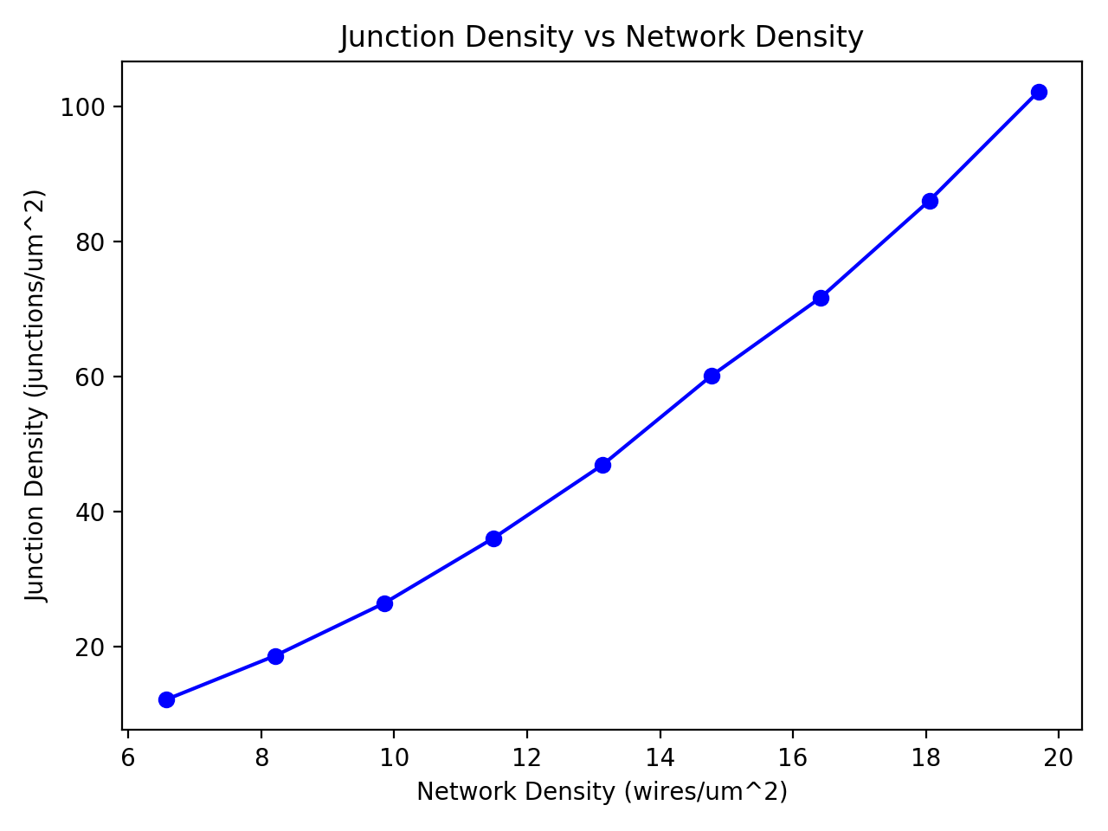

Uniform Wire Length vs Distribution of Wire Lengths
Parameters:
Both: samples=15, length/mean length = 1um, d=1nm, box length=5um, network density: 6.5644 to 19.6932 in 1.6411 wires/um² steps
Distribution of wire lengths: sigma= 0.5um

Slide 9
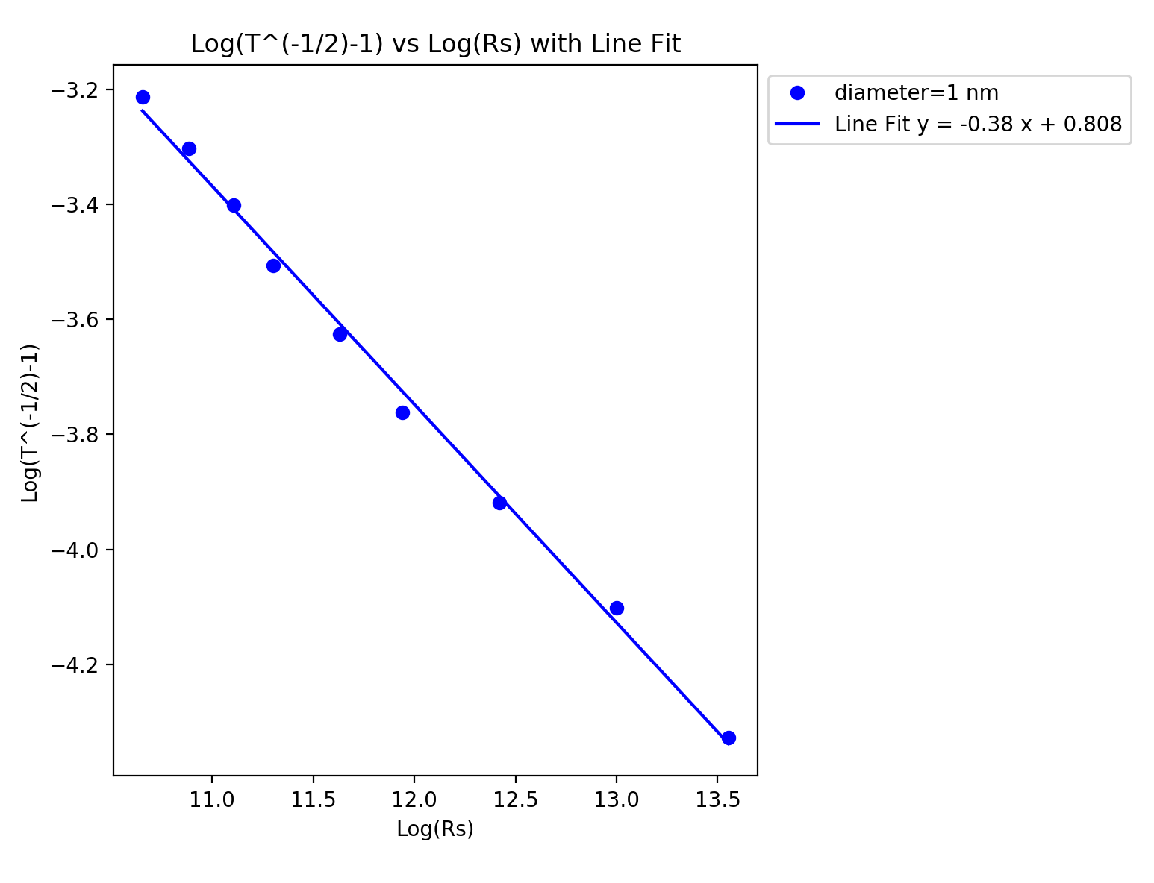
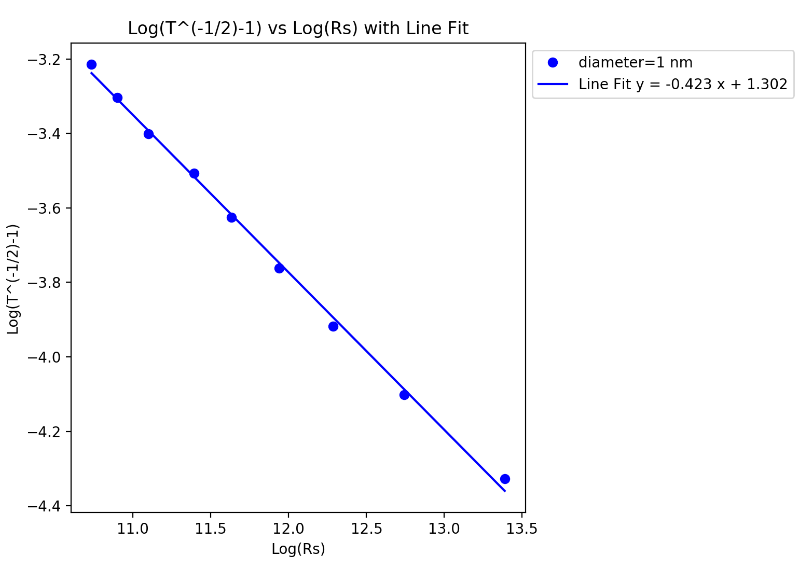
Uniform Wire Length vs Distribution of Wire Lengths
Parameters:
Both: samples=15, length/mean length = 1um, d=1nm, box length=5um, network density: 6.5644 to 19.6932 in 1.6411 wires/um² steps
Distribution of wire lengths: sigma= 0.5um

