Slide 1



Who am I?
Software Developer @SastaTicket.pk
Love to learn new skills.
Interested in Data Sciences.
Passionate about creating true impact.
/JavaEria
@JavaEria1
javerianisar.1993@gmail.com

Slide 2
Exploratory Data Analysis
Using R

Slide 3
Overview
EDA: What and Why?
Things you need to know before understanding data.
Visualization Techniques to kickstart.
Exploring Questions with R.

Slide 4
What is EDA?
To explore data in a systematic way using visualization and transformation that will create a state of mind to ask the rights questions or refine the questions.

Slide 5
Why is it important?
Helps summarize and understand data without any assumption.
Investigate the quality of the data.
Eliminates the wrong questions being asked
Crucial step before machine learning/statistical modeling.
Provides context needed to develop an appropriate model and to correctly interpret its results.
Useful for efficient feature engineering.
Not a good idea to simply feed data to a black box!

Slide 6
EDA Cycle
Generate questions about your data.
Search for answers by visualising, transforming and modelling your data.
Use what you learn to refine your questions and/or generate new questions.

Slide 7
Why we need to ask questions?
To guide your investigation for understanding data.
Focus on the specific part of the data set.
Helps you decide which graphs, models or transformation to make.
the key to asking quality questions is to generate a large quantity of questions
“There are no routine statistical questions, only questionable statistical routines.” - Sir David Cox

Slide 8
Things you need to know before understanding data
Difference between numerical/categorical attributes/variables.
Measures of central tendency.
Measure of spread, variance, standard deviation and interquartile range.
Robust Statistics.

Slide 9
Some Visualization Techniques To Get Started With

Slide 10
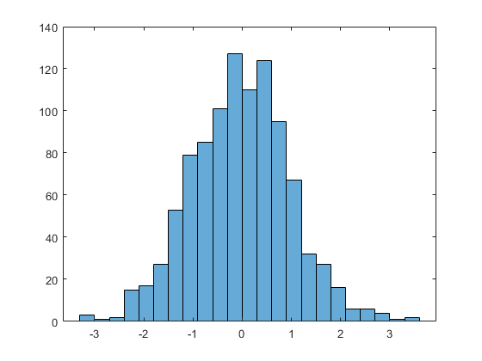
Histogram Visualization

Slide 11
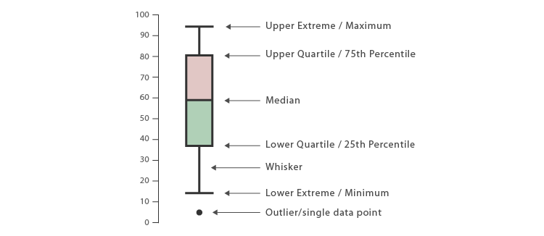
Box plot Visualization

Slide 12
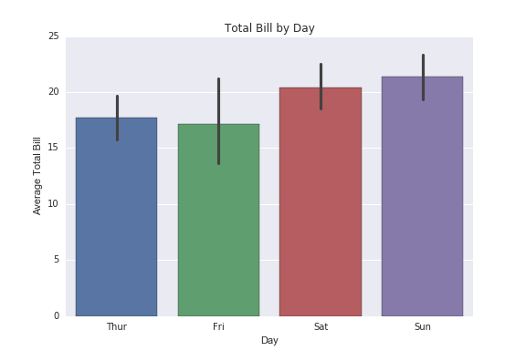
Barplot Visualization

Slide 13
The data set that we will be working on
This data set is a collection of domestic flights from three major airports of New York.
Source: https://stat.duke.edu/~mc301/data/nycflights.RData

Slide 14
Research Questions

Slide 15
Is there any correlation between the departure delays and the time of the year when flights get delayed.
For this we will find the patterns in the month and calculate the average values of the departure delays for each month. We will first plot the histogram and boxplot of the departure delay to see the distribution.

Slide 16
Can the airport origin have an association with the departure rate of the departing flights.
For this we will calculate an on-time departure rate where we will assume if the delay is less than 5 min then it is on-time.

Slide 17
Is there any correlation between the arrival delays and the speed of the airplanes for the flights.
For this we will try to find patterns in the arrival delays and the speed of the airplanes.

Slide 18
There is much more that can be explored!!

