Slide 1
Overview of what we went through last time
The phenomenon of sampling variability
The Central Limit Theorem
For our purpose, the CLT states that the distribution of averages of iid variables (properly normalized) becomes that of a standard normal, as the sample size increases.
The Normal distribution
The cumulative distribution and quantile functions (pnorm and qnorm respectively)

Slide 2
Parameter estimation
What we are interested in: The population parameters
What we get: sample parameters / sample statistics, which we use as point estimates
Problem: sample statistics vary from sample to sample
What we do: We quantify their variance, which gives us a way to estimate a margin of error associated with our point estimate

Slide 3
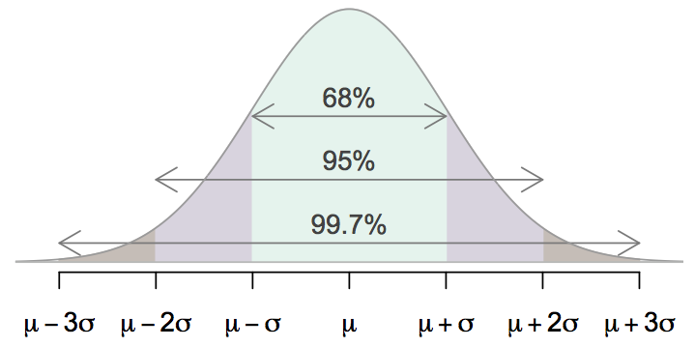
68-95-99.7 Rule
For nearly normally distributed data,
about 68% falls within 1 SD of the mean,
about 95% falls within 2 SD of the mean,
about 99.7% falls within 3 SD of the mean.
It is possible for observations to fall 4, 5, or more standard deviations away from the mean, but these occurrences are very rare if the data are nearly normal.

Slide 4
Simulation for SE
> nosim <- 1000
> n <- 50
> sd(rowMeans(matrix(rnorm(nosim*n), nrow = nosim)))
> 1/sqrt(50)

Slide 5
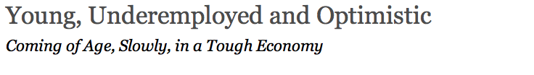
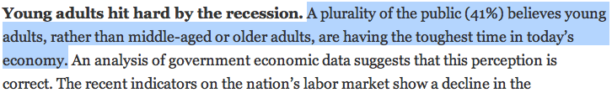
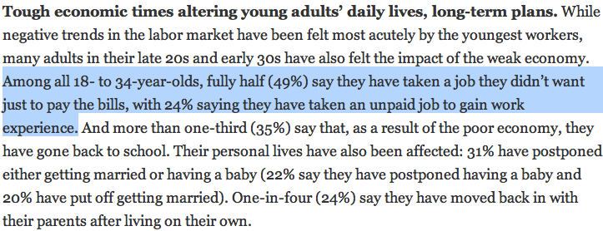
http://pewresearch.org/pubs/2191/young-adults-workers-labor-market-pay-careers-advancement-recession

Slide 6
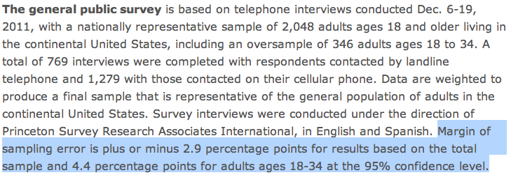
Margin of error
41% ± 2.9%: We are 95% confident that 38.1% to 43.9% of the public believe young adults, rather than middle-aged or older adults, are having the toughest time in today's economy.
49% ± 4.4%: We are 95% confident that 44.6% to 53.4% of 18-34 years olds have taken a job they didn't want just to pay the bills.

Slide 7
Confidence intervals
Confidence interval, a general formula
point estimate ± z* x SE
Conditions when the point estimate = x̄
Independence: Observations in the sample must be independent
random sample/assignment
if sampling without replacement, n < 10% of population
Sample size / skew: n ≥ 30 and population distribution should not be extremely skewed

Slide 8
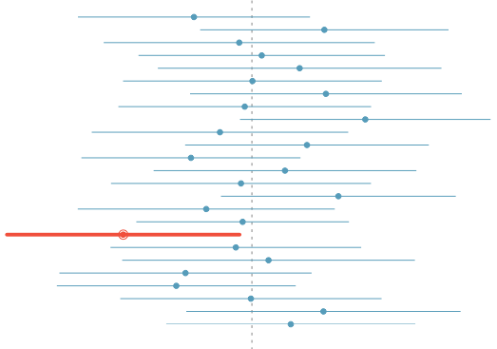
What does 95% confident mean?
Suppose we took many samples and built a confidence interval from each sample using the equation point estimate ± 2 x SE.
Then about 95% of those intervals would contain the true population mean (µ).
The figure shows this process with 25 samples, where 24 of the resulting confidence intervals contain the true average number of exclusive relationships, and one does not.

