Slide 1
Recap
The Central limit theorem, and proof of
The difference between the sample distribution, i.e, the distribution of observations, and the sampling distribution, i.e, the distribution of sample parameters
Proof of the formula for standard deviation of the sampling distribution, i.e, the Standard Error

Slide 2
Changing the confidence level
point estimate ± z* x SE
In a confidence interval, z* x SE is called the margin of error, and for a given sample, the margin of error changes as the confidence level changes.
In order to change the confidence level we need to adjust z* in the above formula.
Commonly used confidence levels in practice are 90%, 95%, 98%, and 99%.
For a 95% confidence interval, z* = 1.96.
However, using the standard normal (z) distribution, it is possible to find the appropriate z* for any confidence level.

Slide 3
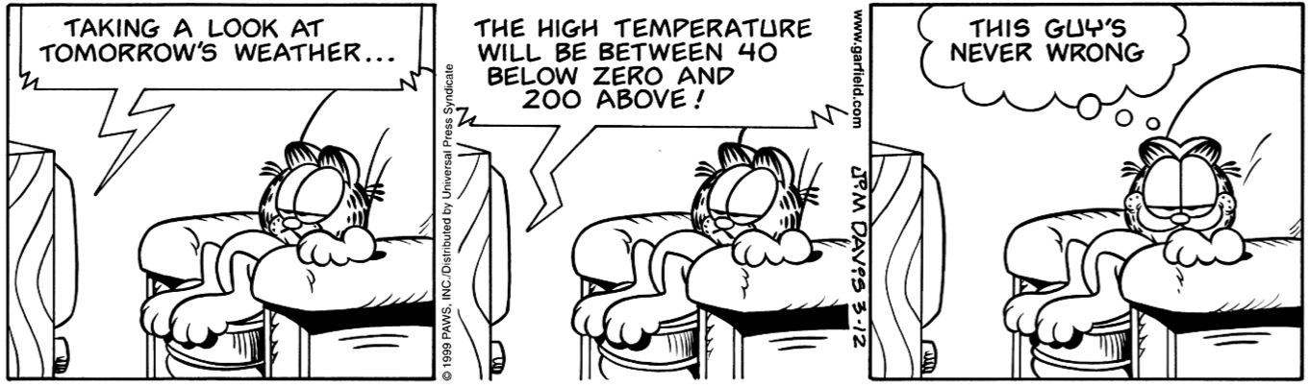
Width of an interval
If we want to be more certain that we capture the population parameter, i.e. increase our confidence level, should we use a wider interval or a smaller interval?
A wider interval.
Can you see any drawbacks to using a wider interval?
If the interval is too wide it may not be very informative.
Image source: http://web.as.uky.edu/statistics/users/earo227/misc/garfield_weather.gif

Slide 4
Practice
Which of the below Z scores is the appropriate z* when calculating a 98% confidence interval?
(a) Z = 2.05
(b) Z = 1.96
(c) Z = 2.33
(d) Z = -2.33
(e) Z = -1.65

Slide 5
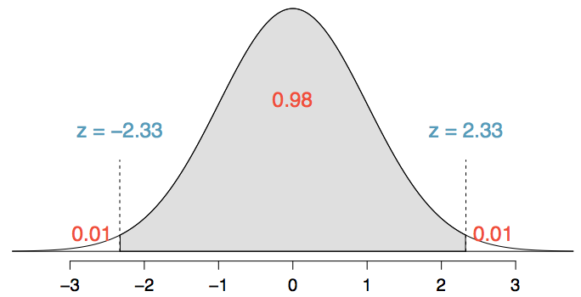
Practice
Which of the below Z scores is the appropriate z* when calculating a 98% confidence interval?
(a) Z = 2.05
(b) Z = 1.96
(c) Z = 2.33
(d) Z = -2.33
(e) Z = -1.65

Slide 6
Hands on the keyboards
Load the data set mtcars in the datasets R package. Calculate a 95% confidence interval to the nearest MPG for the variable mpg.
Notes:
xbar + c(-1,1)*qt(0.975, df = nrow(mtcars)-1)*(sd(mtcars$mpg)/sqrt(nrow(mtcars)))
t.test(mtcars$mpg)

Slide 7
Hands on the keyboards
Give a confidence interval for the average height of sons in Galton’s data.
Notes:
> library(UsingR)
> data(father.son)
> x <- father.son$sheight
> (mean(x) + c(-1, 1) * qnorm(0.975) * sd(x)/sqrt(length(x)))/12

Slide 8
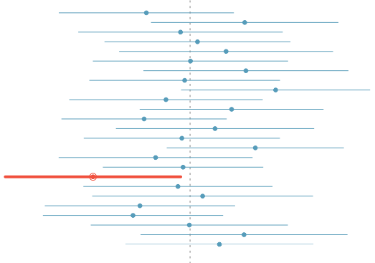
What does 95% confident mean?
Suppose we took many samples and built a confidence interval from each sample using the equation point estimate ± 2 x SE.
Then about 95% of those intervals would contain the true population mean (µ).
The figure shows this process with 25 samples, where 24 of the resulting confidence intervals contain the true average number of exclusive relationships, and one does not.

Slide 9
Discussion
Consider a court of law; the null hypothesis is that the defendant is innocent
We require a standard on the available evidence to reject the null hypothesis (convict)
If we set a low standard, then we would increase the percentage of innocent people convicted (type I errors); however we would also increase the percentage of guilty people convicted (correctly rejecting the null)
If we set a high standard, then we increase the percentage of innocent people let free (correctly accepting the null) while we would also increase the percentage of guilty people let free (type II errors)

Slide 10
Hypothesis testing
The alternative hypotheses are typically of the form <, > or !=
Note that there are four possible outcomes of our statistical decision process
TRUTH | DECIDE | RESULT
H0 | H0 | Correctly accepted null
H0 | Ha | Type I error
Ha | Ha | Correctly rejected null
Ha | H0 | Type II error

Slide 11
Problem
A Respiratory Disturbance Index of more than 30 events / hour, say, is considered evidence of severe Sleep Disordered Breathing (SDB)
Suppose that in a sample of 100 overweight subjects with other risk factors for sleep disordered breathing at a sleep clinic, the mean RDI was 32 events / hour with a standard deviation of 10 events / hour
We might want to test the hypothesis that:
H₀ : mu = 30
H_{a} : mu > 30
Where mu is the population mean RDI

Slide 12
Back to the sleep example
A reasonable strategy would reject the null hypothesis if Xbar was larger than some constant, say C
Typically, C is chosen so that the probability of a Type I error, α, is 0.05 (or some other relevant constant)
α = Type I error rate = probability of rejecting the null hypothesis when, in fact, the null hypothesis is correct
Notes:
Draw Xbar with pen

Slide 13
Continued
Standard error of the mean : 10/sqrt(100) = 1
Under H₀, Xbar ~ N(30, 1)
We want to choose C so that the P(Xbar > C; H₀) is 5%
The 95th percentile of a normal distribution is 1.645 standard deviations from the mean [ > qnorm(0.95) ]
If C = 30 + 1 x 1.645 = 31.645 [ > 30 + 1 * qnorm(0.95) ]
Then the probability that a N(30, 1) is larger than it is 5%
So the rule “Reject H₀ when Xbar >= 31.645” has the property that the probability of rejection is 5% when H₀ is true (for the mu₀, sigma and n given)

Slide 14
Continued
In general we don’t convert C back to the original scale
We would just reject because the Z-score; which is how many standard errors the sample mean is above the hypothesized mean:
[ > (32 – 30)/(10/sqrt(100)) ]
= 2 is greater than 1.645
Or, whenever sqrt(n)*(Xbar – mu₀)/s > Z_{1 - α}
Notes:
Draw the formulae by pen

Slide 15
Now bring up your IDE’s and get to work
Load the dataset mtcars in the datasets R package.
> data(mtcars)
Assume that the dataset mtcars is a random sample. Compute the mean MPG, xbar, or this sample.
You want to test whether the true MPG is mu0 or smaller using a one sided 5% level test. (H0 : mu – mu0 versus Ha : mu < mu0). Using that dataset and a Z test:
Based on the mean MPG of the sample xbar, and by using a Z test: what is the smallest value of mu0 that you would reject for?
Notes:
mn <- mean(mtcars$mpg)
s <- sd(mtcars$mpg)
z <- qnorm(.05)
mu0 <- mn - z * s / sqrt(nrow(mtcars))

Slide 16
Recap: hypothesis testing framework
We start with a null hypothesis (H₀) that represents the status quo.
We also have an alternative hypothesis (H_{A}) that represents our research question, i.e. what we're testing for.
We conduct a hypothesis test under the assumption that the null hypothesis is true, either via simulation or traditional methods based on the central limit theorem (coming up next...).
If the test results suggest that the data do not provide convincing evidence for the alternative hypothesis, we stick with the null hypothesis. If they do, then we reject the null hypothesis in favor of the alternative.
We'll formally introduce the hypothesis testing framework using an example on testing a claim about a population mean.

Slide 17
Number of college applications
A asked how many colleges students applied to, and 206 students responded to this question. This sample yielded an average of 9.7 college applications with a standard deviation of 7. College Board website states that counselors recommend students apply to roughly 8 colleges. Do these data provide convincing evidence that the average number of colleges all Duke students apply to is higher than recommended?
http://www.collegeboard.com/student/apply/the-application/151680.html

Slide 18
Setting the hypotheses
The parameter of interest is the average number of schools applied to by all Duke students.
There may be two explanations why our sample mean is higher than the recommended 8 schools.
The true population mean is different.
The true population mean is 8, and the difference between the true population mean and the sample mean is simply due to natural sampling variability
We start with the assumption the average number of colleges Duke students apply to is 8 (as recommended)
H₀ : 𝝁 = 8
We test the claim that the average number of colleges Duke students apply to is greater than 8
H_{A} : 𝝁 > 8

Slide 19
Number of college applications - conditions
Which of the following is not a condition that needs to be met to proceed with this hypothesis test?
Students in the sample should be independent of each other with respect to how many colleges they applied to.
Sampling should have been done randomly.
The sample size should be less than 10% of the population of all Duke students.
There should be at least 10 successes and 10 failures in the sample.
The distribution of the number of colleges students apply to should not be extremely skewed.
Notes:
d)

Slide 20
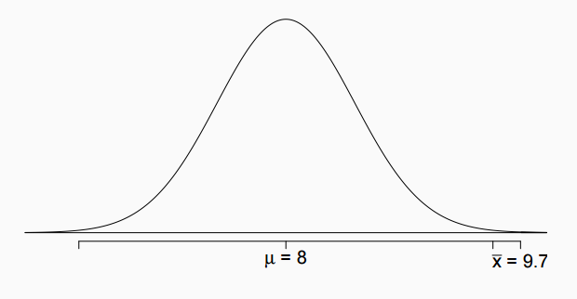
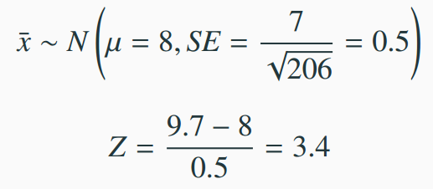
Test Statistic
In order to evaluate if the observed sample mean is unusual for the hypothesized sampling distribution, we determine how many standard errors away from the null it is, which is also called the test statistic.
The sample mean is 3.4 standard errors away from the hypothesized value. Is this considered unusually high? That is, is the result statistically significant?
Yes, and we can quantify how unusual it is using a p-value.

Slide 21
p-values
We then use this test statistic to calculate the p-value, the probability of observing data at least as favorable to the alternative hypothesis as our current data set, if the null hypothesis were true.
If the p-value is low (lower than the significance level, α, which is usually 5%) we say that it would be very unlikely to observe the data if the null hypothesis were true, and hence reject H₀.
If the p-value is high (higher than α) we say that it is likely to observe the data even if the null hypothesis were true, and hence do not reject H₀.

Slide 22
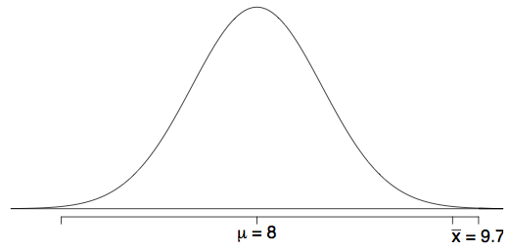
Number of college applications - p-value
p-value: probability of observing data at least as favorable to H_{A} as our current data set (a sample mean greater than 9.7), if in fact H₀ were true (the true population mean was 8).
P(x̄ > 9.7 | µ = 8) = P(Z > 3.4) = 0.0003

Slide 23
Number of college applications - Making a decision
p-value = 0.0003
If the true average of the number of colleges Duke students applied to is 8, there is only 0.03% chance of observing a random sample of 206 Duke students who on average apply to 9.7 or more schools.
This is a pretty low probability for us to think that a sample mean of 9.7 or more schools is likely to happen simply by chance.
Since p-value is low (lower than 5%) we reject H₀.
The data provide convincing evidence that Duke students apply to more than 8 schools on average.
The difference between the null value of 8 schools and observed sample mean of 9.7 schools is not due to chance or sampling variability.

Slide 24
Practice
A poll by the National Sleep Foundation found that college students average about 7 hours of sleep per night. A sample of 169 college students taking an introductory statistics class yielded an average of 6.88 hours, with a standard deviation of 0.94 hours. Assuming that this is a random sample representative of all college students (bit of a leap of faith?), a hypothesis test was conducted to evaluate if college students on average sleep less than 7 hours per night. The p-value for this hypothesis test is 0.0485. Which of the following is correct?
Fail to reject H₀, the data provide convincing evidence that college students sleep less than 7 hours on average.
Reject H₀, the data provide convincing evidence that college students sleep less than 7 hours on average.
Reject H₀, the data prove that college students sleep more than 7 hours on average.
Fail to reject H₀, the data do not provide convincing evidence that college students sleep less than 7 hours on average.
Reject H₀, the data provide convincing evidence that college students in this sample sleep less than 7 hours on average.
Notes:
b)

Slide 25
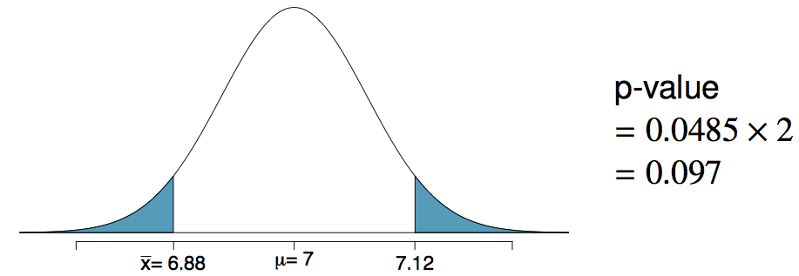
Two-sided hypothesis testing with p-values
If the research question was “Do the data provide convincing evidence that the average amount of sleep college students get per night is different than the national average?”, the alternative hypothesis would be different
H₀: µ = 7
H_{A}: µ ≠ 7
Hence the p-value would change as well:

Slide 26
Two sided test
Suppose that we would reject the null hypothesis if in fact the mean was too large or too small
That is, we want to test the alternative Ha : mu != 30
We will reject if the test statistic, 2, is either too large or to small
Then we want the probability of rejecting under the null to be 5%, split equally as 2.5% in the upper tail and 2.5% in the lower tail
Thus we reject if our test statistic is larger than 1.96 [ qnorm(.975) ] or smaller than -1.96 [ qnorm(.025) ]
2 > 1.96
So we reject the two sided test as well
(If you reject the one sided test, does not mean you will reject the two sided test as well, since the rejection region is further out)

Slide 27
General rules
The Z test for H₀ : mu = mu₀ versus
H₁ : mu < mu₀
H₂ : mu != mu₀
H₃ : mu > mu₀
Test statistic TS = [(Xbar – mu₀)/(S/sqrt(n)
Reject the null hypothesis when
TS <= Z_{α} = -Z_{1- α}
|TS| >= Z_{1- α/2}
TS >= Z_{1- α}
Notes:
Draw the formula of TS by pen

Slide 28
Decision errors
Hypothesis tests are not flawless.
In the court system innocent people are sometimes wrongly convicted, and the guilty sometimes walk free.
Similarly, we can make a wrong decision in statistical hypothesis tests as well.
The difference is that we have the tools necessary to quantify how often we make errors in statistics.

Slide 29
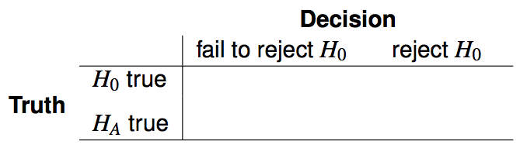


Decision errors (cont.)
There are two competing hypotheses: the null and the alternative. In a hypothesis test, we make a decision about which might be true, but our choice might be incorrect.
A Type 1 Error is rejecting the null hypothesis when H₀ is true.
A Type 2 Error is failing to reject the null hypothesis when H_{A} is true.
We (almost) never know if H₀ or H_{A} is true, but we need to consider all possibilities.

Slide 30
General rules
A confidence interval for the mean contains:
All of the values of the hypothesized mean for which we would fail to reject with α=1−Conf.Level.
All of the values of the hypothesized mean for which we would fail to reject with 2α=1−Conf.Level.
All of the values of the hypothesized mean for which we would reject with α=1−Conf.Level.
All of the values of the hypothesized mean for which we would reject with 2α=1−Conf.Level.

Slide 31
Quick exercise
A sample of 100 men yielded an average PSA level of 3.0 with a sd of 1.1. What are the complete set of values that a 5% two sided Z test of H0:μ=μ0 would fail to reject the null hypothesis for?
Notes:
3+c(-1,1)*qnorm(0.975)*1.1/sqrt(100)

Slide 32
Conclusions
We fixed α to be low, so if we reject H0, either our model is wrong, or there is a low probability that we have made an error
We have not fixed the probability of a type II error, β; therefore we tend to say “Fail to reject H0” rather than accepting H0
Statistical significance is not the same as scientific significance
The region of TS values for which you reject H0 is called the rejection region

Slide 33
What if we don’t have enough samples for the CLT to apply? *he he he …
Z test requires assumption of the CLT and for n to be large enough to apply
I n is small, then a Gossett’s T test is performed exactly the same way, with the normal quantiles replaced by the appropriate Student’s T quantiles and n – 1 degrees of freedom
The probability of rejecting the null hypothesis when it is false is called power
Power is used a lot to calculate sample sizes for experiments

Slide 34
Example reconsidered
Consider our example again. Suppose that n = 16 (rather than 100)
The statistic [ (Xbar – 30)/(s/sqrt(16)) ] follows a T distribution with 15 degrees of freedom under H0
Under H0, the probability that it is larger than the 95th percentile of the T distribution is 5%
The 95th percentile of the T distribution with 15 degrees of freedom is 1.7531 (obtained wia > qt(.95, 15) )
So that our test statistic is now sqrt(16)*(32-30)/10 = 0.8 < 1.7531
We now fail to reject the null hypothesis
Notes:
Write the formulas with pen

Slide 35
Quick exercise
Suppose you get a t statistic of 2.5 for 15 degrees of freedom testing H0 : mu = mu0 versus Ha : mu > mu0. What’s the probability of getting a t statistic as large as 2.5?
> pt(2.5, 15, lower.tail = FALSE)
Notes:
Write the formulas with pen

Slide 36
Hands on the keyboards
Load the data set mtcars in the datasets R package. Calculate a 95% confidence interval to the nearest MPG for the variable mpg.
Notes:
xbar + c(-1,1)*qt(0.975, df = nrow(mtcars)-1)*(sd(mtcars$mpg)/sqrt(nrow(mtcars)))
t.test(mtcars$mpg)

