Slide 1


Milken Money Gang FRAUD PREVENTION
Caroline George
Cary Bourgeois
Simon Ambridge
Kunal Kusoorkar
Special Adviser: Rob Murphy

Slide 2
Problem Definition
What does credit card fraud cost the US annually?
$190 Billion

Slide 3
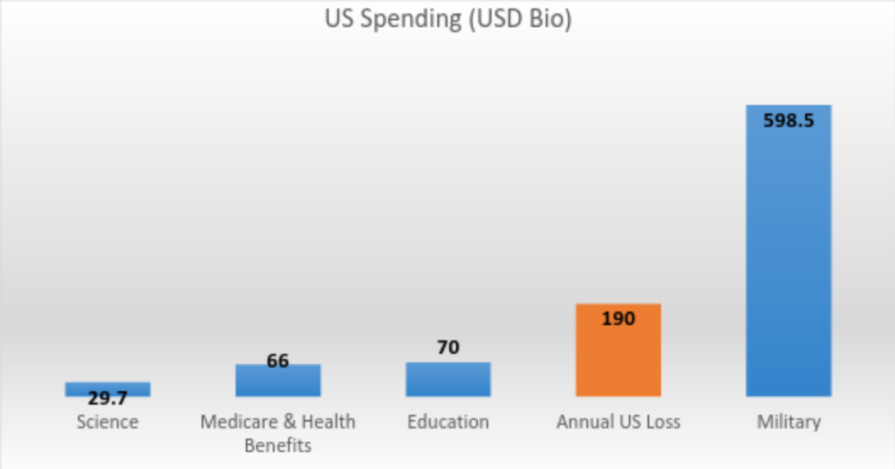
Problem Definition
Lets put $190 Billion in perspective….

Slide 4
Use Case Requirements
Anticipated throughput: 1,000 tps
Number of Accounts: 15,000 merchant
Account Growth: to 50,000 in a year
The solution must be able to:
Handle the high volume of transaction
Identify fraudulent transactions in real-time
Provide a reporting interface to display key fraud-prevention metrics:
Successful transaction ratio
Fraudulent transaction ratio per minute
Moving average of transaction amount over the last hour compared with the transaction amount per minute e.g. 60 min moving average

Slide 5
Use Case Deliverables
The Fraud Prevention engagement pack will contain the following:
Overview – a use case description detailing customer requirements and why DSE is a good fit.
Setup - Requirements and steps
Sample Data Model - including an explanation of how the model was designed
Sample Inserts (CQL)
Sample Queries (CQL)
Stress YAML
Product component Setup details
Data generator code
Client for loading generated data

Slide 6
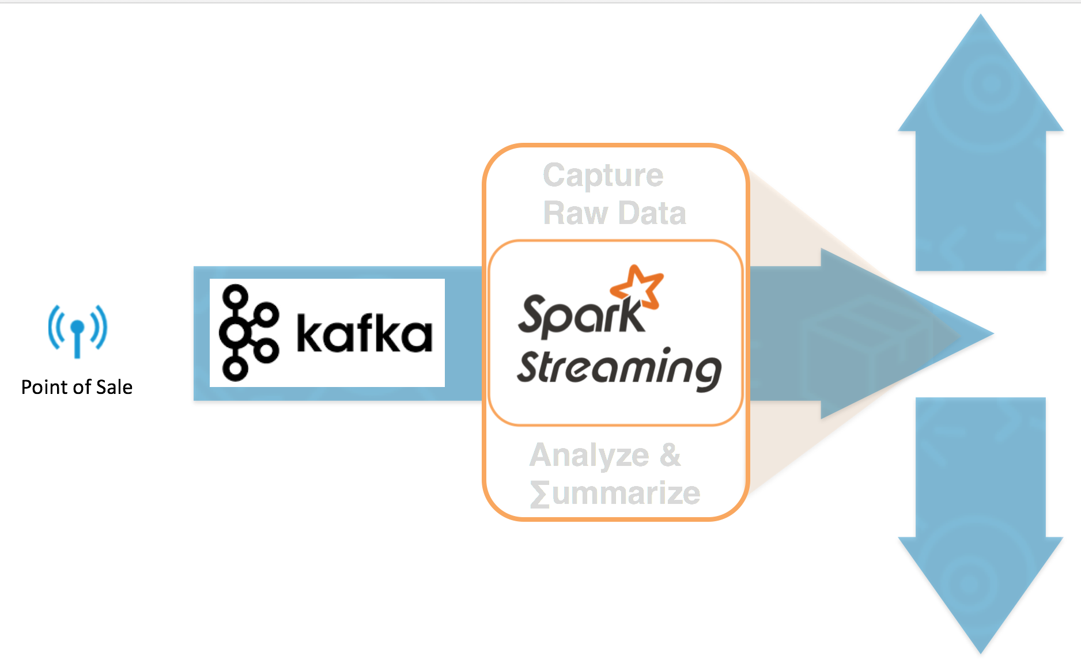
Solution Architecture
Solr ReST

Slide 7
Thank you!

